Slide 1


Keeping Safe Online

Slide 2

The Law: Possessing images
FACTS
Having sexting photos or videos on your phone or computer
If you are under the age of 18, the law sees you as a child. Therefore, if you have any indecent images or videos of somebody who is under 18, including yourself, you would technically be in possession of an indecent image of a child. This is an offence under the Protection of Children Act 1978 and the Criminal Justice Act 1988.

Slide 3
The Law: Sending Images
FACTS
Sending photos or videos
If you are under 18 and you send, upload or forward indecent images or videos to friends or boyfriends/girlfriends, this would also be breaking the law, even if they are photos of yourself (“selfies”).

Slide 4
The Law - Receiving Images
FACTS
If you are in possession of images of a sexual nature of someone under 18 (even if it is your friend or boy/girl friend), you are committing an offence.
Offenders can be placed on the sex offenders register and can be given a prison sentence.
This is also the case if you have kept or printed out an image sent to you by a friend

Slide 5
Consequences
FACTS
Although the Police may not prosecute a teenager for sending or possessing indecent images, this could go down on their record.
This could then affect any future employment such as teaching etc.
Also could affect travel – you can’t
go to America with a criminal record!

Slide 6
Think of the future!
http://www.youtube.com/watch?v=zY13laJuH98

Slide 7
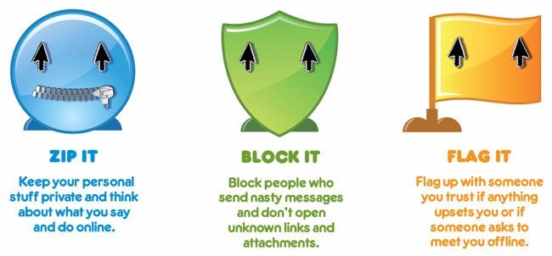
Points of discussion
ACTIVITY
Taking a photo of your friend and posting it on Facebook
Taking a photo of your friend and editing it to make it funny, then posting it online
Taking sexual image of yourself
Sexting an image of yourself to your best friend or boy/girlfriend
Taking a sexual image of your boy/girlfriend
Sexting an image of your boy/girlfriend to your best friend
Allowing your boy/girlfriend to take an image of you without clothes on
Taking your clothes off for a laugh whilst skyping with your friends
Taking your clothes off in front of a webcam because someone online has asked you to
Printing out a sexual image that your friend sent to you to show an adult
Sending a sexual image of yourself to someone you have met online
Sending a sexual image of yourself using snapchat
Posting a sexual image you have received from your friend onto a website like Facebook

Slide 8
Digital Footprint
A digital footprint is a trail of data you create while using the Internet. It includes the websites you visit, emails you send, and information you submit to online services. It leaves a data trail online.
Did you know 88 per cent of sexting images end up on public websites. (Internet Watch Foundation)

Slide 9
What to do
ADVICE
Don't reply to messages that are meant to harass or upset you. This is likely to encourage the bully
Keep the message: you don't have to read it, but keep it as proof. It is vital to have a record of the incident when you look for help or want to report it.
Do not email or print out the image
Report problems to people who can do something about it, parents, school, police.
Block the sender. You don’t have to put up with someone harassing you - block unwanted senders!
Tell someone you trust. Talking to your parents, friends, a teacher, youth leader is usually the first step in dealing with any issue.
Talk to Childline
Respect yourself and respect others - being online is very public and very real, although it doesn’t always feel that way.

Slide 10
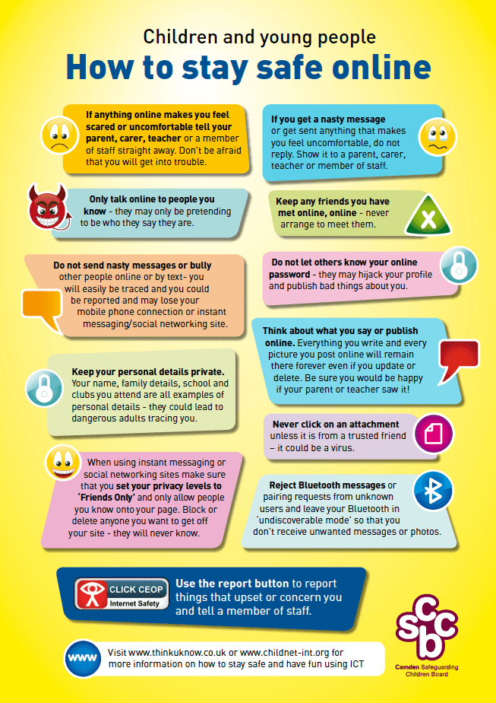
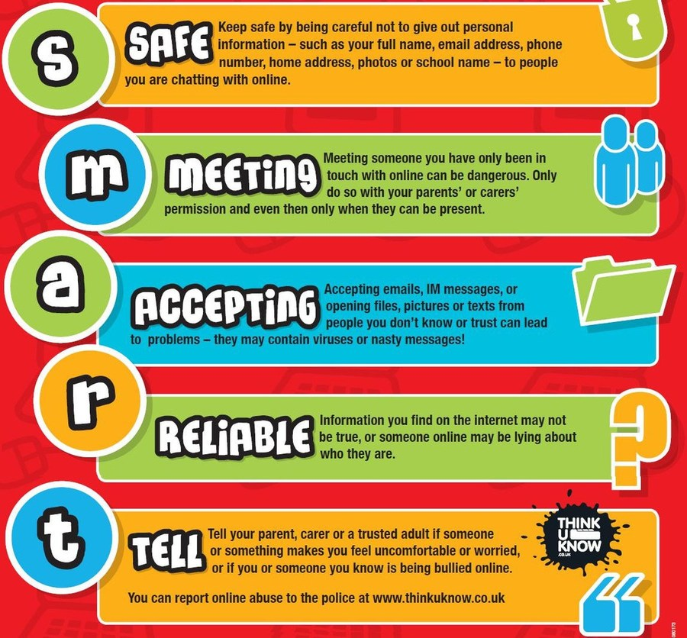
Be SMART

Slide 11
Be Safe Online
ACTIVITY
Think: What are the most important rules for staying safe online?
Share: Together, decide on your top tips
Now write an acrostic using the phrase
Be Safe Online
Each letter needs to begin a sentence giving important advice on internet safety.
Write this up neatly on a footprint and decorate with images/illustrations relating to internet safety
Design a cartoon character to go with your safety message. Draw it in the box on your footprint.

Slide 12
Activities
Additional ACTIVITIES
Write a short message that could be shared with the SAFE Team at school when you return.
Write a poem/rap/song giving advice on how to stay safe online
Design a poster campaign to raise awareness.
Design a slogan or catch-phrase to promote internet safety

Slide 13
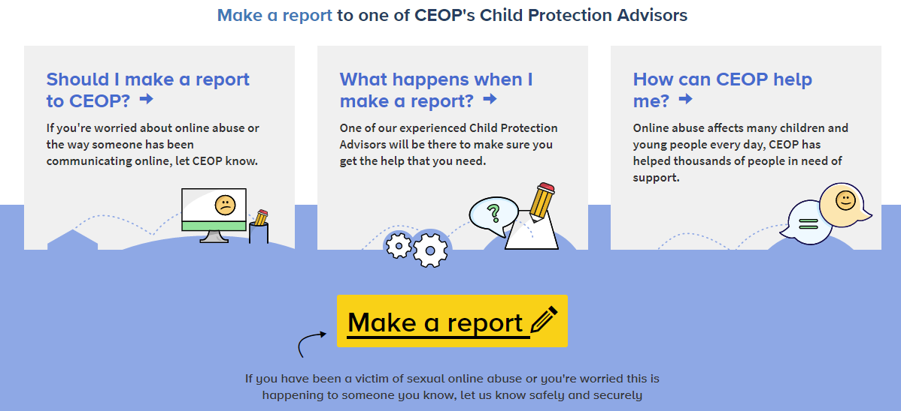

Reporting

Slide 14


Weekly Fact Sheet
Please click on the
SAFE logo
to see the weekly Fact Sheet.

