Slide 1
Notes:
My name is ‘insert name’ and I’m here today on behalf of the Department for Education to talk to you about apprenticeships.
Apprenticeships are one of the many fantastic options available to you when you leave school/college/sixth form and are becoming increasingly popular with students who are looking at their next steps after school/college and are eager to jump straight into the world of work and get earning and learning.
Suggested interaction: Some of you may already have heard of or know a little bit about apprenticeships, or you may know a friend/family member who did an apprenticeship, so before I get started, really quickly I’m going to ask you by a show of hands/using a quick poll:
Who feels confident that they know what an apprenticeship is? Raise your hand/complete the poll to indicate if you know a little bit / a lot / nothing about apprenticeships. (This is to capture impact).
Keep your hand raised if you feel like you roughly know where to look for apprenticeships and how to go about applying for them.
Lastly, is anyone already looking into apprenticeships or considering them as an option?
Excellent, well hopefully by the end of today’s session, you’ll all have a better understanding of:
What apprenticeships are
The range of apprenticeship job roles available
The different levels
How you find an apprenticeship and
What you need to do next to start searching and applying
It’s really important to keep your options open about your future. There are lots of new and exciting programmes, courses, training options and routes to help you to achieve the career that you would like, or to explore future careers you may not know existed, all in a learning style and environment that suits you. It’s important to consider lots of different options so that if your plans change, you still have lots of exciting opportunities open to you.
So even if you already have a Plan A and Plan B, I would encourage you to listen carefully for the next 15 minutes or so and to ask lots of questions so that I can help you to explore how amazing apprenticeships are and whether they might be the right option for you.

Slide 2
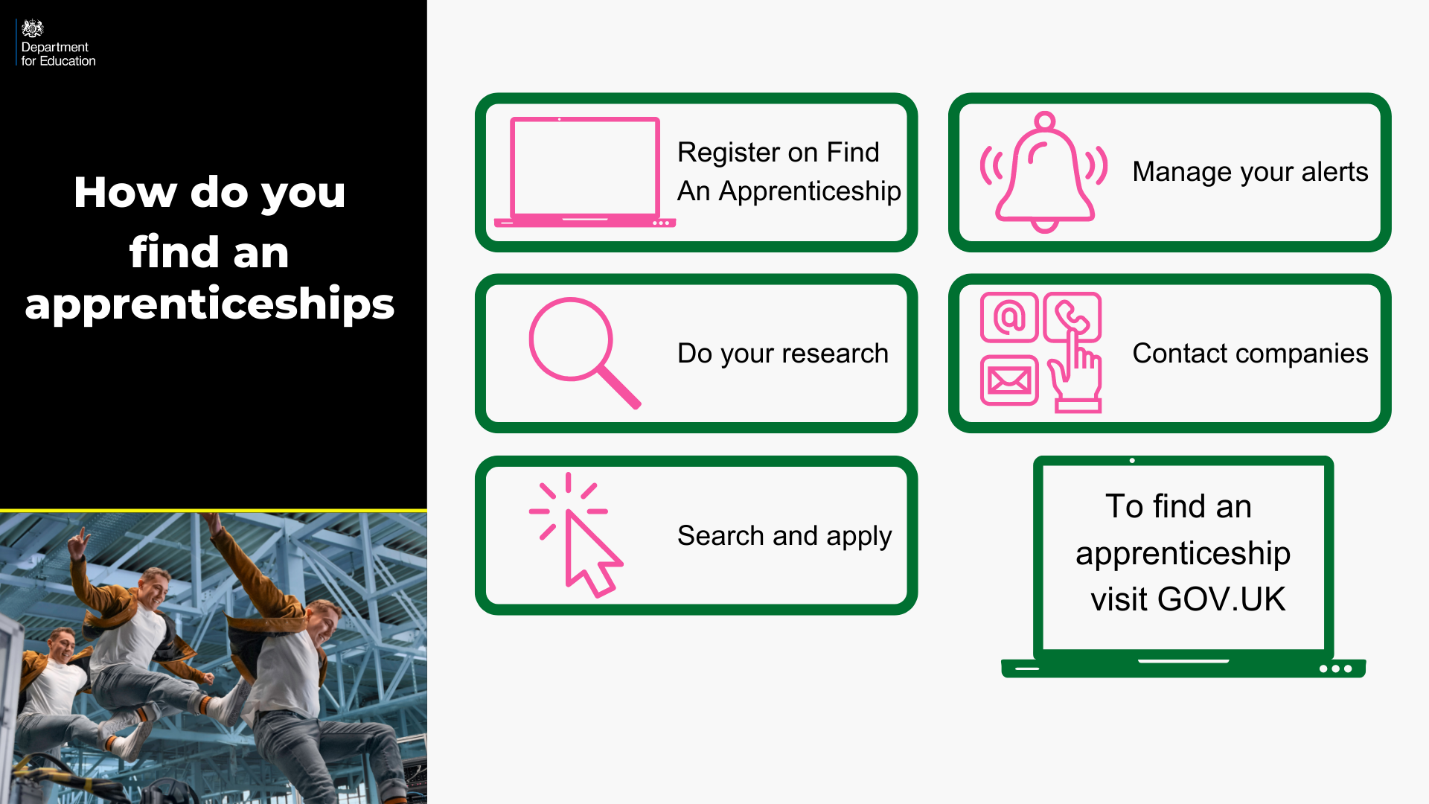
Notes:
Where did I find these vacancies? So one of the first places to look is Find an apprenticeship, the government portal for apprenticeship jobs.
1. It’s really important that you register. Search the internet for ‘Find an apprenticeship’ and it will come up as the first link
The search page is on gov.uk, an official government site.
Once you register you’ll receive an account activation code by email. After activating your account, you’re ready to start applying for apprenticeship vacancies.
2. Have a look at the different jobs that are being advertised. Remember, this is a live jobs site so it may be that you need to try and few different searches or to broaden how far you are looking to find jobs that you are interested in. It also means different vacancies will come up at different times so do not be disheartened if you don’t find something straight away, you may want to look again at another time or on different jobs/employer websites.
3. Start applying for jobs that interest you. You need to remember that typically, some of the bigger companies will advertise quite early in the year (e.g. September/October) for apprentices to start the following September so please don’t leave it until the last minute or you might be disappointed to have missed a great opportunity.
Others may come up later in the year closer to the time you are looking to start your apprenticeship, so use the website to help you with the next step.
4. Set up your alerts. A great feature of this system is that you can get it to do all the hard work for you. You can manage your alert settings so that you receive text messages and emails when jobs come up that you might be interested in.
5. Employers are always telling us that the applicants that really stand out to them, are those that have made a bit of extra effort. You could consider contacting the company and asking them if they have any virtual open days coming up, or work experience or other opportunities to engage with them. That will look really impressive on your application and can give you an advantage over other applicants.

Slide 3
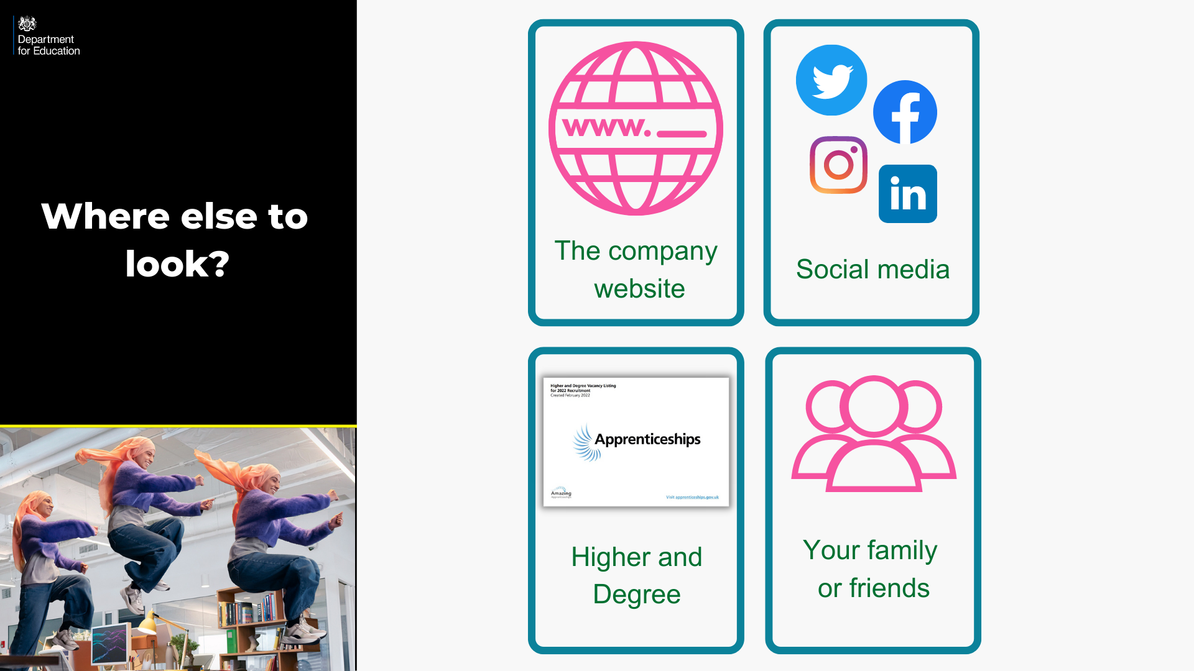
Notes:
Whilst Find an apprenticeship is a great place to start looking for apprenticeships, it is not the only place.
If you have a particular employer in mind, visit their website and see if you can sign up for recruitment alerts or if they send out a newsletter.
Make sure you follow their careers pages on social media using Facebook, Twitter and Instagram too as they will probably use this as a way to promote their vacancies. If you have a LinkedIn profile, it is worth following organisations on there as we have heard from many apprentices more recently that they have found vacancies from employers or training providers on LinkedIn. If you don’t yet have a profile, it may be worth exploring or asking for support in creating one from your school careers adviser or a parent/carer.
We have spoken to lots of apprentices and quite often, they will say that they actually heard about their job through a family member or friend. So make sure you tell everyone you can think of that you’re looking for an apprenticeship and you never know what might come through!
There are lots of other job search sites out there where you can flick through online profiles for some of the UK’s top apprentice employers.
Definitely spend some time looking into the different types of employers. There will be a real mix from your local council who might have a jobs page for young people, through to bigger recruitment sites too.
The Higher & Degree vacancy listing is also a really useful document that is shared in November and then an updated version is released again in February. This contains a list of hundreds of higher and degree apprenticeship vacancies that are open for application, and gives key information about the employer, the apprenticeship, the salary, location and where to apply. This will be shared on the Amazing Apprenticeships website and apprenticeships.gov.uk.

Slide 4

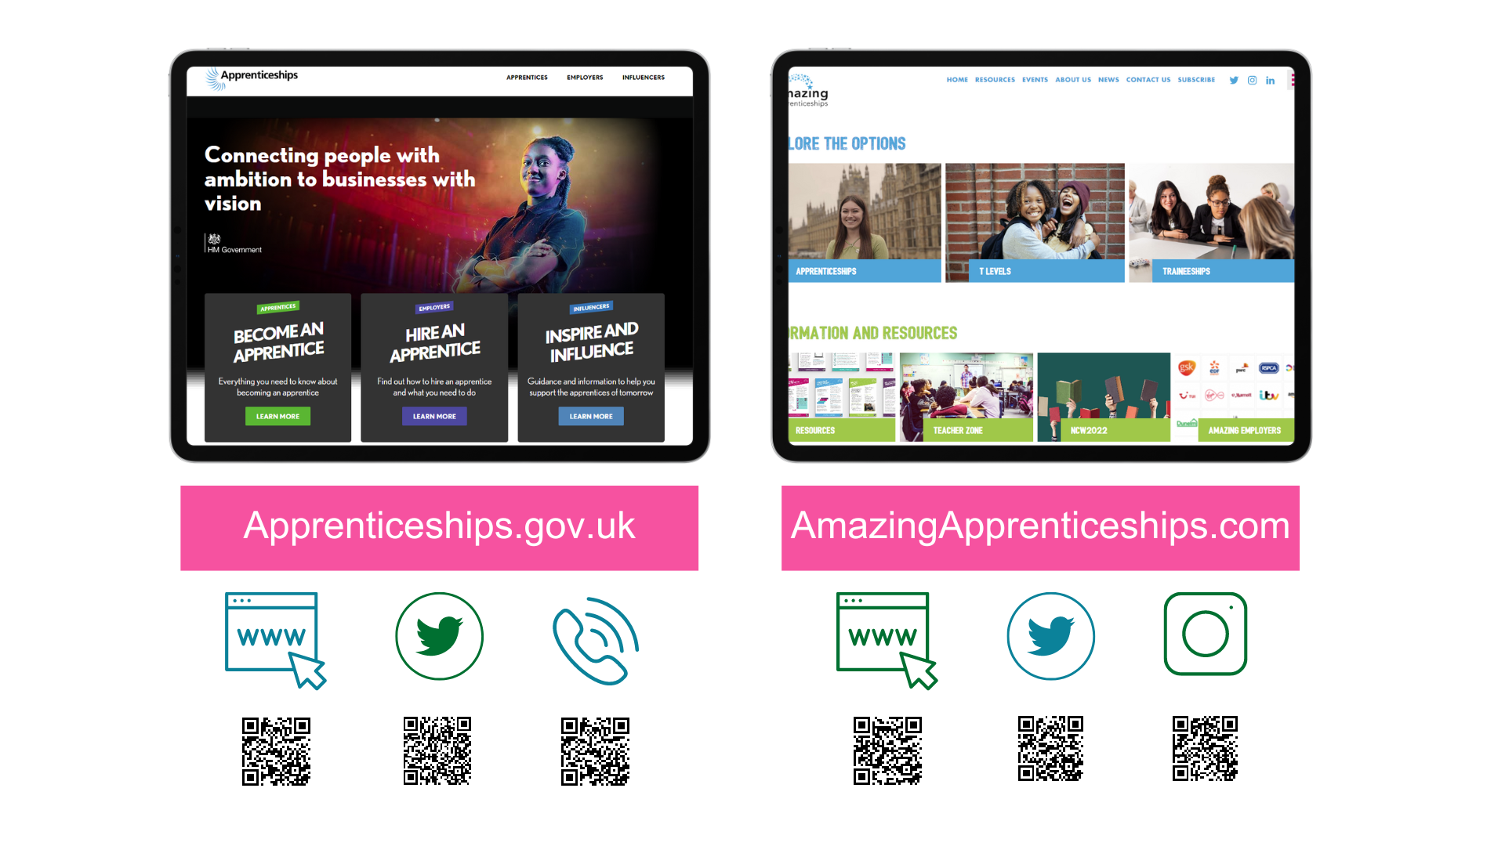
amazing
Notes:
There is lots of support and information out there to help you to stay up to date with the latest apprenticeships information.
Visit www.apprenticeships.gov.uk for more information on apprenticeships and resources to help you to search for and apply for apprenticeships.
You can also follow @apprenticeships on social media for apprenticeship updates or get in touch with the details on the slide.
To find more films, apprentice stories or learn more about apprenticeships, traineeships or T Levels, you can also go to www.amazingapprenticeships.com/student-zone.
You can also contact the National Careers Service, who as we said, can help to give you advice and guidance. Their information is on the next slide.

Slide 5

Notes:
You can visit the National Careers Service website to find out about all of the education and training options available to you once you’ve finished school.
The website gives you information about 9 different options:
3 x study options
A Levels
University (Higher Education)
Higher Technical Qualifications
2 x work options
School leaver schemes
Supported internships
4 x work and study options
Apprenticeships
Traineeships
T Levels
Vocational Technical Qualifications (VTQs)
The website helps to explain what the different options are, how they are similar/different to each other, who they are for and where to find out more information
You can find the website through the link on the slide or by scanning the QR code - https://nationalcareers.service.gov.uk/explore-your-education-and-training-choices
On the website, you will also find contact details for how to get in touch with their advisers through the helpline.

