Slide 1

Adult and Community Learning
VE Day
A party on your front doorstep a family learning course
With: Vanessa Wade

Slide 2
On Friday 8 May 2020 Britain will be commemorating the 75th anniversary of VE Day when the guns fell silent at the end of war in Europe.

Slide 3

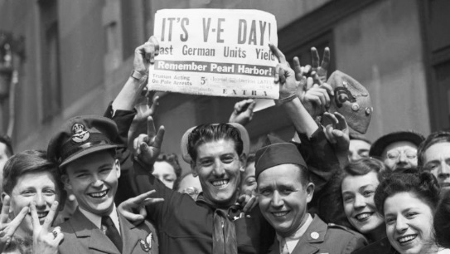

The countries 75th VE Day celebrations have been cancelled and
we are not able to celebrate as we expected. However, why not hold a self isolating tea party in your home or front garden. Invite neighbours, friends and family to join you from their houses. Decorate your house in red, white and blue , send invites and play games from afar.

Slide 4
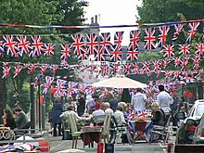
What will we cover?
Let’s invite our neighbours to join in at their houses by making invitations
Let’s decorate the house and make some bunting
Get the party started by learning how to lindy hop and jitterbug
Look at and choose some war time recipes to make
Learn some songs from the era
Celebrate with the UK and learn how to lead a toast

Slide 5
Decorations
Why not decorate your house. In 1945, houses were decorated in red, white and blue and covered in flags. Look at some photos to inspire you.
https://www.english-heritage.org.uk/visit/inspire-me/ve-day/ve-day-in-pictures/
https://www.iwm.org.uk/history/10-photos-of-ve-day-celebrations
You can create your own bunting. May be get everyone in your family to make their own and put together. Or you could use coloured paper or magazines to add extra colour.
http://downloads.bbc.co.uk/england/pdf/how_to_make_your_great_british_bunting_step_by_step.pdf

Slide 6
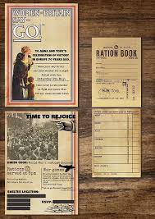

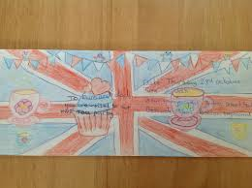

Invitation
Why not post an invitation onto the lampposts in your street or add a notice in your garden. You could text friends and neighbours to join you. Use the examples above to inspire your own or use our template.

Slide 7
Invitation
You are invited to celebrate the 75th Anniversary of VE Day by holding a self isolation party on 8th May 2:30 pm in your front garden or home. We hope that people that live in
……………………………………………………………………………………………………………
will celebrate safely but still together from a distance. We will have songs and games. We can have our own tea party. At 3pm the UK is encouraged to join in a toast to raise a glass for all the brave people in WW2.
RSVP to or just see you on the day…………………………………………………………………………………….

Slide 8
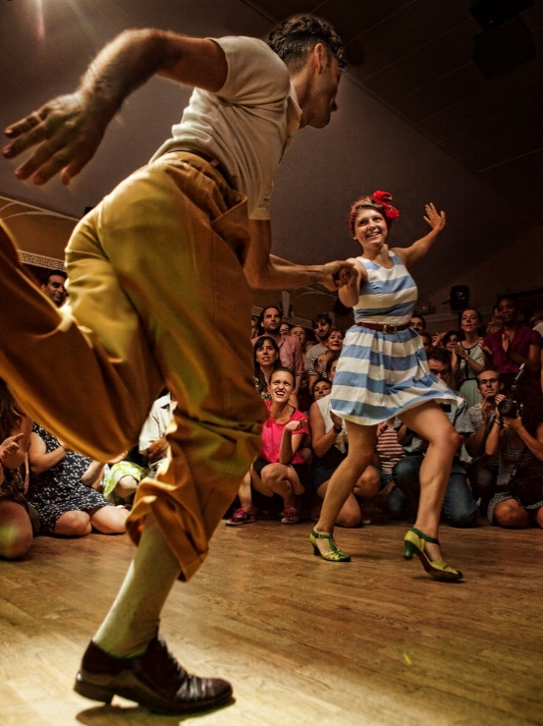
Lets Dance
What music are we going to play? In the 1940’ jazz was really popular. Energetic, athletic and full of fun, the Lindy Hop evolved with the jazz music of the time. The American soldiers stationed in Britain during World War Two brought their dances with them and a craze began. Lindy was a fusion of many dances that preceded it, combining partner and solo dancing. It is mainly based on jazz, tap, breakaway and the Charleston.
Watch some clips of the lindy hop and jitterbug. Then try it yourself.
https://www.bbc.co.uk/bitesize/clips/zwn4wmn
https://www.youtube.com/watch?v=FCT-Qo76C4E
https://www.youtube.com/watch?v=Xu6Y9cAQqIs

Slide 9


Songs to sing
Why not encourage your street to sing. Here are some popular songs of the day.
Well Meet Again Vera Lynn
We'll meet again
Don't know where
Don't know when
But I know we'll meet again some sunny day
Keep smiling through
Just like you always do
'Till the blue skies drive the dark clouds far away
So will you please say hello
To the folks that I know
Tell them I won't be long
They'll be happy to know
That as you saw me go
I was singing this song
We'll meet again
Don't know where
Don't know when
But I know we'll meet again some sunny day
We'll meet again
Don't know where
Don't know when
But I know we'll meet again some sunny day
Keep smiling through
Just like you always do
'Til the blue skies
Drive the dark…
https://www.youtube.com/watch?v=T5C4meGkNyc

Slide 10


Three Little Fishes The Andrews Sisters
Down in the meadow in a little bitty pool,
Swam three little fishes and a mama fishie too,
“Swim” said the mama fishie, swim if you can,
And they swam and they swam all over the dam.
Boop boop dit-tem dat-tem what-tem Chu!
Boop boop dit-tem dat-tem what-tem Chu!
Boop boop dit-tem dat-tem what-tem Chu!
And they swam and they swam all over the dam.
“Stop” said the mama fishie,
“or you’ll get lost”,
The three little fishies didn’t wanna be bossed.
The three little fishies went off on a spree,
And they swam and they swam right out to the sea.
Boop boop dit-tem dat-tem what-tem Chu!
Boop boop dit-tem dat-tem what-tem Chu!
Boop boop dit-tem dat-tem what-tem Chu,
And they swam and they swam right out to the sea.
https://www.youtube.com/watch?v=xaJ-Ou5gTdw

Slide 11
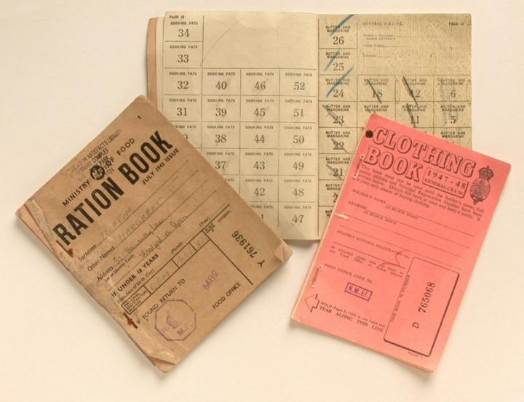
Rationing
Rationing during VE day was still going on. You could make some wartime treats for your celebration or trying looking for some of your own.

Slide 12
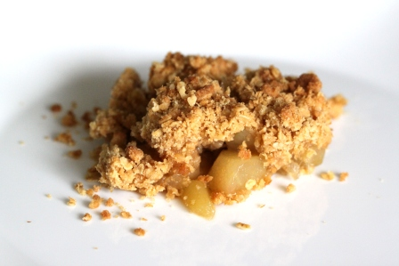
Recipes: Pear Crumble
6-8 cored pears (ripe for eating). Leave skins on
1/2 cup of brown sugar
handful of sultanas
lemon juice/zest if available
1/2 cup of wholewheat flour
1/2 cup of rolled oats
1/2 teaspoon all spice/mixed spice
2 tablespoons margarine
custard powder, sugar and milk (for custard)
Take the 8 ripe to eat pears and core them and chop them up (leaving the skins on)
Squirt a little lemon juice in and zest if available
Mix together with sultanas and place in a greased 7 inch cooking pan for teh oven
Mix the sugar and the all spice together and sprinkle evenly over the top of the pears in the pan
Mix 1/2 cup whole wheat flour and 1/2 cup of rolled oats together in a bowl
Rub in the margarine until mixture resembles bread crumbs
Sprinkle this over the top evenly
Place in pre-heated over at 200 centigrade for about 40 mins
Make a nice thick custard as per instructions on the can and serve hot crumble on top of hot custard
YUM!
Serves 4

Slide 13
Recipes: Glory Buns
12 oz of whole wheat flour (or white)
2 oz margarine
2 oz sultanas/currants/raisins (optional)
2 oz sugar
8 fl oz warm water
3 teaspoons of quick rise dried yeast
1 teaspoon dried cinnamon powder
pinch salt
To glaze:
3 tablespoons water
3 tablespoons sugar
Method
Place all the dried ingredients in a bowl (apart from dried fruit) and stir
Rub in the margarine
Mix in the dried fruit
Add in the warm water
Knead well (use extra flour if mixture is too sticky)
Divide dough into 12 balls
Place on greased deep sided tray (I like to use the 8 x 8 inch foil trays and place 4 balls in each)
Cover with plastic film or plastic bag
Leave to rise somewhere warm for an hour or so
When risen place in oven at 180 C for 15 minutes or so until golden brown
When cooked remove from oven onto a wire rack to cool
When cool prepare glaze by heating the water and sugar together until dissolved
Using a pastry brush apply the glaze generously

Slide 14
Games to play – let’s prepare some socially isolating games
Use your phone to text or film a charade. Neighbours can shout the answer. Keep a score.
Use chalk to add activities onto the pavement. As people are taking their daily exercise they can complete your challenges. Think of things like hop scotch
Someone texts or shouts an item from the home. The first house to bring the item out or send a photo is the winner.

Slide 15
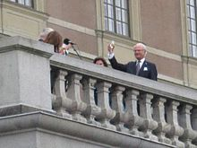
The Toast
We are being encouraged to undertake the ‘Nation’s Toast to the Heroes of WW2’ at 3pm on the 8th May.
This is how you do it:
Identify one person in your household they are called the toast master.
Make sure everyone has a glass of refreshment of their choice. If you are celebrating Ramadan, use an empty glass.
Everyone should be standing.
The Toast Master says while raising their glass
“To those who gave so much, we thank you,”
Everyone copies. Then drinks.
By doing this we pay tribute to the many millions at home and abroad that gave so much to ensure we all enjoy and share the freedom we have today.

Slide 16
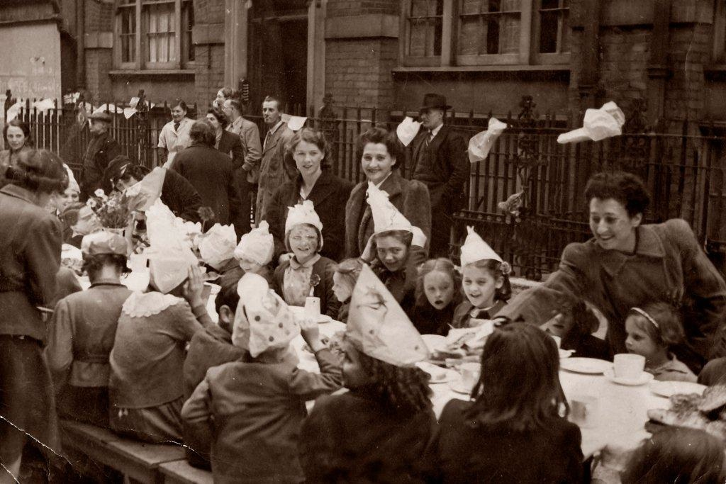

Have a great day, send us some photos on our ACL Facebook page
But don’t forget to socially distance

