Slide 1
Commitments –WHO INSPIRES YOU?
Sign off a commitment this week and recognise those who inspire you!

Slide 2
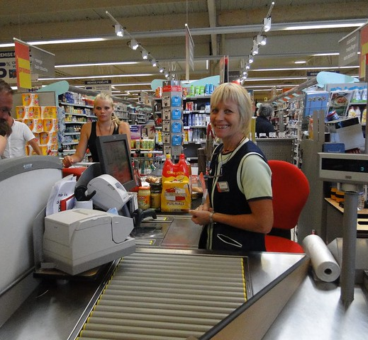
Who inspires you?
.

Slide 3
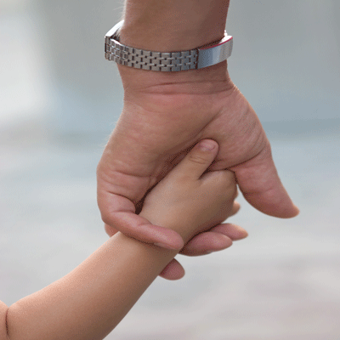
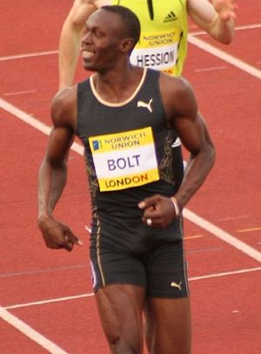
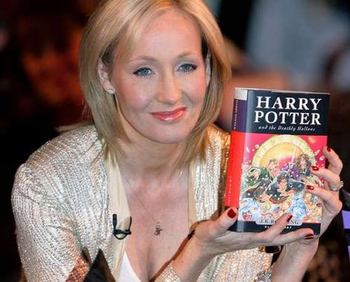
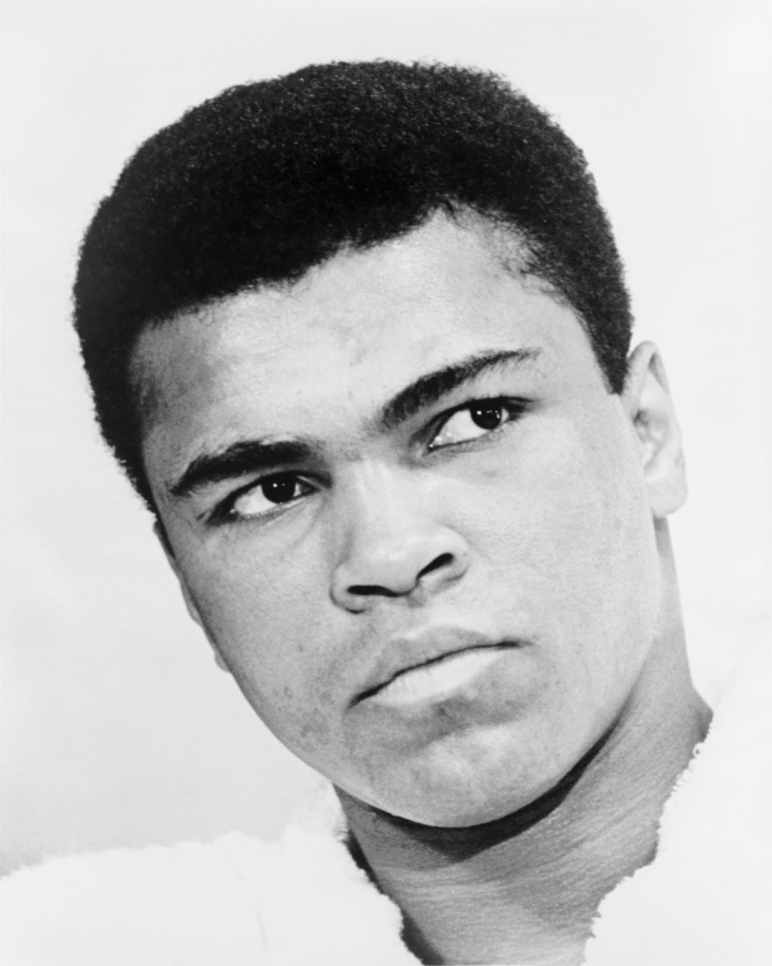
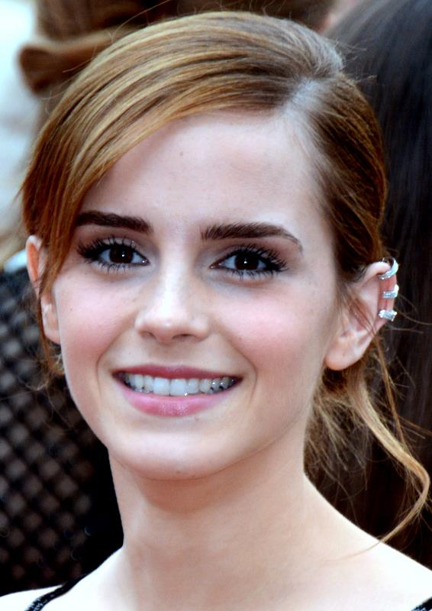
Who inspires you?
This will be very personal to you. A person that inspires you may have the following qualities:
1. People who support and guide others (maybe our NHS workers or parents).
2. People who remain positive in difficult times and show strength and resilience.
3.People who listen and value others.
4. Passionate people who demonstrate commitment and dedication to their work/skills - becoming the best they can be.
5.People who make a positive, significant impact on the lives of others.

Slide 4
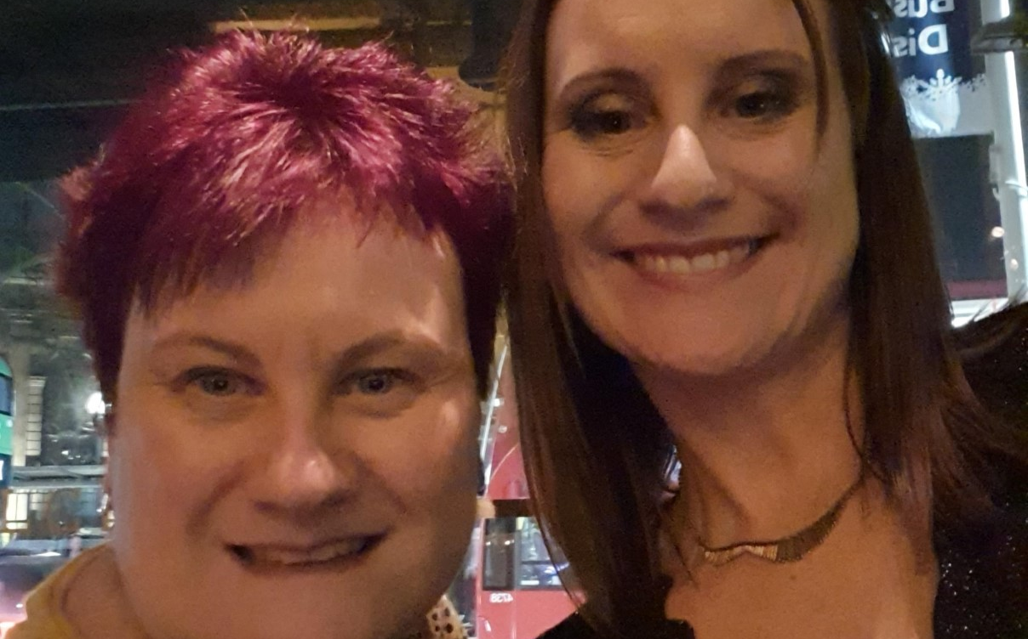
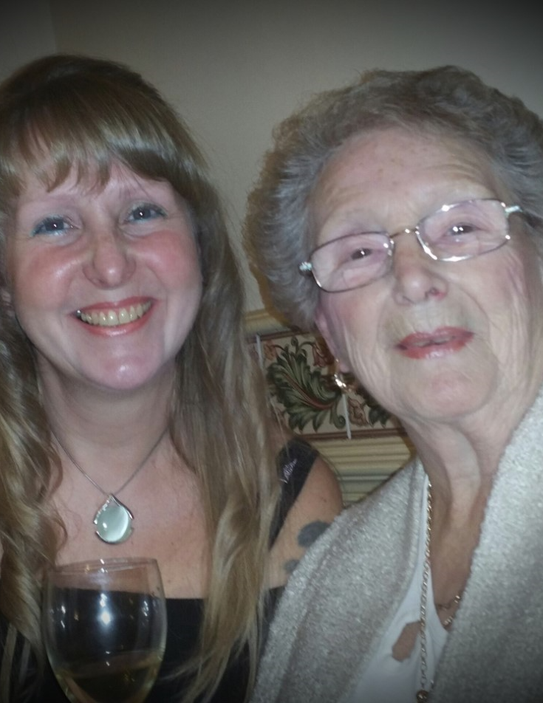
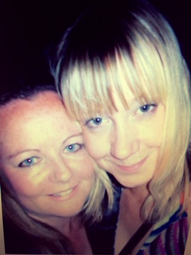
The Link Academy staff share their inspirational person
Mrs Edwards -Morgan
‘My sister works on ward C5 at Russell's Hall Hospital. She does twelve hour shifts selflessly putting people first whilst helping people on the front line.’
Mrs Slater
‘My lovely mom is my inspirational person. She always demonstrates kindness & selflessness towards others, regardless of her own medical condition. Mom makes me smile & loves to laugh! I video call her everyday whilst we are all in this very difficult, strange situation. We share chat & laughter. I get my strength & sense of humor inspired by my mom’.
Mrs Marshall
‘My inspirational person is my best friend Stephanie. She sadly passed away of bowel cancer at the age of 39 two years ago. Her resilience, strength and positivity throughout her illness to support her children and those around her was remarkable. She never gave up fighting and smiling throughout. She inspires me to remain positive everyday.’

Slide 5
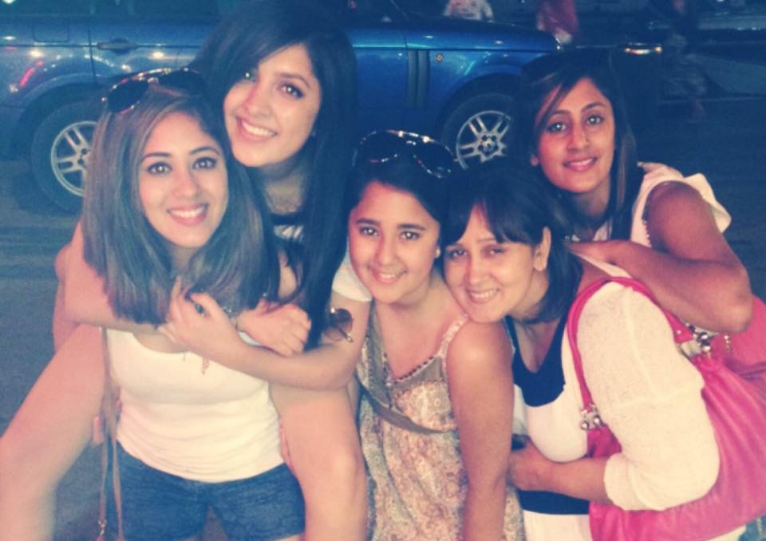
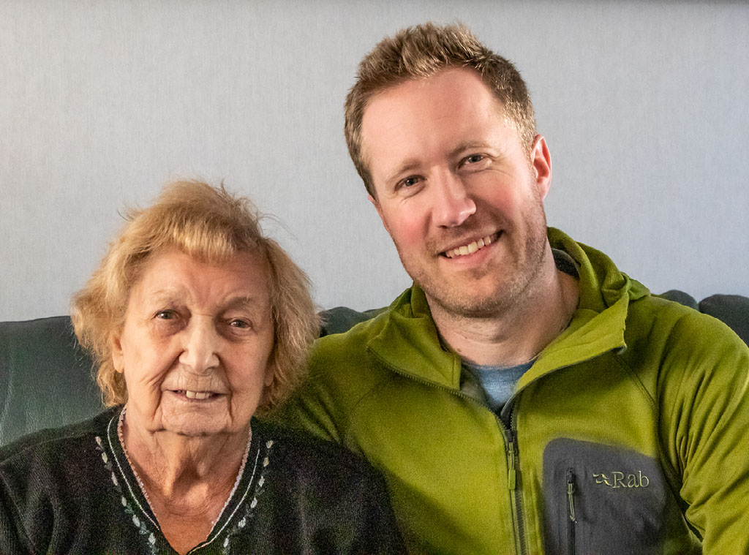
The Link Academy staff share their inspirational person
Miss Jandu
‘My sisters and my mom inspire me - my sisters are so strong minded in breaking traditional barriers and being amazing moms, pursuing their happiness. My mom works as a health care assistant looking after patients in care homes which is pretty much on the front line at the moment - she encourages us all to be strong minded and to follow our own paths. I’m forever surrounded by strong minded females which I am forever grateful for :).’
Mr Roe
‘My inspirational person are all the carers at my Gran’s care home who daily risk their own lives to look after other peoples’ loved ones.’

Slide 6
Dreaming Big –Commitments wheel
Let’s sign off your ‘Research an inspirational person’ commitment.
Each week we will be looking at a different commitment you can complete at home.

Slide 7
Task: Create a poster or presentation on a person that inspires you
This can be a celebrity, family member, friend or someone you know.
Include information about why they inspire you.
What qualities do they have? (Some examples are: supportive, helpful, passionate, positive, respect for others, good listener/communicator, passionate, dedication and commitment to helping others).
What was their journey to where they are today? (What did they study? How long have they worked in that particular field or played that sport? How have they helped others and for how long?)
What qualities about this person have influenced you to think about the kind of job/person you would like to be in the future.

Slide 8
When you have completed the task…
EMAIL to ****** who is keeping a track of what commitments you are achieving in home learning to sign off when we are back at school.

Slide 9
Commitments –WHO INSPIRES YOU?
Sign off a commitment this week and recognise those who inspire you!

