Slide 1


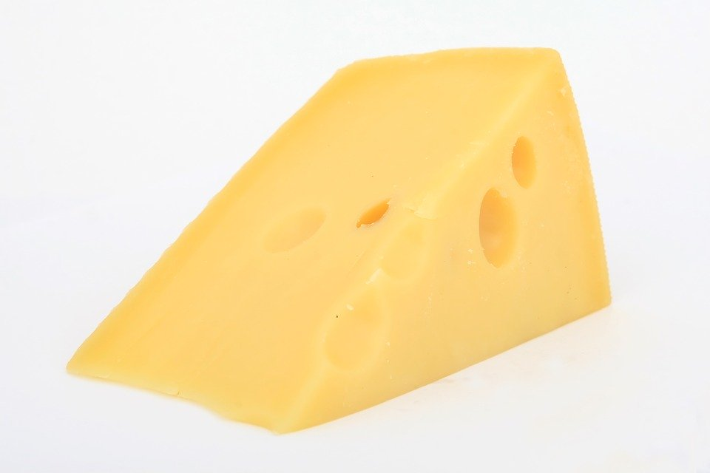
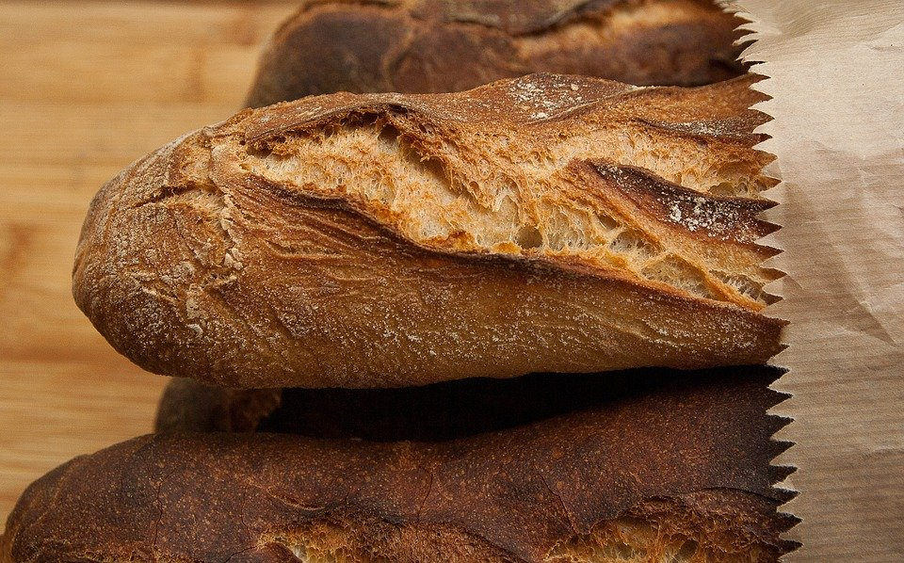
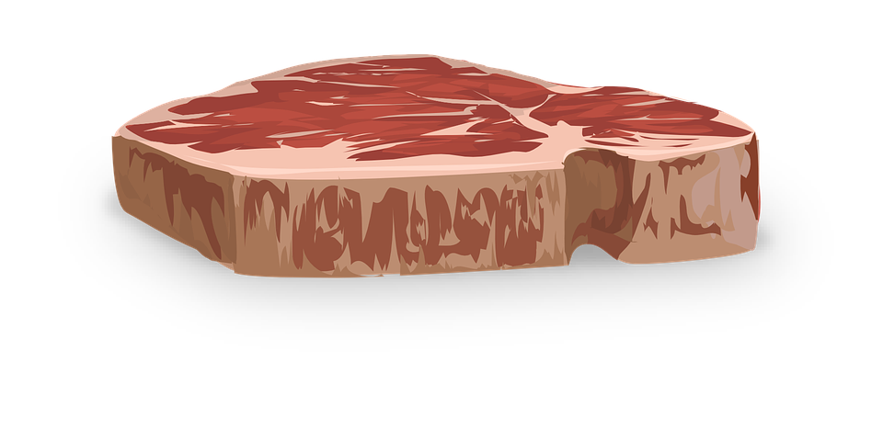
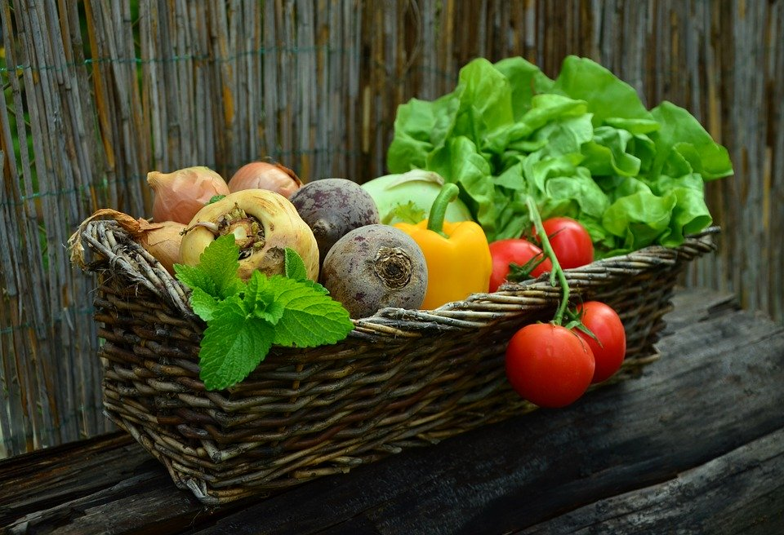
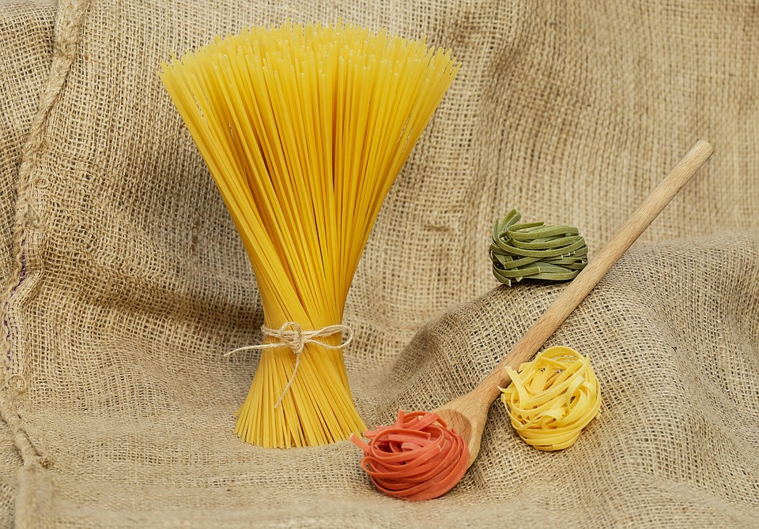
Nutrients
Do now activity: What do you think it means to eat a ‘balanced diet’?

Slide 2
Progress indicators
GOOD PROGRESS:
Recall the components of a healthy diet
Describe the role of each food group in the body
OUTSTANDING PROGRESS:
Compare the nutritional content of different foods

Slide 3

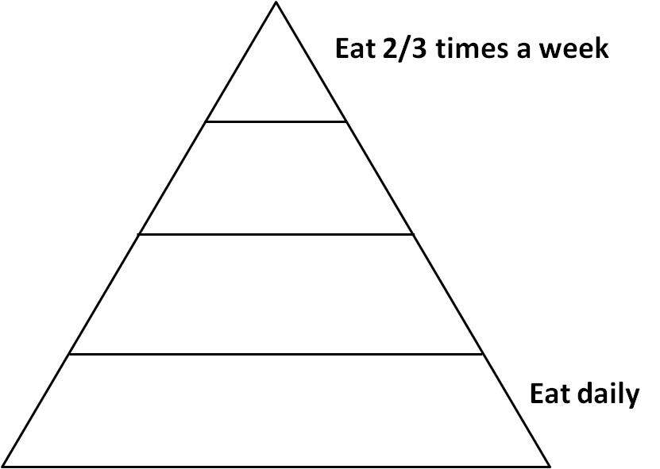
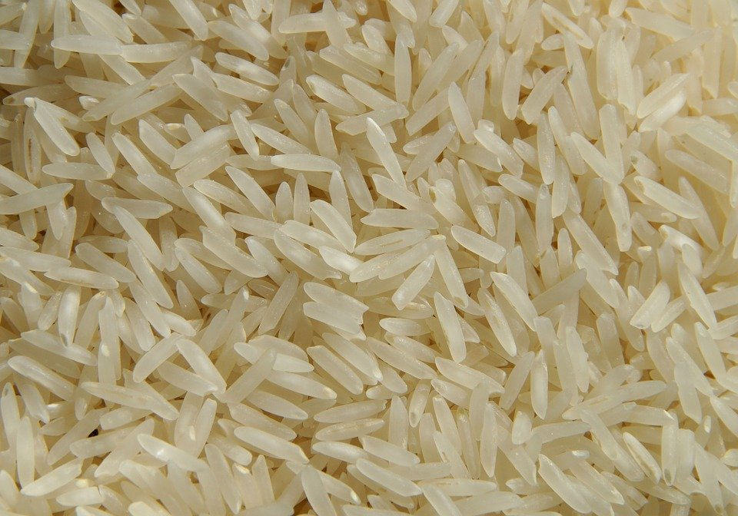
Task: Think about where the different types of food will fit on the pyramid, depending on how often you should eat them each week.
Fruit
Milk
Cheese
Bread
Vegetables
Meat
Sweets
Spaghetti
Rice

Slide 4
How many did you get right?
A balanced diet provides everything you need to survive, including plenty of energy.
If you don’t have a balanced diet you will be malnourished.

Slide 5
carbohydrates
fats
proteins
vitamins
minerals
These are needed to release the energy you need to live
You need small amounts of vitamins and minerals – but they are still very important
Task: Write a couple of sentences to represent this information.

Slide 6
Nutrients
Task: The following slides have information about a specific nutrient. Use this information to complete the following table:
Nutrients | Role in the body | Foods they are found in
Carbohydrates
Lipids
Proteins
Vitamins & Minerals
Water
Fibre

Slide 7
Carbohydrates provide you with your main source of energy. Foods such as pasta, rice and bread contain complex carbohydrates which are broken down by the body to release energy slowly. Sweets contain sugar (a type of carbohydrate) which provides you with a quick source of energy.

Slide 8

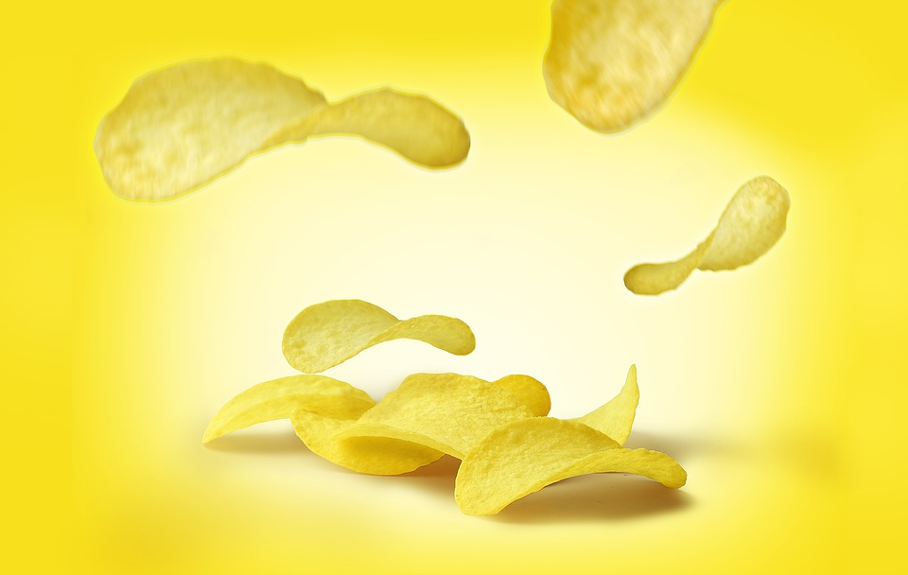
Lipids are found in food such as meat, cheese and fried foods like chips, burgers and crisps. Lipids have three main roles in the body, they are needed to release energy, to provide a layer of insulation under your skin and to protect your organs.

Slide 9
Proteins are found in food such as cheese, milk and eggs. This is a very important nutrient which allows your body tissues to repair themselves, it is also required for new cells to grow.

Slide 10
Vitamins & minerals are essential substances for keeping you healthy. Vitamins and minerals are found in fruits and vegetables, but they are only needed in small quantities. You need them for normal growth and development.

Slide 11



Water is needed so that your cells function healthily. Your body constantly loses water through sweat, urine, faeces and exhalation. You can replace this water by drinking water, squash, juice and tea.

Slide 12
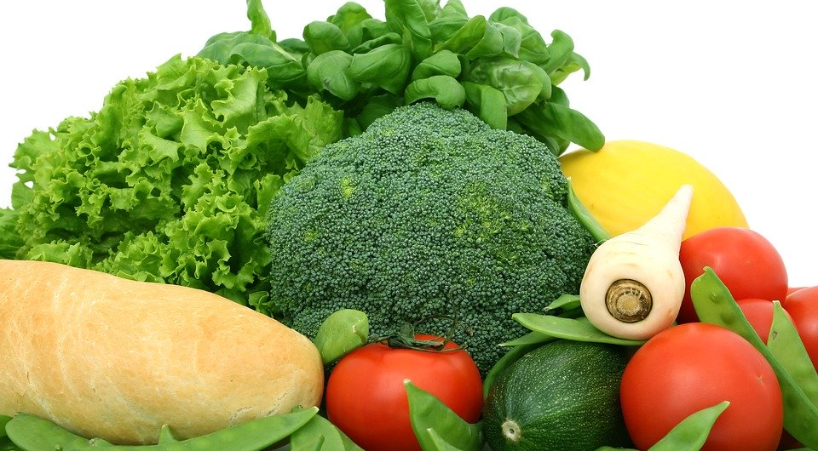
Fibre is a type of carbohydrate which is found in some fruit and vegetables, it is also found in pasta and rice. Fibre helps your digestive system to function normally, it also ensures regular excretion occurs.

Slide 13

Self-assessment:
Nutrients | Role in the body | Foods they are found in
Carbohydrates | Main source of energy | Bread, pasta, rice.
Lipids | Energy source, provide insulation and protect organs from damage. | Meats, fried foods, crisps
Proteins | Repair body tissues and growth of new cells. | Eggs, cheese, milk.
Vitamins & Minerals | Needed to stay healthy, for normal growth and development. | Vegetables and fruit.
Water | Keep your cells healthy. | Water, tea, squash and juice.
Fibre | Helps with normal digestion and excretion. | Fruit and vegetables, past and rice.

Slide 14
How much energy do we need?
Males need to take in more energy than females of the same age
A teenager will need more energy than a 70 year old
If you live in a warmer country you often need to eat less food
Depends on the amount of exercise you do
Task: Use this information to decide which of the people in each row needs to take in the most energy.
Extra Challenge: Use your food pyramid to decide which types of food may be best for each person to eat.

Slide 15
Self-assessment:
Unfit person |  | Fit person
70-year-old person |  | Teenager
Male |  | Female
Girl in winter |  | Girl in summer
Woman who is pregnant |  | Woman who is not pregnant
Cycle delivery rider |  | Office worker
Child who swims a lot |  | Child who likes playing on video games.

Slide 16

Have you ever found that a friend can eat and eat and eat and still not put much weight on?
This is because of their metabolic rate
This is the rate of chemical reactions occurring in your cells and it varies from person to person.
If you have a fast metabolic rate you will need more energy.

Slide 17
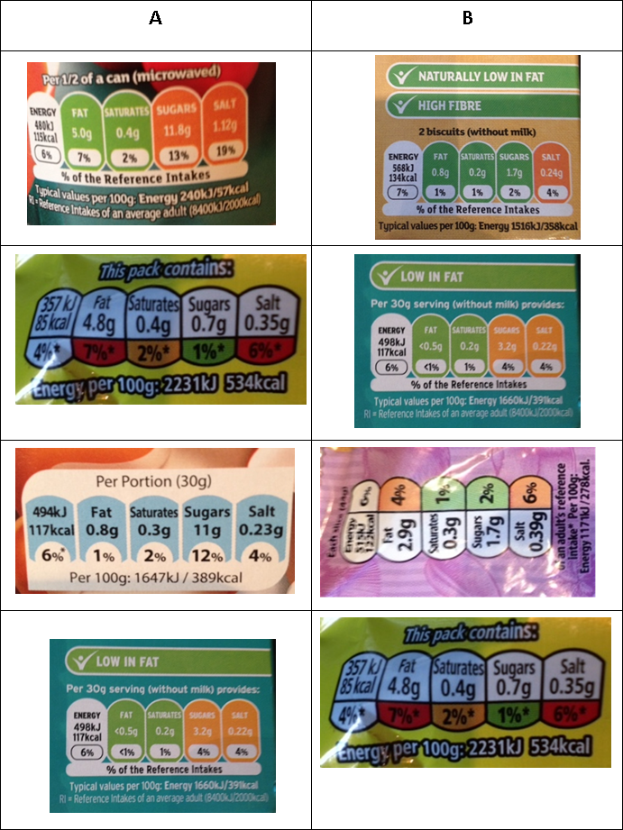
Compare the nutritional content of different foods
Food ___ is healthier than food ___ because the amount of FAT is lower
Food ___ is healthier than food ___ because the amount of SUGARS is lower
Food ___ is healthier than food ___ because the amount of SALT is lower
Food ___ is healthier than food ___ because the amount of SATURATES is lower

Slide 18
Self assess
Food B is healthier than food A because the amount of FAT is lower
Food A is healthier than food B because the amount of SUGARS is lower
Food A is healthier than food B because the amount of SALT is lower
Food A is healthier than food B because the amount of SATURATES is lower

Slide 19


Plenary ~ Take a minute!
Spend a minute talking to the person next to you about what you have learnt today!

