Slide 1
Mitosis
Do now activity:
What would we find in the nucleus of a cell?
Why do cells need to divide?
What could go wrong when cells don’t’ divide properly?
Keywords
Prophase
Metaphase
Anaphase
Telephase

Slide 2
Progress indicators
GOOD PROGRESS:
To be able to identify simple diagrams representing stages of mitosis
OUTSTANDING PROGRESS: Be able to describe, simply, what happens during prophase, metaphase, anaphase and telephase

Slide 3
Mitosis is a type of cell division!
We need mitosis to happen for a number of reasons, most importantly we need Mitosis for:
Growth
Repair
Notes:
Image from Zappy’s Technological Solutions photostream licensed under CC-by-SA 2.0 https://www.flickr.com/photos/102642344@N02/10203178726

Slide 4
Task: Complete the questions as we watch the video
What is mitosis?
Why is mitosis important?
What is mitosis not good for?
Are cells dividing all the time?
What does the nucleus hold?
What is your DNA organised into?
How many chromosomes does a human cell hold?
What does PMAT stand for?
P
M
A
T
http://www.bing.com/videos/search?q=teaching+lesson+on+mitosis&&view=detail&mid=31064B0D87467EE99E9631064B0D87467EE99E96&rvsmid=83EFBAC8B2F51563007783EFBAC8B2F515630077&fsscr=0&FORM=VDFSRV
Notes:
Play video until 5 mins 51 seconds for pupils to complete questions above, then self-assess work using next slide. After self-assessment pupils will then need to play the rest of the video which identifies what happens at each stage during mitosis (PMAT), pupils will now fill in the other side of the worksheet.

Slide 5
What is mitosis?
Why is mitosis important?
What is mitosis not good for?
Are cells dividing all the time?
What does the nucleus hold?
What is your DNA organised into?
How many chromosomes does a human cell hold?
What does PMAT stand for?
P
M
A
T
Mitosis is a type of cell division
Growth & repair
Mitosis does not make sperm or egg cells, that is a process called meiosis
No, they do not divide all of the time. Otherwise this might lead to uncontrollable cell division, this can lead to cancer.
DNA
Chromosomes
46 – 23 pairs of chromosomes
Propahse
Self-assessment
Metapahse
Anapahse
Telopahse

Slide 6
Prophase
What is happening?
Chromosomes are visible, they are condensing – this means they are thickening and visible
Metaphase
What is happening?
Nucleus has been disassembled, chromosomes line up in the middle of the cell
Anaphase
What is happening?
Sister chromatids are separated from one another and move to either pole of the cell. A structure called a spindle helps the chromatids to move.
Telephase
What is happening?
Two new nuclei begin to from around the chromosomes at each pole of the cell
Notes:
Author of images: Boumphreyfr – Own work licensed under CC-by-SA 2.0 https://commons.wikimedia.org/wiki/File:Meiosis.png

Slide 7
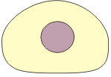
Task: Match the correct statement to the correct diagram to show the stages during mitosis
The chromosomes have become visible
The new cell membranes form and two new cells have been made
The chromosomes are arranged in the middle of cell
The chromosomes now form into two new nuclei
The cells prepare to divide, you cannot see the chromosomes at this stage
The identical copies of each chromosome split apart moving to opposites ends of the cell
Notes:
Author of images: Boumphreyfr – Own work licensed under CC-by-SA 2.0 https://commons.wikimedia.org/wiki/File:Meiosis.png

Slide 8
The cells prepare to divide, you cannot see the chromosomes at this stage
The chromosomes have become visible
The chromosomes are arranged in the middle of cell
The identical copies of each chromosome split apart moving to opposites ends of the cell
The chromosomes now form into two new nuclei
The new cell membranes form and two new cells have been made
Self-assessment
Notes:
Author of images: Boumphreyfr – Own work licensed under CC-by-SA 2.0 https://commons.wikimedia.org/wiki/File:Meiosis.png

Slide 9
Exam-style question
How many pairs of chromosomes are there in a normal body cell of a human? (1 mark)
Explain how the following processes are part of a baby’s normal growth.
a) Cell enlargement (1 mark)
b) Mitosis (3 marks)

Slide 10
Self-assessment:
23 pairs of chromosomes (do no except 46)
a) Any one from:
Cells grow to take up space
Cells have to get bigger in order to divide (carry out mitosis)
b) Chromosomes duplicate/copy themselves
Nuclei divide / chromosomes separate
Two new identical (daughter) cells are formed

Slide 11
Plenary
Draw a phone in your book, what have you learnt this lesson?
Write a message to your friends or tweet a message to let them know!!!

Slide 12
Mitosis
Learning outcomes:
Draw simple diagrams to describe mitosis.
Describe how and why body cells divide by.
What is mitosis?
Why is mitosis important?
What is mitosis not good for?
Are cells dividing all the time?
What does the nucleus hold?
What is your DNA organised into?
How many chromosomes does a human cell hold?
What does PMAT stand for?
P
M
A
T

Slide 13
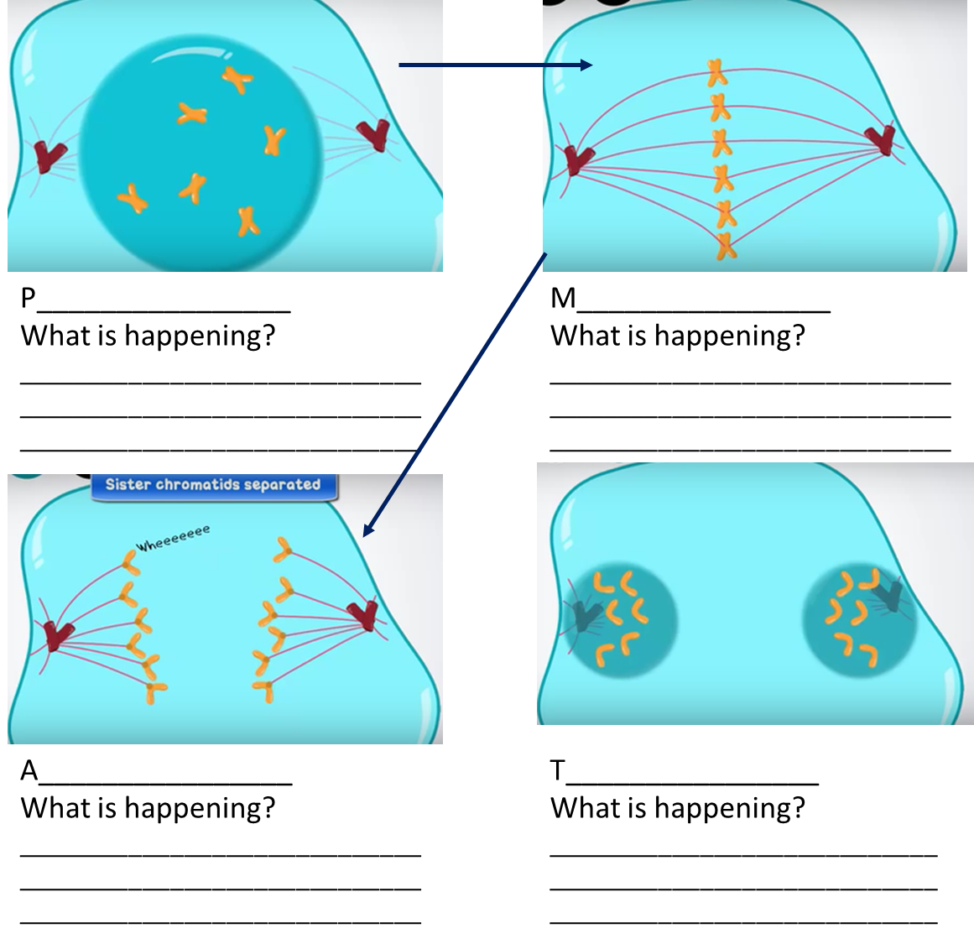
Extension: Design your own quiz questions:
1.
2.
Notes:
Author of images: Boumphreyfr – Own work licensed under CC-by-SA 2.0 https://commons.wikimedia.org/wiki/File:Meiosis.png

