Slide 1
Component 3 exam prep and revision
Good progress: To identify the economic and environmental factors and give examples.
Excellent progress: to demonstrate knowledge and understanding of the economic and environmental factors to a given scenario and apply the pies to show how it affects health and well being.

Slide 2
Economic and environmental factors…
Here are a list of factors:
Economical factors, e.g. financial resources.
Environmental conditions, e.g. levels of pollution, noise
Housing, e.g. conditions, location.
Can you find any factors in this exam?

Slide 3
Economic and environmental factors…
Here are a list of factors:
Economical factors, e.g. financial resources.
Environmental conditions, e.g. levels of pollution, noise
Housing, e.g. conditions, location.
Can you find any factors in this exam?

Slide 4
Income…
What is income?
Income is the money that people get from their wages, savings, pensions, benefits and investments.
What affects income?
Employment status (full time, part time and self employed)
Occupation (the job you have)
Wealth (when you have valuable possessions or money)
Social class (the class you are given based on your social and economic status)
Material possession (belongings owned by yourself)

Slide 5
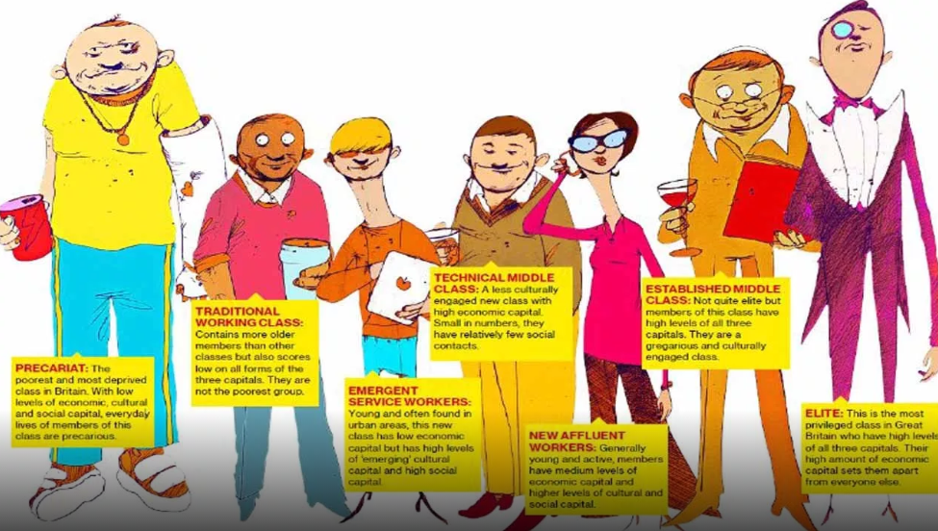
Income…social class
Give an example person for each social class…

Slide 6
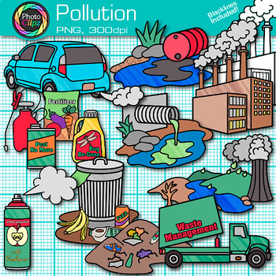
Pollution…
What is pollution?
Pollution is when harmful substances cause damage to the living (people, plants and animals) environment.
Types of pollution:
Air pollution (factories, cars, planes and trains)
Land pollution (waste and chemicals)
Noise pollution (traffic, cities)
Water pollution (from sewage, pesticides and farming)

Slide 7
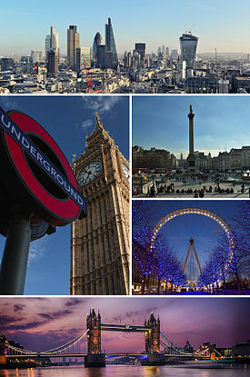
Pollution…task
Task
Brian is considering moving to a flat in London. Identify some positive and negative factors for Brian to make a confident decision to move…(4)
Types of pollution:
Air pollution (factories, cars, planes and trains)
Land pollution (waste and chemicals)
Noise pollution (traffic, cities)
Water pollution (from sewage, pesticides and farming)

Slide 8
Housing…
Housing?
Housing can affect your health and well being by...
Type - bungalow, terraced, detached and semi detached.
Condition – damp, dirt, pets.
Size – large, small.
Personal space – overcrowding, living alone.
Location – cities, villages, high rises.
Influence of others – peer pressure, living with others.
Conflict around the house – divorce, living too close to others, neighbour conflict.

Slide 9
Housing…task
Task:
Using the type of housing, you need to:
Identify how housing affects Brian positively and negatively (4)
Housing can affect your health and well being by...
Type - bungalow, terraced, detached and semi detached.
Condition – damp, dirt, pets.
Size – large, small.
Personal space – overcrowding, living alone.
Location – cities, villages, high rises.
Influence of others – peer pressure, living with others.
Conflict around the house – divorce, living too close to others, neighbour conflict.

