Slide 1
Human Lifespan Development
Lesson Objectives
To identify physical maturity.
To describe and explain the different lifestyle choices.
To create a link between PIES development and the life style choices.
Create a case study on an athlete of your choice. Find out when they reach physical maturity.

Slide 2
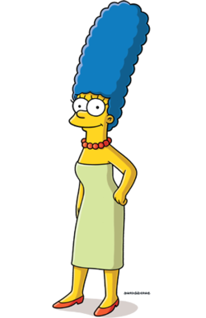
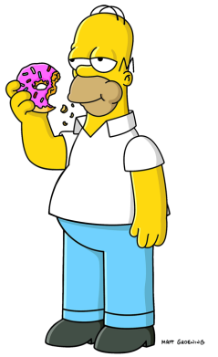
Do Now Activity
Forming ______ships
Manners
Team work
______
Norms
Fill in the gaps…
Problem s____
Muscle tone/stre___h
________
Development
___________
_________
Independence
Contentment
Self esteem and ________
Bon___g
Early Adulthood 19-45 years
A___hment
Security

Slide 3
Progress Indicators
GOOD OUTSTANDING
You understand what is meant by the term “physical maturity” and have completed a table to display your understanding of life style choices.
You have completed a detailed table to display your understanding of life style choices and have colour coded this to include PIES information.

Slide 4
Discuss!
‘Why do athletes peak in early adulthood?’

Slide 5
Main Task
What does being physically mature mean?
Being physically mature means that you are fully grown and sexual characteristics are fully formed…
Examples of physical maturity are:
Being at the peak of your physical fitness.
You have reached your full height.
Women are most fertile.

Slide 6
Lifestyle choices
Definition:
This is how you choose to live; this could be a good or bad choice…
Task:
Watch the episode of Simpsons to be able to discuss what Bart did with his watch to highlight others life choices.
Explain what life choices you could highlight or change?

Slide 7
Lifestyle choices
Task:
Create a table with the lifestyle choices as your headings. Using your PIES, how can the following lifestyle choices affect your growth and development? You need to colour code each PIES development so you are aware of how each lifestyle affects an adults development…
Example diet: | Example exercise: | Example alcohol: | Example smoking: | Example drugs:
Excessive fats and sugars | Running and walking | Intoxication | Smoking drugs | Prescription
 | Swimming |  | Smoking cigarettes | Illegal

Slide 8
Answers
Example Diets:
Whole food
Vegetarian cuisine
Crash diets
Gluten free
Low fat diet
Healthy diet
Low carbohydrate
Low sodium
Excessive fats and sugars
Example Exercise
Endurance
Strength
Balance
Flexibility
Running and walking
Swimming
Example alcohol:
Intoxicatio
Cocktails
Wine
Champagne
Spirits
Example Smoking:
Drugs
Cigerettes
Vape

Slide 9
Intellectual development
Nearly all people have the capability for intellectual development throughout adulthood. Often people decided to continue to develop and carry on with learning new skills e.g. learning a language or learn to play golf. Teachers and other professions will learn new skills for their job and improve their career prospects.

Slide 10
Emotional development
Early adulthood is the time when people develop intimate relationships. Some people decided to live together, marry or some live alone. This time people might experience relationship problems, causing emotional problems like splitting up or divorce. Also at this time people often have children and this brings new emotions, like having a baby.

Slide 11
Plenary Task
Complete this task in your books!

