Slide 1
80/20 – THINK! What do you NEED to cover with your set
Grade | Learning Objective | Learning Outcome
1 | Describe the difference between unicellular and multicellular organisms | Recall what a unicellular organism is Describe the structure of an amoeba Describe the structure of a euglena
2
3

Slide 2
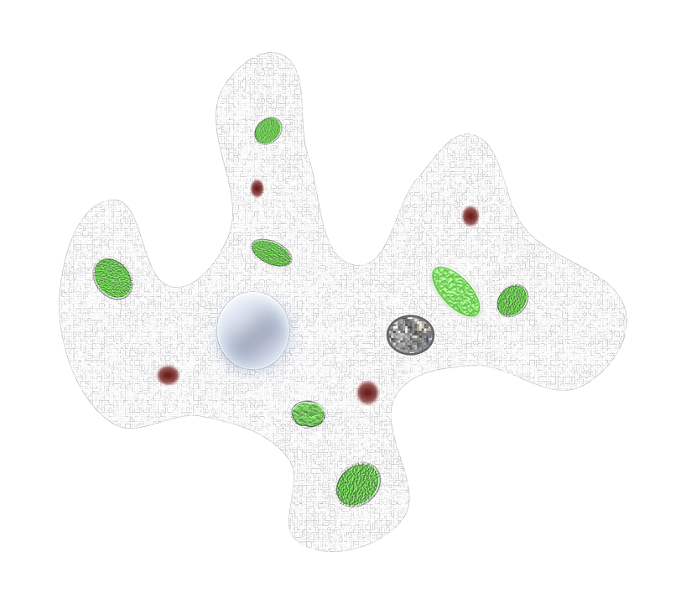
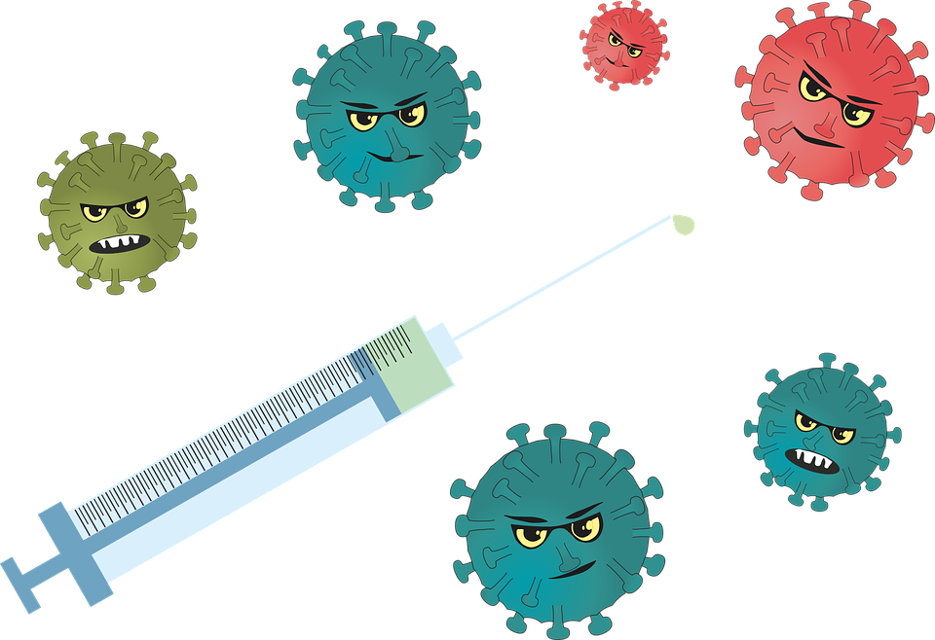
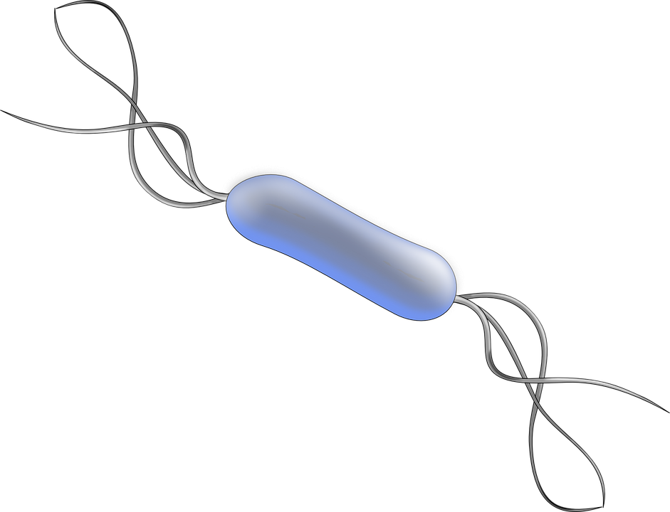
Unicellular Organisms
Do now activity: What is the smallest organism that you can think of, which lives in our environment?

Slide 3
Progress indicators
GOOD PROGRESS:
Recall what a unicellular organism is
Describe the structure of an amoeba
OUTSTANDING PROGRESS:
Describe the structure of a euglena

Slide 4
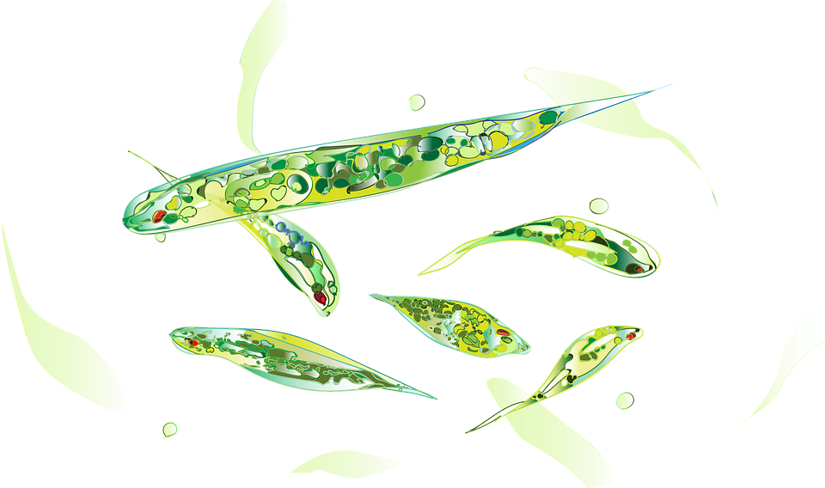
Amoeba and euglena are both types of unicellular organism
http://www.youtube.com/watch?v=7pR7TNzJ_pA

Slide 5
Unicellular Organisms
Task 1: Draw and label a diagram of both an amoeba and euglena.
Task 2: Describe the diet of each organism and explain how both the amoeba and euglena reproduce.
Use the information on Slide 6 and 7 to complete the task on slide 8

Slide 6
Amoeba
An amoeba is a unicellular organism that has no fixed shape, they can move by changing the shape of their body.
Amoebas look a bit like a blob of jelly, they can be found in fresh water, wet soil and even inside animals. They eat algae, bacteria and plant cells. They can engulf food by surrounding the tiny particles of food with their cytoplasm, then forming a food vacuole. Chemicals in the food vacuole digest the food.
They reproduce by a process called binary fission – this means the amoeba cell splits itself into two by firstly the nucleus dividing, then the cytoplasm – producing two identical daughter cells.
Pseudopod
Nucleus
Cell membrane
Food Vacuole
Contractile Vacuole

Slide 7
Euglena
An euglena is a unicellular organism that is found in freshwater.
Euglenas are similar to amoeba in that they contain cytoplasm and a nucleus, but they also have chloroplasts, which make them look green. The chloroplasts trap energy transferred from the Sun so that the euglenas can make food by photosynthesis. They have an eye spot which detects light, also a flagellum to help them swim towards the light.
If euglena is unable to utilize light to produce food it will eat other small microorganisms, such as bacteria and algae. Euglenas also reproduce by binary fission, the same as ameobas.
Flagellum
Eye spot
Chloroplast
Nucleus
Contractile Vacuole

Slide 9
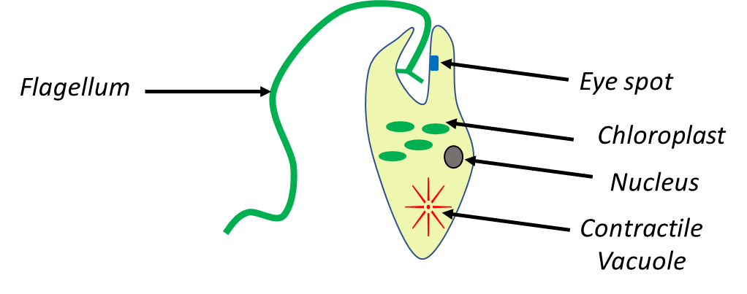
Self-assessment:

Slide 10
Self-assessment:
Amoebas eat algae, bacteria and plant cells. They can engulf food by surrounding the tiny particles of food with their cytoplasm, then forming a food vacuole. Chemicals in the food vacuole digest the food.
They reproduce by a process called binary fission – this means the amoeba cell splits itself into two by firstly the nucleus dividing, then the cytoplasm – producing two identical daughter cells.
If euglena is unable to utilize light to produce food it will eat other small microorganisms, such as bacteria and algae.
Euglenas also reproduce by binary fission, the same as amoeba’s.

Slide 11
Task: Copy and complete the sentences using the following key words:
Binary fission one unicellular engulf photosynthesis
Amoebas and euglenas are examples of __________ organisms. This means that they are only made up of ______ cell. Both organisms reproduce by _________ ______. Amoebas have to _________ food to survive but euglenas can carry out _________ to produce their own food.

Slide 12
Self-assessment:
Amoebas and euglenas are examples of unicellular organisms. This means that they are only made up of one cell. Both organisms reproduce by binary fission. Amoebas have to engulf food to survive but euglenas can carry out photosynthesis to produce their own food.

Slide 13
Key Word Bingo!!
1. Choose 6 of the following words/terms and write them into your books:
Diffusion
Microscope
Nucleus
Red blood cell
Root hair cells
Cell membrane
Stage
Sperm cell
Concentration
Euglena
2. I am going to read a definition, if it matches one of the words/terms you have written down then cross it out.
3. The first person to cross all 6 of their words out, shout BINGO!!!

Slide 14
3-3-1 Reduction
3 facts
3 key words
1 key words

Slide 15
Resources

