Slide 1



5.2 - Sources of Capital for Business Start-ups
Hyperlink(s)
Back button
Forward button
Notes:
Please note that the symbols and buttons behave as follows:
HYPERLINKS – where there is a hyperlink this symbol will be shown in the margin. More information about the hyperlink is given in the notes for each slide
BACK BUTTON – used where hyperlinks have been used to move to a given slide. This button will take you back to the slide the link was from
FORWARD BUTTON – this allows you to move forward to the next section (if there is one) of the presentation. This may skip a number of slides that are linked to from the slide the button appears on.

Slide 2

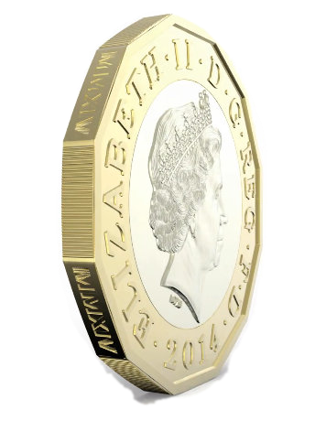
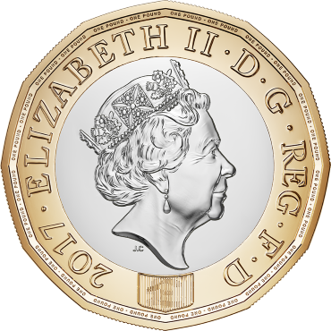
The Need for Finance
Why would a business need capital?
Premises
Equipment
Marketing
Stock

Slide 3


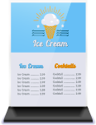
Where Can Capital Come From?
Describe how each source of Capital works as well as the advantages and disadvantages
What sources of capital are available to small businesses
Loans
Crowd-funding
Friends and Family
Small Business Grants
Personal Savings
Business Angels
Progress Indicators
Good – Identify how each sources of Capital works | Excellent – Describe the advantages and disadvantages of each source of Capital

Slide 4



Crowd-funding
What is Crowd-funding?
Crowd-funding gives the advantage of …
A relatively new way of raising finance, it involves obtaining small amounts of money from a large number of people. Usually administered via the internet, it often involves the promise of cheap or free products in return.
Providing access to large amounts quickly
Raising awareness of a new business or product
But..
Providing cheap or free products costs money
New product ideas could be copied unless properly protected
Notes:
For a useful article on the problems of crowd-funding see:
http://www.bbc.co.uk/news/technology-39191064
Back returns to slide 3

Slide 5

Small Business Grants
Obtaining a small business grant
What is a Small Business Grant?
Can be a cost-effective way of obtaining capital
A grant is a gift or contribution given to a business by the government. It does NOT have to be in the form of cash; it could be free equipment, or a reduced fees
But..
Applying for a grant can be very challenging and time-consuming – with over 200 grants available in the UK
There is no guarantee of success
Notes:
Back returns to slide 3

Slide 6

Business Angels
What is a Business
Angel?
Business Angels can be beneficial because…
A Business Angel is a specialist lender, who will invest in new or young expanding businesses. They are willing to take higher more
risk, but
expect more
in return.
They often provide other expertise and business contacts
But..
They are only likely to invest where they see opportunities for a business to grow
They will seek to own part of the business
Notes:
For more details about Business Angels visit the UK Business Angel Association website (www.ukbaa.org.uk)
Back returns to slide 3
Back returns to slide 8

Slide 7

Personal Savings
Savings have the advantage of…
What are Savings?
Sometimes referred to as “owners capital”, personal savings is money invested in the business by an owner.
Not having to repay the sum used
Not having to pay interest on the amount obtained
But..
The amount is limited to how much the owner is willing or able to invest
Notes:
Back returns to slide 3

Slide 8

Friends and Family
What are funds from Friends & Family?
Obtaining funds from friends and family is…
If friends and family have funds available, they may be willing to invest. Where this happens a formal arrangement
should be made
to prevent
future problems.
Likely to be cheaper than other borrowing
May encourage them to take an active interest
But..
It could put strain on family relationships, and lead to the loss of friendships if things go wrong
Notes:
Back returns to slide 3

Slide 9

Loans
Loans can be beneficial because…
What is a Loan?
An amount of money
that is borrowed for a fixed period of time at an agreed rate of
interest. The total sum (loan + interest) is repaid through regular - usually monthly - payments.
Regular repayments help with budgeting
Large purchases can be made even if a firm doesn’t have the cash
But..
Interest, which may be high, must be paid
Some lenders may ask for security against
non-payment
Notes:
Back returns to slide 3

Slide 10
5.3 - The Importance of a Business Plan
Forward button

Slide 11






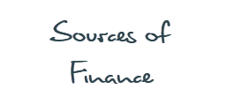




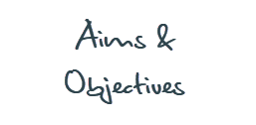
Business Plan
What is a business plan?
What is included in a business plan?
“A formal document outlining what a business wants to achieve, and how it intends to do be successful”

Slide 12


Business Idea
What question should a business be able to answer about its business idea?
The business plan should answer a number of key questions about the products and services to be offered:
Who will the main suppliers be?
What other related products and/or services could be sold?
How much stock will be needed?
What are the main products and/or services being sold?
Are there alternative suppliers available?
BUSINESS
PLAN
Excellent - Why is answering these questions vital for a business?
Progress Indicators
Good – Describe each section of the business plan. | Excellent – Explain why each section of the business plan is important.

Slide 13

Aims and Objectives
What are aims and objectives?
The business plan should outline what the aims and objectives of the business are over different time periods:
Year:
1
2
3
4
5+
Short-Term
E.g. To survive, or to establish a reputation
Excellent – How do Aims and Objective help a business?
Medium-Term
E.g. to achieve growth, perhaps by opening other branches
Long-Term
E.g. to be an ethical business, or make a contribution to society
Progress Indicators
Good – Describe each section of the business plan. | Excellent – Explain why each section of the business plan is important.

Slide 14




Market Research
What do businesses need to research?
The business plan should highlight the results of market research that has been carried out.
Competitors
The Target Market
The Market
Who are they?
Where are they located?
How many of them could there be?
Who are they?
Where are they located?
What are their strengths?
What are their weaknesses?
Is it growing or shrinking?
What is causing this?
Is the market seasonal?
Excellent – Why is Market research vital for a business?
Progress Indicators
Good – Describe each section of the business plan. | Excellent – Explain why each section of the business plan is important.

Slide 15
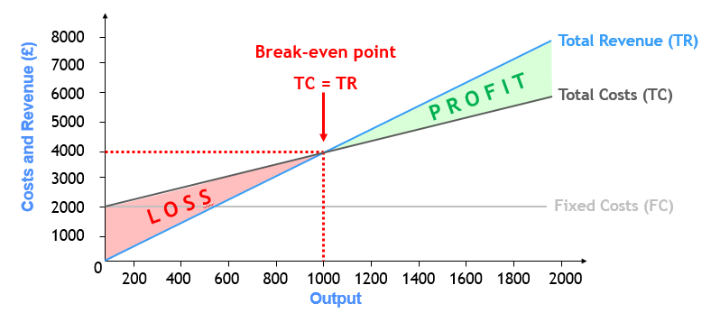
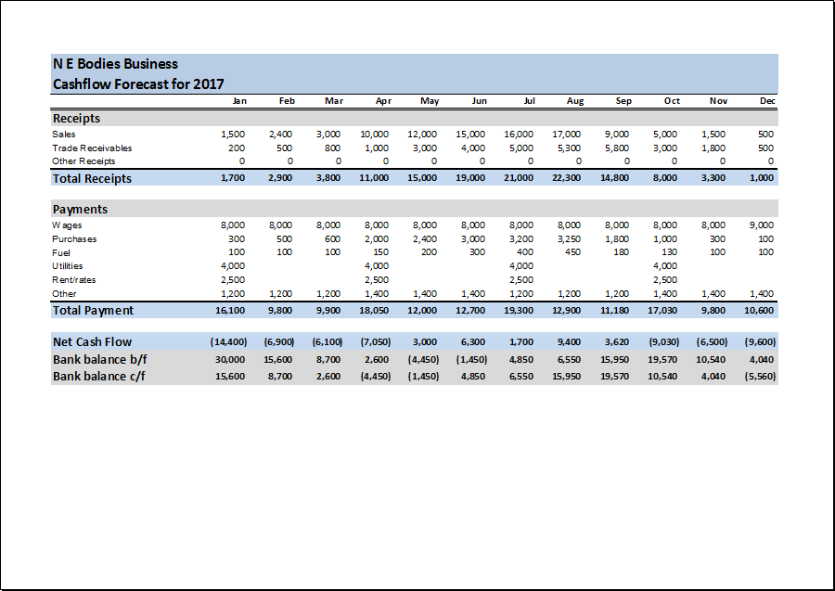
Financial Forecasts
What information is included in a financial forecast?
Break-even Calculations Showing:
A Cash Flow Forecast Showing:
Forecasted revenue
Forecasted costs
Forecasted profit (or loss!)
Expected cash coming in
Expected cash spending
Difference between cash in and out
Excellent – Why is predicting how financially successful your business is important?
Progress Indicators
Good – Describe each section of the business plan. | Excellent – Explain why each section of the business plan is important.

Slide 16

Sources of Finance
What different sources of are available to small businesses?
This section will outline how the business
intends to fund it’s plan.
Excellent – Why does a business need to show how they are financing the business?
Progress Indicators
Good – Describe each section of the business plan. | Excellent – Explain why each section of the business plan is important.

Slide 17
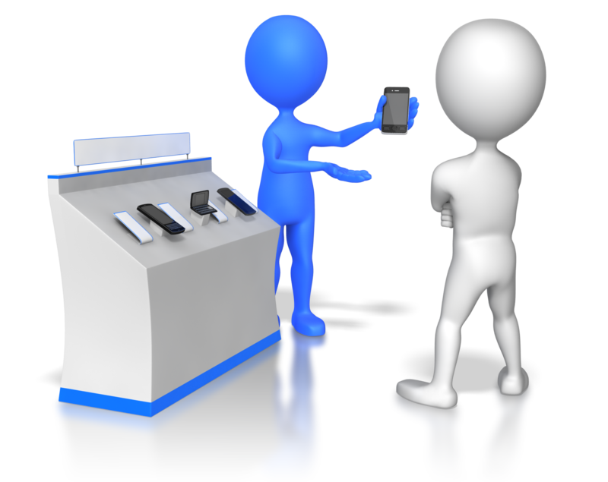
Sales Plan
What does a sales plan show?
A sales plan should set out the sales targets for the business
  Targets should be based on ensuring that the financial forecasts can be met
It should be used alongside the
“Marketing Plan” in order to:
  Choose sales methods that are suited to
  the target market
  Identify sales tactics
  Motivate and focus sales staff
Sales plans should be monitored to
ensure sufficient cash is coming in
Excellent – Why is a sales plan important?
Progress Indicators
Good – Describe each section of the business plan. | Excellent – Explain why each section of the business plan is important.

Slide 18

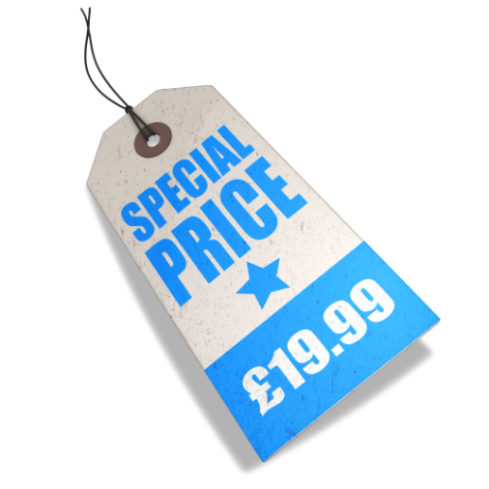


Marketing Plan
What does a marketing plan include?
Excellent – Why is Market research vital for a business?
The marketing plan should be used with the sales plan to show how the target market will be reached through the marketing mix:
PRODUCT
PRICE
PLACE
PROMOTION
Details of the products sold by the business
What price(s) customers will be charged
Where customers will be able to purchase products
How customers will be made aware of products
Progress Indicators
Good – Describe each section of the business plan. | Excellent – Explain why each section of the business plan is important.

Slide 19

What is the Purpose of a Business Plan?
It effectively outlines the road ahead, and can help a business:
  Be more confident that their plan is realistic
  Make business decisions
    Since it will contain most of the information needed
  Use it to gain support from
    Banks and other potential finance providers
    Others interested in the business
“A formal document outlining what a business wants to achieve, and how it intends to do be successful”

Slide 20

Why do Businesses Plan?
It is important for businesses to plan for a number of reasons:
REASONS
TO
PLAN!
Survival
Finance
Risks
Objectives

Slide 21
Clarify Business Idea
Explain why businesses need to clarify a business idea?
The business plan should answer a number of key questions about the products and services to be offered:
Who will the main suppliers be?
What other related products and/or services could be sold?
How much stock will be needed?
What are the main products and/or services being sold?
Are there alternative suppliers available?
BUSINESS
PLAN
Notes:
Back returns to slide 8

Slide 22


Measure Progress towards Goals
When planning, businesses will think about what it wants to achieve
  These targets are called objectives
So the planning process will help to:
Explain why businesses need to measure progress.
Keep the business on track to meet it’s aims
Set targets for
managers and staff
Identify issues and problems before they occur
Notes:
Back returns to slide 3

Slide 23

Potential Problems
Explain what are the potential problems with starting a small business
There are a number of reasons why businesses fail:
Not Knowing The Market
Surprisingly many businesses fail to understand their customers or their competitors
Poor Business Plans
Poor Financial Control
Many businesses fail due to a flawed business idea, or badly implemented plan
The most common reason for business failure is poor cash management
Notes:
Back returns to slide 3

Slide 24

Potential Problems
Risk is everywhere in business
  But good planning can help businesses to avoid unnecessary risks
This involves balancing potential rewards against possible risks:
The Risk
The Reward
What if things don’t go as planned - can the business afford it?
What gains might be obtained if things go as planned…or better!
Notes:
Back returns to slide 3

Slide 25

Manage Cash Flow
Explain why managing cash flow is vital for business.
Running out of cash is the most common cause of business failure
  Many businesses don’t manage cash very well as it comes in or leaves
    The movement of money in and out of a business is called “cash flow”
  This can be easily avoided through careful planning:
Financial forecasts should highlight if and when extra cash will be needed
This will give the business time to make arrangements with lenders before they run out of cash
Notes:
Back returns to slide 3

