Slide 1
Tuesday 11th February 2020
Effects of a poor diet on sports performance and participation
LO3
Good Progress | Outstanding Progress
TBAT define malnutrition showing accuracy and detail (MB2) | TBAT define malnutrition demonstrating detail along with comprehension (MB3)
Describes the effects of overeating, undereating and dehydration using some clear reference to sports performance and participation. | Explains in detail the effects of overeating, undereating and dehydration with clear and specific reference to sports performance and participation.

Slide 2
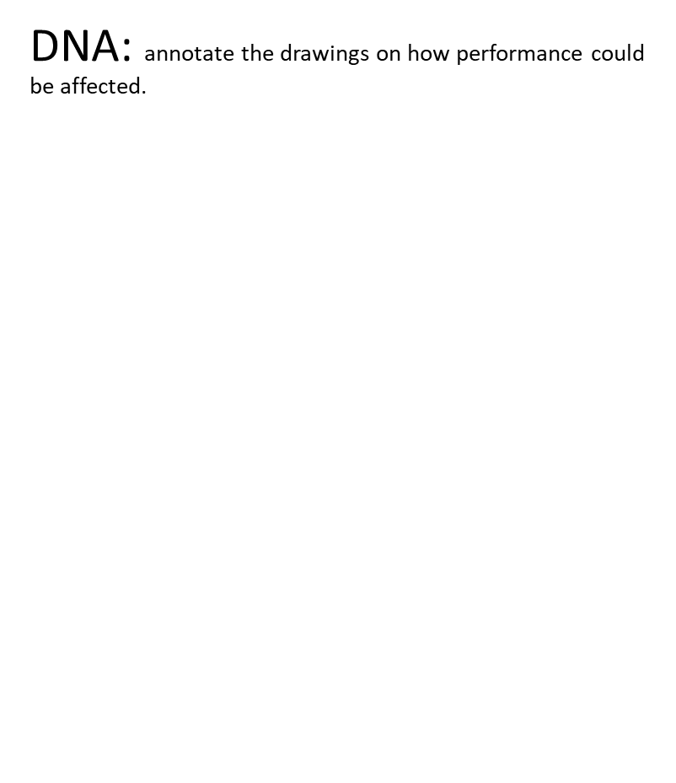
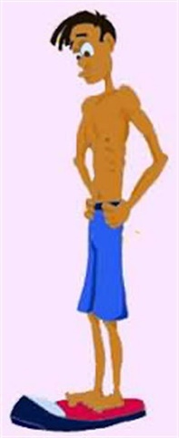
DNA: annotate the drawings on how performance could be affected.

Slide 3
Definition of malnutrition:
I DO!
Malnutrition is the term used to describe someone who does not get the proper nutrition.
‘Malnutrition is defined as deficiencies, imbalances, or excesses in a person’s dietary intake. It is affected by the absolute quantity but also the quality of diets.’
Malnutrition can be used through three main ways:
Not having enough to eat in general
Not eating enough of the right things (nutrients)
Not being able to properly digest and use the food that we do eat
Types:
Under-nourished - Too little food or few nutrients
Over-nourished - Too much food / unbalanced diet
We do!

Slide 4
Name:
Name:
Define malnutrition (MB2) and explain how it could effect sporting performance (MB3)
Name:
Name:

Slide 5
You do!
Write your own definition of malnutrition
Key Points:
Caused by an unbalanced diet
As a result of lack of key macronutrients such as carbohydrates, fats, proteins...
Impact this has (i.e. without carbohydrates we lack energy… without protein…)
5 minutes

Slide 6
Overeating and the effects on performance
This is the excess food consumed in relation to the energy expended.
Frequently overeating leads to excess weight gain and an increased chance of becoming overweight/ obese
Reference to BMI – body mass index (height/weight)
Consequences:
decrease in confidence, motivation to exercise lowers, self-esteem/ moral decreases and increased anxiety and worry (psychological effects)
Difficulty exercising (i.e. running, jumping, twisting) due to pain of joints and the stress that being overweight places on the weight-bearing areas (knees/ joint)
Increased chance of developing illnesses – such as high blood pressure, diabetes…

Slide 7
Effects on sports performance
Low self-esteem and embarrassed i.e changing in front of others / peers (swimming, PE changing rooms…)
Being overweight, not suited to aerobic activities as they tire quickly and cannot perform for long periods of time without needing a break
Slow mobility / agility, not suited to short, intense/ anaerobic activities such as basketball, rugby and hockey where you need to twist and turn quickly at speed.
Good at, sports which need power and strength as they have significant amount of weight behind them to help (sumo wrestler)

Slide 8
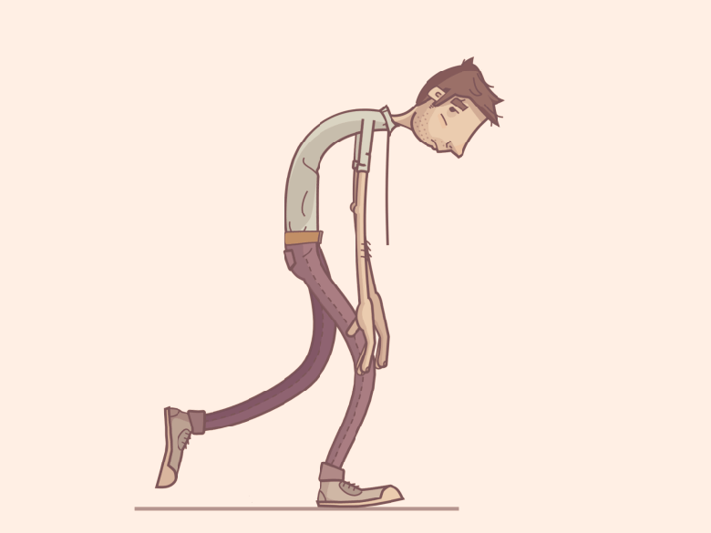
Undereating
When someone is undereating, they are consuming fewer calories than their body needs to function correctly.
Undereating (frequently) will lead to severe weight loss and an increased chance of becoming under-weight or malnourished.
Reference to BMI (what is classed as underweight?)
Consequences:
Illness/ disease – weaker immune system, heart problems, weaker bones, unable to fight off infections (e.g. cough/ cold)
Injury – increased chance of breaks/ fractures when falling, less protection and more vulnerable to injury (e.g. in contact sports)
General health issues – energy and tiredness, muscle mass and strength and poor endurance
Greater chance of having an eating disorder – anorexia, bulimia, binge eating… or other mental health related conditions (depression, low confidence and esteem…)

Slide 9
Effects on sports performance
Lack of certain nutrients may affect a sports performer, Carbohydrates, Proteins… (feeling sluggish and weak, unable to repair damaged muscle/ tissue so more prone to injury)
Unbalanced diet affect performance? Aerobic activities: Poor endurance - carbohydrates / Strength based: Weaker muscles, lack of power - protein
Psychological issues, being laughed at, being too skinny
Under-eating effects growth
Poor diet could cause you to feel dizzy and faint – might have to stop and sit out

Slide 10
Dehydration
When the body loses more fluid then it consumes (Sweating)
Symptoms:
Feeling thirsty, tired, dizzy or lightheaded
Dark coloured urine (as well as increased times you urinate)
Rapid heart beat or breathing rate
Impact:
Without water – blood flow is reduced to muscles meaning the supply less oxygen and therefore tire more quickly (discuss how this might impact an aerobic performer marathon runner)
When we are dehydrated, athletes are unable to sweat – which increases body temperature and therefore means a loss of concentration/ focus.
Increased chance of injury (you and/ or another player) – i.e. cramp (low salt concentration) or when a performer makes a mistake during a game (e.g. tackle technique in rugby or football)

