Slide 1
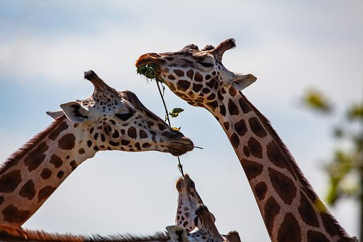
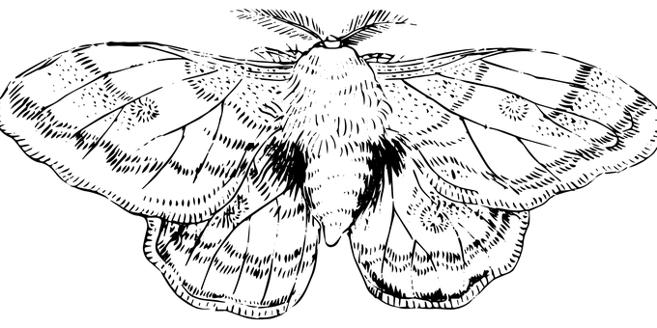
Natural Selection
Learning objectives:
Describe the process of natural selection
Describe how organisms evolve over time
Starter: How is genetic material inherited? Explain using key words: sperm cell, egg cell, chromosome, genes.

Slide 2
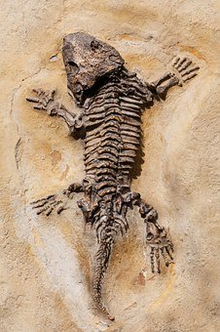
What is evolution?
Think > Pair > Share: What do you think the definition of the term ‘evolution’ is?

Slide 3
Evolution is the process by which organisms have gradually changed over time.
The fossil record provides the most evidence for evolution. Fossils are the remains, or traces, of plants or animals that lived many years ago. They have been preserved by natural processes.

Slide 4
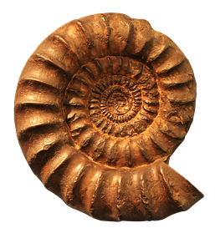
So how are fossils formed?
http://www.bbc.co.uk/programmes/p00ckk6p
1. Outline the stages involved in the fossilisation process.
2. From this short video clip what was absent? Why could decay not take place?
3. Why do you think there are there still ‘gaps’ in the fossil record?
4. Why are there fewer fossils found early in Earth’s history?

Slide 5
Self-assessment:
1. Death > Rapid burial > Anoxic (low oxygen) environment > Long period of time > Rock replaces body tissues > Fossil is formed > Fossil is discovered
2. No oxygen
3. Not all individuals fossilise, not all fossils are found, fossils are often fragmented and broken
4. Early organisms had no skeleton / hard tissues

Slide 6
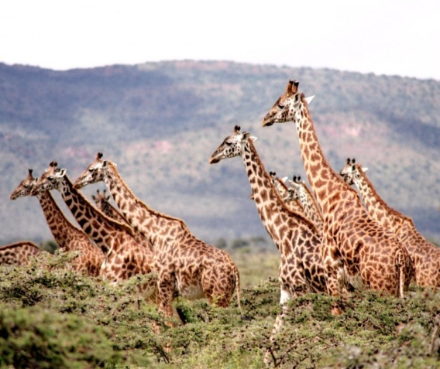
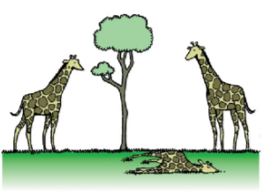
Survival of the fittest – Natural Selection
Individual organisms within a particular species may show a wide range of characteristics. This is known as variation and is caused by differences in genes.
Individuals with characteristics most suited to the environment are more likely to survive and reproduce. Less well adapted organisms will die.
The genes that have enabled these individuals to survive are then passed on to the next generation.
Notes:
Image of giraffe cartoon by Unknownwikidata:Q4233718 [CC BY-SA 3.0 (https://creativecommons.org/licenses/by-sa/3.0)], via Wikimedia Commons

Slide 7
Task: Complete the cartoon strip, with a diagram of an organism of choice (or a made up one!) to demonstrate the process of natural selection:
Key Words: characteristics, alleles, variation, species, breed, survive, phenotype, generation, environment
Individual organisms within a particular _______ may show a wide range of ________, this is caused by differences in their ____.
Individuals with __________ better suited to the _________ are more likely to survive and _______ successfully.
The _________ that have enabled these individuals to _______ are then passed on to the next ________.

Slide 8
Self-assessment:
Individual organisms within a particular species may show a wide range of variation, this is caused by differences in their genes.
Individuals with characteristics better suited to the environment are more likely to survive and reproduce successfully.
The characteristics that have enabled these individuals to survive are then passed on to the next generation.

Slide 9
Examples of Natural Selection in Action
Task: Watch the video and answer the following questions:
Where did Darwin travel to, on the HMS Beagle?
How many different species of finch did Darwin study when he was on the Galapagos Islands?
What was different about the finches he found? How did Darwin explain these differences?
Prior to the industrial revolution, which type of peppered moths were more easily eaten?
Explain how, and why, this changed during the industrial revolution.

Slide 10
Self-assessment:
Darwin travelled to the coast of South America and Australia on his voyage on HMS Beagle.
Darwin found around 15 different species of finch on the Galapagos islands.
The beaks differed from finch to finch, Darwin concluded that this was due to the different food sources the finches had adapted to on the different islands in which they were found.
Prior to the industrial revolution, most of the trees were lighter coloured which meant the paler peppered moths were easily hidden from predators, but the darker peppered moths stood out and were eaten.
During the industrial revolution, black smoke and soot from factories covered the trees, making them appear black. This meant that the darker peppered moths blended in, but the white peppered moths now stood out. As the darker moths were now better adapted to their environment, they survived and reproduced to pass this characteristic wing colour down to the next generation. Over time this meant that the population of the darker peppered moth increased whilst the paler peppered moth population declined.

Slide 11
Plenary ~ Write three quiz questions to test your peers on what you have learnt today! Make sure you know the answer ☺

