Slide 1
Do Now Activity - Whiteboard
Convert these numbers into the Binary / Denary equivalents and add the binary numbers below
41
 | 1010101
010111 001110

Slide 2
Do Now Activity - Whiteboard
Convert these numbers into the Binary / Denary equivalents and add the binary numbers below
41 | 00101001
85 | 1010101
010111 001110 100101
1 1 1 1

Slide 3
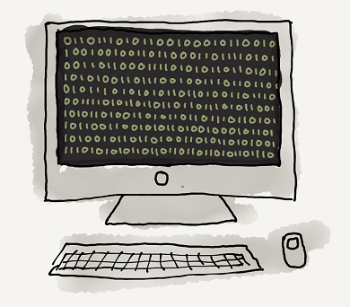
Unit 12 Data Representation
Lesson 3
Good – Convert positive denary whole numbers (0-255) into 2-digit hexadecimal numbers and vice versa.
Outstanding – Explain the use of hexadecimal numbers to represent binary numbers.
Hexadecimal – Base 16 number system

Slide 4
Hexadecimal
Hexadecimal is a base 16 number system.
It uses sixteen symbols to represent numbers instead of the ten used in denary (0,1,2,3,4,5,6,7,8,9) or the two used in binary (0,1).
Hex uses the numbers 0-9 and letters A-F (0,1,2,3,4,5,6,7,8,9,A,B,C,D,E,F).

Slide 5
Hexadecimal
Hex numbers are used a lot in computing because they are shorter and more memorable than binary numbers. But can be easily converted into binary when necessary.
You’ve probably seen hex used to represent colour codes in HTML.

Slide 6
Convert between Denary and Hexadecimal
Convert 163 in denary in to hexadecimal.
Step 1: Write 163 in binary
128 | 64 | 32 | 16 | 8 | 4 | 2 | 1
1 | 0 | 1 | 0 | 0 | 0 | 1 | 1

Slide 7
Convert between Denary and Hexadecimal
Step 2: Split the 8 bit number into two 4 bit nibbles.
128 | 64 | 32 | 16 | 8 | 4 | 2 | 1
1 | 0 | 1 | 0 | 0 | 0 | 1 | 1
8 | 4 | 2 | 1
1 | 0 | 1 | 0
8 | 4 | 2 | 1
0 | 0 | 1 | 1

Slide 8
Convert between Denary and Hexadecimal
Step 3: Convert the 4 bit nibbles to denary.
8 | 4 | 2 | 1
1 | 0 | 1 | 0
8 | 4 | 2 | 1
0 | 0 | 1 | 1
10
3

Slide 9
Convert between Denary and Hexadecimal
Step 4: Convert the 2 denary numbers to hex .
Denary | 15 | 14 | 13 | 12 | 11 | 10 | 9 | 8 | 7 | 6 | 5 | 4 | 3 | 2 | 1 | 0
Hexadecimal | F | E | D | C | B | A | 9 | 8 | 7 | 6 | 5 | 4 | 3 | 2 | 1 | 0
10
3
A
3
Notes:
So 160 in denary is A3 in hexadecimal

Slide 10
Convert between Hexadecimal and Denary
Step 1: Convert the denary number to binary
Step 2: Split the binary number into 4 bit sections
Step 3: Convert each 4 bit section back to denary
Step 4: Convert the two denary numbers to hex
128 | 64 | 32 | 16 | 8 | 4 | 2 | 1
1 | 1 | 0 | 1 | 0 | 0 | 1 | 0
8 | 4 | 2 | 1
1 | 1 | 0 | 1
8 | 4 | 2 | 1
0 | 0 | 1 | 0
13
2
D
2
Notes:
So 210 in denary is D2 in hexadecimal

Slide 11
Practice Task
K Drive
Computing
Computer Science 9-1
Unit 12 - Data representation
Hexadecimal Numbers

Slide 12
Convert Hex to Denary
A8 =
A x 16 = 10 x 16 = 160
8 x 1 = 8
160 + 8 = 168
16 | 1
A | 8

Slide 13
Plenary
What is the number 15 in hexadecimal? [1]
What is the number 9 in hexadecimal? [1]
Why do people prefer hexadecimal to binary? [3]

Slide 14
Plenary
What is the number 15 in hexadecimal? [1]
F
What is the number 9 in hexadecimal? [1]
9
Why do people prefer hexadecimal to binary? [3]
It’s shorter, more memorable and can easily be converted into binary if necessary.

