Slide 1
80/20 – THINK! What do you NEED to cover with your set
Grade | Objective | Outcomes
1-3 | To identify a range of contraceptive methods, explain how they work and discuss the advantages and disadvantages of each | Describe hormonal and non-hormonal methods of contraception.
4-6 |  | Explain how hormonal and non-hormonal contraceptives work.
7-9 |  | Evaluate the use of hormonal and non-hormonal methods of contraception

Slide 2
Controlling Fertility
Do now activity:
Can you name any methods of contraception?
What are the roles of the following hormones during the menstrual cycle: LH, FSH, Oestrogen
If you have been able to name any methods of contraception, can you explain how they work?

Slide 3
Progress indicators
GOOD PROGRESS:
Describe hormonal and non-hormonal methods of contraception.
Explain how hormonal and non-hormonal contraceptives work.
OUTSTANDING PROGRESS:
Evaluate the use of hormonal and non-hormonal methods of contraception

Slide 4
Human fertility is controlled by hormones. This means that the knowledge of hormones can be used to increase or decrease the chances of fertilisation and pregnancy.
Think > Pair > Share: How many different examples of contraception can you identify?

Slide 5
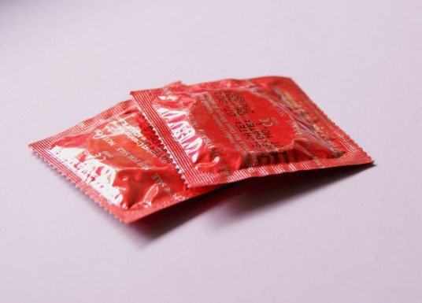
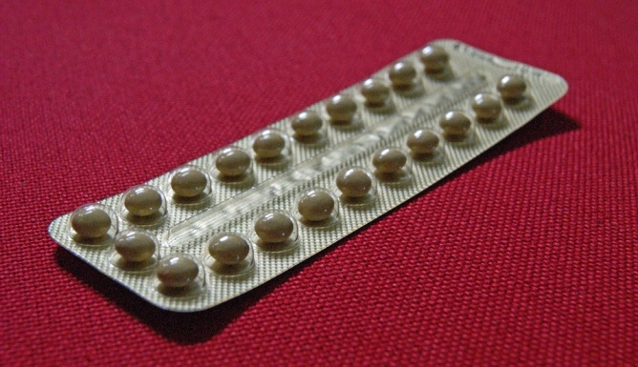
Task: Watch the video and for each of the contraceptive methods listed below identify whether it is a hormonal or non-hormonal method and write a summary of it’s advantages & disadvantages:
Condom ~
Diaphragm or cervical cap ~
Contraceptive pill ~
Implant ~
Intrauterine device ~
http://www.nhs.uk/video/pages/Typesofcontraception.aspx

Slide 6
Self-assessment:
Condom ~ Readily available and very good protection against sexually transmitted disease but should be used in conjunction with another form of contraception to increase reliability. Non-hormonal method.
Diaphragm or cervical cap ~ Ideal for women who do not want to use a hormonal method, does require insertion before intercourse. Non-hormonal method.
Contraceptive pill ~ Combined pill - periods are light, short and pain free and reduces the risk of cancer by 50%. Combined & progesterone-only pill are very reliable forms of contraception but do require women to remember to take them everyday. Hormonal method.
Implant ~ A woman does not have to remember to take a pill everyday, suitable for all women of all age groups. The implant is discrete, lasts for three years. Can help to reduce periods but may prolong them. Hormonal method.
Intrauterine device ~ IUS can be implanted for up to 5 years, it can also help to reduce periods, very quick insertion. Copper IUD contains a spermicide to kill sperm, it can cause heavy and longer periods but can last up to ten years and reduced the risk of endometrial cancer.

Slide 7
Task: On your tables you will be given a set of cards describing different methods of contraception, read through the information and complete the following table:
Type of contraception | How does it work? | Advantages | Disadvantages
Hormone-based contraception
Condom
Diaphragm
Intrauterine device
Abstinence | People will not have sex or abstain around the time of ovulation | No side-effects | Not very reliable, can risk unexpected pregnancy
Surgical methods

Slide 8
Self-assessment:
Type of contraception | How does it work? | Advantages | Disadvantages
Hormone-based contraception | Hormones stop the production of FSH, prevent eggs from maturing and stop the uterus lining developing, stopping implantation. Combined pill Progesterone only pill Contraceptive implant, a tube is inserted under the skin Contraceptive injection Contraceptive patch releases hormones into the blood | Easily reversible Readily available Easy to use Has fewer side effects Can last up to three years Don’t have to remember to take Easily reversible | Have to remember to take the contraception REGULARLY DO NOT prevent STI’s Each type has its own risks… Risk of high blood pressure, thrombosis and breast cancer If you forget to take the pill the levels of hormone drop quickly = pregnancy! Can cause irregular periods Leaves a scar Must be replaced after 3 yrs Only lasts 12 weeks Need to be replaced every 7 days

Slide 9
Self-assessment:
Type of contraception | How does it work? | Advantages | Disadvantages
Condom | Prevents the sperm reaching the egg | Effective for reducing the risk of STI’s | Condom can get damaged, slip = pregnancy
Diaphragm | Placed over the cervix to prevent the entry of sperm | No artificial hormones, natural cycle continues | The cap is not placed correctly, allowing entry of the sperm = pregnancy
Intrauterine device | IUD is placed in the uterus, contains copper which is a spermicide, stops embryo’s implanting. IUS contains progesterone which is slowly released to prevent the build up of the uterus lining. | Very effective Last from 3-10 years | May cause period problems and sometimes infection.
Abstinence | People will not have sex or abstain around the time of ovulation | No side-effects | Not very reliable, can risk unexpected pregnancy
Surgical methods | Men = Vasectomy, sperm ducts are cut and tied, sperm cannot reach egg Women = oviducts are tied, egg can’t be reached by sperm | Permanent – good if you don’t want any more children | Surgical procedures carry risk Have been known to fail Difficult to reverse if you change your mind later

Slide 10
Sexual politics ~ a brief history of contraceptive methods
Task: Watch the video about the struggle of a nurse from Brooklyn, New York, in making contraception readily available to women. Answer the following questions:
Prior to the pill, how were women able to control how many children they had?
What did Margaret Sanger do to help women in controlling child birth?
Why was this a controversial issue?
How did Katherine McCormick help Margaret Sanger?
http://www.bbc.co.uk/education/clips/zjfqhyc

Slide 11
Self-assessment:
Prior to the pill women would have to rely on abstinence or if they became pregnant they sometimes would turn to abortions. They had a choice between self-induced abortion of the back-street abortionist, both equally dangerous.
Margaret Sanger was a nurse at the time and saw the devastating effects that the abortions could cause, she started her own contraception clinic in Brooklyn.
At this time in American history the distribution of contraception was seen to be ‘taboo’, those who took them were believed to be sinful. She was eventually arrested under the very strong anti-obscenity law.
Katherine McCormick was a wealthy American heiress who studied Biology at University, campaigned for votes and formed a friendship with Sanger. In Europe contraceptive were easy to get hold of, she smuggled diaphragms in to the US via dresses she imported. Sanger had now set up another, more successful, clinic. Eventually McCormick bank rolled some incredibly important research into the efficacy of the contraceptive pill, as suggested by Sanger. This was put on the market in 1960.

Slide 12
Quick check ~ Silent 5
Define the term contraception
The mini-pill, the combined pill and the implant are all forms of contraception.
a) State one similarity between each contraceptive
b) For each contraceptive, state one way in which it is different
(1 mark)
(1 mark)
(3 mark)

Slide 13
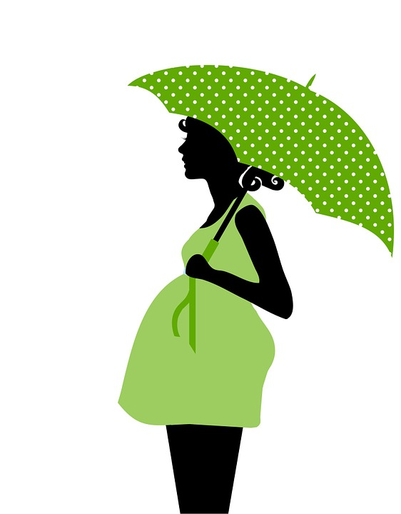
Plenary: Summarise what you have learnt this lesson in three sentences
Key Words:
Contraception
Sperm
Egg
FSH
LH
Oestrogen
Progesterone
Barrier
Condom
IUD
Surgery
Hormone
Spermicide

Slide 14
Hormone-based contraception
Hormones are an essential pert of the menstrual cycle and are therefore important for fertility in women. Scientists have worked out a number of ways to manipulate these hormones to prevent pregnancy.
The contraceptive pill is a form of oral contraceptive, there are two forms of pill: the combined pill and the mini-pill which only contain progesterone.
The combined pill contains a mix of oestrogen and progesterone. The hormones inhibit the production of FSH, preventing eggs from maturing and also stopping the uterus lining developing, therefore stopping implantation. The pill is easy to use but there are some risks including high blood pressure, thrombosis and breast cancer.
The progesterone only pill has fewer side effects but if a women forgets to take this pill the levels of hormone can drop quite quickly which can result in an unexpected baby!
Another option is the contraceptive implant which can last up to three years, a tube is inserted under the skin and releases progesterone. The contraceptive injection uses the same hormone but only lasts 12 weeks and the contraceptive patch releases oestrogen and progesterone into the blood stream but will need to be replaced every 7 days. Each of these methods prevents eggs maturing in the ovaries and prevents ovulation.
Surgical methods
If people do not want any more children, they can be surgically sterilised. Men can undergo a procedure called a vasectomy where the sperm ducts are cut and tied to prevent sperm getting into the semen. In women, the oviducts are tied to prevent the egg reaching the uterus and the sperm meeting the egg.
Barrier methods
A condom is an example of a barrier methods, this prevents the sperm reaching the egg. A condom is made out of thin latex and is placed over the penis during intercourse. This method of contraception is effective for reducing the risk of sexually transmitted infection, but the risk is that they are damaged letting through the sperm. For women a diaphragm or cap can be used, this is placed over the cervix to prevent the entry of sperm. The risk is that the cap is not placed correctly, allowing entry of the sperm.
Intrauterine devices
The IUS or copper IUD can be placed into the uterus by a doctor and can last from 3-10 years. The IUD contains copper which acts as a spermicide and also stops any embryo’s implanting. The IUS contains progesterone which is slowly released to prevent the build up of the uterus lining. They are very effective but may cause period problems and sometimes infection.

Slide 15
Prior to the pill, how were women able to control how many children they had?
What did Margaret Sanger do to help women in controlling child birth?
Why was this a controversial issue?
How did Katherine McCormick help Margaret Sanger?
Prior to the pill, how were women able to control how many children they had?
What did Margaret Sanger do to help women in controlling child birth?
Why was this a controversial issue?
How did Katherine McCormick help Margaret Sanger?
Prior to the pill, how were women able to control how many children they had?
What did Margaret Sanger do to help women in controlling child birth?
Why was this a controversial issue?
How did Katherine McCormick help Margaret Sanger?
Prior to the pill, how were women able to control how many children they had?
What did Margaret Sanger do to help women in controlling child birth?
Why was this a controversial issue?
How did Katherine McCormick help Margaret Sanger?

