Slide 1
Life style factors.
Good progress: You are able to analyse lifestyle data and physiological data.
Outstanding progress: You are able to analyse lifestyle data and physiological data. You are able to explain what the data says about the physical health and future risks for people.

Slide 2
Lifestyle data…
What is lifestyle data?
This is when you measure your own lifestyle choices against data that is officially prepared.

Slide 3
Lifestyle data…smoking…
https://youtu.be/7ctaMwtHwUo
Watch the video on smoking. How you would feel if you smoked and you saw the video?

Slide 4
Smoking is a lifestyle choice

Slide 5
There are now laws to ban smoking...

Slide 6
Smoking statistics…
Smoking causes around 96,000 deaths in the uk annually.
Smokers under the age of 40 are five times more likely to have a heart attack than non-smokers.
Smoking causes around 80% of deaths from lung cancer, 80% of deaths from bronchitis and emphysema and 14% of deaths from heart disease.
More than 25% of all cancer deaths are caused by smoking, lung, mouth, lip, throat, bladder, kidney, pancreas, stomach, liver and cervix.
On average a smoker will die 10 years earlier than a non-smoker.
Women smokers are at greater risk of developing osteoporosis.
Smoking is a cause of impotence and can lead to sperm abnormalities.
Smokers are more likely to develop facial wrinkles earlier and have dental problems.

Slide 7
Smoking and cancer… task
Task:
What does the diagram tell you about the impact of smoking on cancer (1)?
Brian smokes 30 cigarettes a day, give two ways in which smoking is likely to affect Brian…. (2)

Slide 8
Lifestyle data…alcohol…
https://www.youtube.com/watch?v=7F5o3NSHMoM
Watch the video on alcohol. How you would feel if you drank alcohol and you saw the video?

Slide 9
Drinking alcohol is a lifestyle choice. It comes with risk to physical health...

Slide 10
alcohol statistics…
It is strongly linked to at least 7 types of cancers. A lifetime of drinking too much alcohol can increase your risk of bowel cancer by 23%.
Alcohol- related liver disease accounts for 37% of liver disease deaths.
2/3’s of cases of chronic pancreatitis are caused by heavy drinking most common in men aged between 45 and 54.
More than 25,000 people were admitted to hospital with acute pancreatitis in 2013 and 2014.
Around 1,000 people die from acute pancreatitis every year.
You are between 2 and 5 times more likely to have an accident or injure yourself if you drink five to seven units of alcohol in one sitting.
Less than 1/3 of the British public knows the link between alcohol and breast cancer.
Each drink per day increases the risk of breast cancer in women by between 7 and 13%.
In 2011 3,000 cases of breast cancer were directly caused by alcohol consumption.

Slide 11
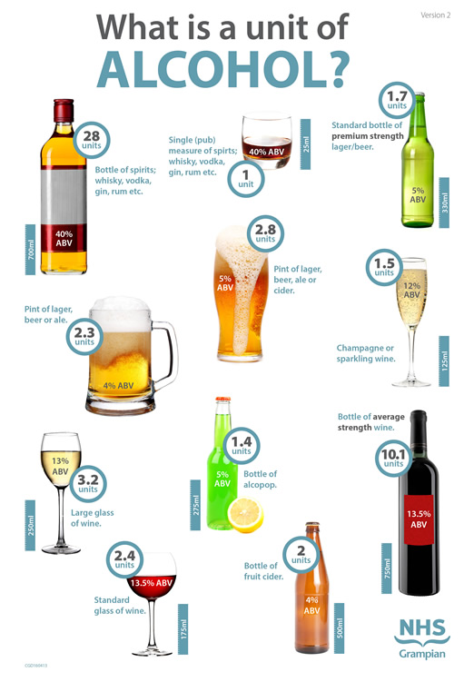
January 2016 guidelines…
Any amount of alcohol can increase the risk of cancer.
Men and women who drink regularly should consume no more than 14 units a week
People should not binge drink all 14 units in one go.

Slide 12
Alcohol…task
Any amount of alcohol can increase the risk of cancer.
Men and women who drink regularly should consume no more than 14 units a week
People should not binge drink all 14 units in one go.
Task:
Brian drinks a couple of glasses a day (4 units a day), work out the following:
How many units he is drinking a week (units times 7)… (1)
Using your statistics and the guidelines above, suggest how this data could affect Brian… (4)

Slide 13
Interpreting lifestyle data on inactivity…

Slide 14
Lifestyle data…being inactive…
Less active and less fit people have a greater risk of developing high blood pressure.
Physical activity can reduce your risk for type 2 diabetes.
Studies show that physically active people are less likely to develop coronary heart disease than those who are inactive. This is even after researchers accounted for smoking, alcohol use, and diet.
Lack of physical activity can add to feelings of anxiety and depression.
Physical inactivity may increase the risk of certain cancers.
Physically active overweight or obese people significantly reduced their risk for disease with regular physical activity.
Older adults who are physically active can reduce their risk for falls and improve their ability to do daily activities.

