Slide 1
Sports Nutrition
Name:

Slide 2
Sports Nutrition
LO1: Know about the nutrients needed for a healthy, balanced diet

Slide 3
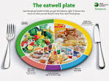
The characteristics of a balanced diet
A balanced diet is the one that contains the proper nutrients that our body needs to stay healthy and perform well. In this sense, a balanced diet is based on eating natural, healthy foods based on the key nutrients they bring.
Fats
Carbohydrates
Protein
Water
Fibre
Vitamins and minerals

Slide 4
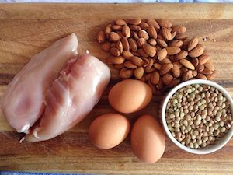
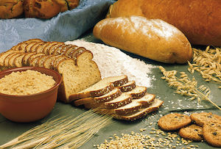
Nutrients are:
Nutrients are molecules in food that all organisms need to make energy, grow, develop, and reproduce. Nutrients are digested and then broken down into basic parts to be used by the organism.
Remember when you do a definition - don’t just copy the first wiki definition!

Slide 5
The role of nutrients
Carbohydrates:
Definition –
Foods-
Fats:
Definition –
Foods-
Protein:
Definition –
Foods-
Vitamins and Minerals:
Definition –
Foods-
Water:
Definition –
Foods-
Fibre:
Definition –
Foods-
You need to give a definition and then examples of food you find it in. Next how will this help you in sports?

Slide 6
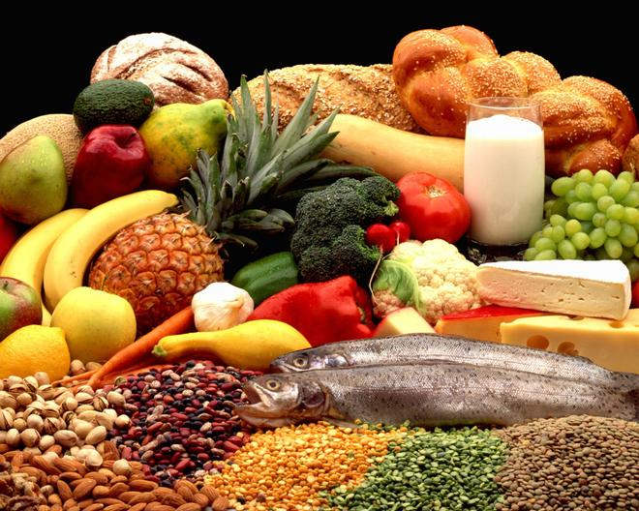
Food groups
LO: I can list the main food groups and describe their role in the body.
Starter: Write down what you ate yesterday for breakfast, lunch and tea

Slide 7
Our bodies need a variety of different foods so that they can keep working properly.
Let’s look at the sort of foods we should be eating and why they are good for us.

Slide 8
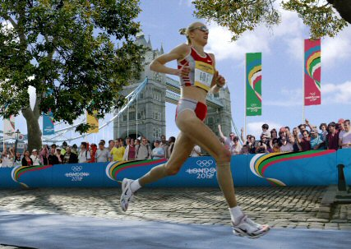

Carbohydrates are in starchy and sugary foods.
Carbohydrates give you energy.
These foods contain carbohydrates.
potato
rice
cereal
pasta

Slide 9
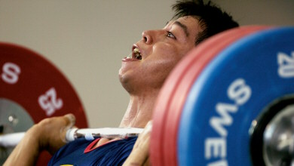

Meat & Fish contain protein.
Proteins help your body grow and repair itself.
Here are some good ways of getting protein.
nuts
beef
eggs
fish

Slide 10

Vitamins & Minerals are found in fruit & vegetables
They help your bodies to work properly.
These are really good for us.
carrot
grapes
apple
corn

Slide 11
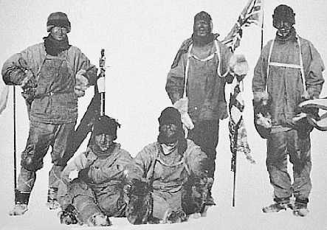

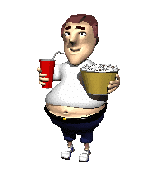


Foods containing fats and oils
Used as an energy store.
Although they taste good these foods can be bad for you if you eat too many!
Oil
butter
chips
cheese

Slide 12
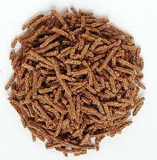
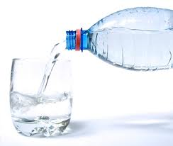
We also need…
Helps to clean your digestive system
Fibre
Needed for chemical reactions in your body
Water

Slide 13
Nutrients helping in Sport
Carbohydrates:
Fats:
Protein:
-
Vitamins and Minerals:
Water:
Fibre:

Slide 14
Balanced Diet Wheel
Remember to reference and explain
Reference:

Slide 15
Sports Nutrition
LO2 Understand the importance of nutrition in sport

Slide 16
Timing of nutrition during exercise
Stage 1 = Before sport:
Stage 2 = During sport:
Stage 3 = After sport:

Slide 17
Dietary requirements in different sports
Aerobic activities
Anaerobic activities
Strength activities

Slide 18
Dietary supplements
Multi-vitamins –
Protein powders –
Creatine –
Herbs -

Slide 19
Effects of Dietary supplements

Slide 20
Sports Nutrition
LO3 - Know about the effects of a poor diet on sports performance and participation

Slide 21
Why malnutrition effects performance:

Slide 22
Why overeating effects performance:

Slide 23
Performance under eating effects performance:

Slide 24
Why dehydration effects performance:

Slide 25
Sports Nutrition
LO4 Be able to develop diet plans for performers

Slide 26
Diet plan:
Age =
Gender =
Allergies =
Religious beliefs =
Budget (food) =
Cooking skills =
Sport training for =

Slide 27
Aim =
How I will measure progress =
How I will make it achievable and realistic =
How long the programme will be =

Slide 28
Foods I have chosen and why:
Breakfast –
Lunch –
Dinner –
Snacks –
Drinks-

Slide 29
Week 1 overview
 | Breakfast | Lunch | Dinner | Snacks | Drinks
Monday
Tuesday
Wednesday
Thursday
Friday
Saturday
Sunday

Slide 30
Week 2 overview
 | Breakfast | Lunch | Dinner | Snacks | Drinks
Monday
Tuesday
Wednesday
Thursday
Friday
Saturday
Sunday

Slide 31
Evaluation of my diet plan

Slide 32
Feedback from my client:

Slide 33
Improvements I can make

