Slide 1
Health & Wellness
Do now activity:
What does it mean to be ‘healthy’?
What is mental illness?
Can you explain the difference between a communicable and non-communicable disease?
Keywords
Health
Wellness
Communicable
Non-communicable
Mental illness

Slide 2
Progress indicators
GOOD PROGRESS:
- Give risk factors associated with cardiovascular disease, Type 2 diabetes, lung diseases and cancers.
- Describe the effects of diet, smoking, alcohol and exercise on health.
OUTSTANDING PROGRESS:
-Explain how and why the Government encourages people to lead a healthy lifestyle.

Slide 3
What is health? What is wellness?
A state of complete physical, mental and social well-being and not merely the absence of disease or infirmity.
The act of seeking health in all aspects of human life, not just physical but mental.
Health
Wellness
How are the two definitions similar? How are they different?

Slide 4
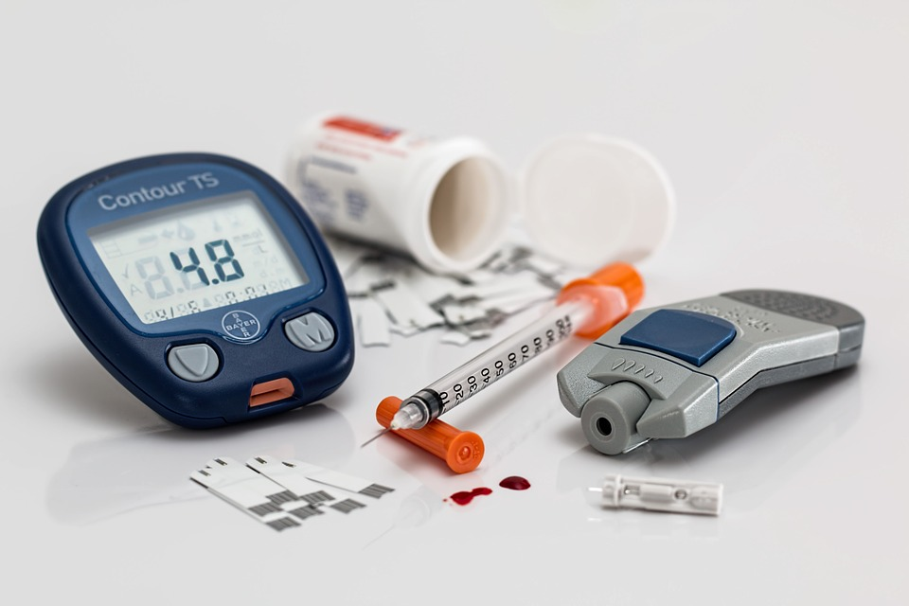
Communicable and non-communicable disease
Communicable – diseases that can be spread between people
Non-communicable – diseases that develop within a person from genetic or environmental factors and cannot be spread between people
Task: In pairs you have been given a list of different diseases, sort them into a table in your books – is it a communicable or non-communicable disease?

Slide 5
Task: In pairs sort these diseases into communicable or non-communicable
HIV
Heart Disease
Cholera
Tuberculosis
Typhoid
Respiratory Diseases
Small pox
Stroke
Chicken pox
High blood pressure
Diabetes
Cancer
Measles
Arthritis
Sickle cell anaemia
Influenza
Communicable | Non-communicable

Slide 6
Self-assessment
Communicable | Non-communicable
Tuberculosis (air borne - bacteria) | Diabetes (pancreas malfunction)
HIV (blood and fluids - virus) | Cancer (genetics/ environmental)
Chicken pox (air borne & fluids - virus) | Heart Disease (genetics/ environmental)
Measles (air borne - virus) | Stroke (genetics/ environmental)
Small pox (body fluids - virus) | Respiratory Diseases (e.g. asthma) (genetics/ environmental)
Cholera (water borne - bacteria) | Arthritis (genetics/ environmental)
Typhoid (water borne - bacteria) | Sickle cell anaemia (genetics)
Influenza (air borne - virus) | High blood pressure( genetics/ environmental)

Slide 7
What is a risk factor?
A risk factor is anything that may increase the chance of a harmful outcome
What are some risk factors for communicable diseases?

Slide 8
Self-assessment:
Not washing your hands
Undercooked food
Poor sanitary conditions
What are some risk factors for communicable diseases?
Dirty water
Lack of medical treatment to stop spread of infection, e.g. antibiotics & vaccines
Not covering your mouth when you cough or sneeze

Slide 9
Risk Factors for Non-communicable Diseases
Can you associate any of the following risk factors below with specific non-communicable diseases?
High blood pressure
Alcohol
Smoking
High cholesterol
Lack of exercise
Raised blood glucose
Poor diet
= Heart attack/stroke/dementia
= Heart disease/liver disease/stroke
= Cancer/heart disease/stroke
= Heart disease/stroke
= Heart disease/obesity/diabetes
= Diabetes
= Obesity/diabetes/anaemia/cancer

Slide 10
Top 10 preventable threats to health
Low weight children and mothers
Unsafe sex
High blood pressure
Tobacco
Alcohol
Unsafe water, sanitation and hygiene
High cholesterol
Indoor smoke from solid fuels
Iron deficiency
Obesity
Together, they account for 40% of the 56m deaths that occur world-wide each year

Slide 11
Unsafe sex Poor nutrition High blood pressure High cholesterol Tobacco
Task: Put these in order of the biggest to the smallest risk to health …
High blood pressure - 7.1m
Tobacco - 4.9m
High cholesterol - 4.4m
Poor nutrition - 3.4m
Unsafe sex - 2.9m
Challenge: What are the types of risk factor which increase the chances of death in these cases?
Hereditary
Physical environment
Social environment
Lifestyle and behaviour choices

Slide 12
Plenary: 3-2-1
3 facts
2 key words
1 question

