Slide 1

AQA English Language Paper 2 Section B/Question 5
In Section B or Question 5 you’re asked to create a piece of non-fiction writing.
You’ll be given ONE task, there’s no choice in this one (sorry!)
Here’s an example P2 Q5 question:
“Fox hunting is a barbaric sport and it should be banned.”
Write an essay for a school newsletter to explain your point of view on this topic.
Read the question carefully and work out the purpose, audience and form of the piece of writing you are being asked to create.
For this particular task you are being asked to explain (purpose) your opinions on banning fox hunting to students and parents (audience) in an essay to be published in a school newsletter (form)

Slide 2

The examiner’s template in a nutshell
The statement will be related to whatever topic you’ve been looking at in Section A. You are allowed to use ideas from Section A in your Section B writing.
‘In a nutshell’ means to sum up something complex into something small. William Shakespeare may have been the first person to write this phrase down!
‘Controversial statement that can be argued a number of ways.’
Write a letter/speech/article/essay/text of a leaflet to [audience] explaining/informing/advising/persuading/arguing your opinion on this statement.
(24 marks for content and organisation 16 marks for technical accuracy) [40 marks]
You are advised to plan your answer to Question 5 before you start to write.
Purpose – Why?
Audience- Who?
Form – What?
Oh! Planning! We’ll come on to that.

Slide 3
Here’s an example exam-style question
‘Markets are an important part of any community and are just as valuable as supermarkets.’
Write a letter to your local council arguing your opinion on this statement.
(24 marks for content and organisation 16 marks for technical accuracy) [40 marks]
You are advised to plan your answer to Question 5 before you start to write.

Slide 4


Form: Letter
Here are the basic features the exam board are looking for:
the use of addresses
a date
a formal mode of address if required e.g. Dear Sir/Madam or a named recipient effectively/fluently sequenced paragraphs
an appropriate mode of signing off: Yours sincerely/faithfully.
Putting these elements into your letter means you are showing the examiner you can write a specific form of writing and also that you think about the register, style and tone of your writing carefully, too!
Tone, style, register
The tone (sound of writing) is confident and changes dependent on the point being made.
The writing is appropriately formal or informal (register).
The pace (speed) of the writing changes depending on the point being made.

Slide 5
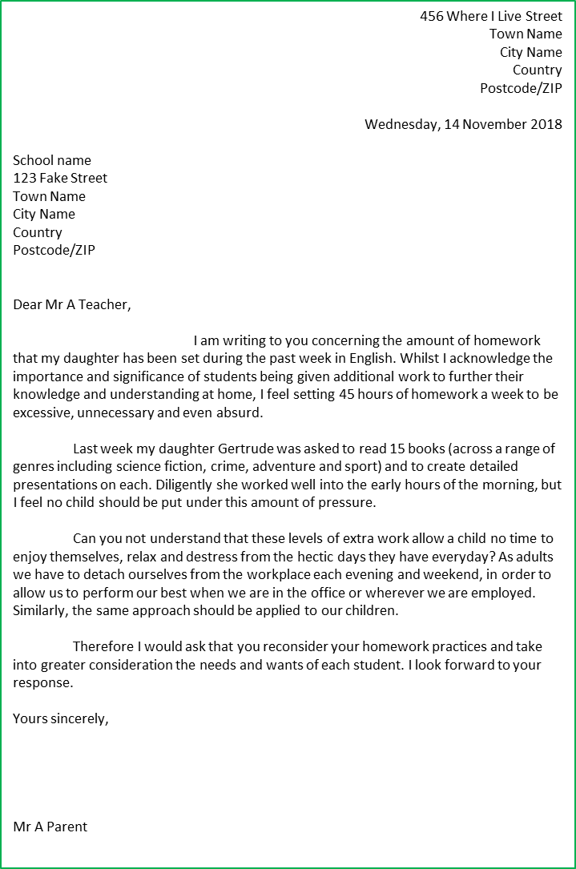
The address of the receiver This is included on the left below the writer’s address.
Writer’s address at the top right and the date written below.
Directly addressing the receiver: If you know the name of the person you are writing it, you write it down formally (Mr A Name, Mrs A Name). However, if you don’t know their name you would put ‘Dear Sir/Madam’.
Clear indent at the beginning of the introductory paragraph: Most formal letters will include a large gap or indent at the beginning like this.
Introductory paragraph: This sets out why you are writing to the receiver and what you hope to achieve through the letter.
Paragraphs linked with connectives: This is to ensure your writing flows well for the reader and links your ideas together. It provides a clear structure to your letter and writing.
The language used is very formal, so extensive vocabulary is employed and a serious tone is established.
Signed off with ‘Yours sincerely’, a signature and the writer’s formal name. If you were writing to someone whose name you don’t know, you would sign off with ‘Yours faithfully’. A signature shows the letter is genuine and authentic.

Slide 6


Purpose: Writing to Argue
Purpose: | WRITING TO ARGUE
What is it? | Giving the case for one side of a debate
What does it involve? | Being aware of the other side of a debate
What key features do you often find in this type of writing? | Includes counter-arguments, rhetorical questions, facts, statistics, emotive language
When you are writing to argue, you are showing you understand what this purpose of writing involves.
It means you are presenting your opinions around a topic, but you are also showing an awareness of other arguments and conveying how these ideas are wrong in comparison to your own.
Writing to argue is different to writing to persuade, as arguing involves showing an awareness of others’ ideas but arguing why they are wrong, whereas persuading means you talk about your own opinions and convince the audience you are right.

Slide 7

Audience: Your local council
In this exam question you are writing to a group of people whose role is to organise and maintain public services within a local area.
They are professional, formal and serious, which means your letter to them needs to be as well if you want to be taken seriously.
That means:
Extensive vocabulary
A carefully planned out structure that supports your arguments
Appealing to the councillors through your use of writing to argue techniques

Slide 8



Vocabulary
Really impressive vocabulary choices chosen for effect
The choice of vocabulary makes the writing interesting and engaging for the reader.
Ideas
Structure
Complex, detailed ideas with specific examples used to develop them and make them relevant for the reader.
Wide-ranging ideas that cover multiple areas within an idea and avoids repetition.
Step 4: Planning
Every teacher will tell you to plan your answer to Section B/Question 5. Even though examiners don’t actually ‘mark’ your plans, they’ll notice them and they’ll see your plans coming through in the organisation and structure of your work.
You can plan in any way you like:
Mind maps
Paragraph plans
Diagrams, graphs, charts, etc
Lists of ideas
Flows from one idea or argument to the next
Engaging opening to the writing.
Powerful finish to the writing.
A carefully chosen and crafted order of ideas including within paragraphs and sentences.
Use of discourse markers/connectives to link complex ideas.
Communication
Paragraphs
Your ideas clear and makes sense to the reader.
You sound confident in the way you write
The writing is engaging and genuinely interesting for the reader.
The writing has a distinctive voice that flows and feels natural not robotic.
Paragraphs are linked together and in an order that engages the reader and makes their argument easy to follow.
Paragraphs allow the structure of the piece to come through to the reader easily.
Tone, style, register
The tone (sound of writing) is confident and changes dependent on the point being made.
The writing is appropriately formal or informal (register).
The pace (speed) of the writing changes depending on the point being made.

Slide 9


Here’s an example plan. Master planning and you master writing!
Introduction: First paragraph to set out who you are, why you are writing to the council and what you hope to get from this letter.
Topic 2: Argue that markets provide not just a transactional role but are there for local people to talk to each other, and for market sellers to improve their services through feedback from customers.
Topic 3: Counter-argument about the range of goods and efficiency of service from supermarkets – markets offer so much more in terms of community support and building relationships in and around the local town.
Topic 4: Provide detailed example of how one seller is working with a local charity to promote its events in the town, provide detailed anecdote about how this work has helped the town.
Topic 5: Write two brief descriptions: A market stall (lively, independent, happy) and a supermarket (sterile, cold and uninspiring). Argue that markets have existed in towns for hundreds of years, serving as hubs to the community. Their historical links must not be lost and they provide a uniqueness and esoteric quality that large brand supermarkets do not.
Topic 6/Conclusion: Thank the council for listening to your ideas and you hope that they will take these on board when considering the importance of the market within the town.
Sign off – Yours faithfully

Slide 10














Beginnings
A puzzle! Hook your reader in with something that isn’t clear at the beginning, perhaps something unusual has happened?
Beginnings and Endings
Imagine you’re an examiner. You’re marking hundreds and hundreds of exam papers and answers. A student needs something different, something catchy and something engaging at the very beginning at a piece of writing, whatever the purpose, audience and form.
Plan your first sentence and your last sentence as part of your overall plan.
Direct address. Talk directly to your readers as a way of engaging them.
Visual hook. Use a powerful image or description to engage the reader at the start.
Amusing hook. Use a joke to establish a comedic tone at the beginning of your text. It’s a great way to make a reader feel at ease and lure them into a difficult or controversial topic.
Dialogue. Have people talking to each other right from the beginning to establish a relevant example to the topic being discussed.
Subtle hook. Hint at what is going to happen in the rest of the text.
Atmospheric hook. Use your descriptive language to build up a particular tone and atmosphere right at the very beginning. It be using a particular example to engage the reader with the topic of the text.
Endings
Cyclical ending: where the ending returns back to the beginning of the text, often using to emphasise the original point.
Twist: a complete change in direction from where the text was going.
Summing up: The writer reflects back on all the topics covered in their text to provide the reader with a summary.
Short sentence: Making your final sentence very, very short can leave the readers with one final ‘punch’ or impactful idea to take away from the whole text.
A final question: Asking the readers a rhetorical question or question at the end of a text means the responsibility or onus is on the reader to make up their own minds.
Repeating examples: A writer could refer back to a specific example they made during their text. For instance, if they spoke about a particular person or place earlier on in the text to provide evidence for their argument, they made decide to repeat that example again for further emphasis:
Maybe if we change our ways, people like Bob would no longer have to suffer.

Slide 11


First sentence
There are special places at the heart of every community, every town and every high street.
Final sentences
For too long the humble town market has been ignored in favour of monstrous, sterile supermarket superstructures. It’s time to change our perspectives.

Slide 12
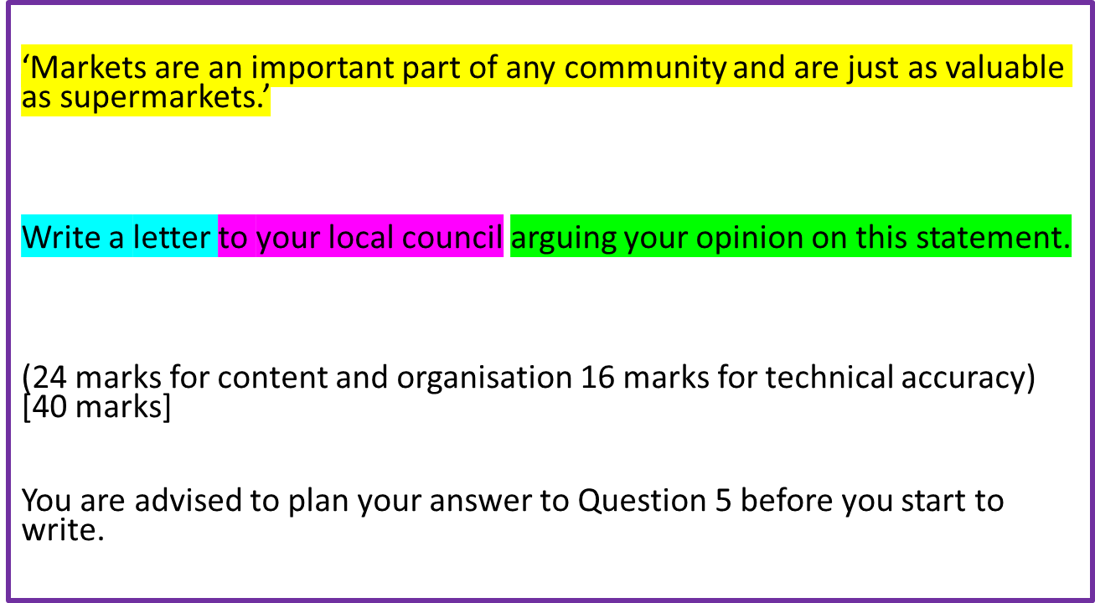
Now, give this a go yourself.
Go through all the steps we’ve looked at and plan out your answer carefully.
If you want to really make it like the exam, time yourself for 45 minutes (allow for any extra time if you are given it).
Remember to think about all the different requirements of the mark scheme.

Slide 13
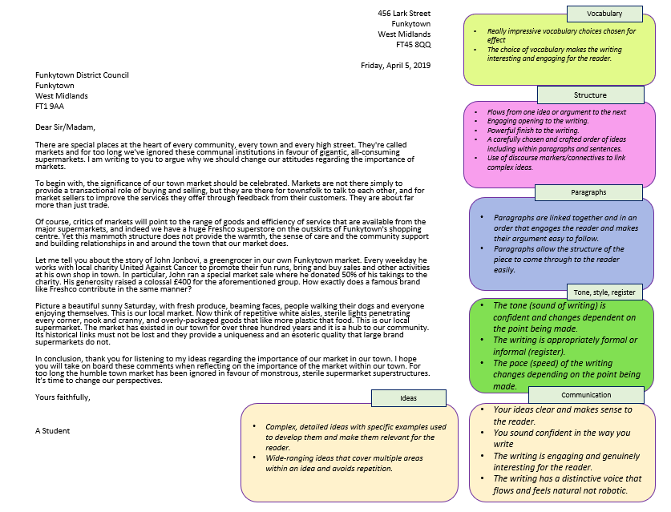
Look at the example answer to the question provided to you
Using the mark scheme boxes and ideas given to you, think about what really works well in this answer in terms of:
Vocabulary
Structure
Paragraphs
Tone, style, register
Communication
Ideas
Go through the answer and highlight sections that work well in your opinion.
Make notes on how this answer works well and meets the requirements of the mark scheme.
Having reflected on this example, what might you add or change to your own version and why?

Slide 14
456 Lark Street
Funkytown
West Midlands
FT45 8QQ
Thursday, March 12, 2020
Funkytown District Council
Funkytown
West Midlands
FT1 9AA
Dear Sir/Madam,
There are special places at the heart of every community, every town and every high street. They're called markets and for too long we've ignored these communal institutions in favour of gigantic, all-consuming supermarkets. I am writing to you to argue why we should change our attitudes regarding the importance of markets.
To begin with, the significance of our town market should be celebrated. Markets are not there simply to provide a transactional role of buying and selling, but they are there for townsfolk to talk to each other, and for market sellers to improve the services they offer through feedback from their customers. They are about far more than just trade.
Of course, critics of markets will point to the range of goods and efficiency of service that are available from the major supermarkets, and indeed we have a huge Freshco superstore on the outskirts of Funkytown's shopping centre. Yet this mammoth structure does not provide the warmth, the sense of care and the community support and building relationships in and around the town that our market does.
Let me tell you about the story of John Jonbovi, a greengrocer in our own Funkytown market. Every weekday he works with local charity United Against Cancer to promote their fun runs, bring and buy sales and other activities at his own shop in town. In particular, John ran a special market sale where he donated 50% of his takings to the charity. His generosity raised a colossal £400 for the aforementioned group. How exactly does a famous brand like Freshco contribute in the same manner?
Picture a beautiful sunny Saturday, with fresh produce, beaming faces, people walking their dogs and everyone enjoying themselves. This is our local market. Now think of repetitive white aisles, sterile lights penetrating every corner, nook and cranny, and overly-packaged goods that like more plastic that food. This is our local supermarket. The market has existed in our town for over three hundred years and it is a hub to our community. Its historical links must not be lost and they provide a uniqueness and an esoteric quality that large brand supermarkets do not.
In conclusion, thank you for listening to my ideas regarding the importance of our market in our town. I hope you will take on board these comments when reflecting on the importance of the market within our town. For too long the humble town market has been ignored in favour of monstrous, sterile supermarket superstructures. It’s time to change our perspectives.
Yours faithfully,
A Student
Vocabulary
Really impressive vocabulary choices chosen for effect
The choice of vocabulary makes the writing interesting and engaging for the reader.
Structure
Flows from one idea or argument to the next
Engaging opening to the writing.
Powerful finish to the writing.
A carefully chosen and crafted order of ideas including within paragraphs and sentences.
Use of discourse markers/connectives to link complex ideas.
Paragraphs
Paragraphs are linked together and in an order that engages the reader and makes their argument easy to follow.
Paragraphs allow the structure of the piece to come through to the reader easily.
Tone, style, register
The tone (sound of writing) is confident and changes dependent on the point being made.
The writing is appropriately formal or informal (register).
The pace (speed) of the writing changes depending on the point being made.
Ideas
Communication
Complex, detailed ideas with specific examples used to develop them and make them relevant for the reader.
Wide-ranging ideas that cover multiple areas within an idea and avoids repetition.
Your ideas clear and makes sense to the reader.
You sound confident in the way you write
The writing is engaging and genuinely interesting for the reader.
The writing has a distinctive voice that flows and feels natural not robotic.
Notes:
Can be printed off. Word document version also included.

Slide 15
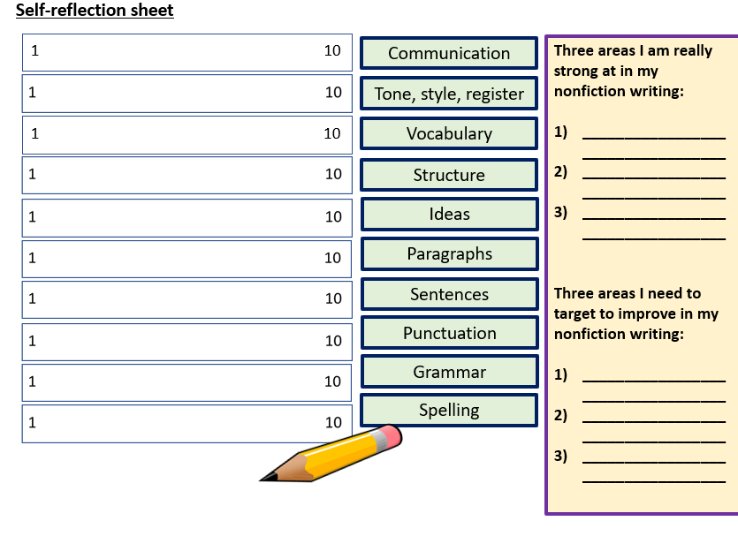
Complete your self-reflection sheet and make changes or additions to your own answer in red pen.
Communication
Tone, style, register
Vocabulary
Structure
Ideas
Paragraphs
Sentences
Punctuation
Grammar
Spelling

Slide 16


Self-reflection sheet
1 10
Communication
Three areas I am really strong at in my nonfiction writing:
__________________________________
__________________________________
__________________________________
Three areas I need to target to improve in my nonfiction writing:
__________________________________
__________________________________
__________________________________
Tone, style, register
1 10
Vocabulary
Structure
Ideas
Paragraphs
Sentences
Punctuation
Grammar
Spelling
Notes:
To print off

