Slide 1
80/20 – THINK! What do you NEED to cover with your set
Grade | Learning Objective | Learning Outcome
1 | Describe some examples of specialised cells | Recall what a specialised cell is Describe examples of specialised plant and animals cells Explain how some cells are adapted for their function
2
3

Slide 2
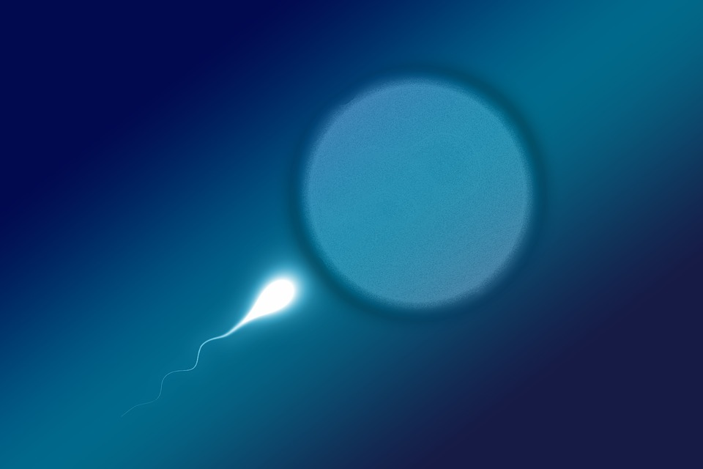
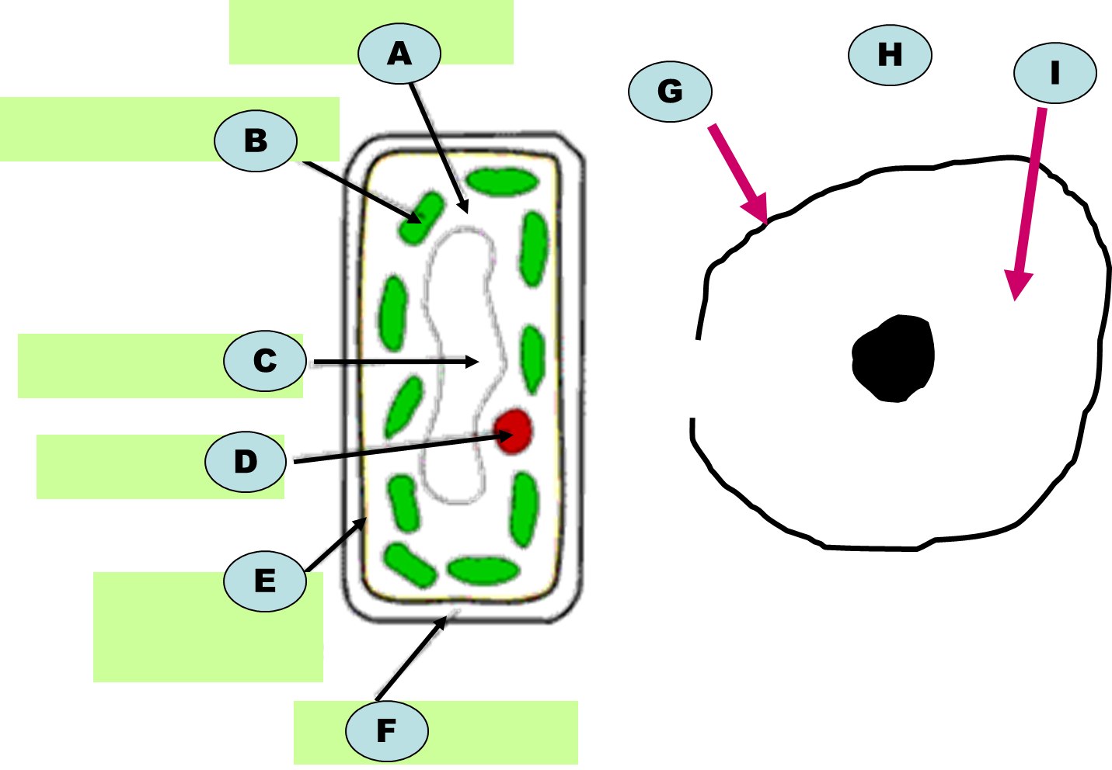
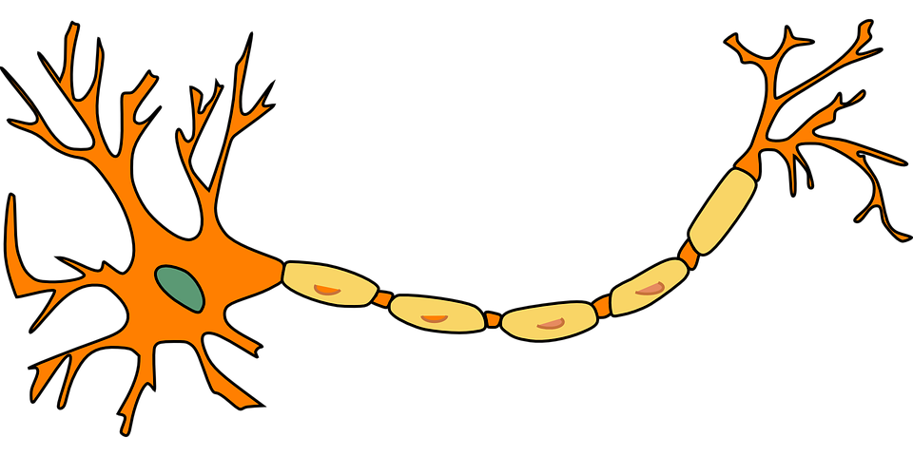
Specialised Cells
Do now activity: Label the following parts of an animal and plant cell:

Slide 3
Progress indicators
GOOD PROGRESS:
Recall what a specialised cell is
Describe examples of specialised plant and animals cells
OUTSTANDING PROGRESS:
Explain how some cells are adapted for their function

Slide 4
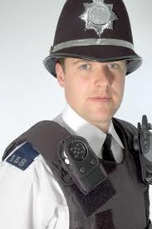
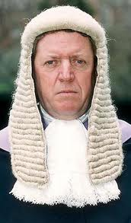
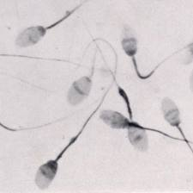
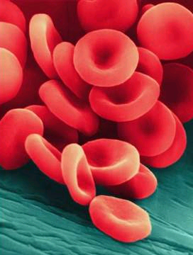
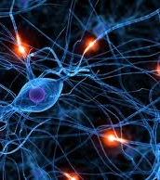
Specialised...
Specialised Cells
Q: What does specialised mean??
Q: What is a specialised cell?
A: A cell that has a special shape and features that help it to do it’s job
A: Something that is designed to do a particular job

Slide 5
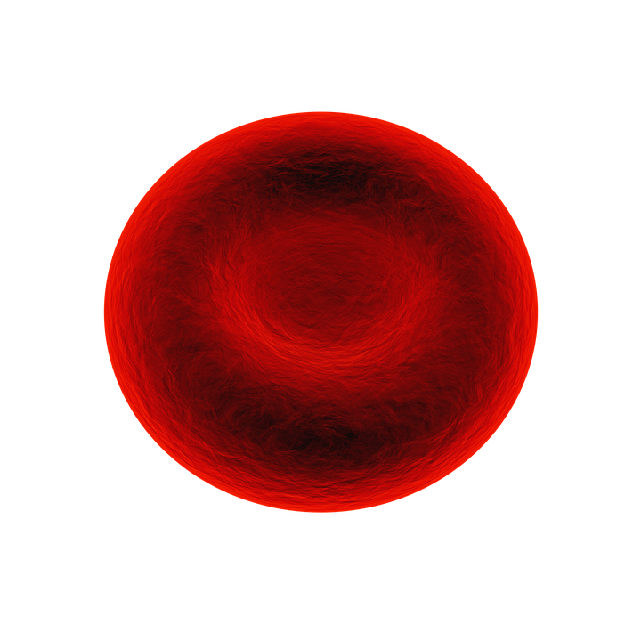
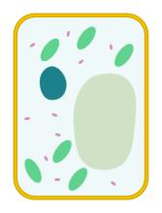
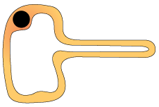
There are lots of different types of specialised cells found in animals and plants.
Task: Watch the video, try to note down as many specialised cells as you can and identify whether they are found in an animal or a plant.
https://www.youtube.com/watch?v=u87QpOOkdxI

Slide 6
Self-assessment:
Sperm cell
Ciliated cell
Nerve Cell
Specialised Cells
Palisade Cell
Root Hair Cell
Red Blood Cell
Ovum (Egg Cell)
Xylem Vessel

Slide 7
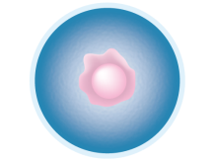
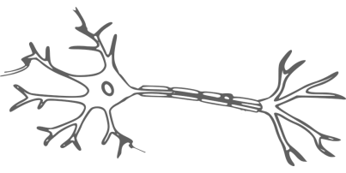
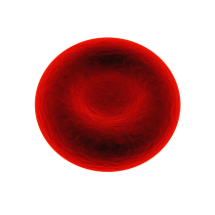
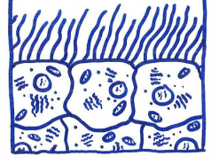
CELL | CELL NAME | FUNCTION (JOB)
Task: Use the information on slide 8 and 9 to complete the table on slide 10.
Notes:
Ciliated cell: By Esaah6 (Own work) [CC BY-SA 3.0 (https://creativecommons.org/licenses/by-sa/3.0)], via Wikimedia Commons

Slide 8
Red Blood Cell
Nerve Cell
Structure:
Large surface area to hold lots of haemoglobin so oxygen can be carried
Has no nucleus to make room for more oxygen
Disk-shape to fit through narrow blood vessels
Function:
Carries oxygen to respiring cells
Structure
Very long, elongated cells
Nerve cells have branched at either end to make connections with many other nerve cells
Function
To carry electrical nerve impulses around your body
Sperm Cell
Egg Cell
Structure:
Long tail to swim towards the egg cell
Lots of mitochondria near tail to release energy to aid swimming
Enzymes in the head of cell to digest outer layer of the egg cell
Function:
To swim towards the egg cell to fertilise it
Structure
Contains vesicles of fat and other nutrients which acts as a food source for the developing embryo
Mitochondria to provide energy for cell division
Function
To be fertilised by the sperm cell
Notes:
Ciliated cell: By Esaah6 (Own work) [CC BY-SA 3.0 (https://creativecommons.org/licenses/by-sa/3.0)], via Wikimedia Commons
Images: Animal cell & plant cell by domdomegg licensed under CC-by-SA 4.0

Slide 9
Ciliated Epithelial Cell
Structure:
Lots of tiny hairs called cilia line the sirface of these cells
Function:
Cilia hairs sweep mucus containing trapped dirt/pathogens back up to the throat
Stop lung/respiratory damage
Palisade Cell
Root Hair Cell
Structure:
Large surface area to absorb large amount of sunlight
Lots chloroplasts to increase sites of photosynthesis
Function:
To trap sunlight, carry out photosynthesis and generate food for the plant
Structure
Large surface area
Thin cell wall so water can pass through easily
Function
To be absorb minerals and water from the soil through the roots
Notes:
Ciliated cell: By Esaah6 (Own work) [CC BY-SA 3.0 (https://creativecommons.org/licenses/by-sa/3.0)], via Wikimedia Commons
Images: Animal cell & plant cell by domdomegg licensed under CC-by-SA 4.0

Slide 10
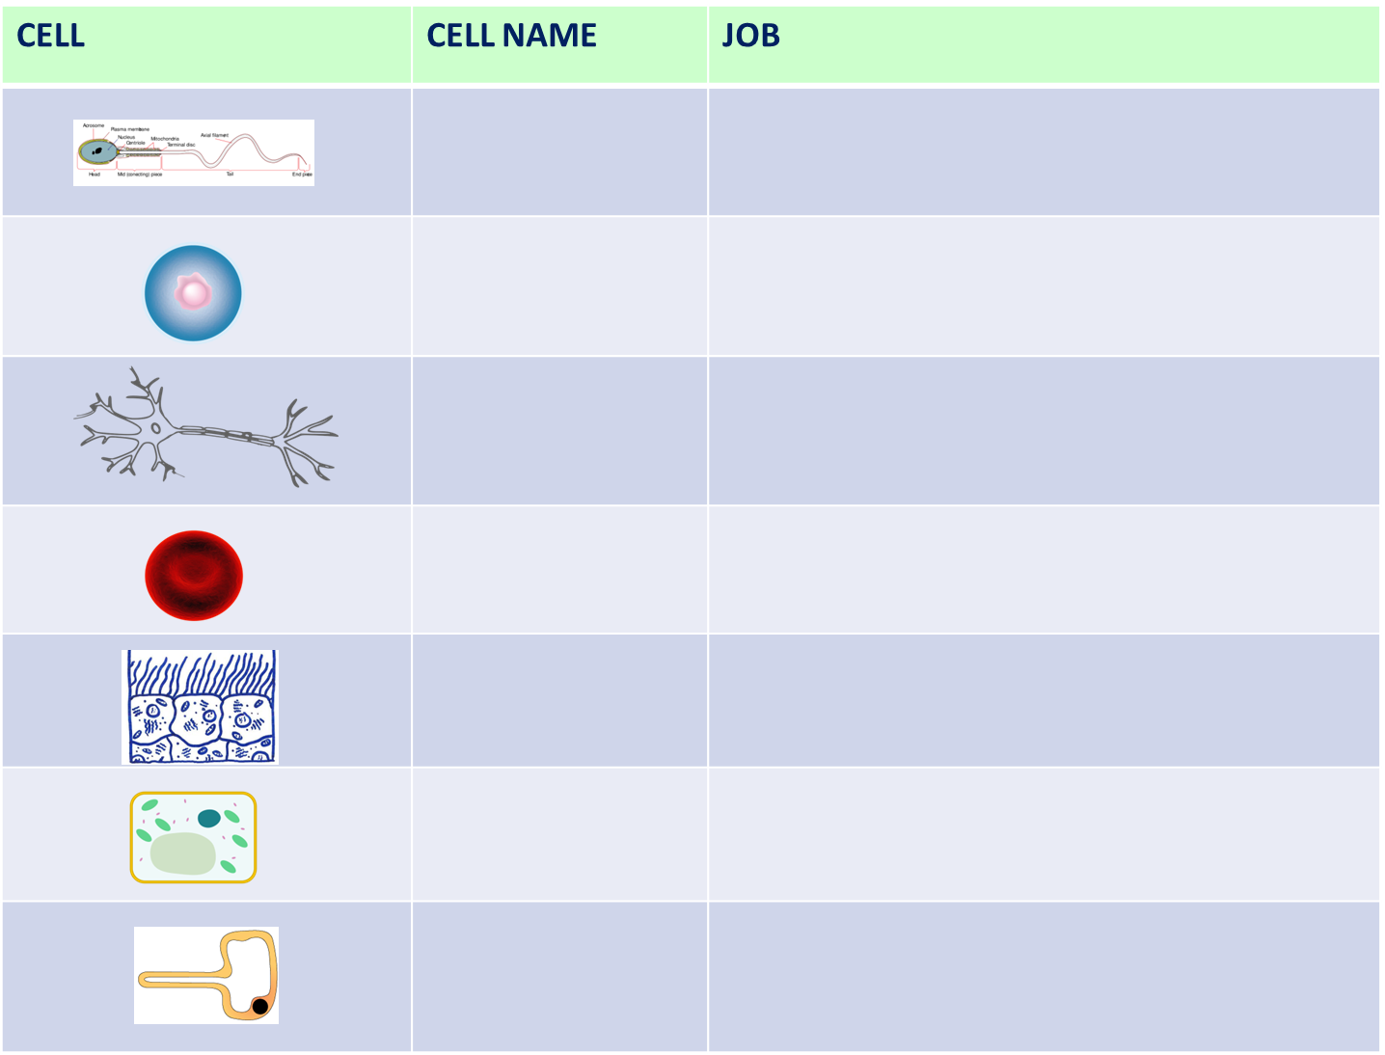

Slide 11
Assessment Task
Task: Answer the following exam style questions:
Name three organelles present in plant cells but not present in animal cells (3 marks)
Which type of specialised cell has a tail in order to swim
(1 mark)
Describe how a red blood cell is adapted for it’s function
(2 marks)
Many cells need oxygen in order to survive, for which process is oxygen needed for? (1 mark)

Slide 12
Self-assessment:
Vacuole, chloroplast & cell wall.
A sperm cell has a tail in order to swim to the egg cell.
A red blood cell has no nucleus which means it can carry more oxygen, a red blood cell also has a disk shape so that it can fit through narrow blood vessels, it also has a large surface area to absorb more oxygen.
Oxygen is needed by cells in order to carry out respiration.

Slide 13
Specialised Cells - Job Advert
Task: Write a job description for one of the specialised cells we have been looking at today.
Example:
WANTED!! A messenger who is RAPID at delivering messages!
Must be:
Extremely efficient at delivering signals
Long and thin so messages are able to reach all over the body

Slide 14
Plenary ~ Copy & Complete:
Specialised cells have special features/structures which allow them to carry out their functions.
Red blood cells carry oxygen around the body, palisade cells are packed full of chloroplasts to carry out photosynthesis.
Sperm cells have streamlined head and long tails which helps it to swim to towards the egg cell.
____________ cells have special _________ which allow them to carry out their functions.
Red blood cells carry __________ around the body, palisade cells are packed full of __________ to carry out ____________.
Sperm cells have streamlined head and long ________ which helps it to swim to towards the _______ cell.

Slide 15
Plenary – What have you learnt
today? Tweet a message – remember only 140 characters! #keywords

Slide 16
Resources

Slide 17
Red Blood Cell
Nerve Cell
Structure:
Large surface area to hold lots of haemoglobin so oxygen can be carried
Has no nucleus to make room for more oxygen
Disk-shape to fit through narrow blood vessels
Function:
Carries oxygen to respiring cells
Structure
Very long, elongated cells
Nerve cells have branched at either end to make connections with many other nerve cells
Function
To carry electrical nerve impulses around your body
Sperm Cell
Egg Cell
Structure:
Long tail to swim towards the egg cell
Lots of mitochondria near tail to release energy to aid swimming
Enzymes in the head of cell to digest outer layer of the egg cell
Function:
To swim towards the egg cell to fertilise it
Structure
Contains vesicles of fat and other nutrients which acts as a food source for the developing embryo
Mitochondria to provide energy for cell division
Function
To be fertilised by the sperm cell
Notes:
Ciliated cell: By Esaah6 (Own work) [CC BY-SA 3.0 (https://creativecommons.org/licenses/by-sa/3.0)], via Wikimedia Commons
Images: Animal cell & plant cell by domdomegg licensed under CC-by-SA 4.0

Slide 18
Ciliated Epithelial Cell
Structure:
Lots of tiny hairs called cilia line the sirface of these cells
Function:
Cilia hairs sweep mucus containing trapped dirt/pathogens back up to the throat
Stop lung/respiratory damage
Palisade Cell
Root Hair Cell
Structure:
Large surface area to absorb large amount of sunlight
Lots chloroplasts to increase sites of photosynthesis
Function:
To trap sunlight, carry out photosynthesis and generate food for the plant
Structure
Large surface area
Thin cell wall so water can pass through easily
Function
To be absorb minerals and water from the soil through the roots
Notes:
Ciliated cell: By Esaah6 (Own work) [CC BY-SA 3.0 (https://creativecommons.org/licenses/by-sa/3.0)], via Wikimedia Commons
Images: Animal cell & plant cell by domdomegg licensed under CC-by-SA 4.0

