Slide 1
Give your most successful image to your shoulder partner for them to discuss improvements

Slide 2
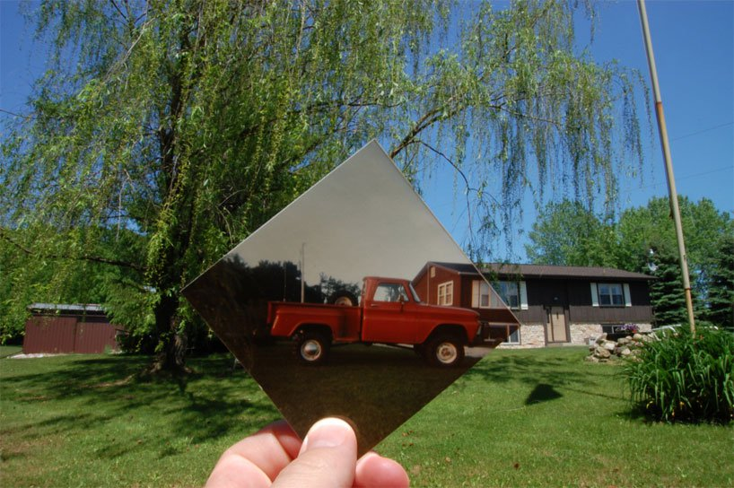
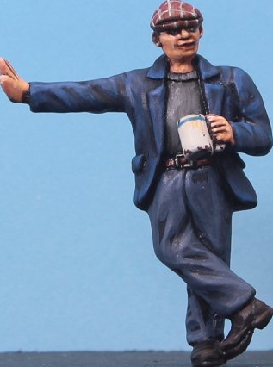
To present the results of the Dear Photograph style photo shoot.
To be able to identify the most successful images from a photo shoot.
GCSE photography Success Criteria
Basic Requirements | A contact sheet is stuck in and annotations are present Best images printed and presented Notes evident to explain the images presented Edited and Final images are saved to the DRIVE
Good | A contact sheet present that has been fully annotated, answering most of the ‘How to Annotate a Contact Sheet’ questions Images have been cropped and scaled to improve the final prints - smaller unedited images presented alongside
Outstanding | Most question prompts have been answered for point number 5 on the ‘How to Annotate a Contact Sheet’ and How to present my work Sheet? Creative and neat presentation of the images and notes used
Title – Dear Photograph Final Idea
TASK 1
Complete the thumbnail contact sheet annotations from the previous lesson.
TASK 2
Using the ‘How do I... Present my work?’ sheet and your A4 best photo - present the results of your photo shoot in your sketchbooks (you may hand write or type up any written work).
TASK 3
Save any edited (cropped/resized) images and final images to your DRIVE in a folder called: Dear Photograph Edits and Finals.

Slide 3
Plenary
Using the sheet and your black folder – flick through and tick what you have completed
This will give you a ‘To Do List’ for next week while I am away.
If you have sticky notes do not tick the words – make comments to remind you
To do List while Miss Bates is away
13 - 17 May 2019
Fully completed | Tasks (tick each word that is completed) |  |  |  | Sticky notes/to do
 | 1st (Rankin) Reference - images, information, possible ideas, one image described in detail
 | 1st (Rankin) Photo shoot Plan - sketches, camera settings, , lighting, models, links to photographer
 | 1st (Rankin) Contact sheet - photos, ticks/crosses, best and worst described
 | !st (Rankin) Best Photo - large best photo (or best two) discussed, developments, links to photographer
 | 2nd (What I Be) Reference - images, information, possible ideas, one image described in detail
 | 2nd (What I Be) Photo shoot Plan - sketches, camera settings, , lighting, models, links to photographer
 | 2nd (What I Be) Contact sheet - photos, ticks/crosses, best and worst described
 | 2nd (What I Be) Best Photo - large best photo (or best two) discussed, developments, links to photographer
 | 3rd Reference - images, information, possible ideas, one image described in detail
 | 3rd Photo shoot Plan - sketches, camera settings, , lighting, models, links to photographer
 | 3rd Contact sheet - photos, ticks/crosses, best and worst described
 | 3rd Best Photo - large best photo (or best two) discussed, developments, links to photographer
 | Final Large Overall project idea - sketches, photos that link to your photographers, discussion on how they link and what you are planning on doing/making

Slide 4
Cropping
What does this word mean?
Why might you crop an image?

