Slide 1
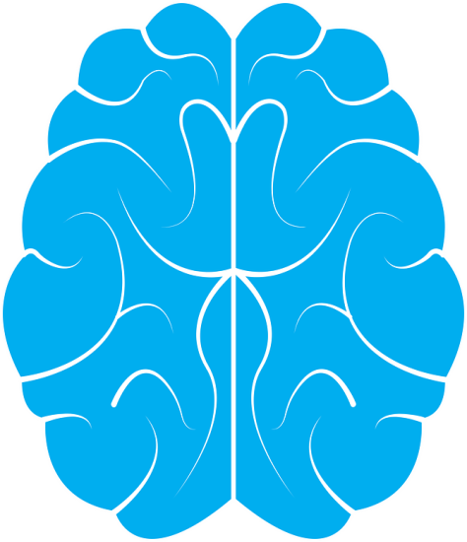
The brain
Do now activity:
Name some of the important structures which are involved in a reflex arc
Describe how an electrical impulse moves from a sensory neurone to a relay neurone
Explain why a nervous impulse could be described as both electrical and chemical

Slide 2
Progress indicators
GOOD PROGRESS:
Identify different areas within the brain
Describe the function of the main areas inside the brain
OUTSTANDING PROGRESS:
Explain how scientists find out about the structure and functions of the brain

Slide 3
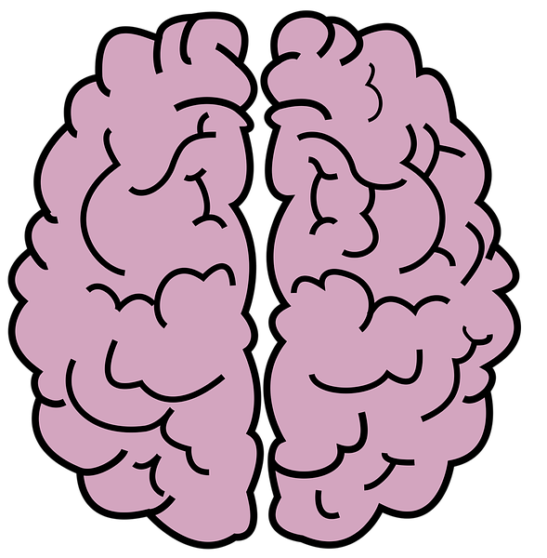
CORTEX
Grey matter composed of …?
LEFT & RIGHT CEREBRAL HEMISPHERES
Frontal lobe
Temporal lobe
Parietal lobe
Occipital lobe

Slide 4
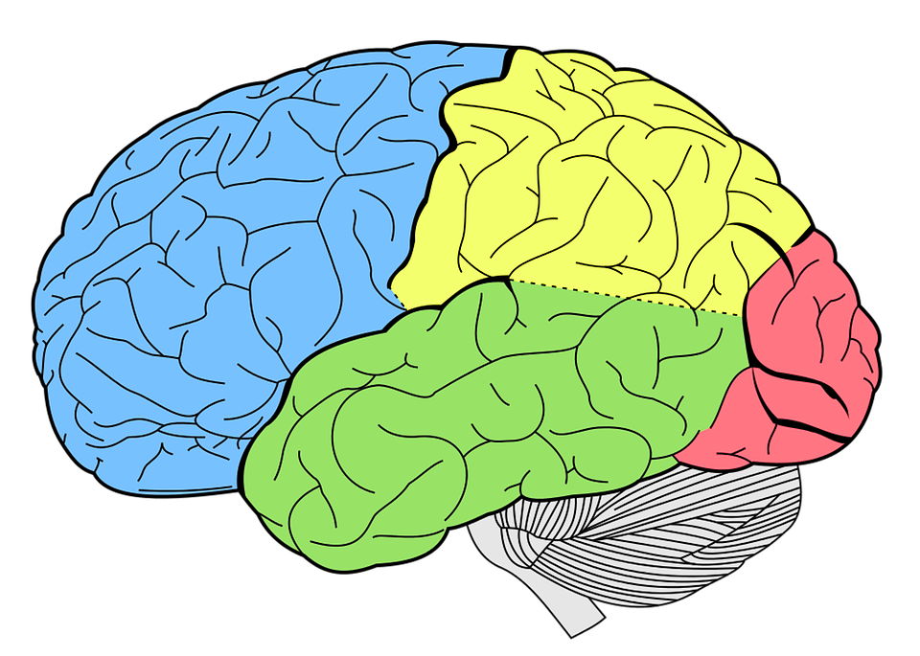
Parietal lobe
The two cerebral hemispheres are connected by a broad band of white matter called the corpus callosum
Frontal lobe
Occipital lobe
Temporal lobe
Task: You have each been given a set of information about each of these lobes. Talk to each other to complete the table outlining the various functions of the brain’s structures
Notes:
Activity 1: Second card sort activity – resources at the end of the PowerPoint Presentation

Slide 5
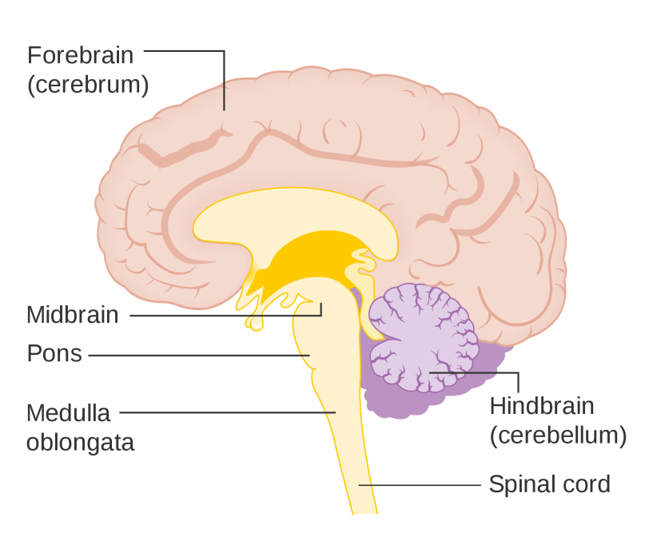
Your brain contains many intricate structures which all play integral roles.
Hypothalamus
You need to know the functions of the following:
Cerebral cortex
Cerebellum
Medulla
Hypothalamus
Pituitary Gland
Task:
Label your diagram of the brain cross-section to demonstrate the location of the structures above.
Use the posters of information around the room to describe the function of each of these structures.
Notes:
Activity 2 – Posters used to label brain on handout and complete table of functions (resources at the end of the PowerPoint)
By Cancer Research UK (Original email from CRUK) [CC BY-SA 4.0 (https://creativecommons.org/licenses/by-sa/4.0)], via Wikimedia Commons

Slide 6
Quick Check: Silent 5
If you were biking downhill and came across an unexpected sharp bend in the road you would need to apply the brakes or turn the handlebars to stop yourself falling. Which regions of the brain, including those in the brain stem, are involved in this subsequent action?
What parts of the brain would be involved in seeing and interpreting your view of the world around you?
Self-assessment:
Frontal lobe; parietal lobe; cerebellum
Sensory information would be sent to the occipital lobe (visual cortex) which processes information from the eyes; the frontal lobe and parietal lobe, part of your cerebral cortex, may be involved in interpreting the information.

Slide 7
Task: Match the structure to the function BEFORE the end of the video on HOMUNCULUS.
Occipital lobe
Temporal lobe
Parietal lobe
Frontal lobe
Hypothalamus
Medulla oblongata
Cerebellum
https://www.youtube.com/watch?v=fxZWtc0mYpQ

Slide 8
How many did you get correct?

Slide 9
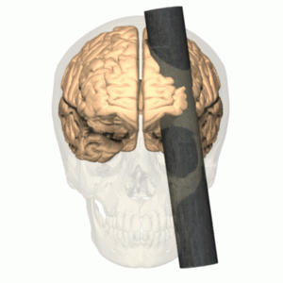
How do we know the function of each brain region?
Historically neuroscientists have collected information on how the brain works by studying pathological specimens.
As time has moved on neuroscientist have begun to use animal models and by studying patients during surgery.
Individual case studies of patients with brain damage will continue to provide evidence in the study of the brain but now neuroscientists can use a range of
non-invasive techniques to study the
function of the living brain.
https://www.youtube.com/watch?v=XLGXAiSpN00
Notes:
Animation by Polygon data is generated by Database Center for Life Science(DBCLS)[3]. [CC BY-SA 2.1 jp (https://creativecommons.org/licenses/by-sa/2.1/jp/deed.en)], via Wikimedia Commons

Slide 10
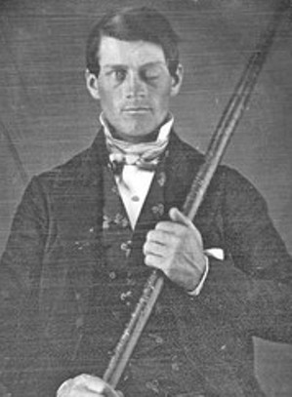
We can study individuals with damaged brain regions:
E.g. Phineas Gage 1848
He went from being a popular responsible man to a foul-mouthed irresponsible and obstinate man
Notes:
Image by [Public domain], via Wikimedia Commons https://commons.wikimedia.org/wiki/File:Phineas_Gage.jpg

Slide 11
Task: Watch the video and answer the following questions:
Describe what happened to Phineas Gage.
Describe what his friends reported of Phineas before and after the incident.
Evaluate the impact of this case study on our knowledge of brain function.
https://www.youtube.com/watch?v=vHrmiy4W9C0

Slide 12
Self-assessment:
Phineas Gage was blasted with an iron rod which shot through his eye and out of the back of his head, passing through part of his brain.
Phineas’ friends reported that Phineas, who was once a mild mannered, polite and softly spoken man, was now rude, angry and vulgar. His personality had changed somewhat since his brain had become damaged in the incident
This case study does provide us with evidence that there are localised areas in the brain dedicated to specific functions, which relate to our psychology. However, this is an individual case-study which occurred many years ago and we do not have any data on how Phineas was before or even after the accident.

Slide 13
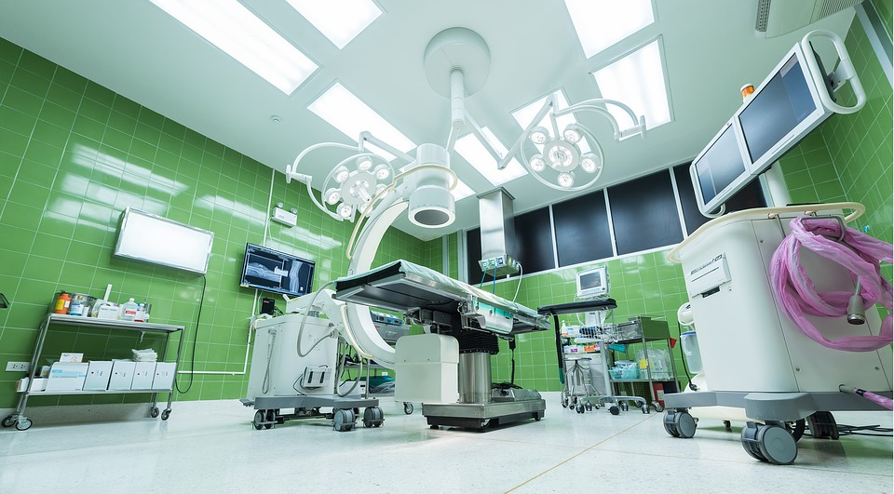
Electrically stimulating parts of the brain
Electrically stimulating parts of the brain can be achieved by removing the top of a patients skull and placing electrodes on a particular area of the brain.
A similar effect can also be achieved
by a more recent technology which
uses magnetic stimulation to stimulate
parts of the brain.
People can experience hunger, thirst, anger or fear simply because that area of the brain is stimulated.
This is carried out on conscious patients and it helps scientists to build a better picture of the function of specific parts of the brain.
https://www.youtube.com/watch?v=KKuS1TLhtGg

Slide 14
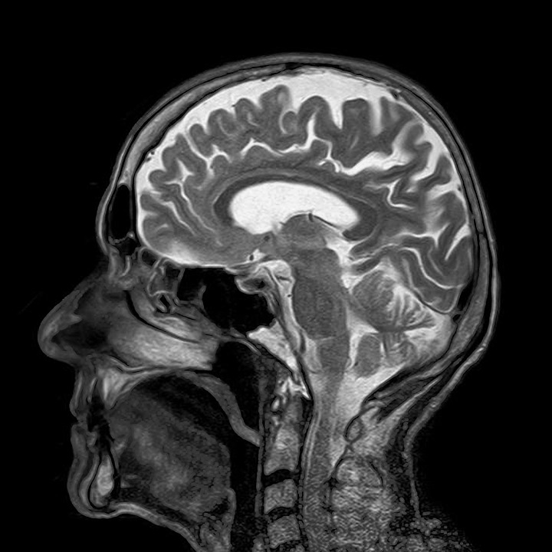
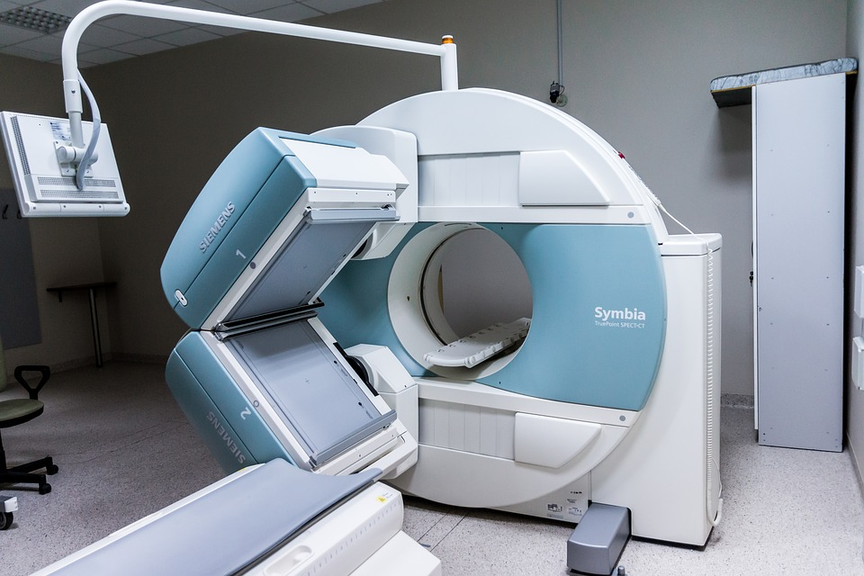
MRI scans
MRI scans have enabled scientists to develop a better understanding of how the brain works.
An magnetic resonance imaging (MRI) scan takes images of the brain in living people and enable scientists to link the loss of a certain function, e.g. speech or hearing, with a specific region of the brain.
The most recent MRI scanners are able to take live images of patients whilst they are undertaking a particular task.

Slide 15
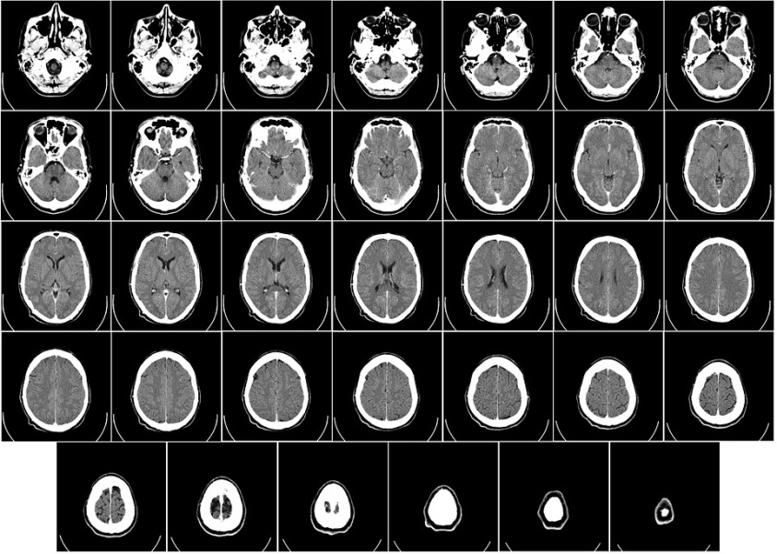
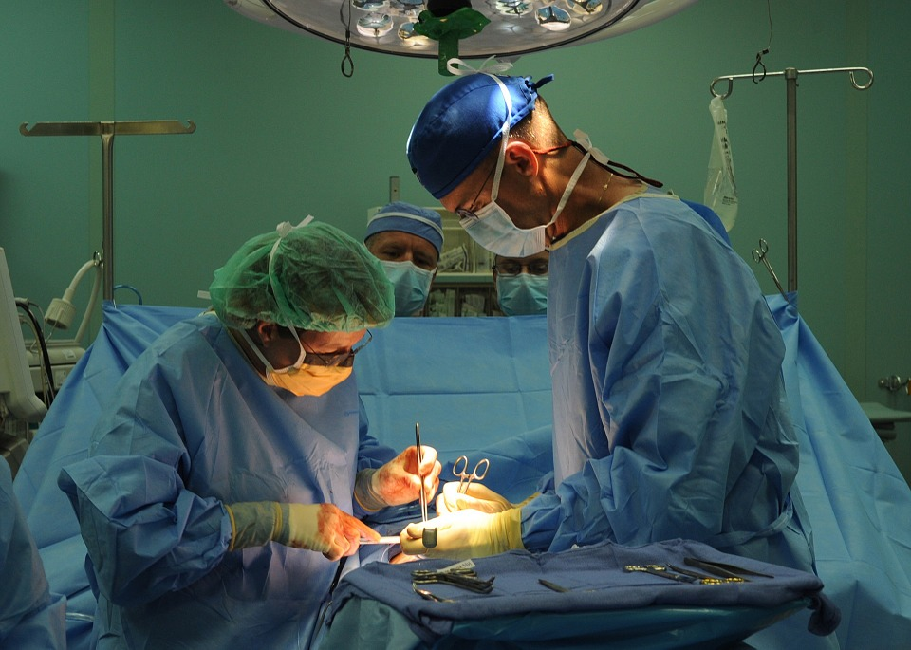
Treating problems with the brain
The brain is incredibly complex and can be easily damaged.
Scientists and doctors do what they can to diagnose and treat conditions related to the brain but it is an incredibly delicate process.
As it is still not fully understood which parts of the brain carry out which functions surgery can be incredibly difficult and damaging to a patients life.

Slide 16
Task: Fill in the blanks on your worksheet:
Key Words: case studies of people with brain damage, animal models, non-invasive techniques, pathological specimens, studying patients during surgery
How do we know the function of each brain region?
Historically neuroscientists have collected information on how the brain works by studying ____________.
As time has moved on neuroscientist have began to use ________ and by ________________________.
Individual ____________________________ will continue to provide evidence in the study of the brain but now neuroscientists can use a range of ______________ to study the function of the living brain.

Slide 17
Self-assessment:
Historically neuroscientists have collected information on how the brain works by studying pathological specimens.
As time has moved on neuroscientist have began to use animal models and by studying patients during surgery.
Individual case studies of patients with brain damage will continue to provide evidence in the study of the brain but now neuroscientists can use a range of non-invasive techniques to study the function of the living brain.

Slide 18
Plenary – 6-mark exam question
Q. Discuss the ways in which scientists can find out about the functions of the different areas of the brain.
(6 marks)

Slide 19
Resources

Slide 21
Frontal Lobe:
Concerned with higher brain functions such as decision making, reasoning, planning and consciousness of emotions.
It is also concerned with forming associations and with ideas
It includes the primary motor cortex, this has neurones directly linked to the spinal cord and brain stem and from there to the muscles. It sends information to the body via the motor neurones to carry out movements.
The motor cortex also stores information about how to carry our different movements
Parietal Lobe:
Concerned with orientation, movement, sensation, calculation and some types of recognition and memory
Temporal Lobe:
Concerned with processing auditory information i.e. hearing, sound recognition and speech (left temporal lobe). Also involved in memory
Occipital Lobe:
(visual cortex) – concerned with processing information from the eyes, including vision, colour, shape recognition and perspective.
To be cut up into a card sort for Activity 1

Slide 22
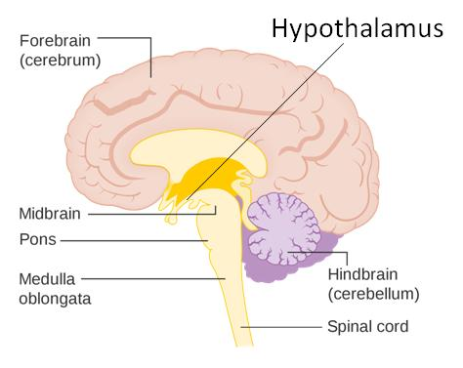
The hypothalamus holds the thermoregulatory centre which is needed for control of body temperature. As well as this it is also controls thirst, hunger and sleep.
The cerebellum is required for coordination of muscular activity and also balance.
Notes:
Posters for Activity 2
Image of brain by Cancer Research UK (Original email from CRUK) [CC BY-SA 4.0 (https://creativecommons.org/licenses/by-sa/4.0)], via Wikimedia Commons

Slide 23
The cerebral cortex us concerned with a vast array of functions. Mainly including consciousness, intelligence, memory and language.
The medulla is concerned with unconscious activities, such as controlling the heartbeat, the movements of the gut and breathing and blood pressure
Notes:
Posters for Activity 2
Image of brain by Cancer Research UK (Original email from CRUK) [CC BY-SA 4.0 (https://creativecommons.org/licenses/by-sa/4.0)], via Wikimedia Commons

