Slide 1
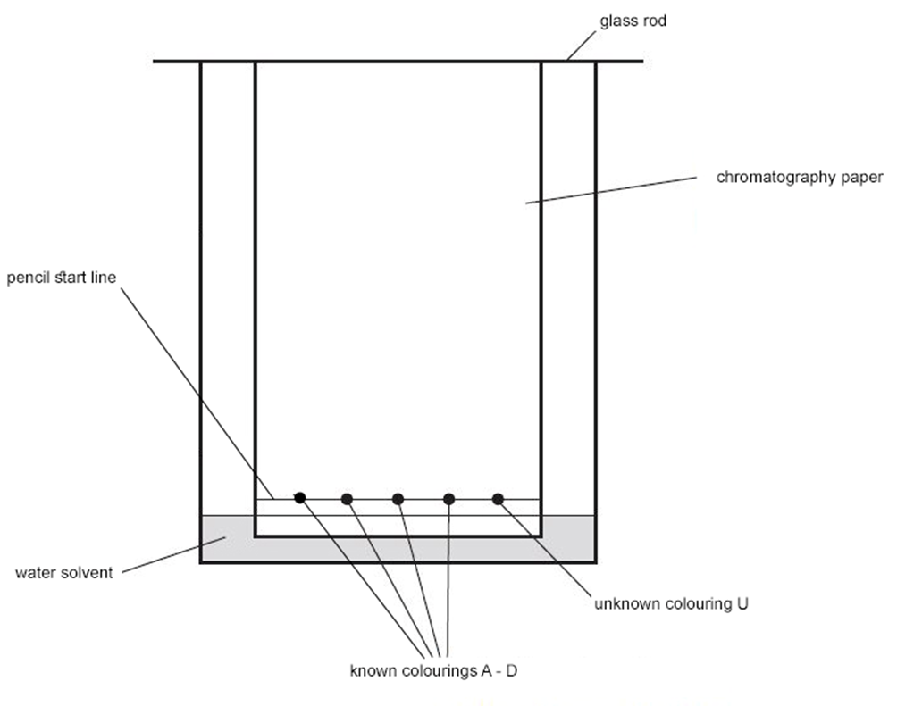
Paper chromatography
B
Do Now: Copy and label parts of the apparatus:
A)
B)
C)
D)
E)
F)
C
Pencil line
A
Glass rod
Chromatography paper
Unknown colouring
Known colourings A-D
F
Water solvent
D
E
Words:
Water solvent, Chromatography paper, Pencil line,
Known colourings (A-D), Unknown colouring, Glass rod
Notes:
A) Pencil line
B) Glass rod
C) Chromatography paper
D) Unknown colouring U
E) Known colourings A-D
F) Water solvent

Slide 2
Progress Outcomes
Good Progress
Interpret chromatograms and determine Rf values from chromatograms
Explain how paper chromatography separates mixture
Outstanding Progress
Suggest how chromatographic methods can be used for distinguishing pure substances from impure substances

Slide 5
Interpret chromatograms and determine Rf values from chromatograms
A scientist used chromatography to analyse the composition of five food colourings. Four of the food colourings were unknown (A-D). The other was sunrise yellow.
Calculate the R_{f} value for the spot of chemical in sunrise yellow which is furthest up the chromatogram.

Slide 6
Exam practice:
Self assess:
?
1
Notes:
Answer - X

Slide 7
Exam practice:
Self assess:
?
2
Notes:
Black food colouring contains contains A and E (1)
and one other (unknown substance) (1)
if no other marks awarded, an answer saying it is made up of three colours gains 1 mark

Slide 9
Explain how paper chromatography separates mixture
Paper and thin layer chromatography
Watch this video and answer the questions below:
Describe the steps used to create a chromatogram.
What is meant by the terms ‘stationary phase’ and ‘mobile phase’?
What does the Rf value tell you about the solubility of a separated component in the mobile phase solvent?
Give examples of where chromatography is used to identify and compare samples.

Slide 10
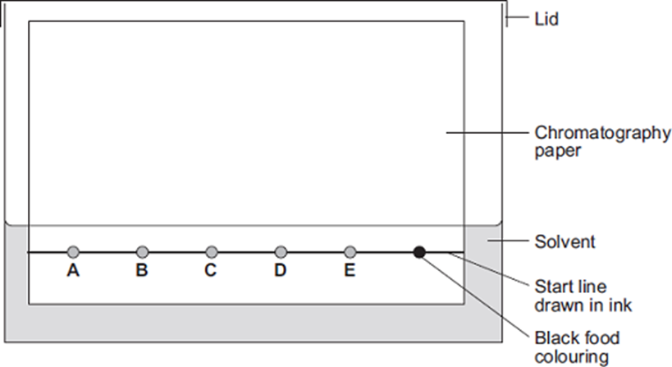
Explain how paper chromatography separates mixture
(2)
Notes:
start line drawn in ink (1)
so it will run / dissolve in the solvent / split up
allow mixes with the spots (1)
spots under solvent or solvent above spots / start line (1)
so they will mix with solvent or wash off paper or colour the solvent or dissolve in the solvent (1)

Slide 11
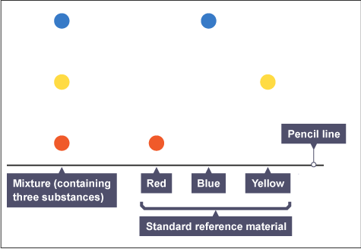
Suggest how chromatographic methods can be used for distinguishing pure substances from impure substances
A pure substance will only produce one spot on the chromatogram during paper chromatography. Two substances will be the same if they produce the same colour of spot, and their spots travel the same distance up the paper. In the example on the left, red, blue and yellow are three pure substances. The sample on the left is a mixture of all three so is classed as impure.
Red, blue and yellow are all pure substances. How can you tell from the chromatogram that they are pure?

Slide 12
Required Practical

Slide 13
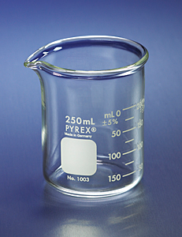
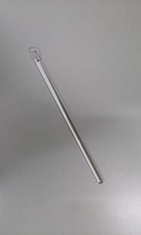
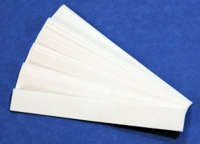
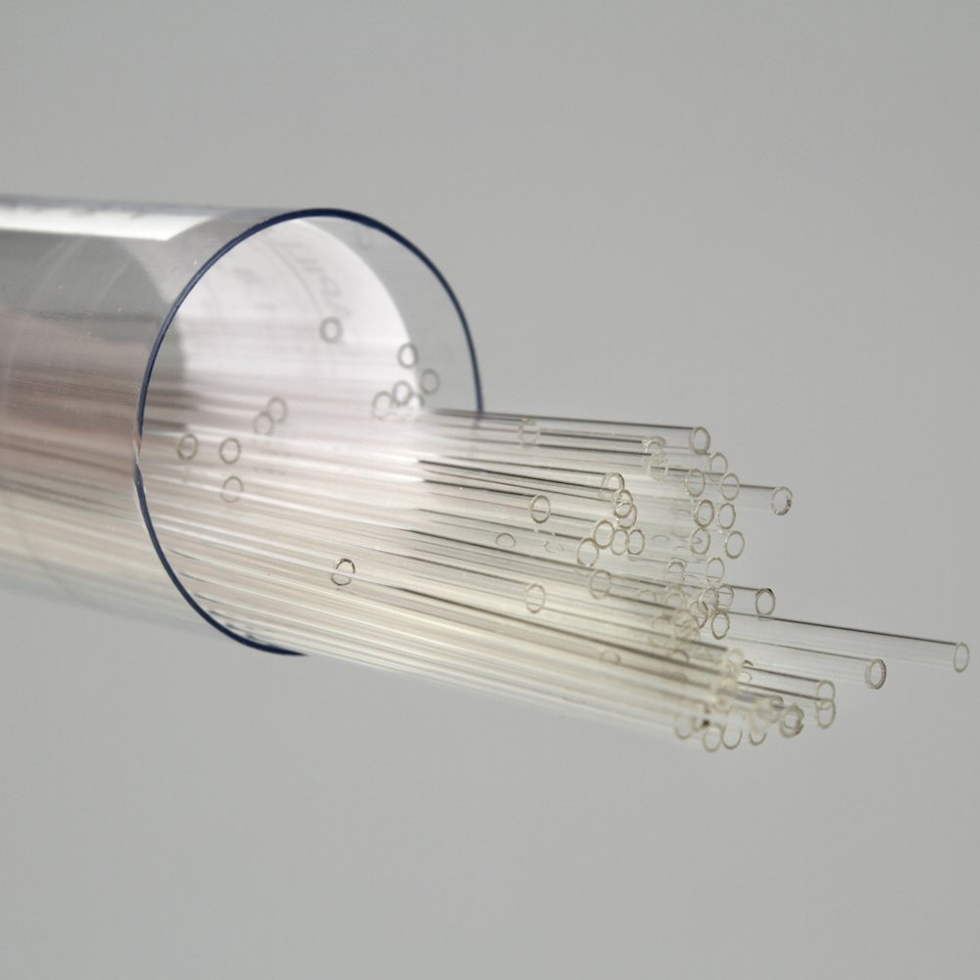
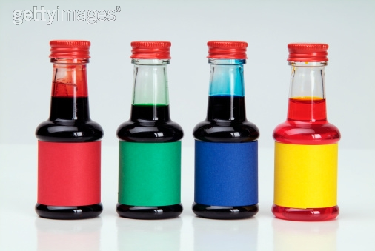
List apparatus
250cm³ beaker
Chromatography paper
Glass rod
Glass capillary tube
known
unknown
Notes:
• 250 cm3 beaker
• Glass rod
• A rectangle of chromatography paper
• Four known food colourings labelled A-D
• An unknown mixture of food colourings labelled U
• Glass capillary tubes.

Slide 14
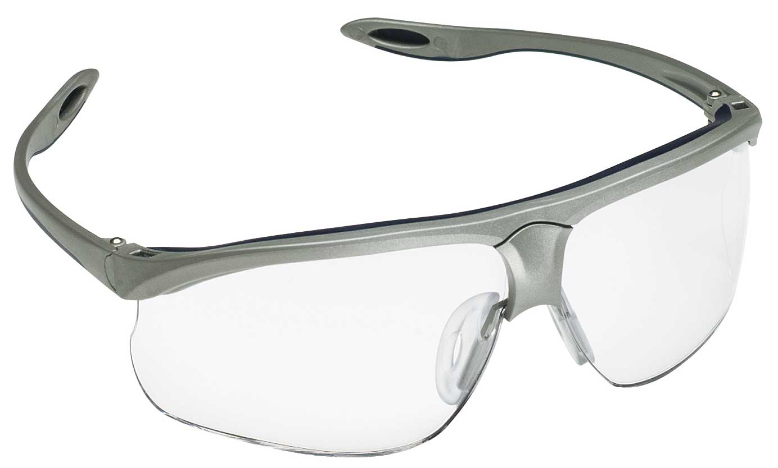
Identify the main hazards and suggest methods of reducing the risk of harm
Copy and complete the table.
Hazard | Associated Risk | Control Measures (minimum two for each)
Slipping on water
Hazard – Something that could potentially cause harm
Associated risk – How the hazard could cause harm
Control measures – What can be done to reduce the associated risk
Notes:
Safety glasses

Slide 15
Hazard | Associated Risk | Control Measures (minimum two for each)
Slipping on water | Someone could fall over | Keep beaker away from the edge of table and other equipment (e.g. book) Ensure spills are mopped up quickly until nearly dry. Handle beakers carefully when walking across the classroom
Slipping on food colouring | Someone could fall over | Keep food colouring away from the edge of table and other equipment (e.g. book) Ensure spills are mopped up quickly until nearly dry. Handle food colouring carefully when walking across the classroom
Glass breaking | Someone could incur a cut in their skin or injure their eyes | Wear eye protection Keep glassware away from the edge of table Ensure breakages are brushed up quickly Handle glassware carefully when walking across the classroom
Chemicals in food colouring | May irritate skin or eyes | Use glass capillary tubes when applying to paper Use disposable gloves
Notes:
Safety glasses

Slide 16
Put the letters of the method in order
A) Wait for the water solvent to travel at least three quarters of the way up the paper. Do not disturb the beaker during this time. Carefully remove the paper. Draw another pencil line on the dry part of the paper as close to the wet edge as possible.
B) Use a glass capillary tube to put a small spot of each of the known colourings on four of the pencil spots. Then use the glass capillary tube to put a small spot of the unknown mixture on the 5th pencil spot. Try to make sure each spot is no more than 5 mm in diameter. Label each spot in pencil.
C) Hang the paper up to dry thoroughly.
D) Tape the edge of the chromatography paper to the glass rod. The paper needs to be taped at the end furthest from the spots. Rest the rod on the top edge of the beaker. The bottom edge of the paper should dip into the water.
E) Pour water into the beaker to a depth of no more than 1 cm.
F) Use a ruler to draw a horizontal pencil line 2 cm from a short edge of the chromatography paper. Mark five pencil spots at equal intervals across the line. Keep at least 1 cm away from each end.
Notes:
F-B-E-D-A-C

Slide 17
Method in correct order F-B-E-D-A-C
F) Use a ruler to draw a horizontal pencil line 2 cm from a short edge of the chromatography paper. Mark five pencil spots at equal intervals across the line. Keep at least 1 cm away from each end.
B) Use a glass capillary tube to put a small spot of each of the known colourings on four of the pencil spots. Then use the glass capillary tube to put a small spot of the unknown mixture on the 5th pencil spot. Try to make sure each spot is no more than 5 mm in diameter. Label each spot in pencil.
E) Pour water into the beaker to a depth of no more than 1 cm.
D) Tape the edge of the chromatography paper to the glass rod. The paper needs to be taped at the end furthest from the spots. Rest the rod on the top edge of the beaker. The bottom edge of the paper should dip into the water.
A) Wait for the water solvent to travel at least three quarters of the way up the paper. Do not disturb the beaker during this time. Carefully remove the paper. Draw another pencil line on the dry part of the paper as close to the wet edge as possible.
C) Hang the paper up to dry thoroughly.
Notes:
F-B-E-D-A-C

Slide 18
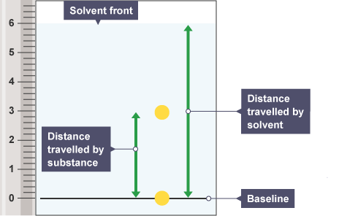
Recording results
Activity 2 - Read measurements off a scale and record appropriately.

Slide 19
Conclusion
Match the spots in mixture U with those from A–D. Use the colour and distance travelled to help you.
1. Which of colourings A–D are in mixture U?
2. Are there any other colourings in mixture U which do not match A–D?

Slide 20
Demonstrate

Slide 21
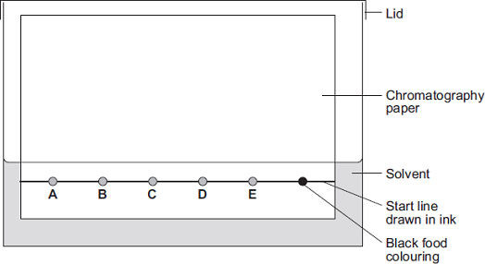
Q3.
Chromatography can be used to separate components of a mixture.
(a) A student used paper chromatography to analyse a black food colouring.
The student placed spots of known food colours, A, B, C, D and E, and the black food
colouring on a sheet of chromatography paper.
The student set up the apparatus as shown in Diagram 1.
Diagram 1
The student made two errors in setting up the apparatus. Identify the two errors and describe the problem each error would cause.
___________________________________________________________________
___________________________________________________________________
___________________________________________________________________
___________________________________________________________________
___________________________________________________________________
___________________________________________________________________
___________________________________________________________________
___________________________________________________________________
___________________________________________________________________
(4)

Slide 22
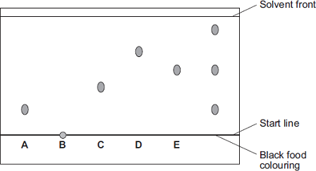
b) A different student set up the apparatus without making any errors. The chromatogram in Diagram 2 shows the student’s results. Diagram 2
(b
(i) What do the results tell you about the composition of the black food colouring?
_________________________________________________________________________________________________________________
__________________________________________________________________________________________________________________
_________________________________________________________________________________________________________________
(2)

Slide 25
0-3
4-5
6-8

Slide 26
Incorrect Question | Connect Task
1a
3a | It is important to draw the start line in ____________ and not ink because ink will dissolve in the s___________ and run. This may run into the spots you are investigating. Another error is the spots are under the solvent and maybe w__________ off the paper.
3b | Draw a chromatogram, showing an unknown substance consists of component A, C but not B and D.
Scored 8/8
Recall the Rf equation
Rf is always between which two values?

