Slide 1
CwK
Thursday, 24 September 2020
Viral Diseases
Do Now Activity
Explain how a bacteria makes you feel ill.

Slide 2
Self Assess
Bacteria reproduce rapidly, releasing harmful chemicals called toxins, toxins damage tissues which makes us feel ill.

Slide 3
Progress Indicators
Good Progress
State how measles, HIV and Tobacco Mosaic Virus are spread
Outstanding Progress
Describe the causes and symptoms of measles, HIV and Tobacco Mosaic Virus
https://www.youtube.com/watch?v=KrJsoreR2Z4&list=PL2D816042F5B7DA99&index=2&t=14s

Slide 4
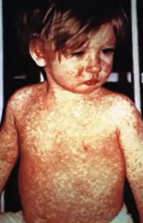
Measles
Fever
Red skin rash
Spread in droplets when a person sneezes or coughs
Droplets inhaled
Can cause damage to breathing system and the brain
Can be fatal
Most young children vaccinated against it

Slide 5
HIV
First symptom flu like illness
Virus attacks body’s immune cells
Controlled by antiretroviral drugs- not a cure
Late stage HIV or AIDS means the body cannot deal with other infections or cancers
Spread by sexual contact, exchange of bodily fluids
E.g blood when sharing needles

Slide 6
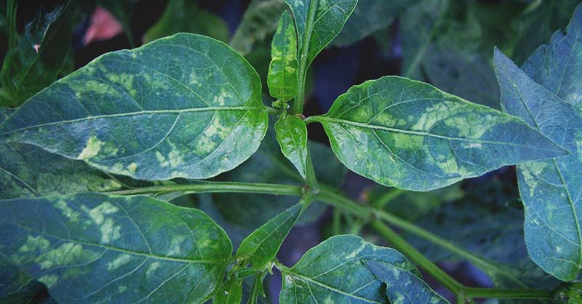
Tobacco Mosaic Virus
Widespread plant pathogen
Affects many species of plants including tomato plants
Distinctive mosaic pattern on leaves
Affects growth due to lack of photosynthesis
Spread by contact

Slide 7
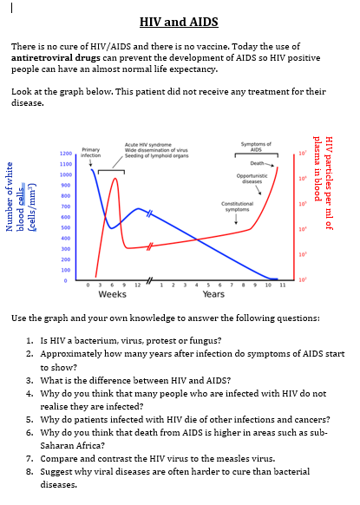

Slide 8
Plenary
State how measles, HIV and TMV are spread
How could we reduce the number of cases of measles?

