Slide 1
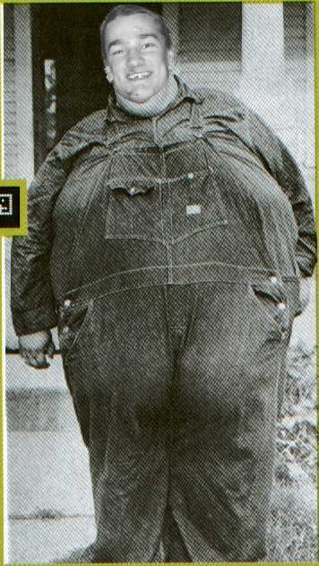
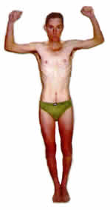
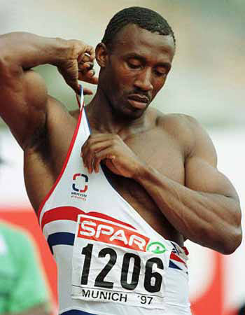
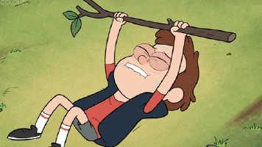
Somatotypes
Body Types

Slide 2
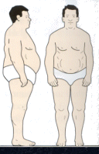
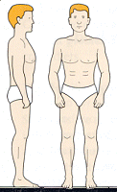
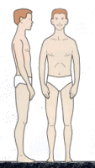
Body Type There are three extremes of body types
Endomorph
Mesomorph
Ectomorph

Slide 3
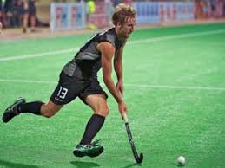
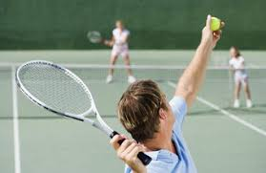
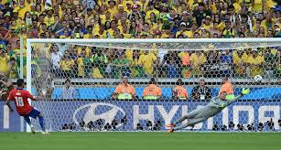

Slide 5
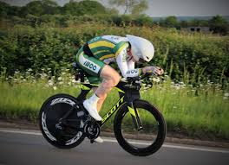
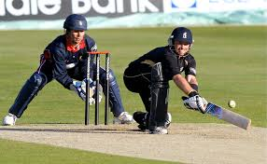

Slide 6
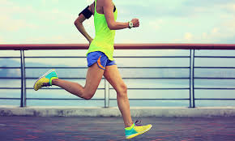
Basic Skills
Basic skills are
Simple
Need little thought
Require little decision making

Slide 7
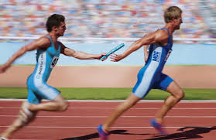
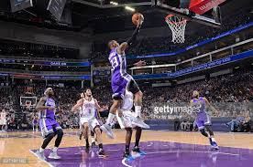
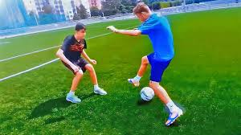
Complex Skills
Complex skills are
Difficult
Need a high level of decision making

Slide 12
Discuss the term in more detail &
link/analyse to the question
AO3
Apply the term to the question
link to a sporting example
AO2
State the correct term, principle, content
AO1

Slide 13
AO1 (assessment outcome 1)
1 mark
Demonstrate basic content to achieve 1st mark in all questions
Key words to look out for:
IDENTIFY
STATE
GIVE
EXPLAIN
DESCRIBE
These key words in questions will usually gain you 1 mark!
Don’t get flustered by the question………

Slide 14
AO2 (assessment outcome 1)
marks 2-4
Apply to AO1 using examples of knowledge that underpins the meaning of your AO1.
Key words to look out for:
EXPLAIN
DESCRIBE
EXAMINE
STATE WITH EXAMPLE
Apply your AO1 statement to a practical example or the context of the question
These key words are looking for more than one mark! AO2

Slide 15
AO3 (assessment outcome 1)
3 – 9 marks
Analyse and evaluate the factors that the content is on, consider performance, involvement and the physical activity itself.
Key words to look out for:
ANALYSE
EXPLAIN
JUSTIFY
EXAMINE
DISCUSS
ASSESS
Always consider the question direction with the content for AO3
AO1 – state content
AO2 – Example/application
AO3 – Considering context of question with content

