Slide 1
Do Now Activity - Whiteboards
Calculate the file size of both images below in using suitable units:
20 pixels
600 pixels
20 pixels
800 pixels
True Colour (24 bit / 3 bytes)
5 colours = 3 bits (8 possible colours)

Slide 2
Do Now Activity - Whiteboards
Calculate the file size of both images below in using suitable units:
20 pixels
600 pixels
20 pixels
800 pixels
True Colour (24 bit / 3 bytes)
5 colours = 3 bits (8 possible colours)
20 x 20 x 3 = 1,200 bits
1,200 / 8 = 150 bytes
800 x 600 x 3 = 1,440,000 bytes
1,440,000 / 1000 = 1,440 kb
1,440 / 1000 = 1.44mb

Slide 3
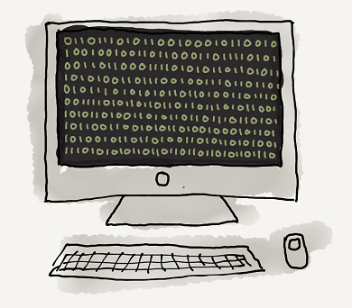
Unit 12 Data Representation
Lesson 7 - Sound
Good – Explain how sound can be sampled and stored in digital form
Outstanding – Explain how sampling intervals and other considerations affect a sound file
Key Terms: Sample / Frequency / Bit Rate /

Slide 4
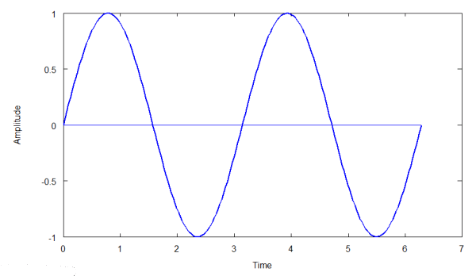
Sound waves
Sound is made up of waves and is measured in frequency and amplitude.
Frequency is the number of sound vibrations in one second.
Amplitude is how powerful the wave is.

Slide 5
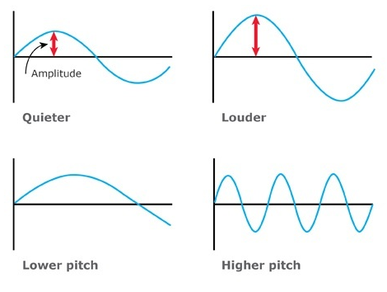
Sound waves

Slide 6
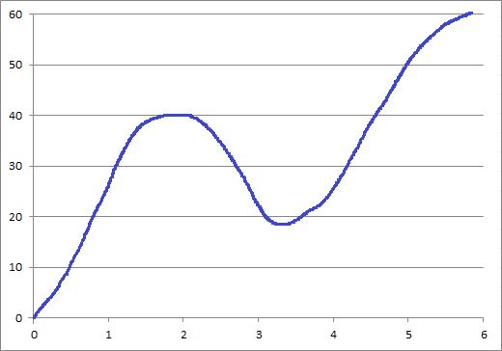
Converting sound waves to binary
So how do we into this?
turn this
0001110000101000 0001011000011001 0011001000111100
Use the sample sound wave to think of a way you could represent it using binary.

Slide 7
Sampling
You can represent these waves as binary by sampling the wave at different places and recording the amplitude using binary.

Slide 8
Converting sound waves to binary
Sample 1 = 28
00011100
Sample 2 = 40
00101000
Sample 3 = 22
00010110
Sample 4 = 25
00011001
Sample 5 = 50
00110010
Sample 6 = 60
00111100
00011100 00101000 00010110 00011001 00110010 00111100

Slide 9
Converting sound waves to binary
Sample Interval:
Original sound wave:
Binary sound wave:
What’s the issue with these waves?

Slide 10
Converting sound waves to binary
Sample every 0.5 second
Sample Interval:
Original sound wave:
Binary sound wave:

Slide 11
Converting sound waves to binary
=
0001110000101000 0001011000011001 0011001000111100
0001110000101000
0001011000011001
0011001000111100 0001011000011001
0001110000101000 0011001000111100
=

Slide 12
Exam Question
Compare the advantages and disadvantages of having a higher or lower sampling rate when converting sound into binary?
More samples
...means a more accurate recording
…better quality
...but a higher file size
Fewer samples..
…means less accurate recording
…poor quality
…but a smaller file size.

