Slide 1
DNA: Ask a question make a statement
Notes:
Option 1

Slide 2
Convert between Mixed Numbers and Improper Fractions
Unit 4C

Slide 3
Prior learning:
Place value.
Percentage as an amount out of 100.
Multiplication and division.
Ordering integers on a number line.
Unit 5 - Fractions, Decimals
and Percentages
Shading fractions of diagrams, equivalence and simplification of fractions.
57-59,61
Convert between improper fractions and mixed numbers.
63-64
65-66,
67-70
Four operations with mixed and improper fractions.
60
Order fractions.
Find fractions of an amount.
77
Calculate a percentage of an amount and percentage change.
84-90
73-76,
82-83
Convert between fractions, decimals and percentages and compare them.
Calculate simple and compound interest.
93-94
Next steps:
Calculating proportions of pie charts.
Using multipliers.
Reverse percentages.
Reverse fractions.

Slide 4
Progress Indicators:

Slide 5
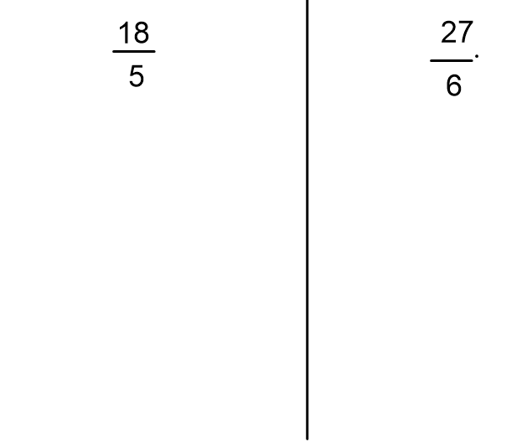
Worked Example:
We Do You Turn

Slide 6
Improper
1
2
3
4
5
6
7
8
9
10
11
12

Slide 7
Answers
1
2
3
4
5
6
7
8
9
10
11
12

Slide 8
Mixed Numbers to Improper Fractions

Slide 9
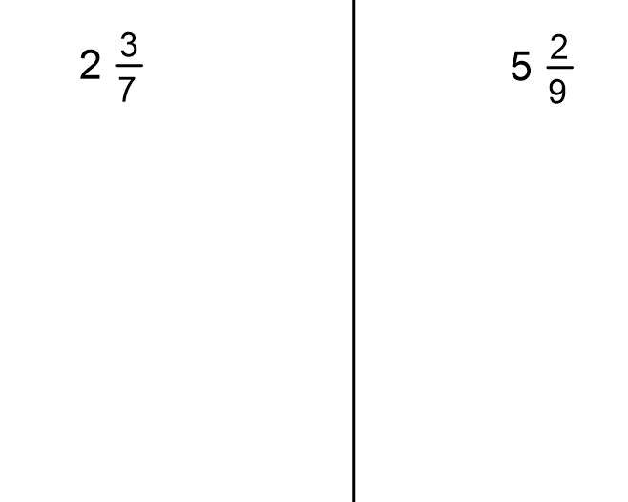
Worked Example:
We Do You Turn

Slide 10
Improper
1
2
3
4
5
6
7
8
9
10
11
12

Slide 11
1
2
3
4
5
6
7
8
9
10
11
12

Slide 12
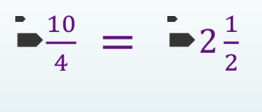
c)True or False
a) Change the following to an improper fraction

Slide 13
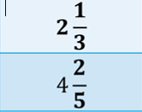
Connect
Change to a Mixed Number
Change to a Mixed Number or an improper fraction
Mr Carpenter and Mr Landers had a bike ride.
Mr Carpenter says he cycled 5$\frac{3}{7}$km.
Mr Landers says he cycled $\frac{37}{7}km.$
Who cycled further?

