Slide 1
Eukaryotic vs. Prokaryotic Cells
Do now activity:
Describe the role of the nerve cell in the human body
Compare the function of the root hair cell and palisade cell in the plant
Can you give any examples of eukaryotic or prokaryotic cells?
Key Words
Eukaryotic
Prokaryotic
Membrane
Organelles
Nucleus

Slide 2
Progress indicators
GOOD PROGRESS: Identify organelles found in eukaryotic and prokaryotic organisms
OUTSTANDING PROGRESS: Label diagrams of bacteria cells and relate the structure of the bacteria cell to it’s function

Slide 3
Word Consciousness
Eukaryotic – A cell with a “true” nucleus (in a membrane). This includes animal and plant cells Prokaryotic – A cell with no “true” nucleus. For example bacteria cells.
Organelles – Small components that make up the cell. E.g. nucleus, mitochondria, chloroplasts
Nucleus – an organelle that contains the cells genetic material
Genetic Material – The material used to store information, usually in the form of DNA
DNA – stands for Deoxyribose Nucleic Acid. It is the genetic material in cells.

Slide 4
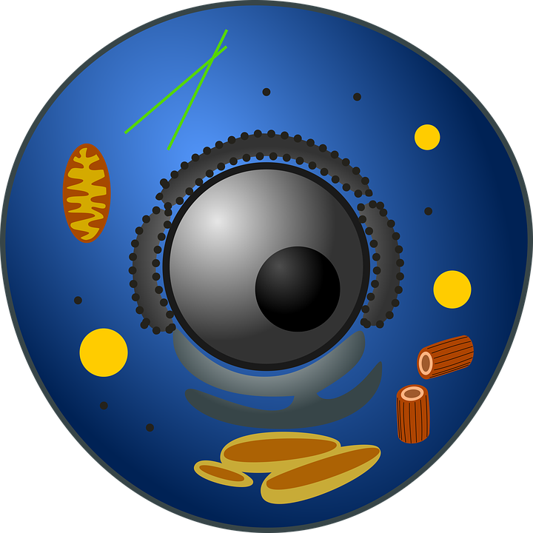
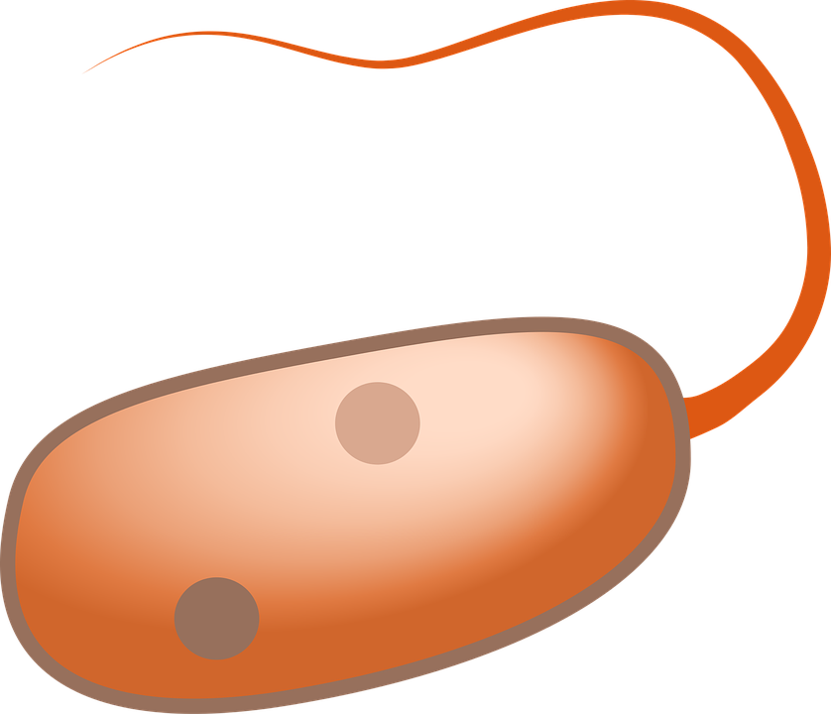
Eukaryotic cell
Prokaryotic cell
Prokaryotic cells, such as bacteria, are far smaller than eukaryotic cells such as plant, animals and fungal cells.
On top of their difference in size there are other notable differences in the structures of these two types of cell.

Slide 5
Learning Task: Watch the video and complete the tasks below.
Copy and label the diagram of a prokaryotic cell (5 marks)
Complete the table (5 marks)
Structure | Function
Flagellum
 | Strengthens the cell and protects from invading pathogens
Cell Membrane
Plasmid DNA
Chromosomal DNA

Slide 6
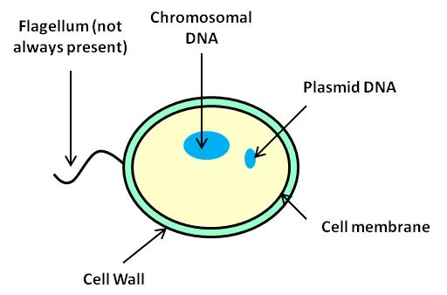
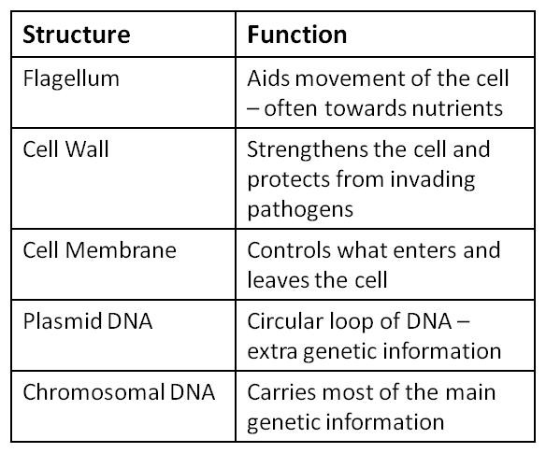
Self-assess

Slide 7
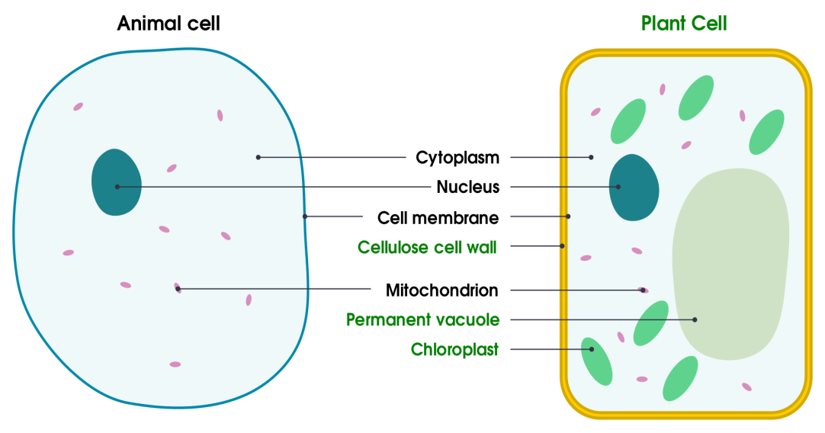
Apply your knowledge: Look at the diagrams below of the prokaryotic bacteria cell and the eukaryotic animal and plant cell. Make a list of the similarities and differences between these two groups of cells.
Prokaryotic cell
Eukaryotic cell
Notes:
Images: Animal cell & plant cell by domdomegg licensed under CC-by-SA 4.0

Slide 8
Similarities
Differences
Both eukaryotic and prokaryotic cells contain a cell membrane cytoplasm
Some eukaryotic cells, fungi and plant cells, contain a cell wall which prokaryotic cells also contain
Prokaryotic cells do not contain a nucleus.
The DNA within prokaryotic cells is contained within circular chromosomes or loops of DNA called plasmids.
Some prokaryotic cells also have flagella, which eukaryotic cells do not have
Self-assess

Slide 9
Assessment: COVER YOUR WORK and have a go at this question:
The diagram below shows the structure of a bacterial cell.
On the diagram label structures A, B & C. (3 marks)
Give one difference between the structure of a bacterial cell and an animal cell (1 mark)
Name on structure that you would find in a plant cell but not in a bacteria or animal cell. (1 mark)
A
B
C

Slide 10
Self-assessment:
a) cell wall
b) cell membrane
c) plasmid/chromosomal DNA
A bacterium has a cell wall / no nucleus / no mitochondria / has plasmids present
Chloroplast or vacuole

Slide 11
Plenary: True or False?
Animal, plant and bacterial cells all contain a cell wall and cytoplasm
The DNA in prokaryotic cells such as bacterial cells is contained within circular chromosomes and plasmids
Some prokaryotic cells have a flagellum, to help them move
One example of a eukaryotic cell is a palisade cell
Prokaryotic cells and eukaryotic cells both have a nucleus
F
T
T
T
F

Slide 12
Flagellum (not always present)
Chromosomal DNA
Plasmid DNA
Cell membrane
Cell Wall
Structure | Function
Structure | Function
Flagellum | Aids movement of the cell – often towards nutrients
Cell Wall | Strengthens the cell and protects from invading pathogens
Cell Membrane | Controls what enters and leaves the cell
Plasmid DNA | Circular loop of DNA – extra genetic information
Chromosomal DNA | Carries most of the main genetic information
Notes:
Each student should get a blank sheet to fill in, each student should be given part of the completed sheet (either the diagram of one structure & function) for them to walk around the room and discuss with other pupils.

