Slide 1


DNA: Ask a question make a statement!

Slide 2
Ordering Fractions with the same Denominator
16.9.20
Unit 4F1

Slide 3



Prior learning:
Place value.
Percentage as an amount out of 100.
Multiplication and division.
Ordering integers on a number line.
Unit 5 - Fractions, Decimals
and Percentages
Shading fractions of diagrams, equivalence and simplification of fractions.
57-59,61
Convert between improper fractions and mixed numbers.
63-64
65-66,
67-70
Four operations with mixed and improper fractions.
Order fractions.
60
Find fractions of an amount.
77
Calculate a percentage of an amount and percentage change.
84-90
73-76,
82-83
Convert between fractions, decimals and percentages and compare them.
Calculate simple and compound interest.
93-94
Next steps:
Calculating proportions of pie charts.
Using multipliers.
Reverse percentages.
Reverse fractions.

Slide 4

Progress Indicators:
Good Progress: Pupils can order Fractions through equivalence with a common Denominator
Outstanding Progress: Pupils can solve worded questions

Slide 5





It is easy to order fractions when they have the same Denominators!
$$\frac{2}{5}$$
$$\frac{4}{5}$$
$$\frac{1}{5}$$
$$\frac{5}{5}$$
$$\frac{3}{5}$$
How do we order them when they don’t have the same Denominator?

Slide 6

Ordering Fractions
Fractions can be ordered more easily by making the denominators the same.
Find the common denominator
Multiply fractions to make the denominators the same
Compare the numerators. If the numerator is bigger then the fraction is bigger.

Slide 7



I Do:
Put the following fractions in ascending order:
2 1 3
5 4 10
The common denominator is 20.
Each fraction needs to then be converted so that all the denominators are the same.
x 4
x 5
x 2
8
5
6
__ __ __
20 20 20
So, in order from smallest to largest
$$\frac{1}{4}$$
$$\frac{3}{10}$$
$$\frac{2}{5}$$

Slide 8




You Do:
Put the following fractions in ascending order:
3
5
7
The common denominator is 24.
Each fraction needs to then be converted so that all the denominators are the same.
4
4
6
8
12
$$×\frac{6}{6}$$
$$×\frac{4}{4}$$
$$×\frac{3}{3}$$
$$×\frac{2}{2}$$
18
16
15
14
24
24
24
24
7
5
4
3
12
8
6
4

Slide 9


You Do:
Put the following fractions in descending order:
1
1
2
The common denominator is 18.
Each fraction needs to then be converted so that all the denominators are the same.
1
1
6
3
18
9
$$×\frac{3}{3}$$
$$×\frac{6}{6}$$
$$×\frac{2}{2}$$
3
6
19
4
18
18
18
18
1
1
2
1
1
18
3
9
6

Slide 10
Practice

Slide 11
Answers (smallest to largest) Qs 1 - 4
1 3 1 5 3
4 8 2 8 4
2 1 3 7 2
5 2 5 10 2
1 5 1 4 3
3 12 2 6 4
1 2 3 5 7
2 3 4 6 8

Slide 12
Practice

Slide 13
Answers (smallest to largest) Qs 5 - 8
1 2 1 6 3
4 5 2 10 4
1 4 1 2 5
3 9 2 3 6
1 2 5 2 7
4 6 12 3 9
2 2 5 11 3
7 4 8 14 2

Slide 14
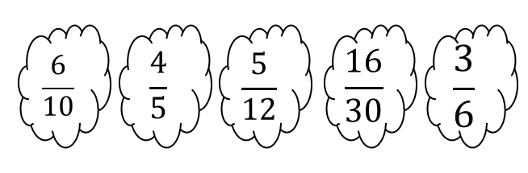
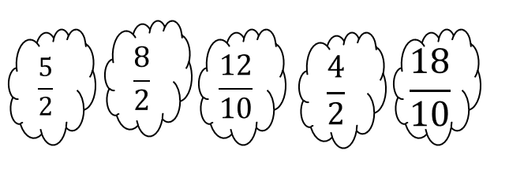
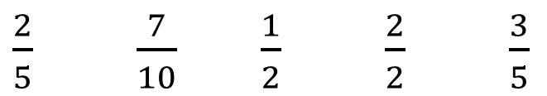
Demonstrate:
(a)Put the following fractions in ascending order?
$\frac{2}{5}$ $\frac{7}{10}$ $\frac{1}{2}$ $\frac{2}{2}$ $\frac{3}{5}$
(c)
Be Careful with this one!

Slide 15
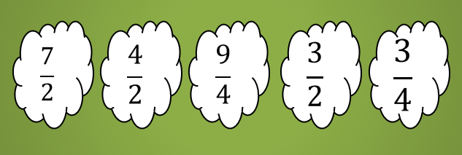
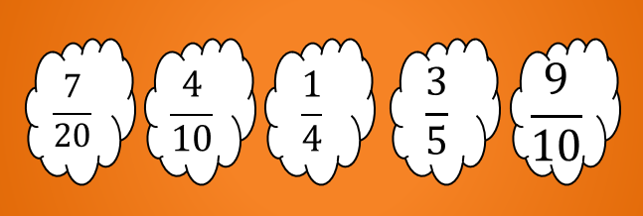
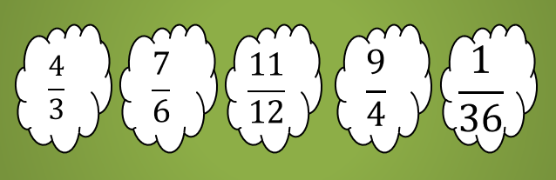
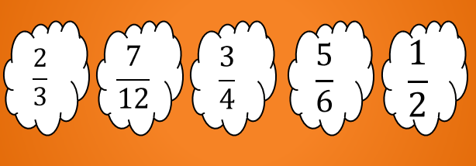

Connect
Put the following fractions in ascending order? | Order these in Ascending order: | Order the following in Descending order:
$\frac{ 7}{8}$
$\frac{6}{24}$
$\frac{2}{4}$
Would you rather have
2 1 3
5 4 10
of a pizza?

