Slide 1
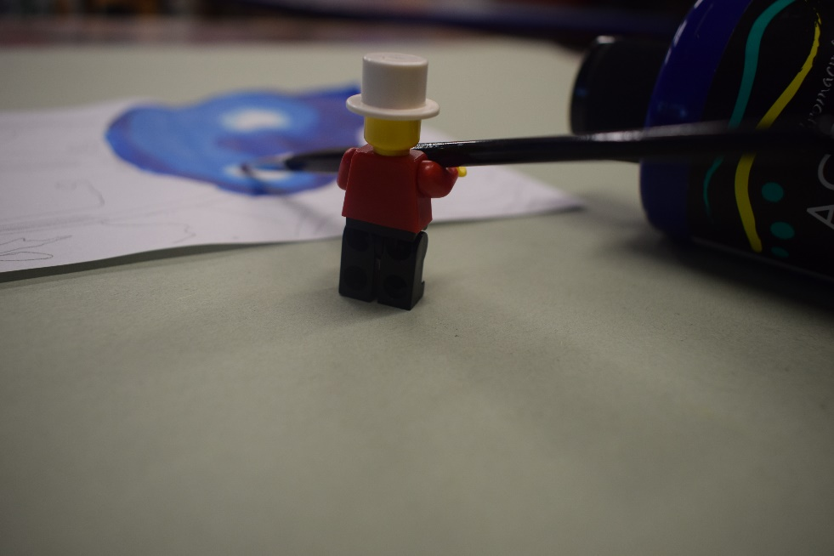
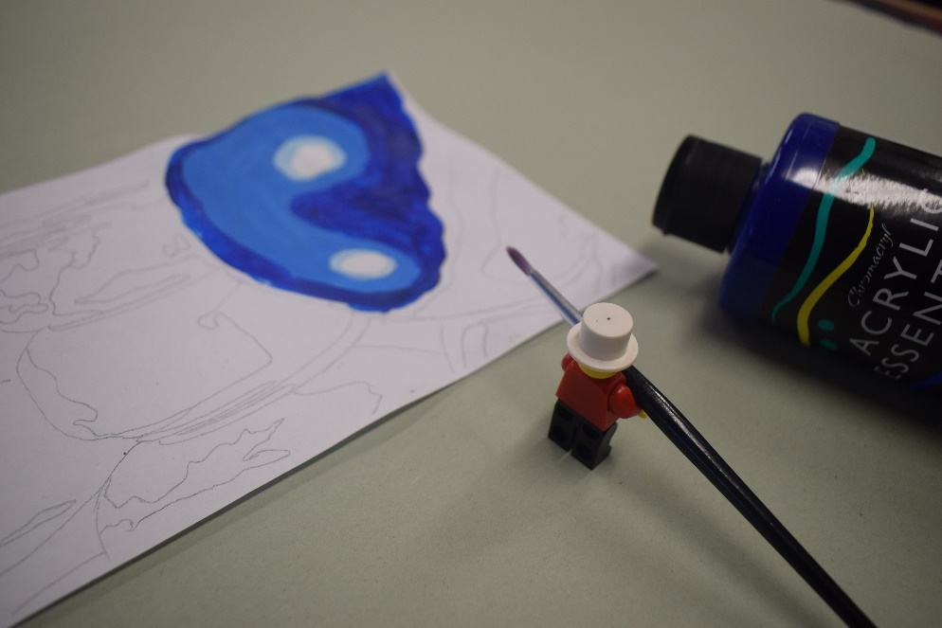
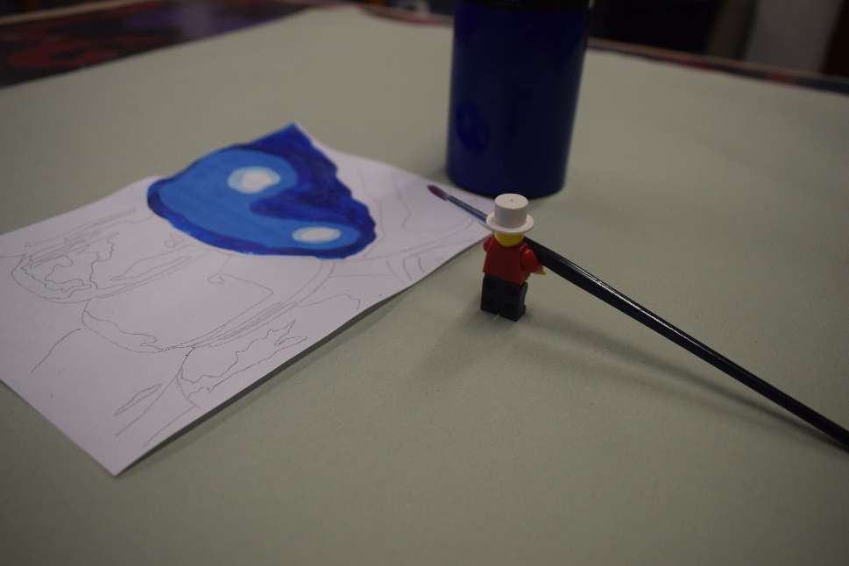
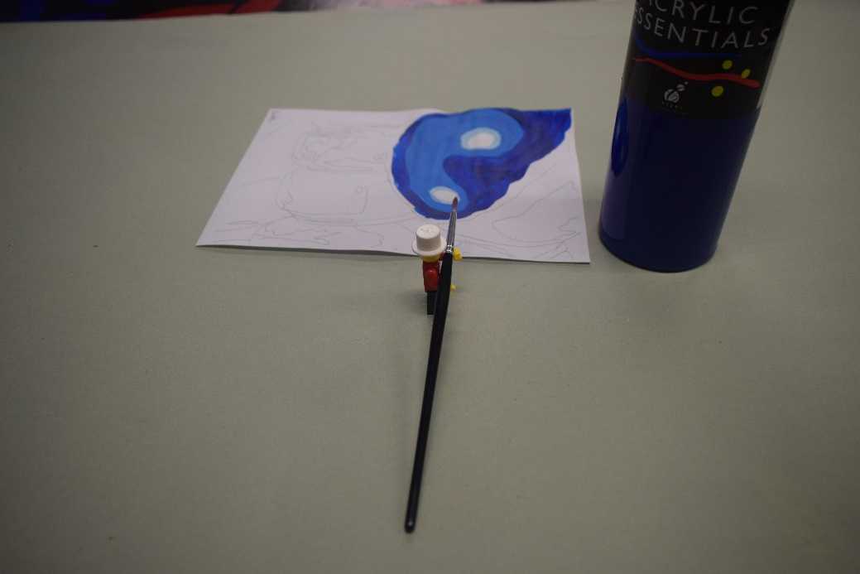
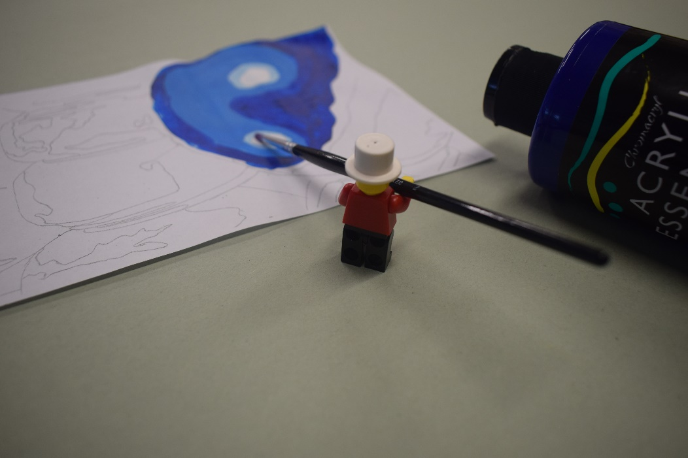
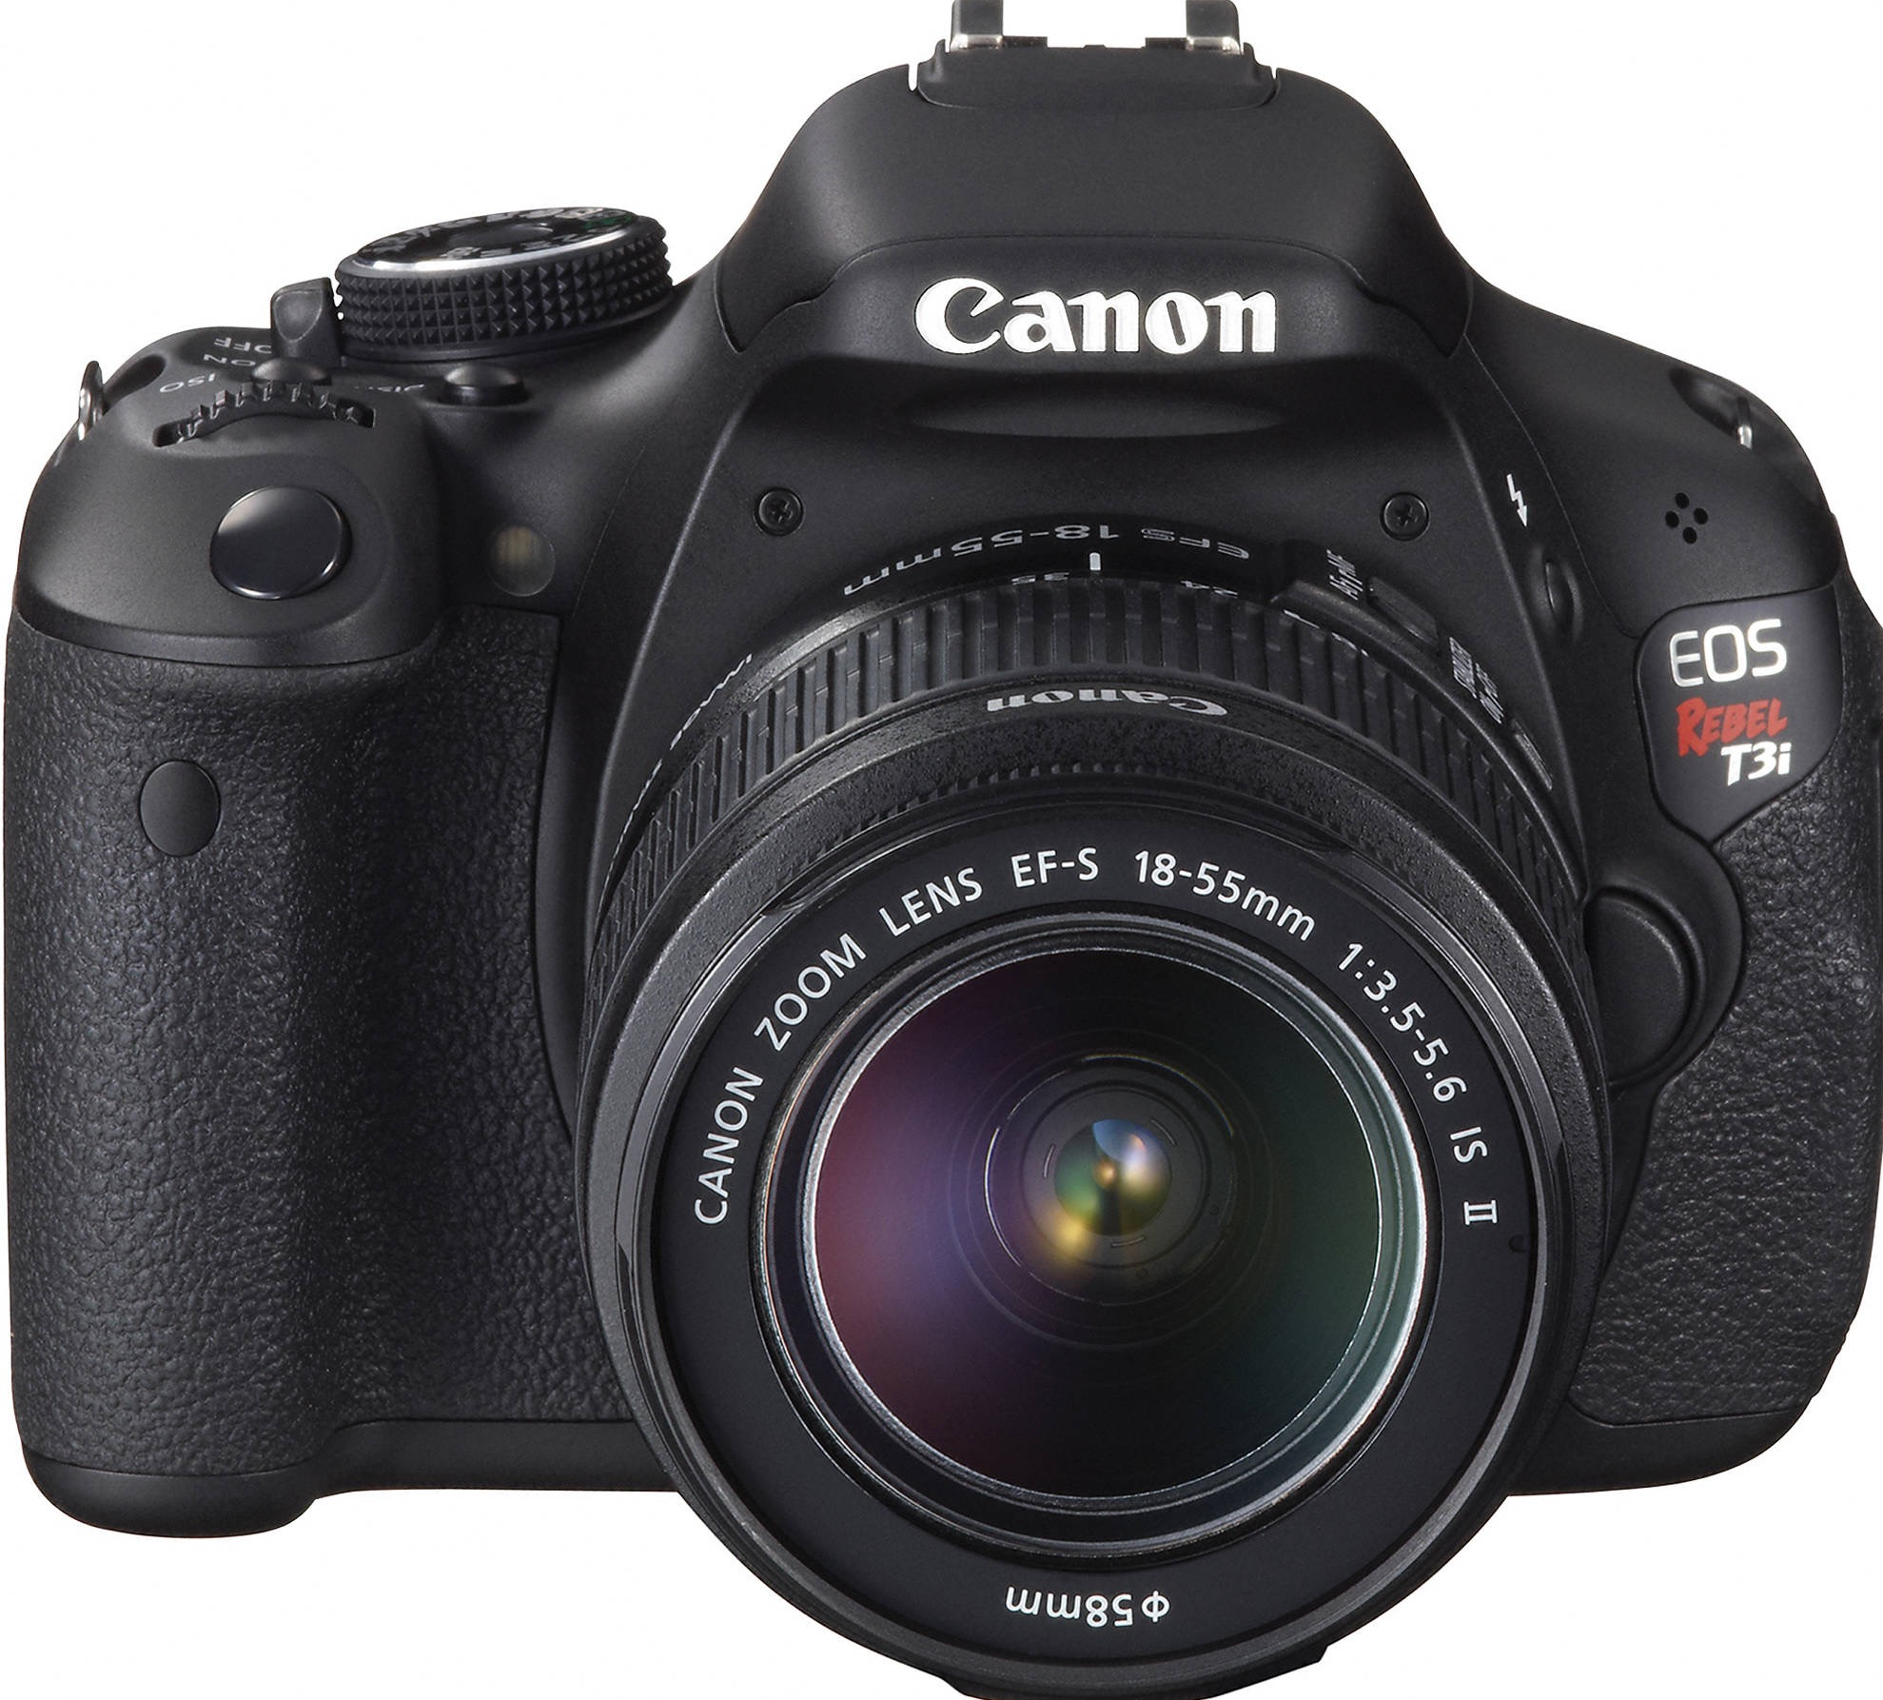
Composition
What is the difference between these photos?

Slide 2
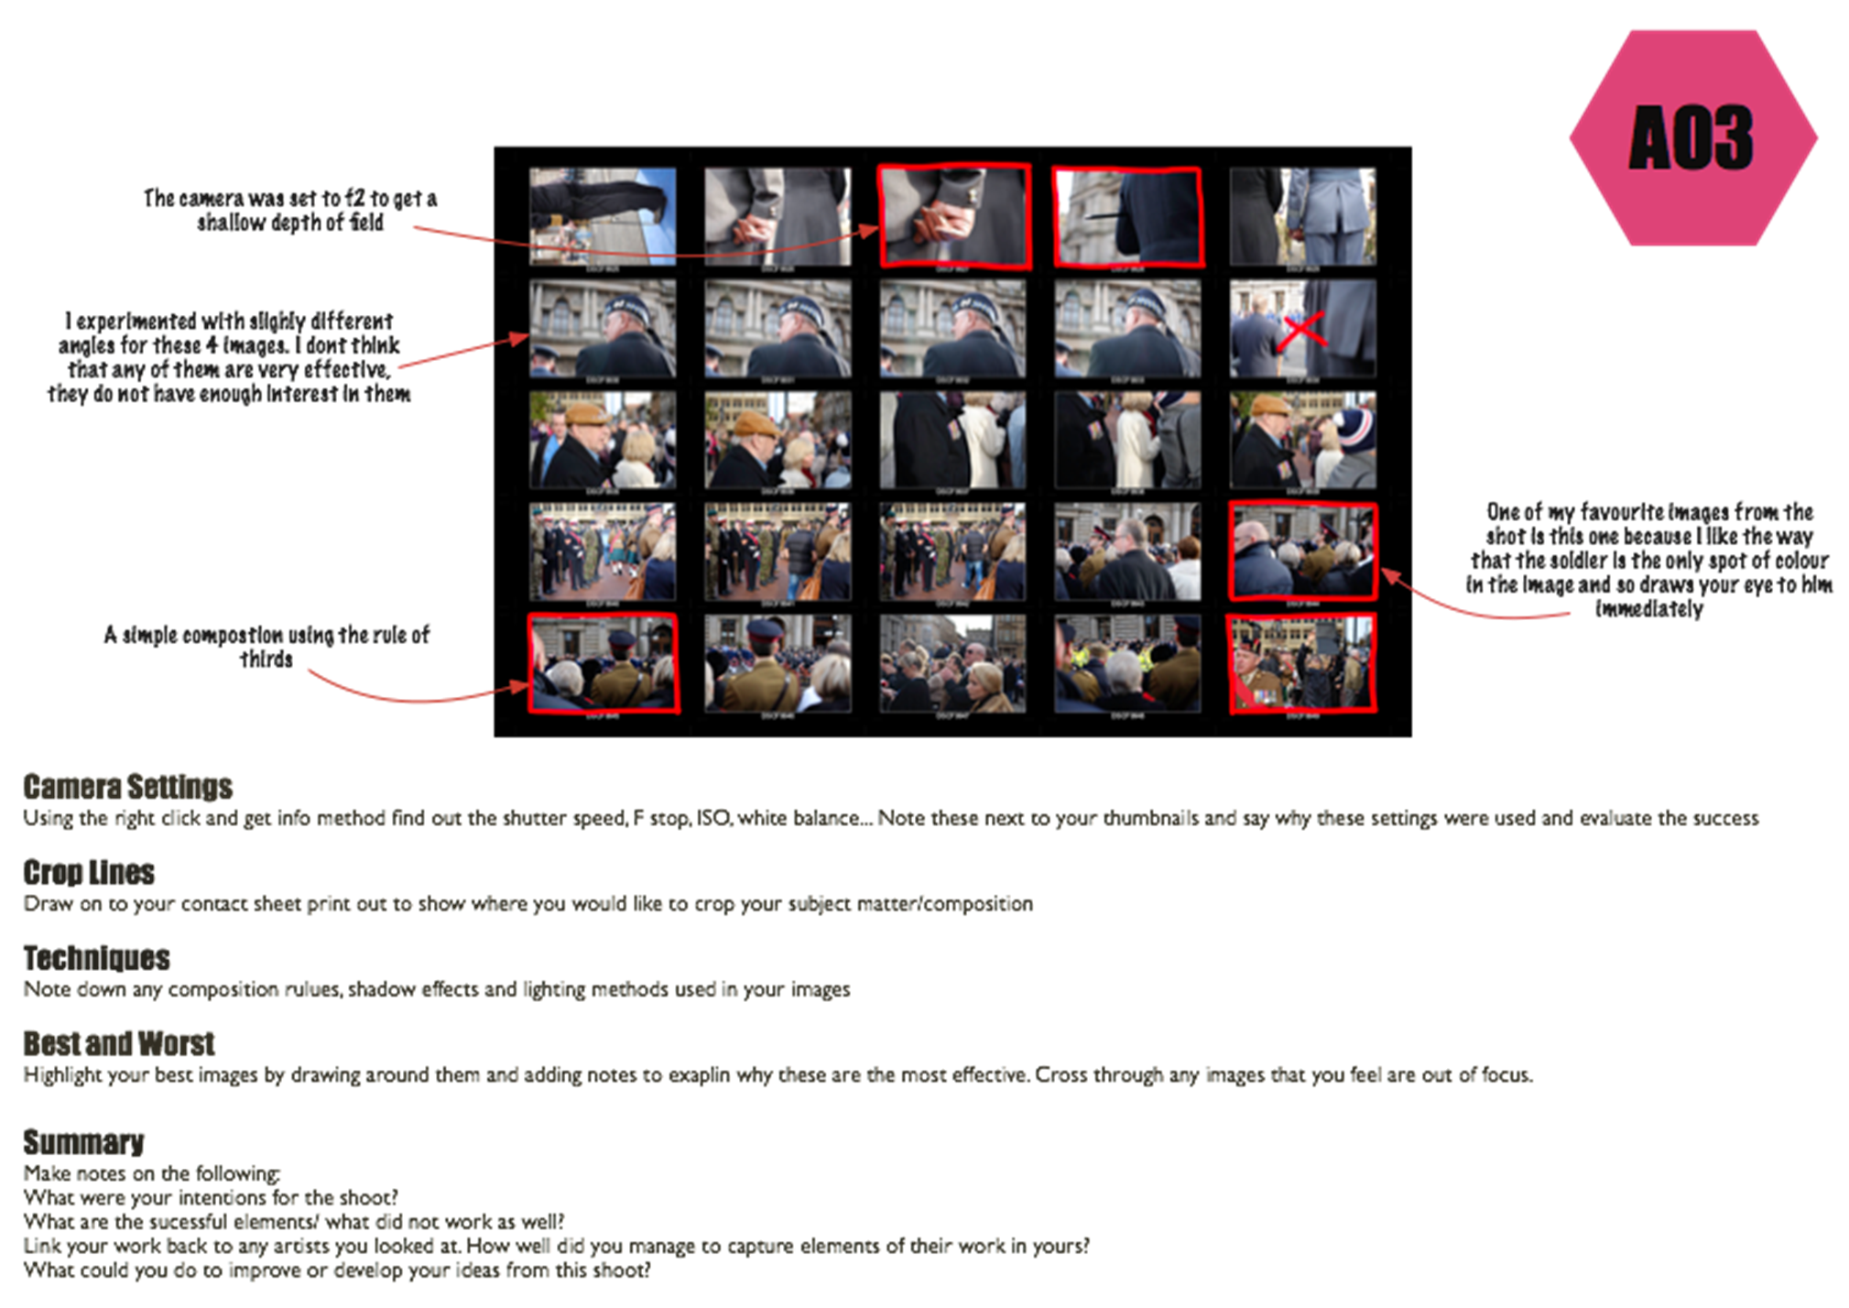
Annotating a Contact Sheet
To take a set of photographs that are inspired by the work of The Little People Projects
Title –
Contact Sheet
GCSE photography Progress Indicators
Basic Requirements | Taken a range of photos using the mini figures as props Saved all images to your one DRIVE Printed a contact sheet
Good | Taken wide selection of images that show links to the work of Tatsuya Camera settings/compositions have been experimented with when on the photo shoot and discussed
Outstanding | Taken a wide, varied and creative selection of photos that show strong links to the work of Tatsuya Camera settings/compositions have been expertly and creativity used and discussed
TASK 1
Take your photos in the style of Tatsuya/Slinkachu/Little People Project.
Remember that you should demonstrate your understanding of aperture, focus and composition in your photographs!
TASK 2
Save your photos to your OneDRIVE area under the file name: Contact sheet Little People Project
If they get deleted by accident they can be restored – so you must up load and save them
Print ALL your images and then using the ‘Annotating a contact sheet’ add notes to your sheet.
Print your best photo to A4 or best 2 photos A5 and mount only on black paper not on to white

Slide 3
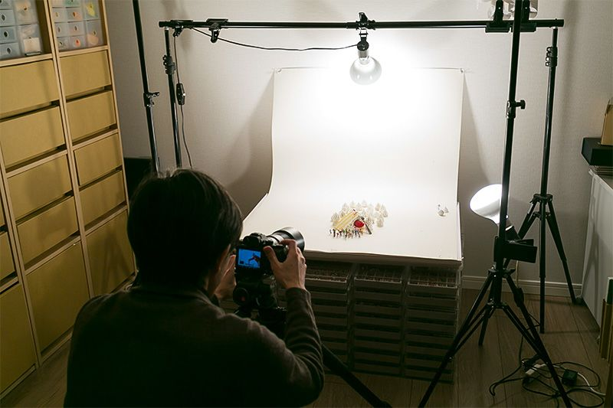
Bring up your most successful image and be ready to discuss why you feel it is your best shot

Slide 4
Annotating a Contact Sheet

