Slide 1
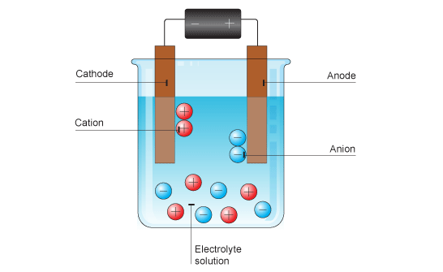
Changes at the electrodes
Spec 5.4.3.4
DO NOW
Which electrodes would you expect hydrogen ions (H⁺) and oxide ions (O²⁻) to be attracted to? Why?

Slide 2
Changes at the electrodes
Spec 5.4.3.4
DO NOW
Which electrodes would you expect hydrogen ions (H⁺) and oxide ions (O²⁻) to be attracted to? Why?
The hydrogen ions (H⁺) are attracted to the oppositely charged electrode, the negative electrode (cathode).
The oxide ions (O²⁻) are attracted to the oppositely charged electrode, the positive electrode (anode).

Slide 3
PROGRESS INDICATORS
 | Good progress | Outstanding progress
Grade 1-3 | State the electrodes where oxygen and hydrogen are produced. | Write a word equation to describe electrolysis of a solution.
Grade 4-6 | Write a balanced symbol equation to describe electrolysis of a solution. | Predict the products at each electrode for the electrolysis of a molten ionic compound or its solution.

Slide 4
Word Consciousness
Brine – a mixture of sodium chloride (salt) and water
State symbols – a subscript letter in brackets added to an equation to state what state of matter the compound/ element is in. (s) = solid (l) = liquid (g) = gas (aq) = aqueous
Aqueous – dissolved in water
Discharged – the charge removed (becomes neutral)

Slide 5
ACTIVITY 1: Describe the process of electrolysis of brine
Watch the video clip and answer the questions Electrolysis of brine
Name 2 compounds found in brine
What material are the electrodes made of?
What ions are found in sodium chloride?
Name the ions found in water
At which electrode is hydrogen produced?
At which electrode is chlorine gas produced?
Which 2 ions are attracted to the anode?
Overall what are the 3 products of the electrolysis of brine?
Sodium Chloride & Water
Carbon (Graphite
Sodium (Na⁺) & Chloride (Cl⁻)
Hydrogen (H⁺) & Hydroxide (OH⁻)
Cathode
Anode
Chloride (Cl⁻) & Hydroxide (OH⁻)
Sodium Hydroxide, Chlorine and Hydrogen
SA
Challenge: What gas tests could we use to identify chlorine gas and hydrogen gas?
Chlorine gas – Damp litmus paper turns white
Hydrogen – Squeaky Pop Test
Notes:
https://www.youtube.com/watch?v=N_HQGiC9OJE

Slide 6
ACTIVITY 2: Write a word equation to describe electrolysis of a solution.
Copy and complete the table.
Choose from the following:
Sodium hydroxide
Water
Chlorine
Hydrogen
Sodium chloride
Reactants of the electrolysis of brine | Products of the electrolysis of brine

Slide 7
ACTIVITY 2 ANSWERS
Copy and complete the table.
Reactants of the electrolysis of brine | Products of the electrolysis of brine
Water Sodium chloride | Sodium hydroxide Chlorine Hydrogen
SA
Self assess in red pens please

Slide 8
ACTIVITY 3: Write a balanced symbol equation to describe electrolysis of a solution.
Use the table to write a balanced symbol equation for the electrolysis of brine.
CHALLENGE: Add the state symbols for the electrolysis of brine.
Reactants of the electrolysis of brine | Products of the electrolysis of brine
Water Sodium chloride | Sodium hydroxide Chlorine Hydrogen
Sodium chloride + water → sodium hydroxide + hydrogen + chlorine
2NaCl _{(g)} + 2H₂O _{(l)} → 2NaOH _{(aq)} + H₂ _{(g)} + Cl₂ _{(g)}
SA
Self assess in red pens please

Slide 9
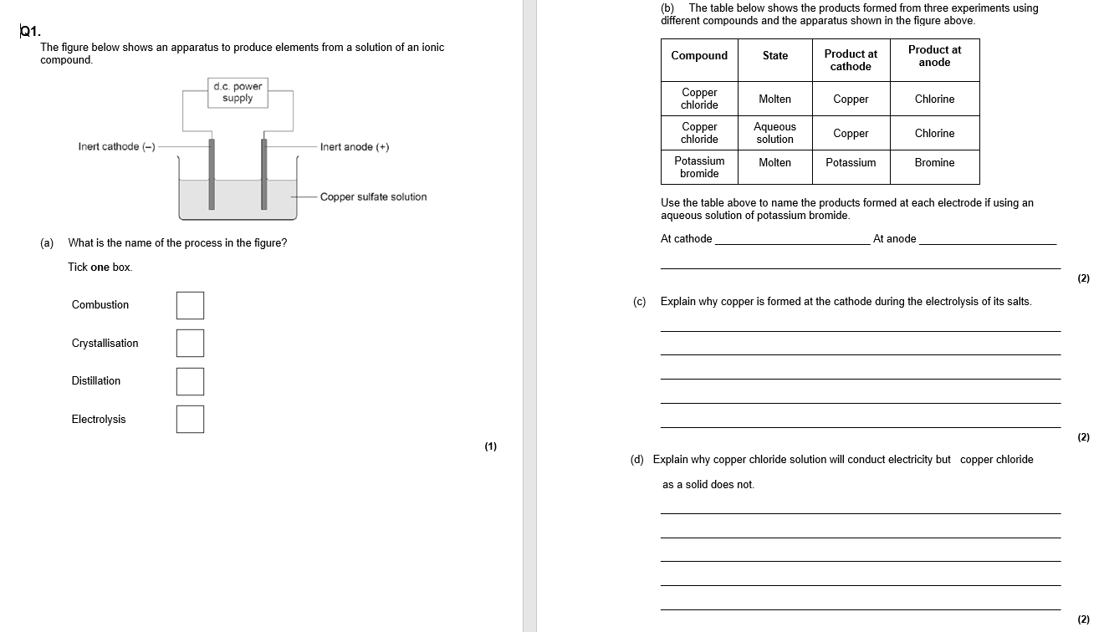

Slide 10
Answers
SA
Self assess in red pens please

Slide 11
plenary
Choose from the correct word in bold to complete the sentences.
The ions discharged when an aqueous solution is electrolysed using reactive/inert electrodes depend on the relative reactivity of the elements involved. At the positive/negative electrode (cathode), hydrogen is produced if the metal is more reactive than hydrogen/oxygen. At the positive/negative electrode (anode), hydrogen/oxygen is produced unless the solution contains halide ions when the halogen is produced. This happens because in the aqueous solution water molecules break down producing hydrogen/oxygen ions and hydroxide ions that are discharged.
inert
negative
hydrogen
positive
oxygen
hydrogen

