Slide 1
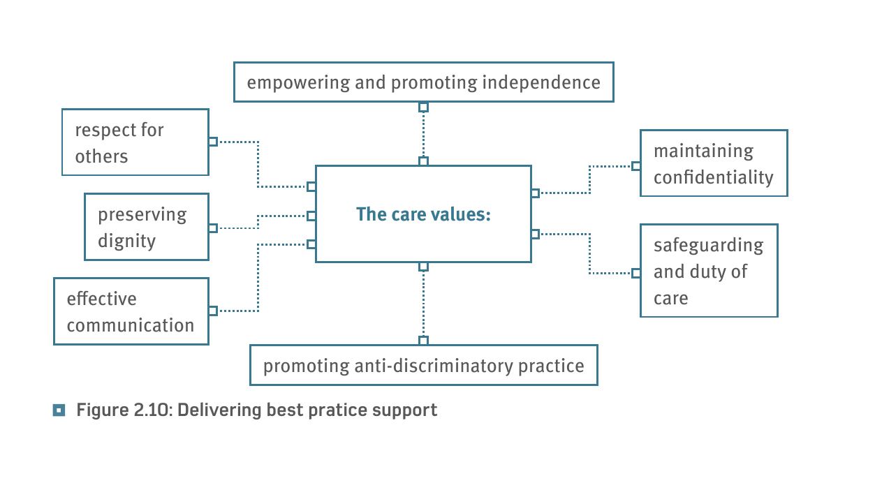
The Seven Care Values.

Slide 2
Do now……
https://www.youtube.com/watch?v=hgVMKEnkvHo
https://www.youtube.com/watch?v=LLBpwMVnpHw&pbjreload=10
https://www.youtube.com/watch?v=xM9UJVjZpRs
https://www.youtube.com/watch?v=rDC0N_49V3U
https://www.youtube.com/watch?v=edqmrxaQhSc
https://www.youtube.com/watch?v=A3vb-IoUGno

Slide 3
Task……
You are explaining the seven care values and how you will demonstrate these whilst you are on work experience in a residential home for older adults. Some of the residents have dementia and arthritis. You are helping the residents at lunch time. You have to help them sit down, order food and eat it.

Slide 4
Task…
You are volunteering in a hospital shadowing a play therapist who works on a children’s ward. An eight year old girl has been admitted for some tests, but it is suspected that there is a safeguarding issue as there are unexplained bruising on her body.
Write an introduction to explain the scenario.
Explain what a children’s ward is.
Explain what a play therapist is.
You only have to write about three care values.
Communication.
Safeguarding and duty of care.
Maintaining confidentiality

