Slide 1
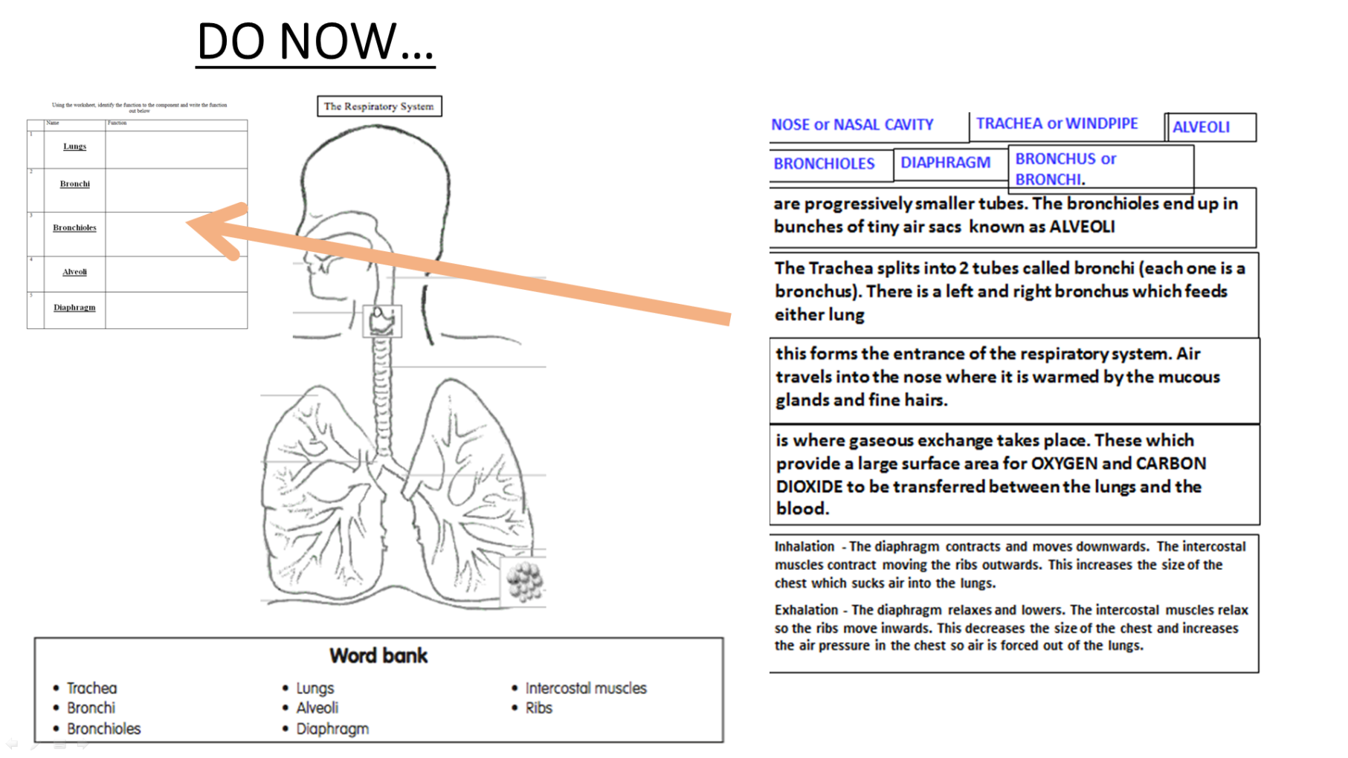
Title: Respiratory system
LO: To recap the different role of Respiratory system in the body
Progress Indicators
Good Progress | Outstanding Progress
To identify and explain the role of key functions of the respiratory system | To be able to explain how a range of aspects of the respiratory system contribute to performance

Slide 2
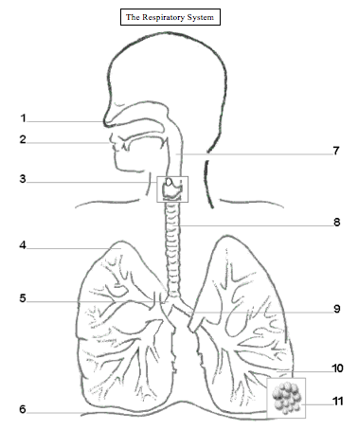
DO NOW…

Slide 3
NOSE or NASAL CAVITY
TRACHEA or WINDPIPE
ALVEOLI
NOSE or NASAL CAVITY
TRACHEA or WINDPIPE
ALVEOLI
BRONCHIOLES
DIAPHRAGM
BRONCHUS or BRONCHI.
BRONCHUS or BRONCHI.
BRONCHIOLES
DIAPHRAGM
are progressively smaller tubes. The bronchioles end up in bunches of tiny air sacs known as ALVEOLI
are progressively smaller tubes. The bronchioles end up in bunches of tiny air sacs known as ALVEOLI
The Trachea splits into 2 tubes called bronchi (each one is a bronchus). There is a left and right bronchus which feeds either lung
The Trachea splits into 2 tubes called bronchi (each one is a bronchus). There is a left and right bronchus which feeds either lung
this forms the entrance of the respiratory system. Air travels into the nose where it is warmed by the mucous glands and fine hairs.
this forms the entrance of the respiratory system. Air travels into the nose where it is warmed by the mucous glands and fine hairs.
is where gaseous exchange takes place. These which provide a large surface area for OXYGEN and CARBON DIOXIDE to be transferred between the lungs and the blood.
is where gaseous exchange takes place. These which provide a large surface area for OXYGEN and CARBON DIOXIDE to be transferred between the lungs and the blood.
Inhalation - The diaphragm contracts and moves downwards. The intercostal muscles contract moving the ribs outwards. This increases the size of the chest which sucks air into the lungs.
Exhalation - The diaphragm relaxes and lowers. The intercostal muscles relax so the ribs move inwards. This decreases the size of the chest and increases the air pressure in the chest so air is forced out of the lungs.
Inhalation - The diaphragm contracts and moves downwards. The intercostal muscles contract moving the ribs outwards. This increases the size of the chest which sucks air into the lungs.
Exhalation - The diaphragm relaxes and lowers. The intercostal muscles relax so the ribs move inwards. This decreases the size of the chest and increases the air pressure in the chest so air is forced out of the lungs.

Slide 4
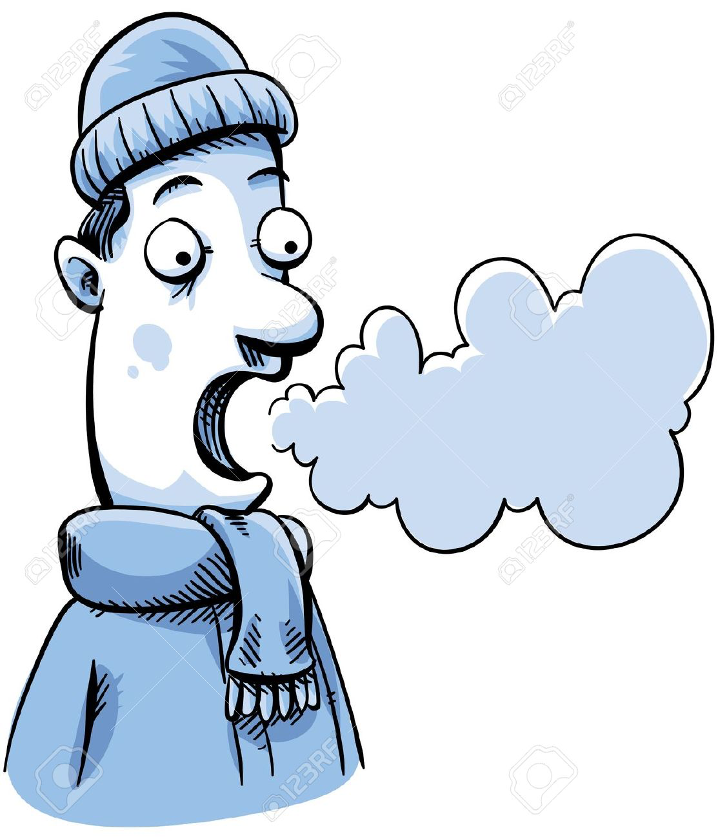
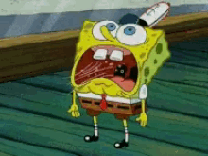
Composition of breathing
Inspire
Expire
79% Nitrogen
20 (21) % Oxygen
0.4% (Trace) - Carbon Dioxide
79% Nitrogen
16% Oxygen
4% Carbon Dioxide

Slide 5
KEY WORDS
RESPIRATORY RATE =
is how many breaths you can take in a minute
TIDAL VOLUME =
is the amount of air used when breathing normally in and out (like a tide)
To bring in more oxygen during aerobic exercise and remove lactic acid during anaerobic
This increases during exercise!
To breath out more carbon dioxide
Vital Capacity =
is the most air you could possibly breathe in after breathing the largest volume of air you can
The larger the vital capacity, the more oxygen you can take in
You can increase this through exercise
RESIDUAL VOLUME=
is the amount of air that stays in our lungs to prevent them collapsing
Vital Capacity + Residue Volume = Total Lung capacity

Slide 6
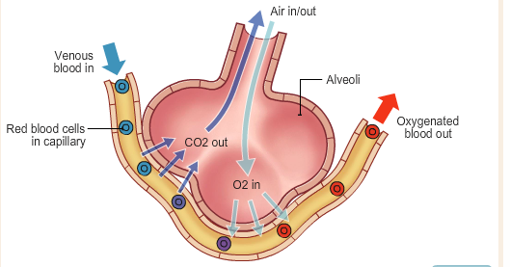
Structure of the alveoli to enable Gaseous exchange…
The Cardiovascular and respiratory system work together to get oxygen to the muscles, can carbon dioxide away = Exchanging gases between alveoli and the capillaries
In Alveolus
In Capillary
Diffusion of O2
High Concentration of 02
Low Concentration of CO2
Low Concentration of 02
High Concentration of CO2
Diffusion of CO2

Slide 7
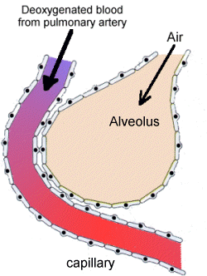
The Gaseous Exchange

Slide 8
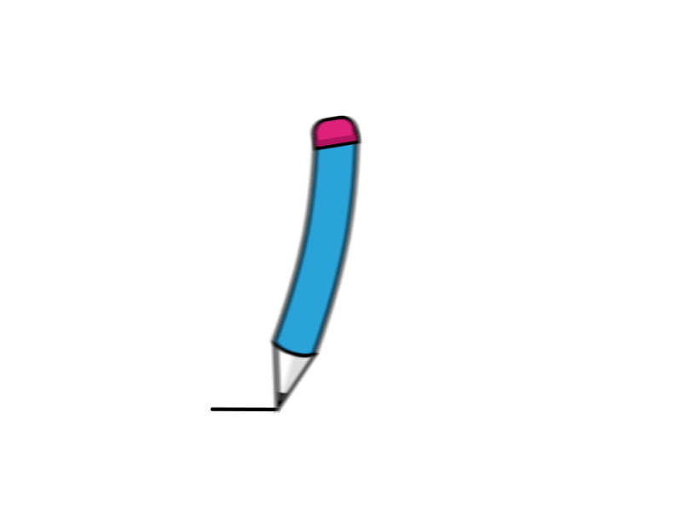
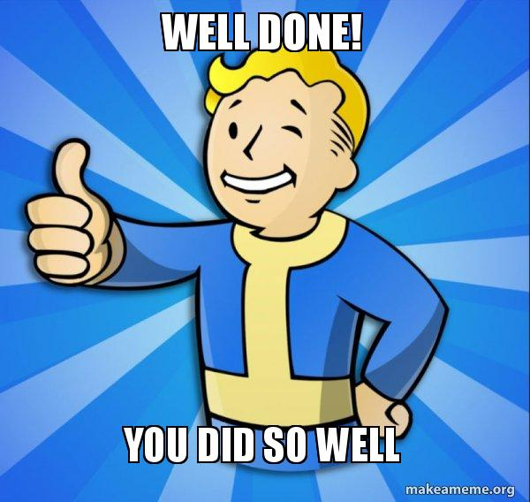
Last week you did so well!

Slide 9
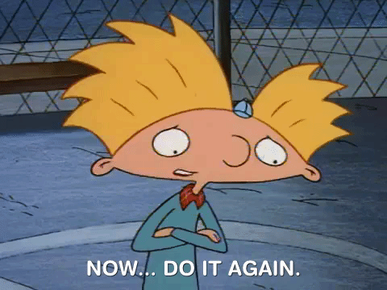

Slide 10
Task 1
Use half a page to draw this and label!
Task 2
Once drawn as accurately as possible, annotate the gaseous exchange identifying where it occurs

Slide 11
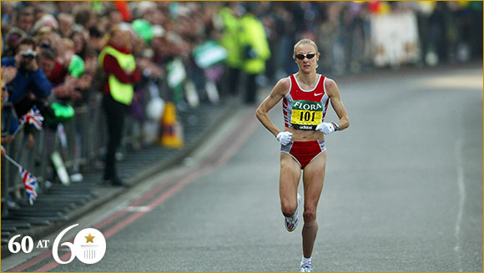
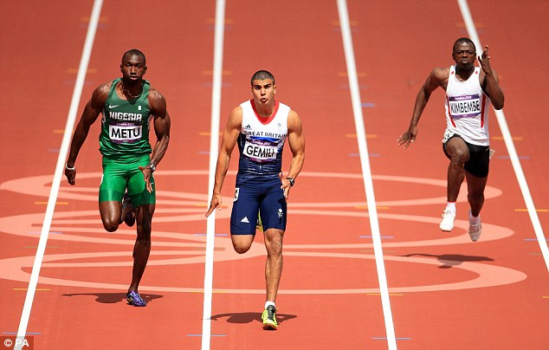
Aerobic exercise
Anaerobic exercise
No oxygen is used in its initial release, energy is produced from the supplies already in the body.
Maximum bursts of energy
Time it takes to do is very short
Aerobic exercise need a sufficient supply of oxygen to the tissues.
Work for a long time
Moderate – hard work
Periods of more then 60s
Extension task Explain how a games player would use both aerobic and anaerobic systems
(4 marks)
Glucose
Glucose + Oxygen
CO2 + water + Energy
Energy + Lactic acid

Slide 12
Aerobic exercise
Anaerobic exercise
No oxygen is used in its initial release, energy is produced from the supplies already in the body.
Maximum bursts of energy
Time it takes to do is very short
Aerobic exercise need a sufficient supply of oxygen to the tissues.
Work for a long time
Moderate – hard work
Periods of more then 60s
Extension task Explain how a games player would use both aerobic and anaerobic systems
(4 marks)
Glucose
Glucose + Oxygen
CO2 + water + Energy
Energy + Lactic acid

Slide 13
Energy
The muscles and liver store glucose (main source of energy from food)
Aerobic Respiration -
Glucose + oxygen -----Energy + CO2 + water
Is toxic!, causes muscle ache, cramps eventually stopping them from working!
Anaerobic Respiration -
Glucose -----Energy + lactic acid
The muscles and liver store glucose (main source of energy from food)
Fats:
Fuel source for aerobic activity
Carbohydrates:
Fuel source for anaerobic and aerobic activity

Slide 14
Oxygen debt
Oxygen debt is….
Oxygen debt is…
The amount of oxygen needed at the end of a physical activity to break down lactic acid. Often after a 400m race lactic acid is build up as oxygen is not being used. Oxygen is repaid through deep gasping breaths at the end of exercise
Anaerobic Respiration -
Glucose -----Energy + lactic acid

Slide 15
Explain how the Cardiovascular system and the respiratory system work together (6)?
State
define
knowledge and understanding of a topic
describe
Identify
Explain how
Explain why
Apply knowledge and understanding
Give examples to back up your point
assess
discuss
Justify why
Analyse and evaluate
evaluate
analyse

