Slide 1



4.4 Sales Promotion Techniques
Hyperlink(s)
Back button
Forward button

Slide 2





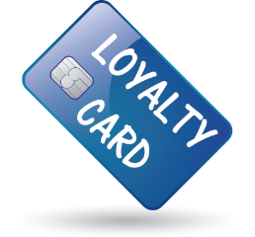

Sales Promotion Techniques
Identify the different sales promotion techniques using the images.

Slide 3
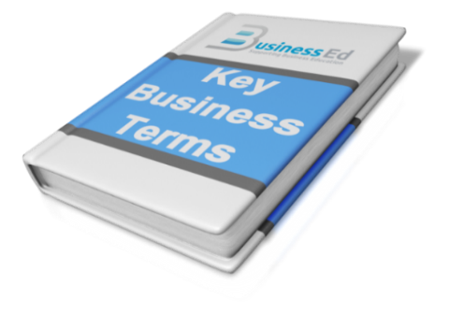
Sales Promotion
Write a definition for sales promotions
“The use of incentives to persuade a consumer to make a purchase”
or
“The focus with sales promotions is in converting a potential sale into an actual sale”

Slide 4

Sales Promotion Techniques
Investigate how each technique operates
TECHNIQUE | WHAT IS INVOLVED
DISCOUNTS | Offering a reduced price for a limited period to encourage immediate sale
COMPETITIONS | On-pack competitions offering attractive prizes to encourage a purchase
BOGOF | Buy one get one free – giving an additional product for no charge to encourage purchases
POINT OF SALE MATERIAL | Displays in store that are designed to attract consumer attention to a particular product or offer
FREE GIFTS/ PRODUCT TRIAL | Offering a free gift with a purchase, or offering to refund the price paid to encourage consumers to try a product
LOYALTY SCHEMES | Encourage repeat sales by offering points based on the amount spent. Points can be used to gain discounts in future visits
Progress Indicators
Good - Describe how different sales promotions work | Excellent – Explain the positive and negatives of each sales promotion

Slide 5

Things to Consider With Sales Promotions
Identify the advantages and disadvantages for each techniques
  Good for encouraging customers to try a new product
  Will increase
  sales
  Can be used to “upsell” – selling more expensive items
  Useful or getting
  rid of old stock
  Increase in sales may only be temporary
  Customers may come to expect offers – and then buy more and store
  Brand image can be damaged
  Profit margin will be lower
ADVANTAGES
DISADVANTAGES
Progress Indicators
Good - Describe how different sales promotions work | Excellent – Explain the positive and negatives of each sales promotion

