Slide 1
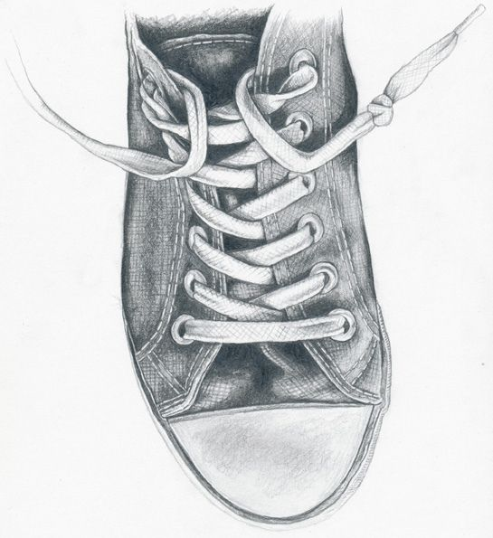
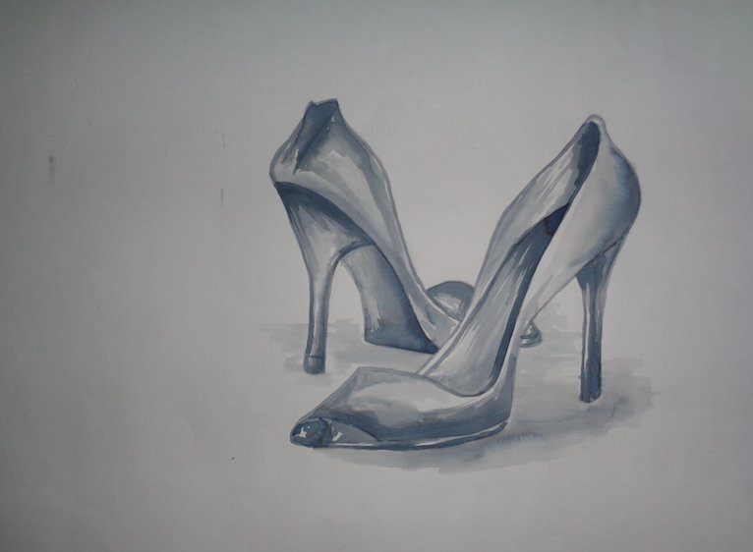
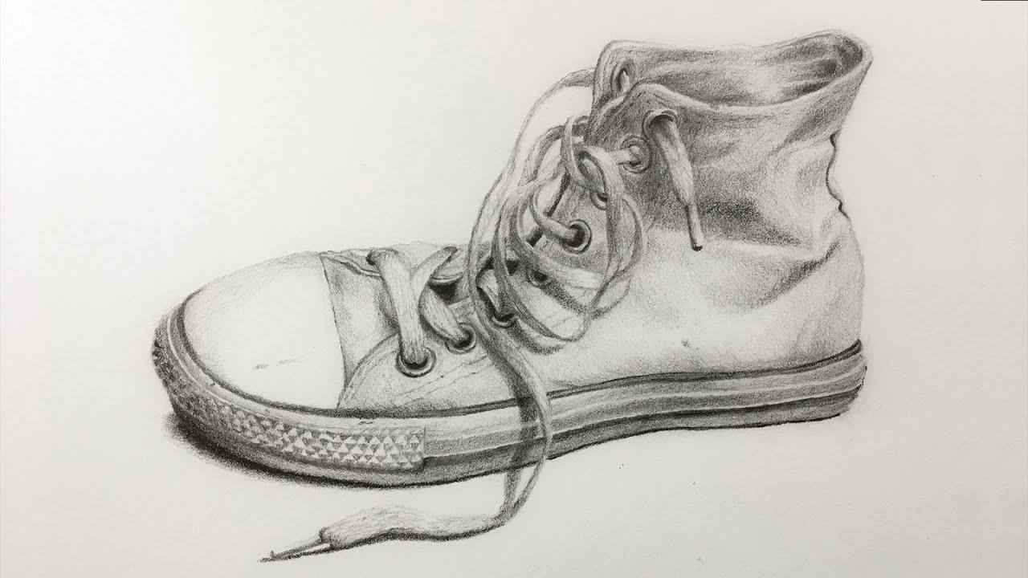
Task 5 - Observational drawing of a shoe or trainer
Put the shoe or trainer in front of you – observe it closely.
Once you have completed the outline and added the finer detail like laces, designs etc try to add shading to give the drawing a more realistic look and 3D
Make sure your drawing is large (A4) to be able to add finer details
Use the images to help

