Slide 1
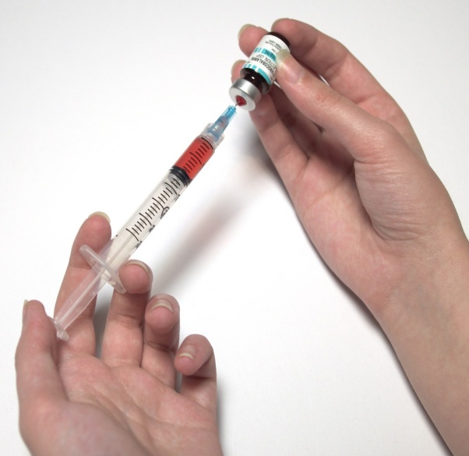
Vaccination
Do now activity:
What have you already learnt about viruses?
Describe some of the major differences between bacteria and viruses?
Explain why a virus can’t be treated with antibiotics

Slide 2
Progress indicators
GOOD PROGRESS:
To describe how the immune system response to pathogens in the body
To explain how vaccines work
OUTSTANDING PROGRESS:
To explain the benefits of herd immunity

Slide 3

A vaccination is administered by needle injections, by mouth or by aerosol.
A vaccine is a produce which produces immunity, therefore protecting you against a disease.
This is how it works….
Task: Watch the video and answer the questions on the worksheet
https://www.youtube.com/watch?v=gzptBqDuLNY

Slide 4
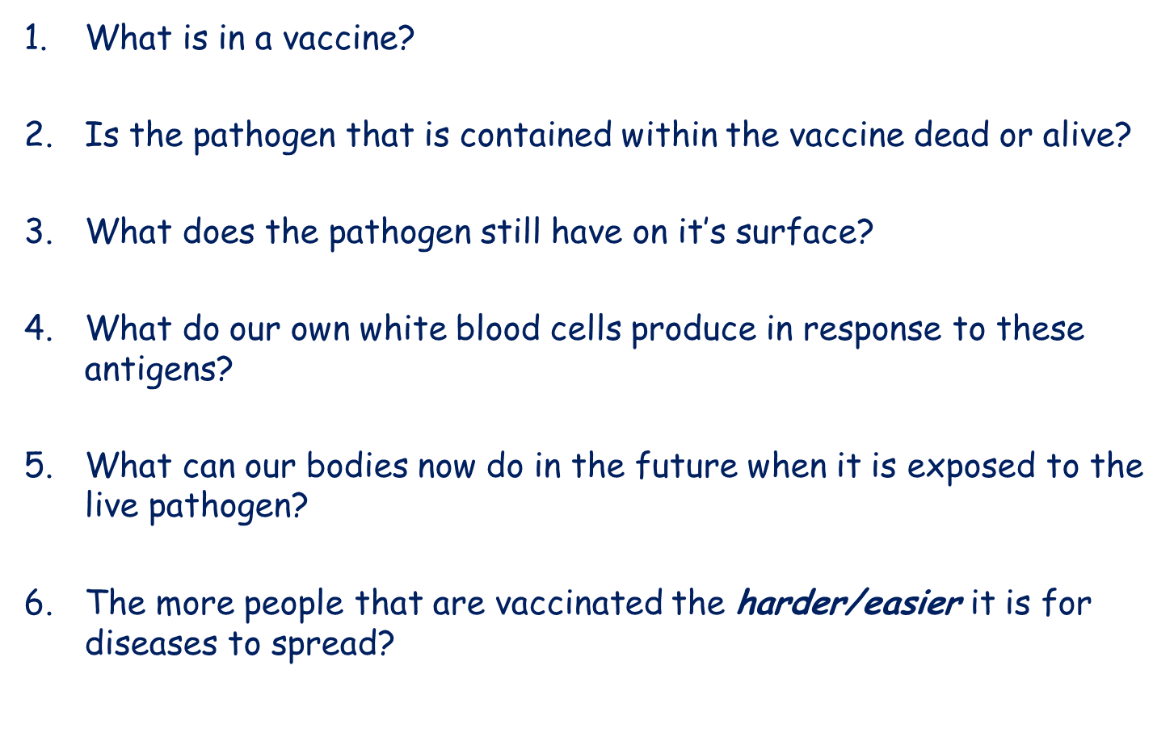

A vaccine contains a dead or inactive form of a pathogen
The pathogen is dead
Antigens
Antibodies
Our bodies are able to produce specfic antibodies to target and kill the invading pathogen before the infection spreads
The more people that are vaccinated the harder it is for the disease to spread.
Self-assess

Slide 5
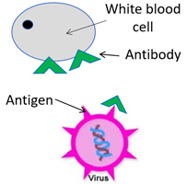
Every cell has unique proteins on its surface, called antigens.
The antigens on pathogens are different to your own cells.
Your white blood cells recognise that they are different and make antibodies which join up with the antigen to destroy the pathogen

Slide 6
Quick check: Key Words Quiz
antibody
antigen
white blood cell
pathogen
Task: Write these words in a list in your books, leave a space between each one.
A picture or description will flash up on the board which will match one of the words above, write/draw it next to the correct key word

Slide 7
Key Words Quiz
1.
?

Slide 8
Key Words Quiz
2.
A unique protein which every cell has on its surface
This is what our white blood cells recognises as foreign when a pathogen enters our body

Slide 9
Key Words QUIZ
3.
?

Slide 10
Key Words
4.
This is your body’s second line of defence, they help to defend your body against pathogens by several mechanisms:
Ingest (eat) microorganisms
Produce antibodies
Produce antitoxins.

Slide 11

Self-assessment:
Antibody
Antigen
Pathogen
White blood cell

Slide 12

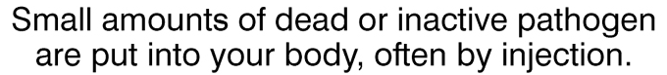
This is how vaccines protect you against dangerous infectious diseases…
Step 1

Slide 13
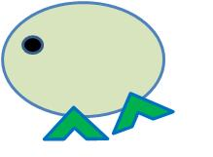
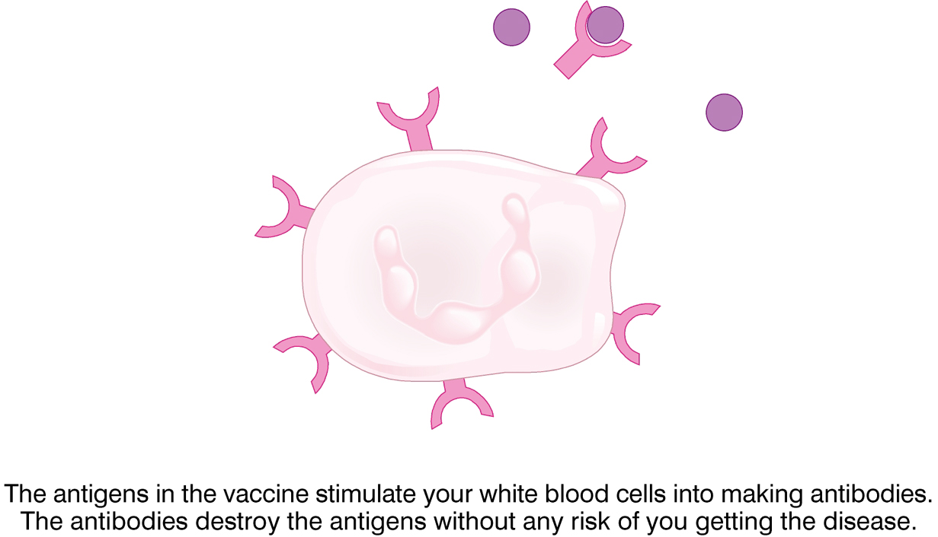
Step 2
Antibody
White blood cell
Antigen

Slide 14
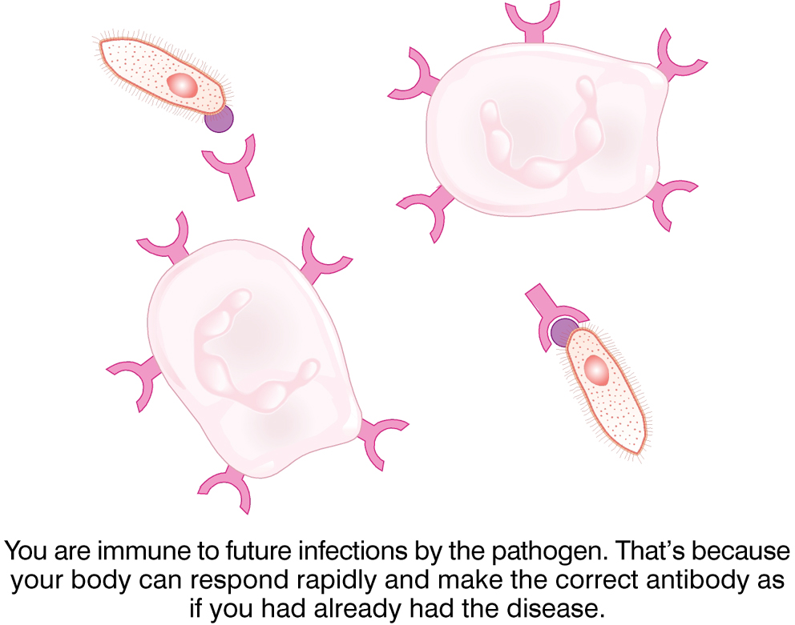
Step 3

Slide 15
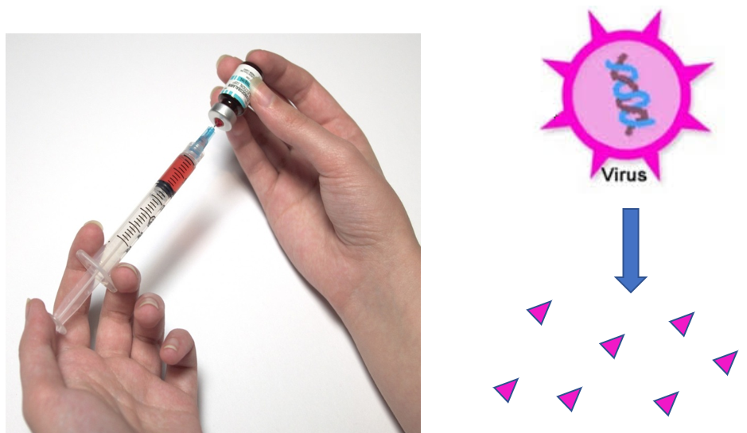
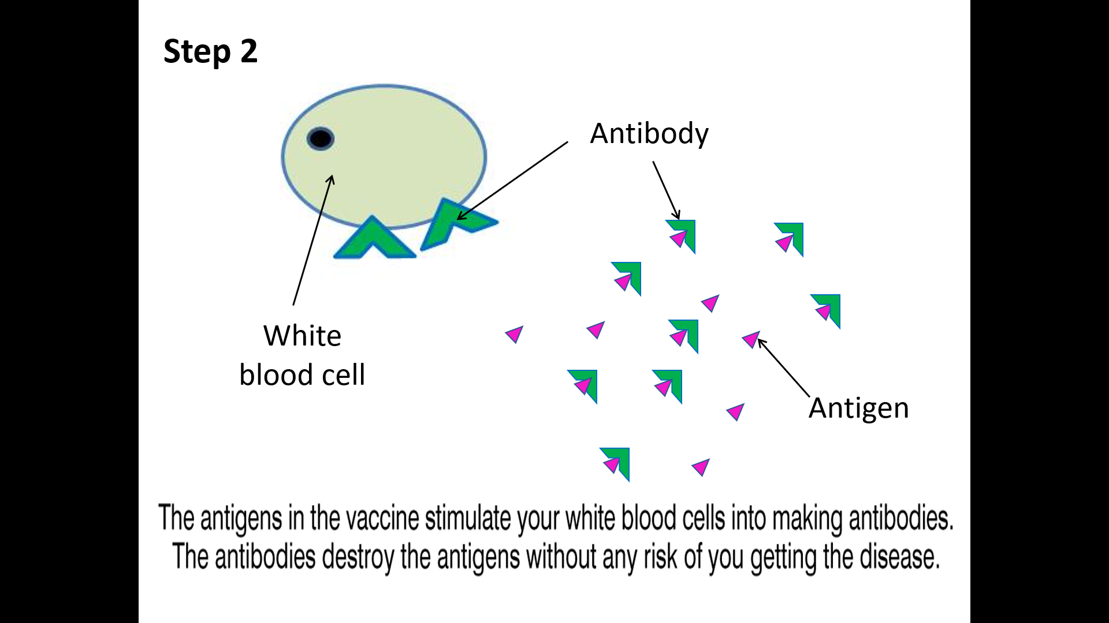

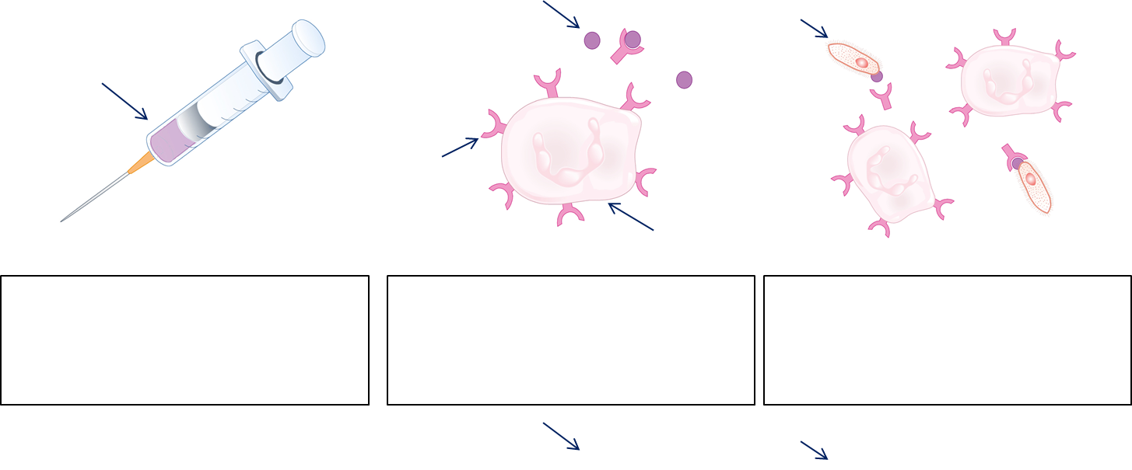
Task: Complete the cartoon strip to describe how a vaccination works. Use the key words to complete the captions and label the diagram:
pathogen
white blood cell
antibody
antigen
vaccine

Slide 16
Self-assessment:
Small amounts of dead or inactive pathogen are introduced to the body usually by injection
The antigens in the vaccination stimulate your white blood cells to make the correct antibodies to destroy the pathogen without the risk of becoming ill
If you are ever exposed to the same pathogen in the future your white blood cells can rapidly make the correct antibodies so you are immune

Slide 17
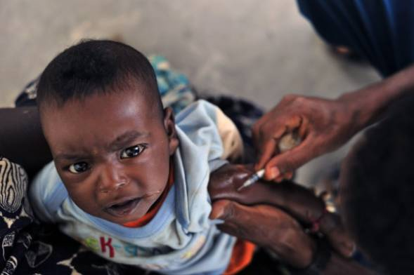
Every medicine has risks:
Children can have bad reactions which can result in death.
Defects
Side effects
Benefits:
More immunity – herd immunity
Less death from horrible and deadly diseases.
Task: What do you know about herd immunity? Discuss in pairs what you already know or what you think this term might mean!

Slide 18
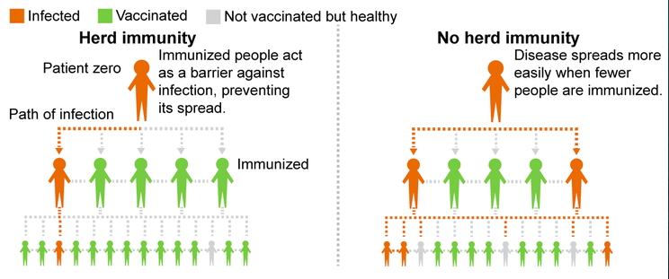
Task: Read the information on herd immunity and answer the following questions:
Give a definition of herd immunity
Explain what happens within a community if there is a drop in vaccination rates. Include an example.
(2 marks)
(3 marks)
Notes:
Image by Mmmkayshea (Own work) [CC BY-SA 4.0 (https://creativecommons.org/licenses/by-sa/4.0)], via Wikimedia Commons

Slide 19
Self-assessment:
If a large proportion of the population is immune to a disease, the spread of the pathogen in the population is very much reduced and the disease may even disappear.
If the number of people taking up a vaccine falls significantly, the herd immunity is lost and the disease can reappear as it spreads much more quickly. E.g. people were scared the whooping cough vaccine was unsafe so stopped vaccinating and it came back and killed many children in the 1970’s
(2 marks)
(3 marks)
Notes:
Image by Mmmkayshea (Own work) [CC BY-SA 4.0 (https://creativecommons.org/licenses/by-sa/4.0)], via Wikimedia Commons

Slide 20

Plenary: Using as many of they key words below as possible, describe how a vaccination works on a post it note
pathogen
antibody
white blood cell
vaccine
antigen

Slide 21
Resources

Slide 22
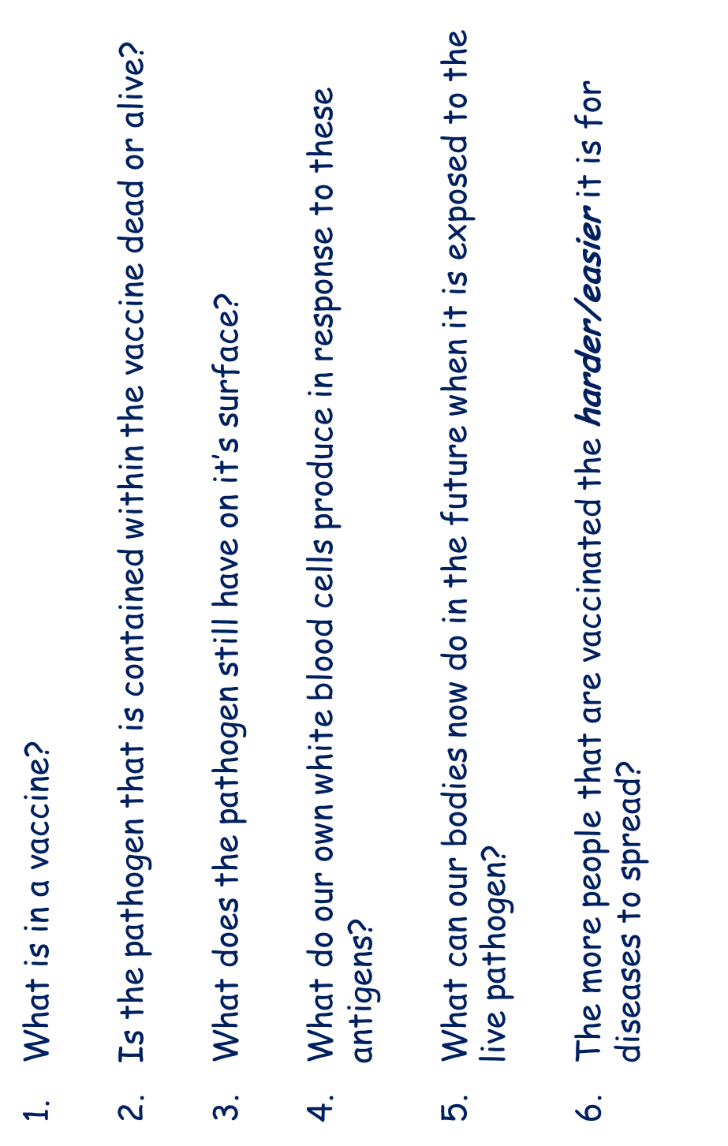

Slide 23
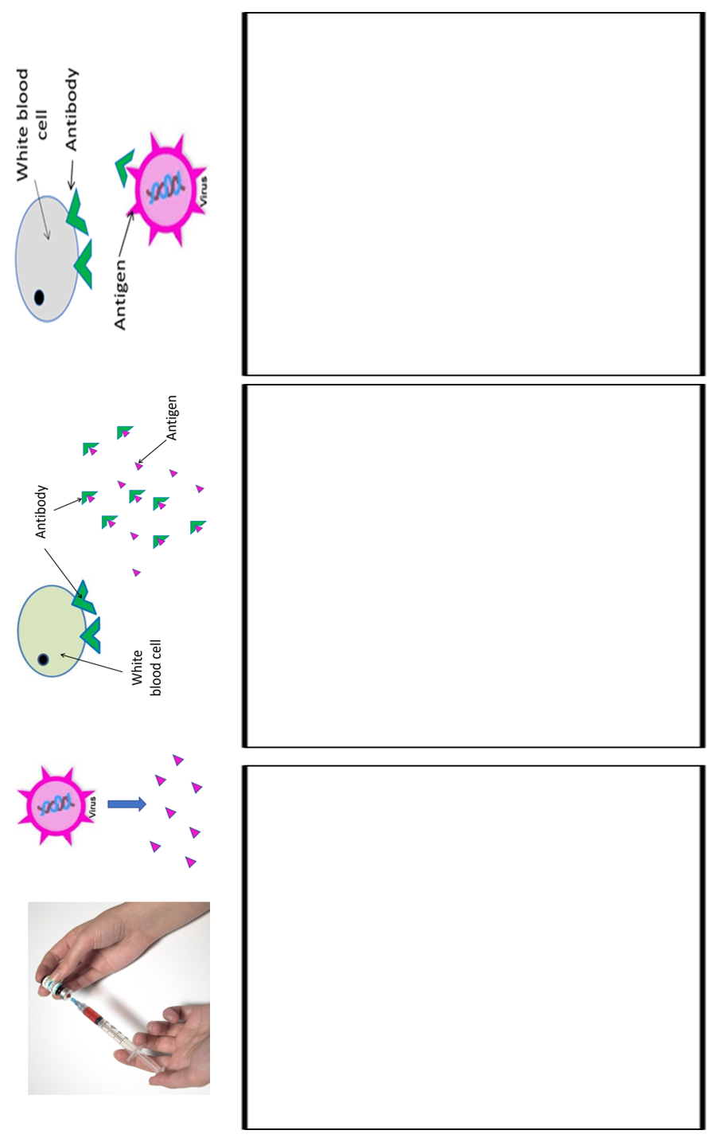

Slide 24
Herd Immunity
If a large proportion of the population is immune to a disease, the spread of the pathogen in the population is very much reduced and the disease may even disappear. This is known as herd immunity. If, for any reason, the number of people taking up a vaccine falls, the herd immunity is lost and the disease can reappear. This is what happened in the UK in the 1970’s when there was a scare about safety of the whooping cough vaccine. Vaccination rates fell from over 80% to around 30%. In the following years, thousands of children got whooping cough again and a substantial number died. Yet the vaccine was as safe as any medicine. Eventually people did realised this and enough children were vaccinated for herd immunity to be effective again.
Herd Immunity
If a large proportion of the population is immune to a disease, the spread of the pathogen in the population is very much reduced and the disease may even disappear. This is known as herd immunity. If, for any reason, the number of people taking up a vaccine falls, the herd immunity is lost and the disease can reappear. This is what happened in the UK in the 1970’s when there was a scare about safety of the whooping cough vaccine. Vaccination rates fell from over 80% to around 30%. In the following years, thousands of children got whooping cough again and a substantial number died. Yet the vaccine was as safe as any medicine. Eventually people did realised this and enough children were vaccinated for herd immunity to be effective again.
Notes:
Image by Mmmkayshea (Own work) [CC BY-SA 4.0 (https://creativecommons.org/licenses/by-sa/4.0)], via Wikimedia Commons

