Slide 1
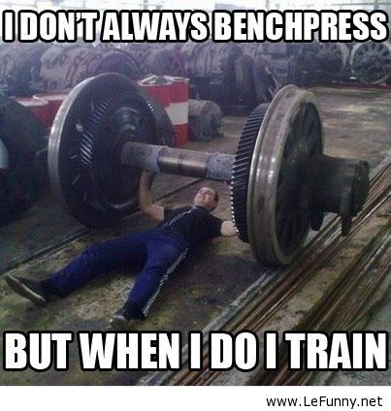
Fitness Components & Methods of training
DNA
With your shoulder partner give them 10 seconds and see how many components of fitness they can name, then your turn with methods of training

Slide 2
Title: Health and Fitness
Health – not merely the absence of illness or disease. For you to be classed as healthy you need to have developed each of the following components
Physical well-being
Mental well-being
Social well-being
One part of good health is FITNESS
Fitness – the ability to meet the demands of the environment.
Health and fitness is achieved by doing exercise
Exercise – the participation in an activity that requires effort which exerts your muscles in order to sustain or improve your health and fitness.
You health and fitness will effect your performance
Performance– is how well a task is completed

Slide 3
Health and Fitness
Health – not merely the absence of illness or disease. For you to be classed as healthy you need to have developed each of the following components
Physical
Mental
Social
Increase cardiovascular fitness
Increase in strength
Increased in muscular endurance
Increased flexibility
Increase in body composition
Improved performance
Relieve or prevent stress / tension
Psychological challenge (can I do it?)
Increase in self-esteem and confidence
Help the individual feel good
Appreciate an improved body shape / composition
Contribute to the enjoyment of life
Mix with others
Make new friends
Develop teamwork / co-operation skills
Work with others

Slide 4
The link
Fitness
Exercise can increase fitness.
If you are fitter you can exercise more
Being fit will help you perform better
Poor health can effect your fitness as you cannot train
Keeping fit helps keeps you physically healthy
Exercise
Performance
Exercise can improve your health.
If you are healthy you can exercise more
Being In good health can help you perform well
Health

Slide 5
Fitness Components-
Title: Revision – Fitness Components
Components of Skill Related Fitness
Components of Health Related Fitness

Slide 6
Fitness Components-
You need to know the Definition OF EACH!!!!...
Task: write down a definition for each
Cardiovascular Fitness (aerobic endurance)
Agility
Muscular Endurance
Balance
Coordination
Flexibility
Components of Health Related Fitness
Components of Skill Related Fitness
Power
Reaction Time
Body Composition
Muscular Strength
Speed

Slide 7
Fitness Components-
The ability to exercise the entire body for long periods of time
The ability to change the position of the body quickly
The ability to keep the body’s centre of mass above the base of support
The ability to use muscles many times without getting tired
Cardiovascular Fitness (aerobic endurance)
The ability of your joints to move through their full range
Agility
The ability to use 2 or more body parts together
Muscular Endurance
Balance
Coordination
Flexibility
Components of Skill Related Fitness
Components of Health Related Fitness
Power
Reaction Time
Muscular Strength
The ability to perform strength quickly
Body Composition
The time it takes to react to a stimulus
The percentage of body weight which is fat, muscle and bone
The amount of force a muscle can exert against a resistance
Speed
The ability to cover a distance quickly in a period of time

Slide 8
Fitness Testing – Name the tests
Cardiovascular Endurance & aerobic endurance:
Flexibility:
Muscular Strength:
Muscular Endurance:
Power:
Agility:
You need to know the METHOD OF EACH!!!!
Speed

Slide 9
Fitness Testing -
Cardiovascular Endurance & (AE):
12min Copper run test
Harvard step test
Flexibility:
Sit and Reach
Muscular Strength:
Hand grip dynamometer test
Muscular Endurance:
One min press up
One min sit up
Power:
Vertical Jump Test
Agility:
Illinois Agility Run
You need to know the METHOD OF EACH!!!!
Speed
30m Sprint

Slide 10
Why we do Fitness Test:
To see how fit you are
To see what you need to improve
To see what you are good at
Give you a target
Monitor Progress
To compare yourself to normative data from across the country world
Give your training a focus

Slide 11
1) Choose the right test
When thinking of fitness tests….
If you want to test your flexibility – do the sit and reach test!!!!!
If there is more then one fitness test for the component you want to test, think about the S&W of each test.
2) Follow the method for performing the test
Use the correct equipment and the standard method to make sure it is valid and reliable.
If you do not follow the method correctly the results will not be correct either.
3) Be safe – follow the pre test procedures
When you carry out fitness tests you need to do certain things to follow the correct protocol and guidelines …
Check Equipment and calibrate (if needed)
Sign a consent form that tells them exactly what they going to do
Understand that they can stop the tests at any point

Slide 12
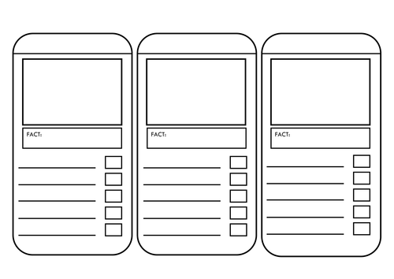
Continuous Training
Fartlek Training
Circuit Training
Fitness Class:
Body Pump
Fitness Class:
Aerobics
Fitness Class:
Pilates
Interval Training
Plyometric Training
Weight/resistance Training
Methods of Training
FACT: = Characteristics
of the method of training.
Then give advantages & disadvantages
Fitness Class:
Yoga
Fitness Class:
Spinning

Slide 13
Interval
Progress Indicators
Good progress: to be able to recall most of the principles of training and know some of the types of training
Excellent progress: to be able to recall all of the principles of training and know some of the advantages and disadvantages of the different types of training
Continuous
Definition:
Definition:
It uses fixed patterns of high intensity exercise and either low intensity exercise or rest. It has a strict structure
Training at constant rate for at least 20 min with no break
Component it improves:
Cardiovascular endurance
Anaerobic fitness
High intensity = Speed
Component it improves:
Cardiovascular endurance
Muscular endurance
Body composition
Keeping HR in the Aerobic zone = 60-80%HRM
Advantages
Disadvantages
Advantages
Disadvantages
Easy to adapt to improve aerobic or anaerobic by changing the intensity and length of work and recovery
It can be hard – you need to be able to mentally push yourself – some people cant
Easy to do – run doesn't’t need specialist equipment
No rest helps prepare you for doing long periods of play in sport
It only improves aerobic not anaerobic fitness
It can be boring doing the same thing

Slide 14
Fartlek
Progress Indicators
Good progress: to be able to recall most of the principles of training and know some of the types of training
Excellent progress: to be able to recall all of the principles of training and know some of the advantages and disadvantages of the different types of training
Resistance
Definition:
Definition:
Similar to continuous training, but involves changes in the intensity over different intervals through speed or terrain
Using your muscles against a resistance. Weight training is when you use a weight to do this
Component it improves:
Cardiovascular endurance
Muscular Endurance
Speed
Component it improves:
Strength –
high resistance – low reps
Muscular Endurance –
Low resistance – high weights
Advantages
Disadvantages
Advantages
Disadvantages
Its easily adapted to suit different sports – so you can focus on the relevant muscles
Some of the exercises require very little equipment
It puts muscles under high stress levels, so can leave them very sore after
It is very adaptable, so you can make it fit to your training needs of your sport
Lots of changes to intensity an make it lack structure, so it is is easy to skip the hard buts
Hard to monitor progress

Slide 15
Circuit
Progress Indicators
Good progress: to be able to recall most of the principles of training and know some of the types of training
Excellent progress: to be able to recall all of the principles of training and know some of the advantages and disadvantages of the different types of training
Plyometric
Definition:
Definition:
Performing a series of exercises in a special order
Exercises where muscles use maximum force in short intervals of times
Component it improves:
You can plan for it to improve different areas
Component it improves:
Power
speed
Advantages
Disadvantages
Advantages
Disadvantages
It’s the only form of training that directly improves power
It puts muscles under high stress levels, you need to be fit to do it otherwise you could get injured
Takes a while to set up
Can require a lot of equipment and space
Made to suit your needs
Adds variety so it keeps it interesting

Slide 16
Fitness Classes
Fitness that is in a class making it more social and fun
Body pump
Aerobics
Pilates /Yoga
Spinning
Definition:
Definition:
Definition:
Definition:
Choreographed workout that combines weight training and aerobics
Doing aerobic activity to music
High intensity workout using exercise bikes which is set to different levels of resistance
Series of exercises and stretches that help you
Component it improves:
Component it improves:
Component it improves:
Component it improves:
Strength
Muscular endurance
Cardiovascular endurance
Cardiovascular endurance
Strength
Flexibility
Strength
Flexibility
Balance
Cardiovascular endurance
Anaerobic fitness
Advantages
Disadvantages
Progress Indicators
Good progress: to be able to recall most of the principles of training and know some of the types of training
Excellent progress: to be able to recall all of the principles of training and know some of the advantages and disadvantages of the different types of training
More social
Makes it fun
Sometimes they wont improve specific components for sport

Slide 17
Homework
Task 1
Complete the method of training task from this lesson into your purple book.
Task 2 (write out and answer the below exam question)
Edward is a keen runner and and wants to take part in an upcoming long distance cycle and Howard is boxer. Explain how their training would differ and how you could test their progress (9)

