Slide 1
Welcome to Science!
On the front of your book you need…
Your Name . Science . Miss Osmond .
Notes:
Lower Ability

Slide 2
Every Lesson Expectations
Your planners must be on your desk open to the right week.
You must have the CW underlined in the top left hand corner of your book.
You must have the date and title underlined.
You start your DNA activity straight away.
CW
9th September 2020
Plant and Animal Cells
DNA:
Notes:
Lower Ability

Slide 3
Animal and Plant Cells
Do now activity:
What are some structures that make up either animal or plant cells?
Sort the organelles into three groups; animals only, plants only, both animal and plants
Can you describe the function of any of these organelles?
Key Words
Organelle
Structure
Function
Animal
Plant
Algae

Slide 4
Progress indicators
GOOD PROGRESS: Identify the organelles found with an animal and a plant cell
OUTSTANDING PROGRESS: Describe the role of the structures found with an animal and a plant cell and describe the order of size of a cell, nucleus, chromosome and gene.

Slide 5
All living things are made of cells.
Animal and plant cells share some similarities and differences.
Task: Watch the video to recap key ideas of plant and animal cells from Year 7&8 to help you complete the levelled questions.
https://www.youtube.com/watch?v=oTOOZ4kov9k

Slide 6
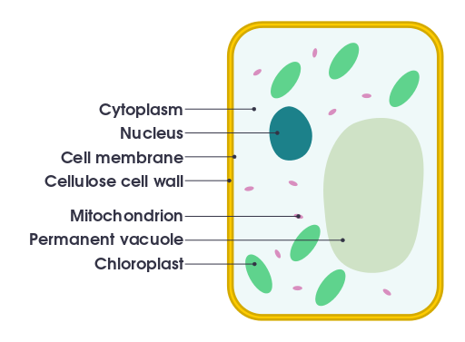
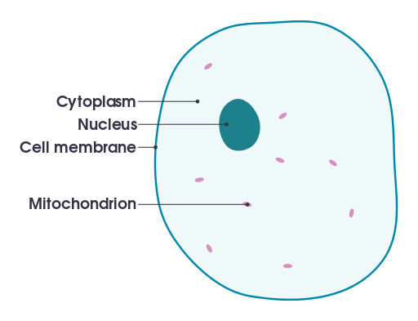
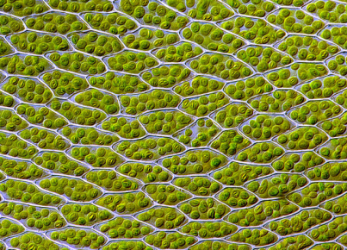
List three structures that are found in animal cells and also in plant cells
List three structures that may be found in plant cells but not in animal cells
3. Copy and label the diagrams below to identify the organelles present in animal and plant cells:
Grade 4
Grade 5
Grade 6
4. Complete the table below to show to show :
5. Look at the diagram of the algal cells, as seen down a microscope. The cells of algae are very similar to plants. How do you think this particular alga, called Spriogyra, might feed?
Structure | Present in an animal cell? | Present in a plant cell? | Function
Nucleus | Yes | Yes | Controls the activity of the cell
Cytoplasm
Cell Membrane
Mitochondria
Ribosome
Cell Wall
Vacuole
Chloroplast
Grade 7/8
____________________________________________________________________________________________________________________________________________
8/9
Peer assessment: What grade did they achieve? What do they do well? What more could they have done to reach a higher grade?
___________________________________________________________________________________________________________________________________________________________________________________________________________________________________________________________________________________________________________________________
Notes:
Images: Animal cell & plant cell by domdomegg licensed under CC-by-SA 4.0

Slide 7
Task: Peer-assess your work
List three structures that are found in animal cells and also in plant cells
List three structures that may be found in plant cells but not in animal cells
Cytoplasm, mitochondria, cell membrane, nucleus, ribosome
Vacuole, Cell Wall, Chloroplast

Slide 8
Notes:
Images: Animal cell & plant cell by domdomegg licensed under CC-by-SA 4.0

Slide 9
Structure | Present in an animal cell? | Present in a plant cell? | Function
Nucleus | Yes | Yes | Controls the activity of the cell
Cytoplasm | Yes | Yes | Where metabolic reactions occur
Cell Membrane | Yea | Yes | Controls what enter and leaves the cell
Mitochondria | Yes | Yes | Site of respiration, energy release
Ribosome | Yes | Yes | Site of protein synthesis
Cell Wall | No | Yes | Strengthens the cell
Vacuole | No | Yes | Contains cell sap, maintains turgidity of cell
Chloroplast | No | Yes | Site of photosynthesis, absorbs light energy to make food

Slide 10
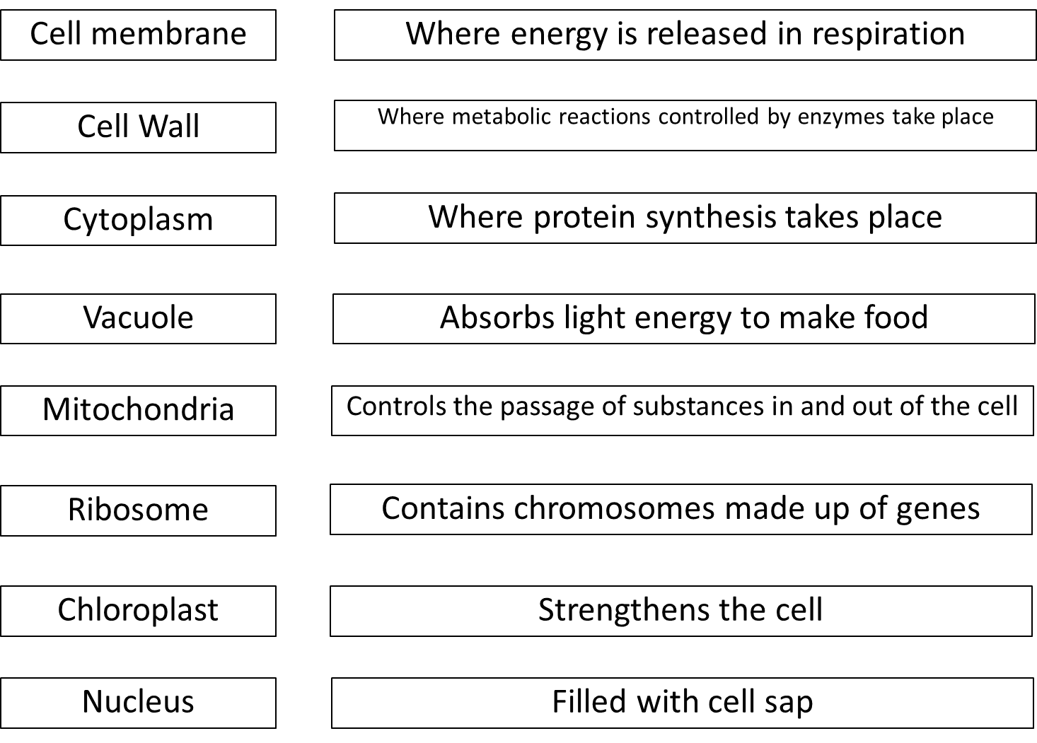
Revision Task: Copy the table and match the organelle to it’s function

Slide 11
Plenary: Assessment Task: COVER YOU WORK and complete this exam-style question:
An animal cell contains three organelles, name these organelles and explain the function of each of them 6 marks
Describe the role of the following plant organelles: chloroplast, vacuole and cell wall.
3 marks
9 mark question

Slide 12
Cytoplasm – this is where the chemical reactions take place within the cell
Cell membrane – this allows substances to enter and leave the cell / helps keep the shape of the cell
Nucleus – controls the activity of the cell / contains the genetic material (DNA/genes/chromosomes) 6 marks
Chloroplast – contains chlorophyll / absorbs light energy to carry out photosynthesis
Vacuole - contains cell sap & excess water / keeps the cell turgid
Cell wall – supports the cell / makes sure the cell remains rigid
3 marks

Slide 13
Cell membrane
Where energy is released in respiration
Cell Wall
Where metabolic reactions controlled by enzymes take place
Cytoplasm
Where protein synthesis takes place
Vacuole
Absorbs light energy to make food
Mitochondria
Controls the passage of substances in and out of the cell
Ribosome
Contains chromosomes made up of genes
Chloroplast
Strengthens the cell
Nucleus
Filled with cell sap

