Slide 1
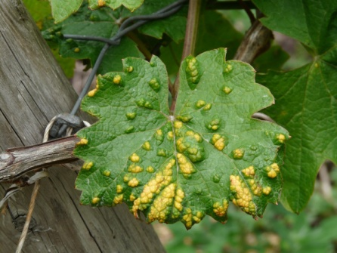
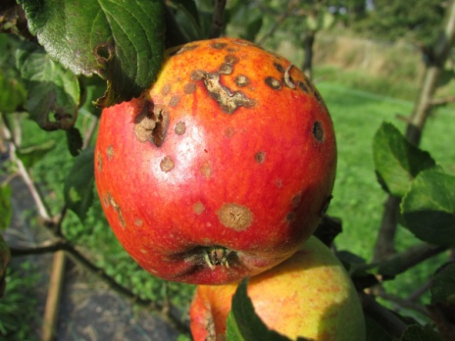
Plant Diseases & Responses
Do now activity:
Name a plant disease that we have studied in the course so far
Describe some of the symptoms of this disease
What other symptoms might plants display if they are infected with a pathogen?

Slide 2
Progress indicators
GOOD PROGRESS:
Describe how mineral deficiency can cause disease in plants
Describe and explain how plants have evolved mechanisms to defend against pathogens and herbivores
OUTSTANDING PROGRESS:
Explain how you might detect plant diseases

Slide 3
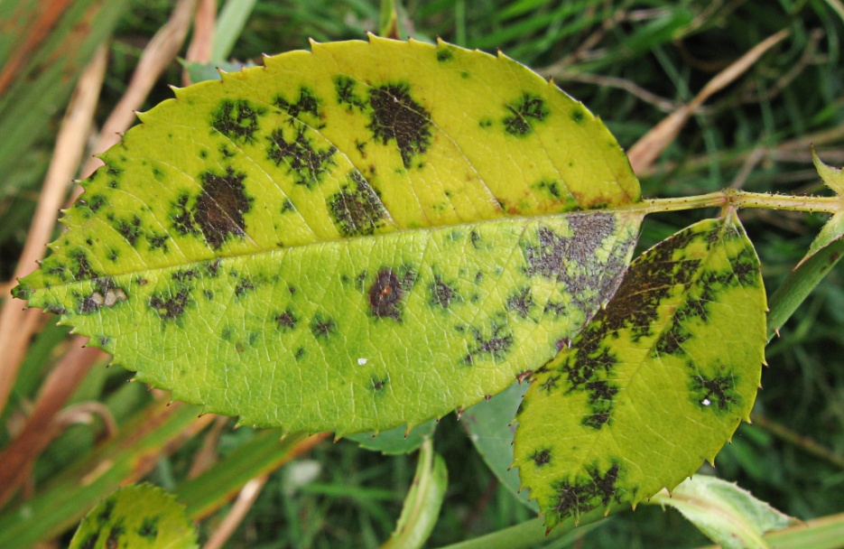
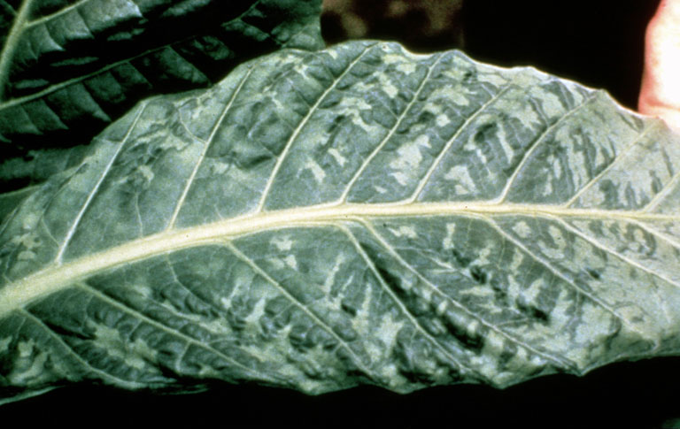
Rose black spot
- purple/black spots on the leaves
Tobacco Mosaic Virus
- ‘mosaic’ pattern of discolouration on the leaves
Notes:
Image of TMV: By R.J. Reynolds Tobacco Company Slide Set [Public domain], via Wikimedia Commons

Slide 4
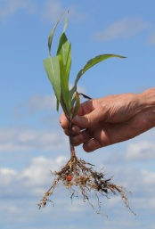
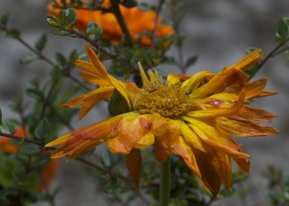
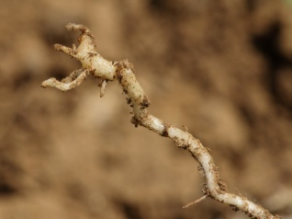
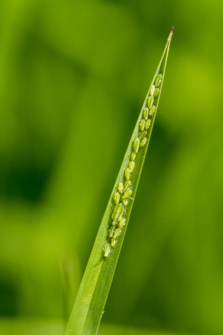
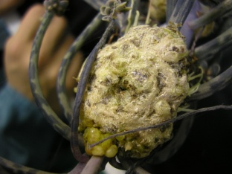
What other signs/symptoms might you expect to see in plants which are infected with a pathogen?
Stunted growth
Spots on leaves
Areas of decay/rotting
Signs/symptoms of plant disease
Malformed stems, leaves & roots
Presence of visible pests
Discolouration
Growths
Notes:
Stunted growth image by Alandmanson (Own work) [CC BY 4.0 (http://creativecommons.org/licenses/by/4.0)], via Wikimedia Commons
Malformed stem, roots and leaves by Alandmanson (Own work) [CC BY-SA 4.0 (https://creativecommons.org/licenses/by-sa/4.0)], via Wikimedia Commons

Slide 5
It is important to detect the cause of plant disease in plants very early on so that treatment can starts straight away, which makes it more likely to be successful.
There are many ways people can diagnose plant diseases:
Diseases in the garden can be identified by comparing symptoms to those described in gardening manuals or online
With crop plants or forest trees, experts may visit the field/woodland to take samples which can then be taken to a lab to undergo DNA analysis. This would help to identify the specific pathogen causing the problem.
Plant scientists, foresters, farmers and market gardeners can use testing kits which contain monoclonal antibodies to identify the presence of pathogens quickly and easily.

Slide 6
Mineral deficiency in plants
Some plant diseases are a result of mineral deficiencies in the soil where the plant is growing. They are non-communicable – which means they are not passed from one plant to another.
Task: Each student will be given a slip of information about a specific mineral. Talk to each other to complete the following table:
Mineral | Why it is needed by the plant | Symptoms if the plant is deficient of this mineral
Nitrates
Magnesium
Potassium

Slide 7
Self-assessment:
Mineral | Why it is needed by the plant | Symptoms if the plant is deficient of this mineral
Nitrates | Needed to convert sugars made during photosynthesis into proteins which the plants need for growth. | Symptoms of nitrate deficiency include stunted growth, upper leaves pale green and lower leaves yellow and dead.
Magnesium | This mineral ion is needed for the synthesis of chlorophyll in the plant. Chlorophyll is needed for photosynthesis. | Lack of magnesium means less chlorophyll will be made. Therefore, a symptom of magnesium deficiency is yellowing leaves (chlorosis) and growth slows down.
Potassium | This ion is needed for the plant to produce flowers and fruit. | Symptoms of potassium deficient plants include poor growth of flowers and fruit, yellow leaves and dead spots.

Slide 8
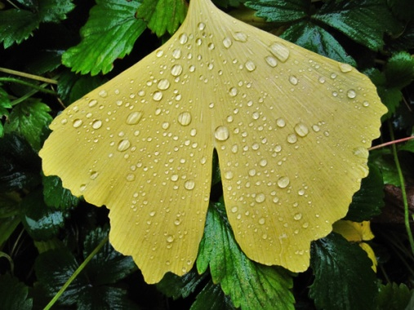
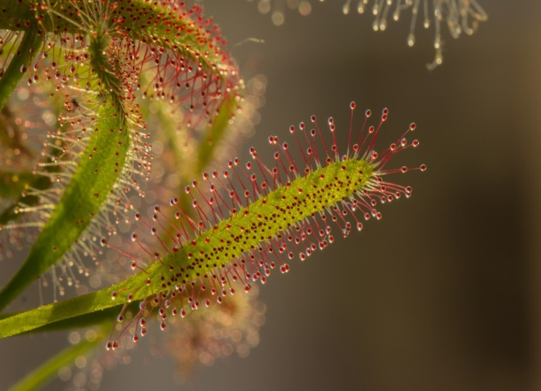
Plant defence responses
Think > Pair > Share: in what ways do you think plants might defence themselves against pathogens or predators?

Slide 9
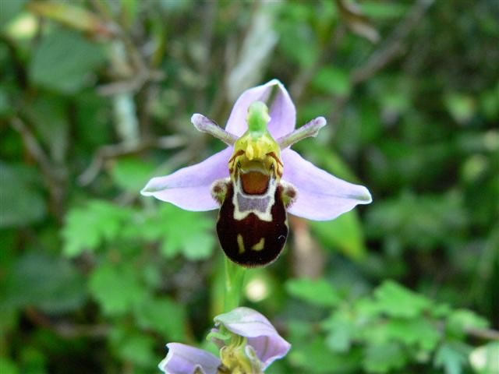
Task: You are going to be given a card sort of the methods plants use to defend against pathogens or herbivores. You will need to sort the cards into the following columns:
Physical Barriers
Chemical Barriers
Defence against herbivores

Slide 10
Self-assessment:
Physical Barriers
Chemical Barriers
Defence against herbivores
Cellulose cell walls
Waxy cuticle
Bark on trees
Antibiotics
Poisons
Thorns
Hairy stems/leaves
Mimicry
Drooping/curling of leaves

Slide 11
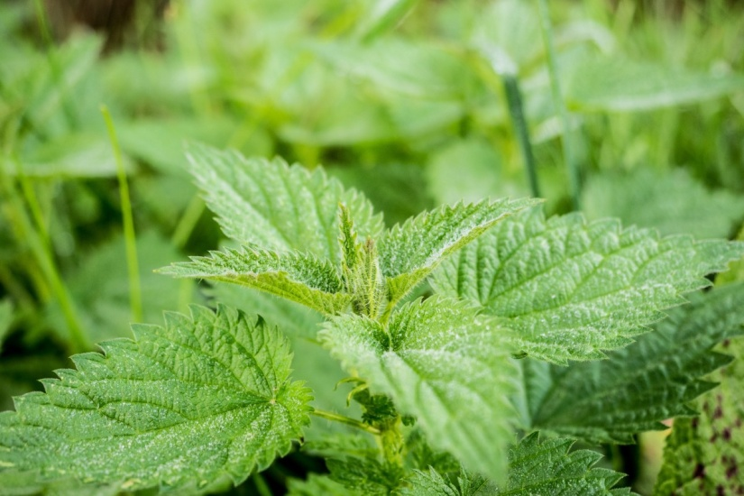
Exam-style questions:
1. Plants have adaptations to help defend themselves and to help them to survive.
Explain how this nettle is adapted for defence and protection.
(3 marks)
2. A gardener is looking at plants in his greenhouse.
Some of the plants have a disease. Give 2 ways in which the gardener could identify the pathogen infecting his plants. (2 marks)
Plants can become unhealthy if they do not have essential mineral ions
Describe the appearance of plants with:
Nitrate deficiency
Magnesium deficiency
(2 marks)

Slide 12
Self-assessment:
1.
It can sting organisms that touch it / by use of stinging hairs
This harms herbivores / stops animals eating them
Less of the plant is removed / damaged
2.
Compare them to diagrams from a gardening manual / website
Send to a laboratory to be tested
Stunted growth due to lack of nitrates
Yellowing of leaves due to lack of magnesium

Slide 13
Plenary: 3-2-1
3 key words
2 facts
1 question – to test your peers!

Slide 14
Cellulose cell walls | Cellulose cell walls strengthen the plant cell to help resist invasion by microorganisms.
Waxy cuticle | This covers the surface of the leaf of the plant and act as a barrier for the entry of microorganisms. It is the underside of the leaf where the stomata are where pathogens can gain entry.
Bark on the trees | A layer of dead cells on the outside of the stems form a protective layer that is hard for pathogens to penetrate.
Antibiotics | Many plants produce antibacterial chemicals that protect them against invading pathogens. These are very effective at preventing bacterial disease in plants.
Poisons | These can be produced by some plants to deter herbivores from eating them. Animals will quickly learnt to avoid eating plants that make them feel unwell.
Thorns | These make it unpleasant or painful for large herbivores to eat them.
Hairy Stems | Hairy stems or leaves deter insects and larger animals from feeding on them or laying eggs on the stem or leaves.
Drooping or curling when touched | This is a rare but effective mechanism, when touched the leaves will automatically curl which can dislodge insects and frighten off larger species.
Mimicry | Some plants can droop to look as though they are diseased and trick animals into not eating them. They can also resemble larger insects to scare away any potential threats.

Slide 15
Nitrates | Needed to convert sugars made during photosynthesis into proteins which the plants need for growth. | Symptoms of nitrate deficiency include stunted growth, upper leaves pale green and lower leaves yellow and dead.
Magnesium | This mineral ion is needed for the synthesis of chlorophyll in the plant. Chlorophyll is needed for photosynthesis. | Lack of magnesium means less chlorophyll will be made. Therefore, a symptom of magnesium deficiency is yellowing leaves (chlorosis) and growth slows down.
Potassium | This ion is needed for the plant to produce flowers and fruit. | Symptoms of potassium deficient plants include poor growth of flowers and fruit, yellow leaves and dead spots.
Nitrates | Needed to convert sugars made during photosynthesis into proteins which the plants need for growth. | Symptoms of nitrate deficiency include stunted growth, upper leaves pale green and lower leaves yellow and dead.
Magnesium | This mineral ion is needed for the synthesis of chlorophyll in the plant. Chlorophyll is needed for photosynthesis. | Lack of magnesium means less chlorophyll will be made. Therefore, a symptom of magnesium deficiency is yellowing leaves (chlorosis) and growth slows down.
Potassium | This ion is needed for the plant to produce flowers and fruit. | Symptoms of potassium deficient plants include poor growth of flowers and fruit, yellow leaves and dead spots.

