Slide 1
DNA- Complete Connect activity in your books
Monday 20th January 2020
Cardiovascular system
Good Progress | Outstanding Progress
TBAT describe the structure and function of the different blood vessels | TBAT explain the effects of exercise on the circulatory system & blood pressure
TBAT identify the different blood vessels in the body | TBAT describe the structure and function of the different blood vessels

Slide 2
Annotate the drawings, what do you think they are? What are the differences?

Slide 3
Arteries, Veins and Capillaries carry blood
Artery
Veins
Capillaries
Arterioles branch off from arteries and venues which meet to form veins
Carries blood Away from the heart
Exchanges oxygen, nutrients and CO2
Deoxygenated
Has valves
High pressure
One cell thick
Oxygenated
Thin wall
Large lumen
Very thin walls
Lumen (inside space) changes shape during exercise
Thick muscle
Thin muscle
Fix it-green pen it
Strong pulse
Low pressure
No pulse

Slide 4
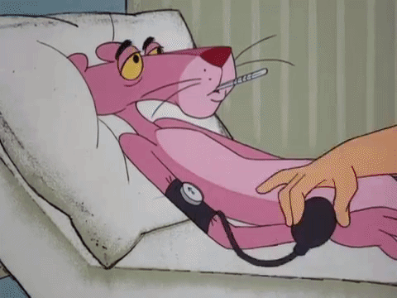
Blood pressure: where is this measured?
It’s measured in an artery
Normal blood pressure is around 120/80
This means that when your heart contracts the pressure in the artery is 120mm (systolic)
Squeeze
When the heart relaxes the pressure is 80mm
(diastolic)

Slide 5
What causes high blood pressure?
Smoking (as smoking can act as a stimulant)
Poor diet intake (high salt)
High cholesterol (Low Density Lipoproteins / LDL)
Stress
If it is recorded during or just after exercise

Slide 6
Write down ways in which HIGH blood pressure can be reduced?
To reduce high blood pressure you must…..
Effects of high blood pressure
Heart attack
Strokes
Decrease stress
avoid worrying situations
regular exercise
less salt and don’t smoke
decrease LDL in diet
Blood pressure = DONE!!!!

Slide 7
Cardiac Output
What's this got to do with blood pressure?
What is
Cardiac Output = Stroke Volume x Heart Rate
(ML/MIN) (ML) (BPM)
Cardiac Output is the amount of blood pumped out of the heart PER MINUTE (5 litres)
Stroke Volume is the amount of blood pumped out of the heart PER BEAT (70ml)
Heart Rate is the number of times the heart beats PER MINUTE (75bpm)

Slide 8
DEMONSTRATE:
How is cardiac output affected during exercise?

Slide 9
Mark Scheme
How is cardiac output affected during exercise?
Explains and describes why it is important
States (correct) formula and definition of all
Explains what happens during exercise
0-2
3-4
5-6

Slide 10
Home learning:
What is HDL and LDL? How can this effect your Blood Pressure?

