Slide 1
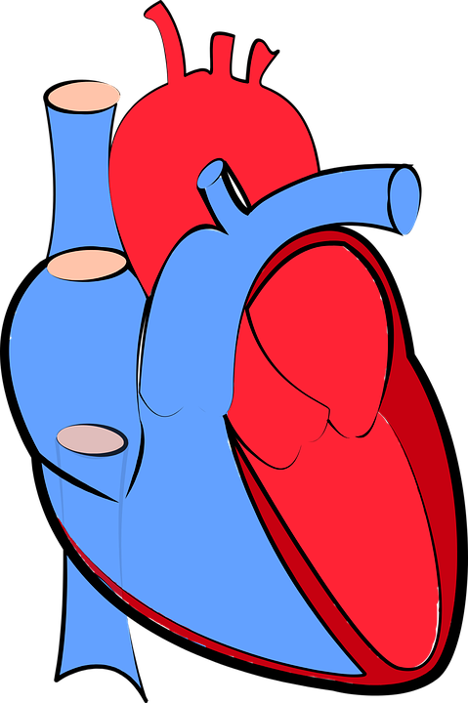
The heart
Do Now activity:
Identify the role of the arteries, veins and capillaries
Why do veins need valves but arteries do not?
Explain the role of the systemic and pulmonary circulation in the double circulatory system.

Slide 2
Progress indicators
GOOD PROGRESS:
- Identify and label the parts of the heart
- Describe the journey of the blood through the heart
OUTSTANDING PROGRESS:
- Explain how the structure of each part of the heart is related to its function

Slide 3
The heart
= a muscular organ that pumps blood around the body
through repeated rhythmic contractions
We need blood circulation to
• move glucose and other nutrients, oxygen,
carbon dioxide, hormones and urea to and from cells
• help fight disease
• help stabilize body temperature
Memory Test!
Task: You have 2 minutes to read through this information and try and remember it!

Slide 4
Key Words: carbon dioxide, disease, muscular, contractions, temperature
Task:
The heart is a __________ organ that pumps blood around the body through rhythmic ___________.
We need a blood circulation to:
Move glucose and other nutrients, oxygen, ________ __________, hormones and urea to and from the cells
Help fight __________
Regulate body ___________.

Slide 5
Answer:
muscular
The heart is a __________ organ that pumps blood around the body through rhythmic ___________.
We need a blood circulation to:
Move glucose and other nutrients, oxygen, ________ __________, hormones and urea to and from the cells
Help fight __________
Regulate body ___________.
contractions
carbon
dioxide
disease
temperature

Slide 6
Using the video clip and info sheet, annotate the
diagram of the heart on your worksheet.
Grade 3 Task
2. Answer the questions at the bottom of the page about the structure and function of the heart.
Grade 5 Task
Extra challenge Grade 7: Why do you think one side of the heart is shaded blue and the other side is shaded red? What does this represent?

Slide 7
https://www.youtube.com/watch?v=ruM4Xxhx32U
These are called the heart valves
Task: Think > Pair > Share
What do you think the importance of the heart valves actually are?
The heart valves are needed to control the flow of blood in one direction. As soon as the blood flows through a valve, it closes to stop blood flowing back in the wrong direction!

Slide 8
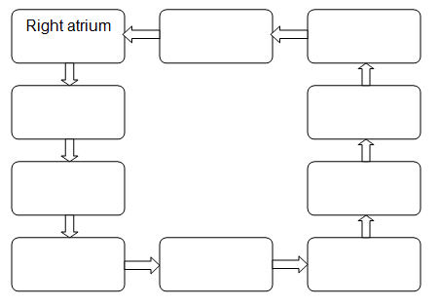
Task: Insert the correct term, from the list below into the flow diagram to show how blood circulates in the body. Start with blood in the right atrium
Pulmonary artery
Left ventricle
Aorta
Lungs
Left atrium
Right ventricle
Body
Vena cava
Pulmonary vein

Slide 9
Self-assessment:
Vena Cava
Body
Right ventricle
Aorta
Pulmonary artery
Left Ventricle
Pulmonary vein
Lungs
Left atrium

Slide 10
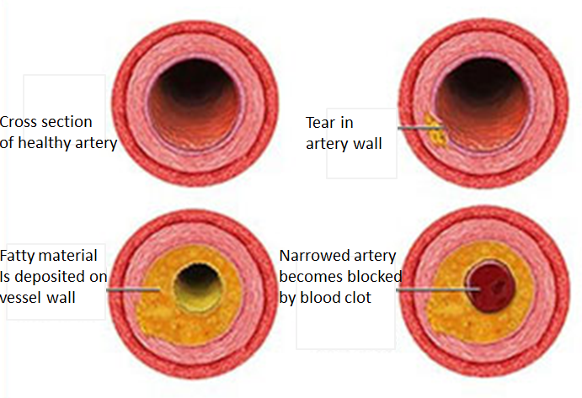
Problems with blood flow through the heart
Coronary arteries carry oxygenated blood to the heart muscle.
Cholesterol sticks to the wall of the artery which narrows the artery, preventing the flow of blood.
This can cause the blood to clot and block the vessel. This blockage is known as a thrombosis.
These blockages mean that there is a reduced flow of oxygen to the heart muscle, this can lead to chest pain, heart attack or even death.
Q1. Why does the muscle in the heart need oxygen?
Q2. Which other substance from the heart does the muscle tissue require?
Q3. What effect does a partially blocked coronary artery have on the heart compared to a fully blocked artery?
Self-assessment:
Q1. The muscle cells in the heart needs oxygen to carry out respiration. This provides energy to the heart tissue for contraction
Q2. The muscle cells in the heart also require glucose from the blood in order for respiration to be carried out
Q3. A partially blocked artery might lead to chest pains but a full blocked artery can lead to a heart attack and even death.
Notes:
Image by United States: Centers for Diseases Control and Prevention (https://www.cdc.gov/heartdisease/coronary_ad.htm) [Public domain], via Wikimedia Commons

Slide 11
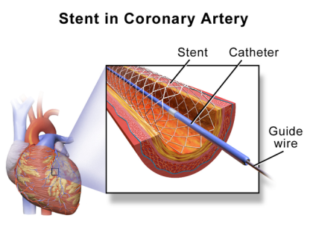
Surgery, statins and stents
Doctors can solve problems of coronary heart disease by a number of methods:
Bypass surgery – Doctors can replace narrow or blocked coronary arteries with bits of vein from other parts of the body. This works well for badly blocked arteries, the surgery is expensive and involves the risk associated with general anaesthetic
Statins – This is a very common drug for over 50’s to take, it reduced blood cholesterol levels and slows down the rate at which fatty deposits build up in the coronary arteries.
Stents – a stent is a metal mesh that is placed in the artery, a tiny balloon is used to open the stent and the blood vessel at the same time. The balloon is then removed but the stent remains, keeping the blood vessel open
Notes:
Image: By BruceBlaus. When using this image in external sources it can be cited as: Blausen.com staff (2014). "Medical gallery of Blausen Medical 2014". WikiJournal of Medicine 1 (2). DOI:10.15347/wjm/2014.010. ISSN 2002-4436. (Own work) [CC BY 3.0 (http://creativecommons.org/licenses/by/3.0)], via Wikimedia Commons

Slide 12
Quick Check
Describe what a stent is (2 marks)
Construct a table to identify the advantages and disadvantages of using a stent to improve the blood flow through the coronary arteries compared to bypass surgery (4 marks)
Notes:
Image: By BruceBlaus. When using this image in external sources it can be cited as: Blausen.com staff (2014). "Medical gallery of Blausen Medical 2014". WikiJournal of Medicine 1 (2). DOI:10.15347/wjm/2014.010. ISSN 2002-4436. (Own work) [CC BY 3.0 (http://creativecommons.org/licenses/by/3.0)], via Wikimedia Commons

Slide 13
Self-assessment:
A stent is a metal mesh that is placed in an artery. A tiny balloon is inflated to open up the blood vessel and the stent at the same time. The stent remains in the blood vessel, keeping it open to allow the smooth flow of blood.
Stents |  | Bypass Surgery
Advantages | Disadvantages | Advantages | Disadvantages
The procedure is quite straight forward, there is no need for patients to be under general anaesthetic which reduces the risk of complications. | This can be used for partially blocked coronary arteries but it is not a successful procedure for badly blocked arteries | This procedure can be used on arteries that have more severe blocks | It is an expensive procedure Patients will need to have portions of their veins removed from elsewhere in their body They will be under general anaesthetic which can be risky for more elderly patients

Slide 14
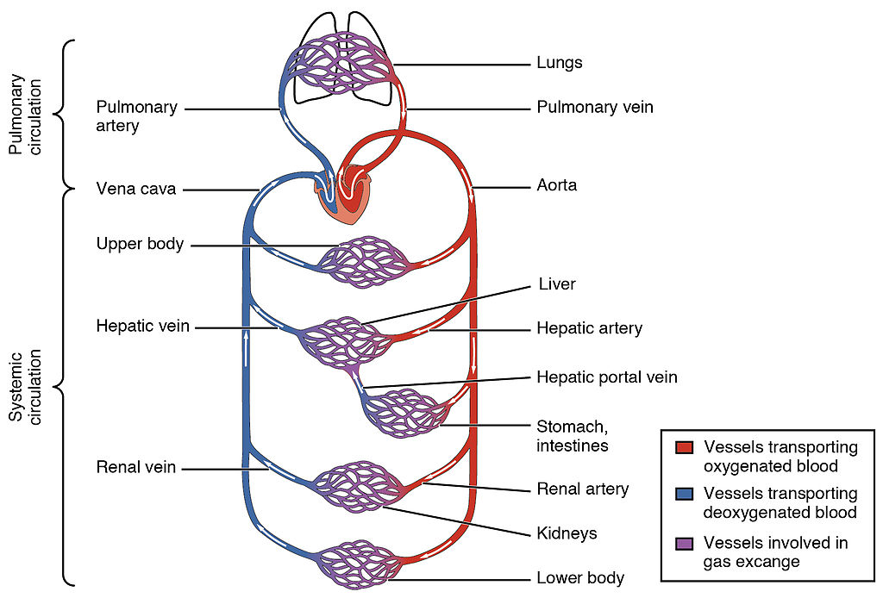
Plenary – Write a twitter message about something you have learnt about today!
#keywords
Notes:
Image: By OpenStax College - Anatomy & Physiology, Connexions Web site. http://cnx.org/content/col11496/1.6/, Jun 19, 2013., CC BY 3.0, https://commons.wikimedia.org/w/index.php?curid=30148241

Slide 15
Resources

Slide 16
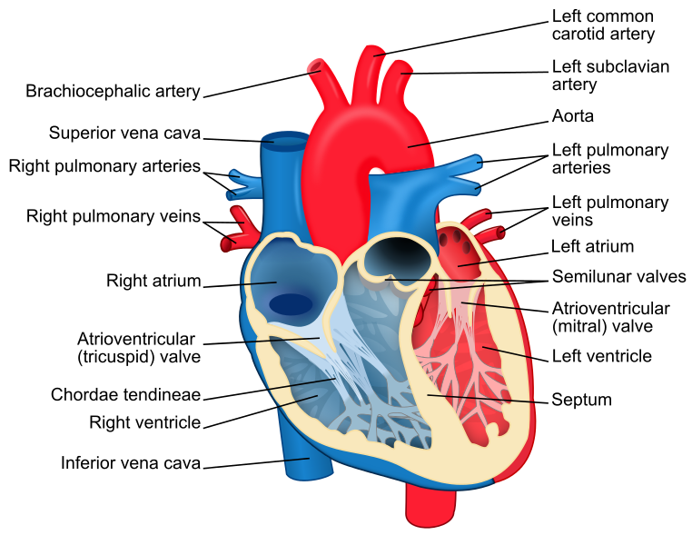
The heart as a pump
The structure of the human heart is perfectly adapted for pumping blood to your lungs and your body. The two sides of the heart fill an empty at the same time, giving a strong, coordinated heartbeat.
Blood enters the top chambers of your heart, which are called the atria. The blood coming into the right atrium from your vena cava is deoxygenated blood from your body. The blood coming into the left atrium in the pulmonary vein is oxygenated blood from your lungs. The atria contract together and force blood down into the ventricles. Valves close to stop the blood flowing backwards out of the heart.
The ventricles then contract and force blood out of the heart, the right ventricle forces deoxygenated blood to the lungs in the pulmonary artery and the left ventricle pumps oxygenated blood around the body in an artery called the aorta.
Notes:
Image: By ZooFari [CC BY-SA 3.0 (https://creativecommons.org/licenses/by-sa/3.0)], via Wikimedia Commons

Slide 17
What is the name of the chambers at the top of the heart?
What is the name of the chambers at the bottom of the heart?
Describe the roles of the following blood vessels:
Vena cava –
Pulmonary artery –
Pulmonary vein –
Aorta –
What is the name of the chambers at the top of the heart?
What is the name of the chambers at the bottom of the heart?
Describe the roles of the following blood vessels:
Vena cava –
Pulmonary artery –
Pulmonary vein –
Aorta –

