Slide 1
IDENTIFY the 4 lifestyle factors (4)
Identify with one example of each of the benefits of exercise
EXPLAIN what a sedentary lifestyle is
Explain the 3 different type of energy balance
DNA
Challenge – Explain what a balanced diet is

Slide 2
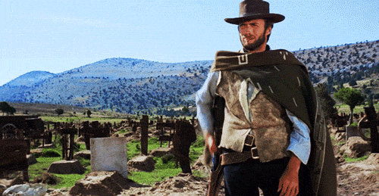
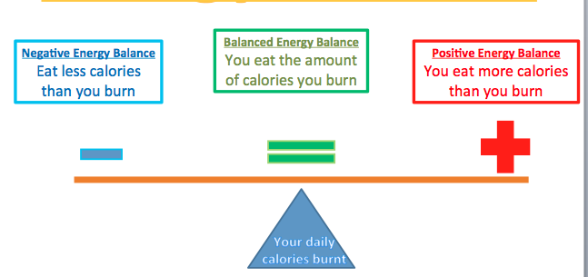
IDENTIFY the 4 lifestyle factors (4)
Identify with one example of each of the benefits of exercise
Emotional
Relieve stress
DNA
Physical
Stronger bones – less prone to osteoporosis
Social
Meet new people
EXPLAIN what a sedentary lifestyle is
Explain the 3 different type of energy balance
A lifestyle with NO EXERCISE &
A POOR DIET
Challenge – Explain what a balanced diet is

Slide 3
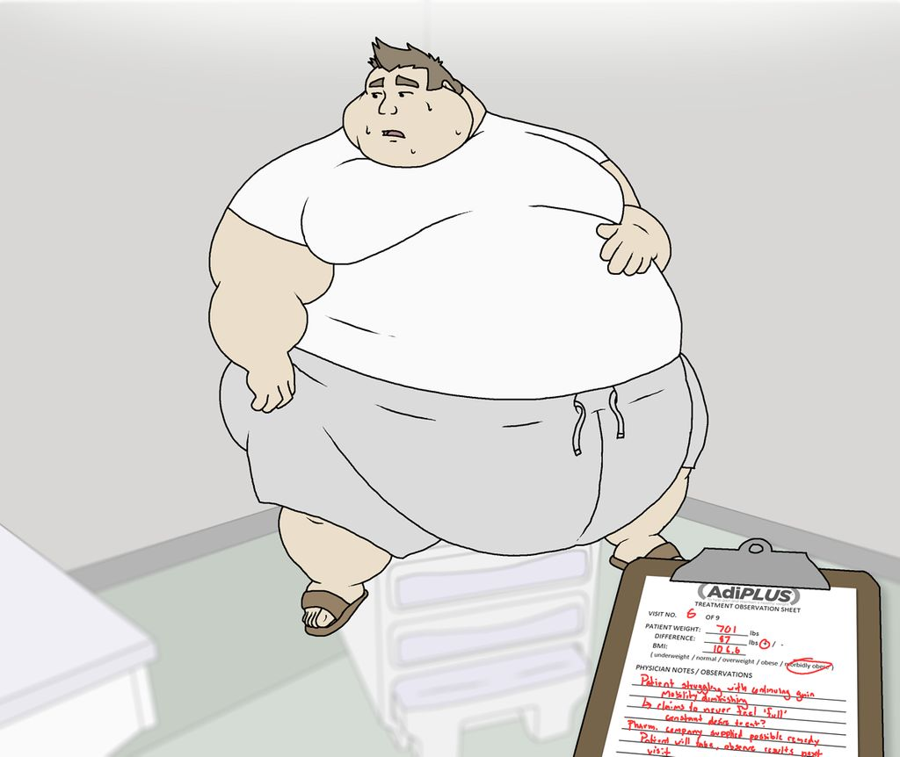
BALANCED DIET & OPTIMUM WEIGHT
 | Good Progress | Outstanding Progress
6-9 | To explain what a balanced diet is with examples and explain optimum weight | To describe what a balanced diet is with examples and explain the factors that affect optimum weight and how different sports may also have an effect on this
3-5 | To state some foods needed for a balanced diet and begin to know what affects optimum weight | To know what a balanced diet is and what affects optimum weight
Nandos Moody

Slide 4
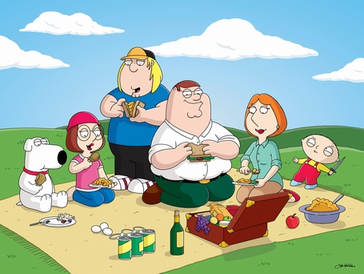
Question… What is a balanced diet?
Answer in your books

Slide 5
Question… What is a balanced diet?
A balanced diet is divided into:
Macro nutrients – carbohydrates, fats and protein. Makes up the bulk of the dietary intake, energy and growth
Micro nutrients – Vitamins and minerals. Small amounts – enable cells of our body to function correctly
Water – In all food in bulk. Essential to the body, keeps temperature and keeps you hydrated
Fibre – keeps the digestive system active and helps lower cholesterol
A balanced diet is divided into Macro nutrients which are carbohydrates, fats and protein and also Micro nutrients which are Vitamins and minerals. You also need water and fibre

Slide 6
Factors affecting optimum weight

Slide 7
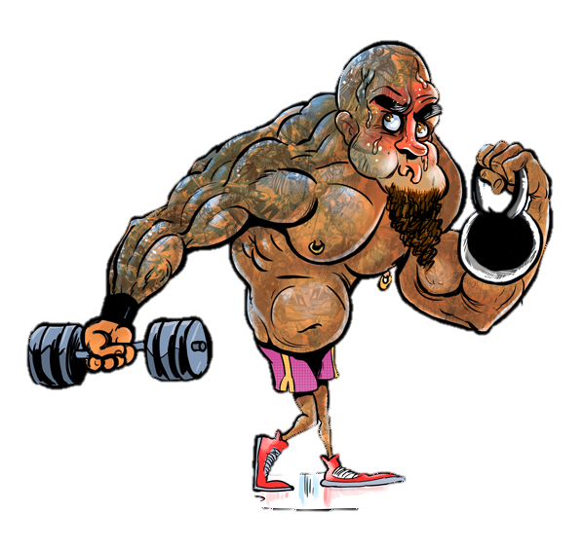
FOUR factors that affect optimum body weight
Big, Guys, Have, Muscle
Bone structure – people with heavier bone structure would normally be heavier in weight.
Gender - men have a higher optimum weight because of the heavier bone structure and bigger muscle girth.
Height –its most likely a taller person is likely to be heavier then a shorter person (although other factors may affect this)
Muscle girth – people with bigger muscles will weight more

Slide 8
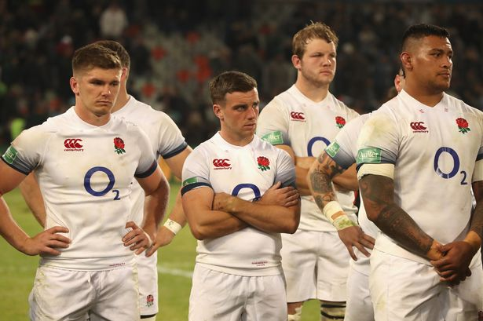
Variation in optimum weight.
Different sports offer different demands
For e.g. rugby
Players within the sport tend to be different sizes and shapes.
Forwards = bigger, heavier and stronger
Backs = smaller, slimmer and more agile
The factors that affect weight are very apparent here. Sports people tend to have different things that affect their weight and are not always the ‘average weight’

Slide 9
Exam Question:
Sports person | Sport | Height | weight
Wayne Rooney | Football | 1.76 | 83kg
Steph Houghton | Football | 1.72m | 62kg
Jessica Ennis-Hill | Athletics | 1.65m | 57kg
Mo Farah | Athletics | 1.65m | 58kg
Marko Vuipola | Rugby Union | 1.80m | 121kg
Anthoney Watson | Rugby Union | 1.85 | 93kg
Question 1: Marko Vuipola and Anthony Watson both represented England in 2015 for rugby union. They are roughly the same height as each other. Using the table explain the variation in their optimum weight according to their body build and role in their sport. (4marks)
Remember to write about the 4
CHALLENGE = Question 2: looking at the table explain the difference in height and weight of the different sports performers and why this may effect their own performances in their sports
Big, Guys, Have, Muscle

Slide 10
Task
Using the diet, health and hygiene worksheet you are going to fill in your pie chart with each food group.
Inside the pie chart
Name of food group
Main functions of that food group (what it does for the body)
Examples (minimum 2) of food
Then for 3 food types, draw an arrow to space on your page and explain a sporting example of how that food group contributes to the performance
(only do this for protein, carbohydrates & water)

Slide 11
EXAMPLE
After a shot put competitive event the athlete would experience muscle fatigue and have some pain in his deltoids. He would take a protein shake and eat high protein foods such as chicken to allow for a quicker recovery
Protein.
Main function is to help repair muscles.
Examples: chicken, eggs
INFO TO FIND:
Job
Food Examples
How they help in sport *only
Protein
Carbohydrates
Water
12 MIN TASK (INCLUDING LOGGING ON TIME).
No finished = computer room in sports hall to finish
Challenge:
Explain how each nutrient will help a boxer’s performance

Slide 12
BALANCED DIET & OPTIMUM WEIGHT
 | Good Progress | Outstanding Progress
6-9 | To explain what a balanced diet is with examples and explain optimum weight | To describe what a balanced diet is with examples and explain the factors that affect optimum weight and how different sports may also have an effect on this
3-5 | To state some foods needed for a balanced diet and begin to know what affects optimum weight | To know what a balanced diet is and what affects optimum weight
Progress Check….
I have made __________ progress because

