Slide 1
DO NOW ACTIVITY….
Mind map as many words you can think of that are related to the circulatory/cardiovascular system in the front of your books:
Cardiovascular system
Notes:
Teachers will strategically work with their students to develop a climate that is conducive to learning. It will include consideration of 3 main areas:
The physical environment
The social/emotional environment
The intellectual environment

Slide 2
DO NOW ACTIVITY….
Mind map as many words you can think of that are related to the circulatory/cardiovascular system in the front of your books:
Cardiovascular system
Notes:
Teachers will strategically work with their students to develop a climate that is conducive to learning. It will include consideration of 3 main areas:
The physical environment
The social/emotional environment
The intellectual environment

Slide 3
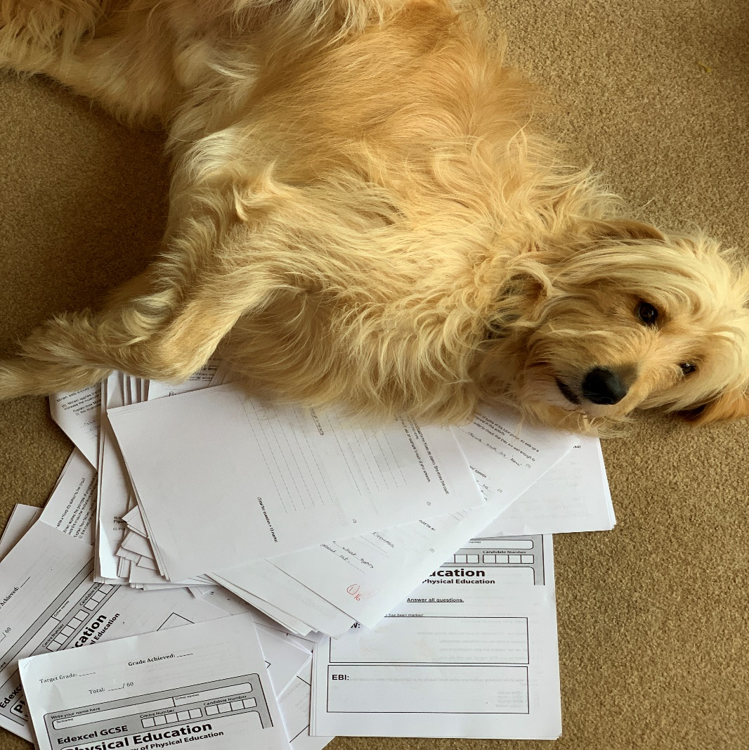
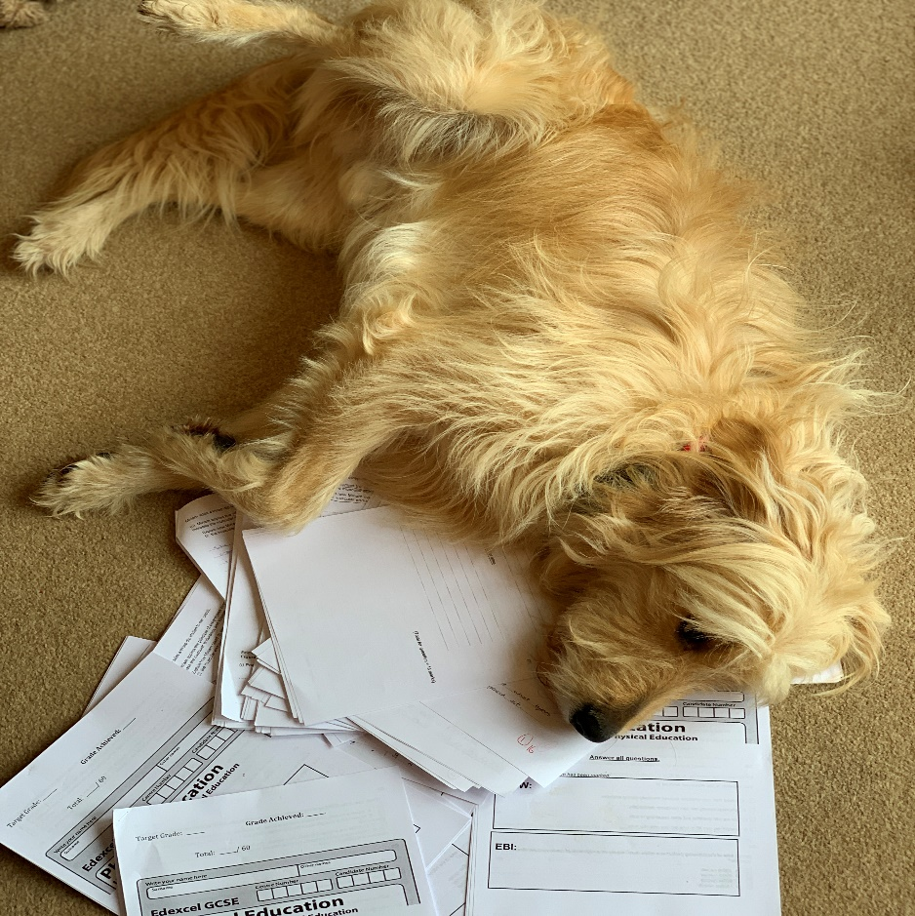
MARKING YOUR TESTS… the process!!!!
Middle!
Start!
END!!!!!!!

Slide 4
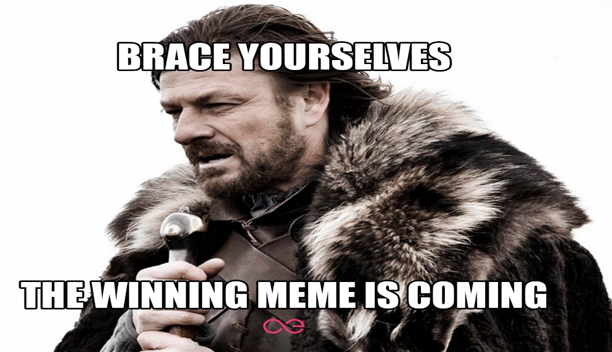
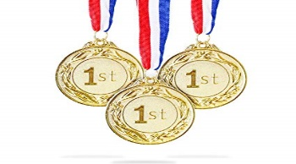
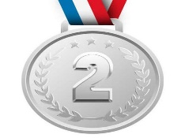
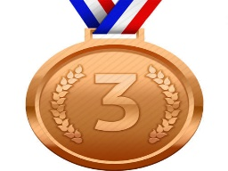
SWEET LEADERS TABLE
Position | Name | /64
 |  | 49
 |  | 41
 |  | 31
4th |  | 28
5th |  | 27
Tahir Zada
Mohammad Annas
Ruben Wilkinson
Izzy Pearson
Dally Samra

Slide 5
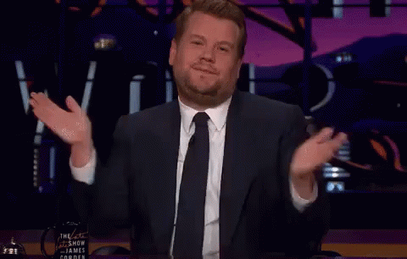
Tahir Zada – Top marks in the exam

Slide 6
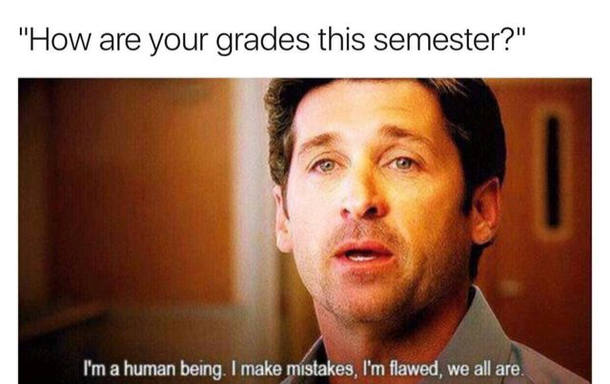
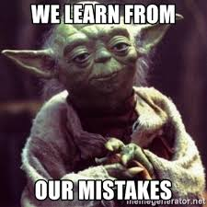
EXAM RECAP
Mark with your red pen
Correct / add to your answers you can with your green pen

Slide 7
Muscles work with the skeleton to bring about specific sporting movements. Complete table 1 by: (4)
Part 1 – Question 2!!
Muscle | Function | Specific sporting movement
Triceps
Quadriceps
FUNCTION OF A MUSCLE = MOVEMENT!
Extension at the elbow
Extension at the elbow to throw a ball in a chest pass
Extension at the knee to jump up in the air to get a rebound in basketball
Extension at the knee

Slide 8
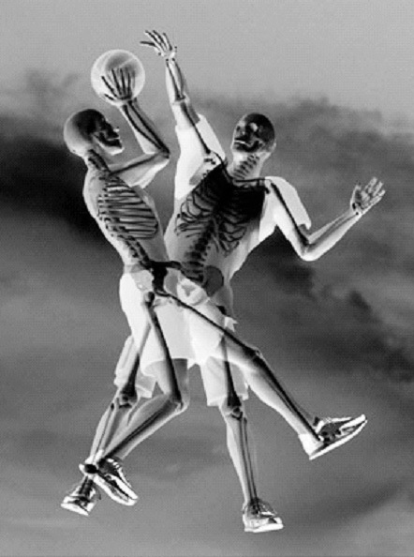
Part 2 – Question 7!!.... WE HAVE DONE THIS!!!!!!
5) The skeletal system plays an important role in allowing for a healthy, active lifestyle. Figure 5 shows the skeletal system of two basketball players. Figure 5
Function of the skeletal system during physical activity | Example of use during a basketball game
Protection
protects the vital organs when someone tries to charge or if you fall over
provides points for muscle attachment which means you can run or throw the ball
Movement
Red blood cells carry oxygen so that the performer can work for longer and last the whole game
Blood production

Slide 9
FUNCTIONs OF A MUSCLE = MOVEMENT!
Extension = Triceps
Extension = Quadriceps
Abduction = Deltoid
Plantar flexion = Gastrocnemius

Slide 10
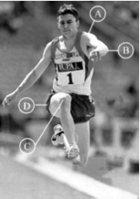
Question 13
Name the type of synovial joint at A, B and C.
A (shoulder) (1)
B (elbow) (1)
C (knee) (1)
(b) Name one of the joints, A, B or C, which only allows flexion and extension(1)
Ball and socket
Hinge
Hinge
(c) Name the type of movement currently shown at joint C (knee) (1)
What types of movement are possible at joint D (hip)?
......................and ………………...(1)
......................and.........................(1)
………………………………(1)
Is the knee bent?????? =
Flexion
Flexion
Extension
These always come together!
Adduction
Abduction
These always come together!
Rotation

Slide 11
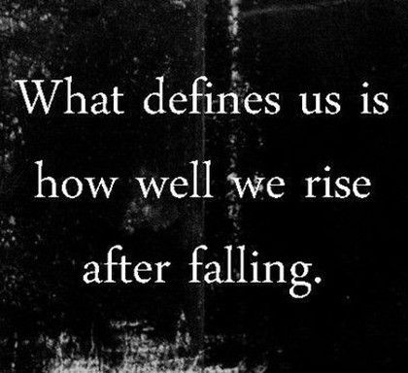
WE MUST LEARN FROM THIS!!!!!!!!!
You will get a homework task on Thursday that is linked to this exam!...
If you got below 10 = re sit on Thursday DURING our practical lesson.
NEXT TIME IF YOU GET BELOW 20 YOU WILL RESIT AFTER SCHOOL!

Slide 12
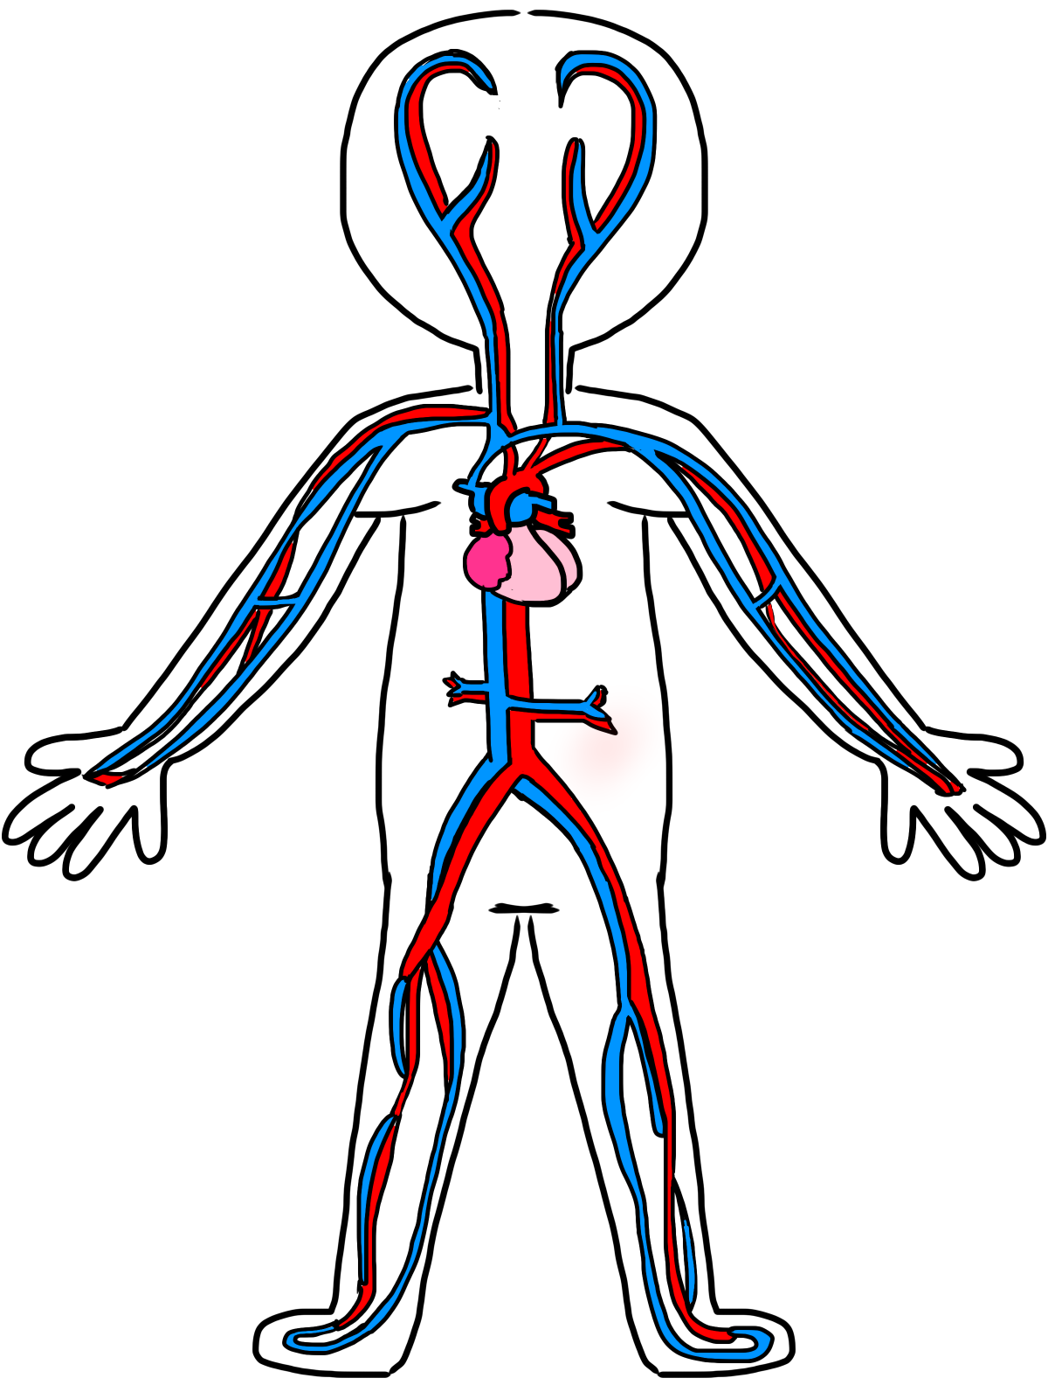
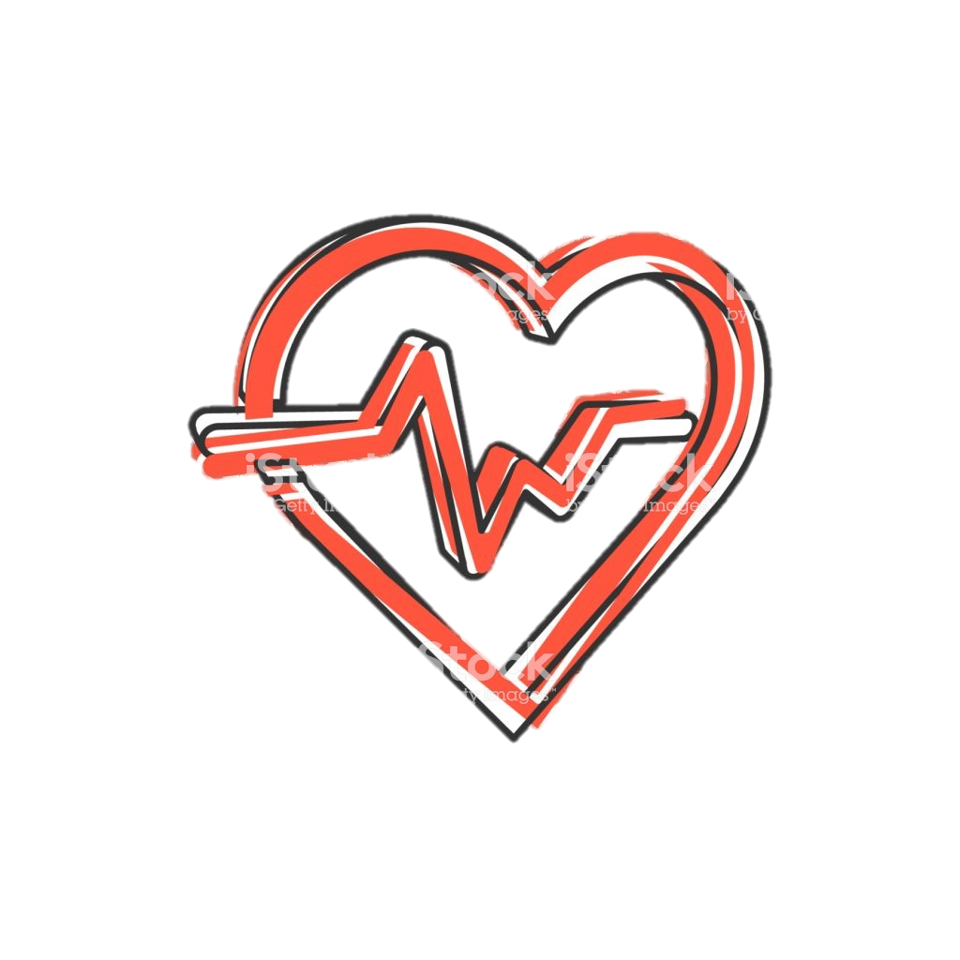
Date: 6 January, 2020
Cardiovascular system
Progress indicators:
6+ | TBAT describe how the structure of the heart allows one way blood flow. | TBAT explain how the blood is pumped continuously around the heart and body to maintain physical activity.
3-5 | TBAT outline the key functions of the CV system | To begin to describe the structure and of the heart allows one way blood flow.
Home learning:
Watch the GCSE Pods on cardiovascular systems to support your learning
Notes:
Teachers explicitly share the purpose of the lesson/s with their students so that the students are in no doubt as to what is expected of them during the lesson. The teacher will:
Make the content, skills and thinking explicit
State clearly what the students will have learned by the end of the lesson
Share the criteria against which the learning will be assessed.

Slide 13
What are the functions of the Cardiovascular system?
3 main functions:
Transport
Protection
Regulate body temperature
Discuss in pairs and feedback your ideas to mind map
Notes:
Now students will be presented with or introduced to the new information that they are required work with. Teachers need to consider what will be the best way to present the information so that it provides for maximum inclusion of the students.

Slide 14
Functions:
Transport of oxygen, carbon dioxide and nutrients
Clotting the open wounds
Transports oxygen to every cell of the body
Transports nutrients to every cell of the body
Removes waste products from every cell of the body
Removes carbon dioxide from the working muscles
Removes lactic acid from the working muscles
Transports hormones around the body from the glands
Prevents infection by transporting white blood cells
Helps to clot open wounds following injury.
Cross reference our list, how did you get on?
ADD IN GREEN PEN AT LEAST 1 FROM EACH FUNCTION
Regulation of body temperature
Helps to maintain body temperature
Helps to maintain the body's fluid levels

Slide 15
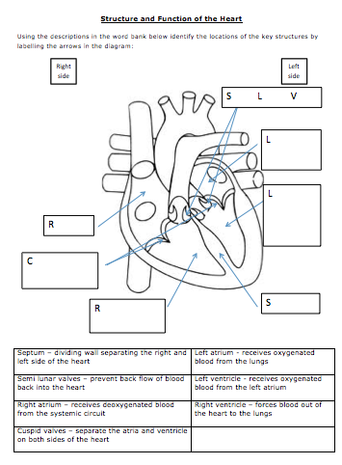
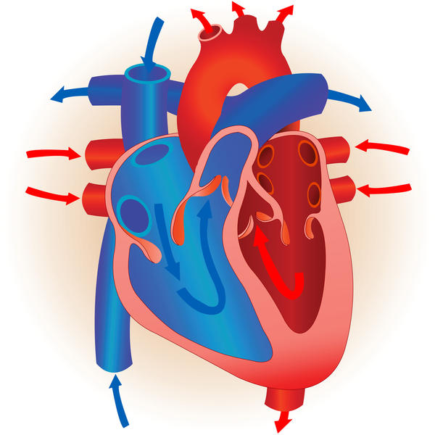
Heart Structures
Task 1
Using the descriptions in the word bank try to identify the locations of the key structures by labelling all the arrows on your diagram.

Slide 16
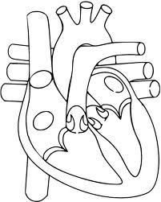
To identify the structure and function of the heart
Structures of the Heart
Semi Lunar Valves
How did you do?
Correct in GREEN PEN
Left Atrium
Left Ventricle
Right Atrium
Cuspid Valves
Right Ventricle
Septum

Slide 17
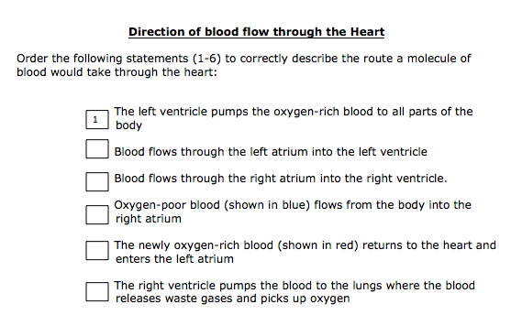
Circulation
Discuss with your partner how blood flows around the heart
Use this picture to help you
Starting statement
Extension question:
What is the purpose of the septum?

Slide 18
Circulation
Discuss with your partner how blood flows around the heart
2
1) Blood flows through the left atrium into the left ventricle
3
5
6
2) The left ventricle pumps the oxygen-rich blood to all parts of the body
1
4
3) Oxygen-poor blood (shown in blue) flows from the body into the right atrium
4) Blood flows through the right atrium into the right ventricle
5) The right ventricle pumps the blood to the lungs where the blood releases waste gases and picks up oxygen
6) The newly oxygen-rich blood (shown in red) returns to the heart and enters the left atrium
Extension question:
What is the purpose of the septum?

Slide 19
How the Heart Pumps Blood
SHOULDER PARTNER TASK:
USING THE PREVIOUS TASK
Draw on your heart diagram from task 1 (Picture) the flow of blood through the heart.
Notes:
Students are given the time and opportunity to develop understanding of the new information and to practice using their developing skills. The students are actively engaged in exploring the content. At this time it would be common for them to be working in groups, talking with each other about, their work quite often making errors but most of all working towards building a personal understanding what they have been presented with.

Slide 20
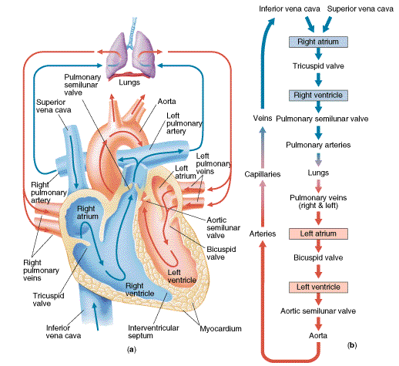
How the Heart Pumps Blood
2
3
5
6
1
4
Notes:
Students are given the time and opportunity to develop understanding of the new information and to practice using their developing skills. The students are actively engaged in exploring the content. At this time it would be common for them to be working in groups, talking with each other about, their work quite often making errors but most of all working towards building a personal understanding what they have been presented with.

Slide 21
Blood Bus: The journey around the heart!
Discuss the route…
Act it, display it!
Task 3
Describe the route a molecule of blood would take through the heart by organising the statements and numbering by stating its journey: left ventricle aorta.
OR
Complete the statements on your sheet, then organise them in the correct order to help explain the journey of a molecule of blood around the heart
O2+

Slide 22
The Double Circulation System
Extension task: Explain why the left side of your heart is thicker than the right hand side?
Low O2
High CO2
Answer Task 4 on your sheets regarding the double circulation systems.
High O2
Low CO2

Slide 23
Review
Revisit your earlier ‘mind map’ regarding the circulatory system.
Using a GREEN PEN add any additional terms or words which you now know without using your notes!
Notes:
Reviewing is a critical element in the process of teaching and learning as it is at this point that teachers can challenge the students to make their learning explicit. Although Review is the last of the elements of the cycle to be described, it should not be seen as coming only at the end of a lesson. It is useful to include different review opportunities throughout every lesson so that teachers and students can identify challenges and supports, and strengths and weaknesses. Review is a significant part of developing metacognitive awareness.

Slide 24
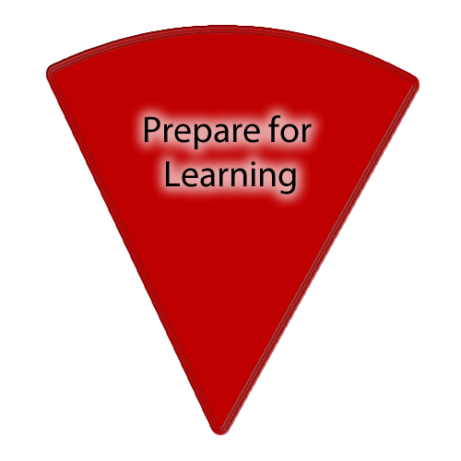
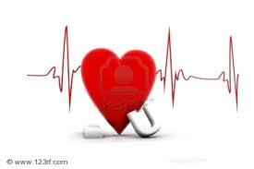
Quiz Time! Back of books!
Q. What helps the blood travel through between the atriums and ventricles?
Q. + What are their anatomical names?
Valves + Tricuspid and Bicuspid/Cuspid/mitral
Q. Is the blood Oxygenated or Deoxygenated when it enters into the right atrium?
Q. + Which blood vessel has delivered this?
Deoxygenated, + the vena cava.
Q. Where has it been?
Q. + What has happened to it?
It has been to the body, + It has transported oxygen to the body tissues and removed carbon dioxide from the cells.
Q. What separates the left and right side of the heart?
The septum
Q. Which chambers pump blood out of the heart?
Q. + Which chamber of the heart is thicker and why?
The top chambers: Atrium, the bottom chambers: Ventricles. + The LV as it has to pump the blood to the whole body.
Notes:
Teachers will strategically work with their students to develop a climate that is conducive to learning. It will include consideration of 3 main areas:
The physical environment
The social/emotional environment
The intellectual environment

