Slide 1



5.1 Appropriate Forms of Ownership for
Business Start-ups
Hyperlink(s)
Back button
Forward button

Slide 2

Features of Business Ownership
DNA - Write a description for each feature of business ownership
Owners
Liability
  Limited
  Unlimited
Incorporated or Unincorporated
Legal Requirements
  HM Revenue & Customs
  Deeds of Partnership
  LLP
Decision Making
Profits
- The people that own the business.
- Who makes the decisions for the business.
- Who receives the profits of the business

Slide 3
Progress Indicators
Outstanding - Describe the advantages and disadvantages of each form of business ownership
Good – Identify the features of each form of business ownership.

Slide 4
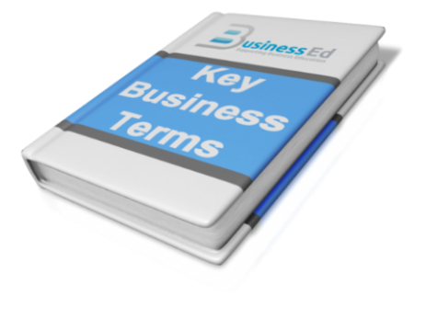

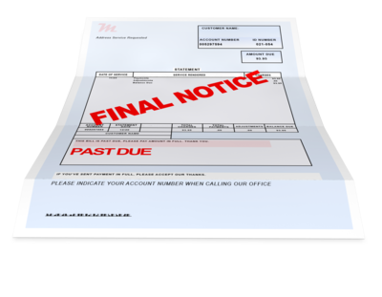



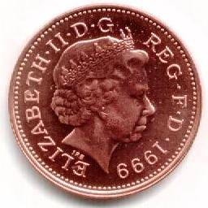
Liability
“Being legally responsible for any debts or financial commitments of a business”
Unlimited Liability
Limited Liability
  …is (are) responsible for ALL debts. These debts have to be paid even if the business hasn’t got the money…
  …can only lose the money they have invested in the business meaning that their risk is minimised as none of their personal possessions can be lost
  …so they may have to sell their own assets to raise the money
  (e.g. their house)
Notes:
Click on the relevant box to visit the slide that explains that type of liability further.
Forward takes you to slide 7.

Slide 5

Unincorporated Vs Incorporated
Incorporation is a legal process of forming an entity recognised in law
  You may have noticed American companies have the letters “inc” at the end of their name
Unincorporated Businesses…
Incorporated
Businesses…
ARE NOT a separate legal entity.
So in law,
THERE IS NO DIFFERENCE between the owner(s) and the business meaning that any legal action is effectively taken against the owner(s)
ARE a separate legal entity.
So in law,
THERE IS A DIFFERENCE between the owner(s) and the business, meaning that legal action can be taken against the business.

Slide 6




The Process of Incorporation
An agreement is written, listing the members and their responsibilities – including a minimum of 2 “designated members”
The business to begin trading as an LLP
Registering a LIMITED LIABILITY
Business
This must be sent to…
This enables…
Companies
House
Who will issue
A Certificate of Incorporation

Slide 7
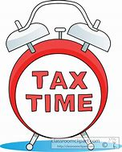


Legal Requirements
Register with HMRC
Deeds of Partnership
LLP
The business is incorporated, which means that it has its own legal identity
When selling any product or service in the UK you must pay tax.
In order to do this you must make the HMRC aware that you are trading.
They will then calculate the tax you owe based on a self assessment
An agreed legal document that outlines the rules by which a partnership will be run
The partners have limited liability, so their personal possessions are not at risk should the business fail
It would usually outline:
  Who the partners are
  How much each partner has invested
  How profit should be shared
  How major decisions will be made
  The process when a partner leaves or joins
The business must submit copies of
their accounts to
the Registrar of Companies

Slide 8


Investigating forms of Business Ownership
Investigate the features, advantages and disadvantages of these type of business ownership:
Sole trader
Partnership
Limited Liability Partnerships
Franchise
Owners
Liability
  Limited
  Unlimited
Incorporated or Unincorporated
Legal Requirements
  HM Revenue & Customs
  Deeds of Partnership
  LLP
Decision Making
Profits
Advantages
Disadvantages

Slide 9

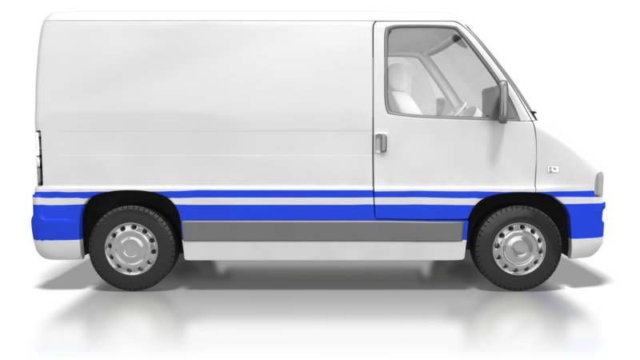



Sole Traders
Sole Traders are the smallest type of UK business
  Examples include hairdressers, small shops and local plumbers…
As a sole trader my plumbing business…
  Is owned and controlled by 1 person
  Did not require much money to start trading
  Was easy to set up – I just had to tell the tax authorities (HMRC)
  Is unincorporated - which means that legally the owner is the business
  Has unlimited liability
Sue Ridgepipe Plumbing
Stop dealing with drips

Slide 10

Sole Traders – The Advantages
  The owner makes all decisions, and keeps all profits
  Can respond quickly to changes in customer needs
3
4
  Usually small – so need little capital
Advantages
  Individualised services can be provided
2
5
  It is very easy to set up as a sole trader
  Accounts can
  remain private
1
6

Slide 11


Sole Traders – The Disadvantages
  Costs are usually higher, resulting in higher prices
  It may be difficult for the owner to take holidays
3
4
  Extra capital may be hard to raise
Disadvantages
  The owner may have to work long hours
2
5
  The owner has unlimited liability
  Illness can cause problems
1
6

Slide 12




Partnerships
Partnerships allow 2 or more people to run a small business together
  Examples include dentists, accountants and estate agents…
As a Partnership Dolittle & Dalley…
  Is defined in law as a business run by 2 or more people aiming to make a profit
  Obtains some capital from partners
  Was easy to set up – we opted for a “Deed of Partnership”, but you don’t have to
  Is unincorporated – but this doesn’t apply to Limited Liability Partnerships (LLPs)
  Has unlimited liability (except Limited Partners
  and LLPs)

Slide 13
Partnerships – The Advantages
  It is easy to set up – but a Deed is
  advisable
  Responsibilities & decisions can be
  shared
3
4
  Usually small – so need less capital
Advantages
  Allows family ownership of the business
2
5
  Capital can be obtained from partners
  Accounts can remain private
1
6

Slide 14
Partnerships – The Disadvantages
  External capital may be difficult to obtain
3
  Possible disagreements between partners
  Complications of partners leaving or joining
Disadvantages
2
4
  Ordinary partners have unlimited liability
  Possible legal costs of drawing up a deed
1
5

Slide 15



Franchise
This is where one business allows another business to buy the right to trade under their name
Examples are often found in service industries, such as retail or food…
  Have signed an agreement with a franchisor
  Will provide the money needed to start the business
  Will make regular payments to the franchisor
  In return the franchisor will:
    Allow the use of their business name for an agreed time period
    Provides materials, training and advice
My Fast Food business is a franchise. As a franchisee
I…

Slide 16
Franchising – The Advantages
  It’s likely to be easier to borrow, because of proven success
  Franchisees are often small, so can focus on details
3
4
  Most problems will have been overcome
Advantages
  Franchisor will provide support and help
2
5
  There’s a good chance of success
  Training and marketing is usually provided
1
6

Slide 17
Franchising – The Disadvantages
  Cannot sell the franchise without the agreement of the franchisor
3
  Franchisee can’t make all the decisions
Disadvantages
  Have pay royalties to the franchisor
2
4
  Risk that franchise can be removed
  Have to buy supplies from franchisor
1
5

