Slide 1
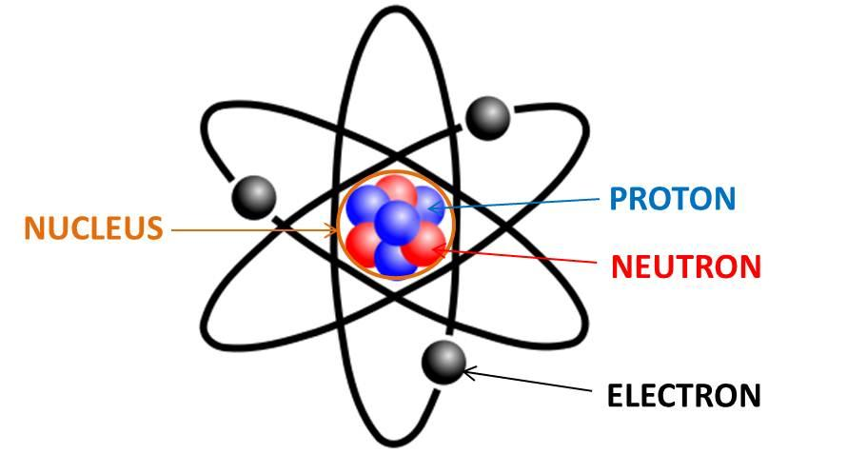
Discovery of the Nucleus
Last Lesson:
Atoms & Radiation
This Lesson:
Discovery of the Nucleus
Next Lesson:
Changes in the Nucleus
Do now activity:
Draw a model of the atom?
Label the components of the atom?
Identify the Charge of these sub-atomic particles
Identify the Mass of these sub-atomic particles.

Slide 2
Progress indicators
GOOD PROGRESS:
Identify the structure of the plum pudding model of the atom.
Explain why the plum pudding model was rejected by the scientific community
OUTSTANDING PROGRESS:
Describe using evidence the particle path of approaching alpha particles towards the nucleus.

Slide 3
Atoms
How did we get to our current nuclear model of the atom?
Notes:
Question students on any prior knowledge

Slide 4
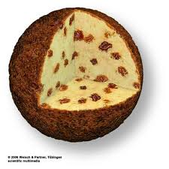
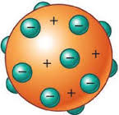
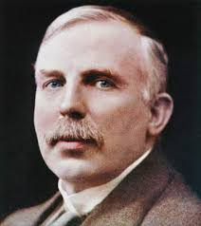
Development of the model of the atom
Before the discovery of the electron, atoms were thought to be tiny spheres that could not be divided.
The discovery of the electron led to the plum pudding model of the atom. The plum pudding model suggested that the atom is a ball of positive charge with negative electrons embedded in it.
Ernst Rutherford
1871 to 1936
A plum pudding with the plums evenly distributed through out the pudding
Rutherford was convinced the plum pudding model was not correct and set two students to investigate

Slide 5
Atoms
In Thomson's model of the atom “Plum Pudding model” the atom is composed of electrons surrounded by a soup of positive charge to balance the electrons' negative charges, like negatively charged "plums" surrounded by positively charged "pudding".

Slide 6
Alpha Scattering Experiment - DEMO
Use a hula hoop and nerf gun, allow students to try and hit the suspended mass in the centre of the hula hoop.
This represents the Alpha scattering experiment. Explain this as you go in relation to + and – charge and empty space.
As a scale explain if the nucleus was the size of a grain of rice, the nearest electron would be at a distance of 100m away.
Or use the simulator
https://phet.colorado.edu/en/simulation/rutherford-scattering

Slide 7
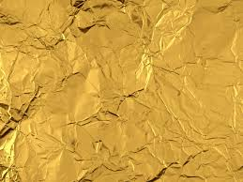
Alpha Scattering Experiment
Experiment Basics
Alpha Particle
Rutherford proposed to Geiger and Marsden that the atom had lots of empty space and there was a centre of positively charged matter.
n
p
p
n
Positively Charged
Au “Gold Leaf”
High Density
+
+
Same Charges Repel

Slide 8
Alpha Scattering Experiment (Simplified)
e
e
p
n
p
n
p
n
p
n
p
n
p
n
n
p
n
p
n
p
n
p
n
p
p
n
p
n
n
p
n
p
n
n
n
p
p
p
p
p
e
p
p
n
n
n
n
n
n
p
p
p
p
n
n
n
n
p
p
p
n
p
n
“Danger Radioactive Material” Symbol
e
e

Slide 9
Radioactivity
Explain the Alpha Scattering Experiment?
Why did they carry out this test?
What did the test involve them doing?
What did they find out about the atom because of this?
Rutherford…
The experiment involved…
As a result they found that…

Slide 10
Radioactivity
Self Assess
Rutherford was convinced the plum pudding model of the atom was incorrect and carried out an experiment to test this.
The experiment involved shooting Positive alpha particles at a sheet of gold foil. With the plum pudding model of the atom these positive alpha particles should have gone straight through the gold foil. They took over 100,000 measurements.
These particles instead reflected back at different angles, meaning that there had to be a dense positive charge in the centre (nucleus) of the atom meaning that the atom has mainly empty space.

Slide 11
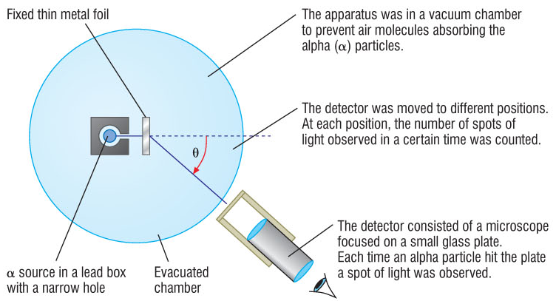
Radioactivity
More Detail.

Slide 12
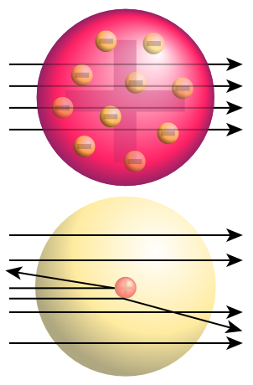
Radioactivity
Plum Pudding Vs Rutherford
Result if Plum Pudding model (Thompson) was correct.
Weak positive charge would not repel the positive Alpha particles
Result if Nuclear model (Rutherford) was correct.
Concentrated positive charge repelling the positive Alpha particles
This was the actual result!

Slide 13
Radioactivity
What other model of the atom do we use in Science?
e
Bohr’s Model of the Atom
e
e
Electrons orbit the Nucleus at specific distances and energy values.
Chemists refer to these orbits as shells
p
n
p
n
p
n
n
p
n
p
n
p
n
p
n
n
p
p
p
p
e
p
n
n
n
n
n
p
p
p
p
n
n
n
n
p
p
p
n
p
n
e
e
e

Slide 14
Radioactivity
Bohr’s Model of the Atom
e
e
Electrons can move up an orbit by absorbing electromagnetic radiation.
Electrons move down and orbit by emitting electromagnetic radiation.
The electromagnetic radiation is a photon.
p
n
p
n
e
n
n
p
n
p
e
p
n
p
n
p
n
n
p
p
p
p
e
p
n
n
n
n
n
p
p
p
p
n
n
n
n
p
p
p
n
p
n
e
e

Slide 15
Radioactivity
Which path would an Alpha particle follow and why?
Why couldn’t the Alpha particle follow the other three paths?
A
n
p
n
p
B
n
p
n
p
p
n
p
n
n
n
p
n
p
p
n
p
n
p
n
n
p
p
p
p
e
p
n
n
C
n
n
n
n
p
p
p
p
p
p
n
n
n
n
p
p
n
p
n
p
n
D
n
p
n
p

Slide 16
Radioactivity
Which path would an Alpha particle follow and why?
RED / GREEN PEN – Swap your work with someone
B
n
p
n
p
p
n
p
n
n
n
p
n
p
p
n
p
n
p
n
n
p
p
p
p
e
p
n
n
n
n
n
p
p
p
p
n
n
n
n
p
p
p
n
p
n
B: Positive α repelled by positive nucleus

Slide 17
Radioactivity
Why couldn’t the Alpha particle follow the other three paths?
A: Positive α attracted by positive nucleus
C: α unaffected by positive nucleus
D: α repelled in wrong direction by positive nucleus
RED/GREEN Pen
A
n
p
n
p
p
n
p
n
n
n
p
n
p
p
n
p
n
p
n
n
p
p
p
p
e
p
n
n
n
n
n
p
p
p
p
n
n
n
n
p
p
p
n
p
n
C
n
p
p
n
D
n
p
n
p

Slide 18
Exam Style Questions.

Slide 19
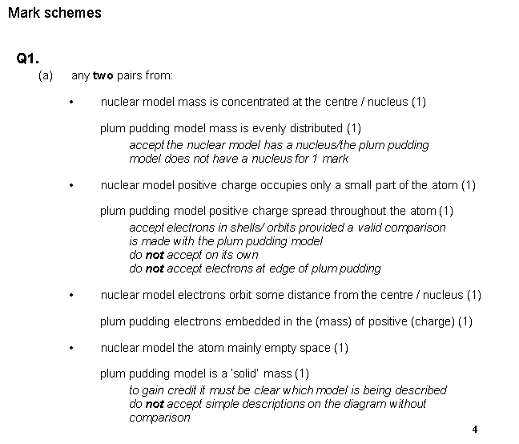
Self Assess.

