Slide 1
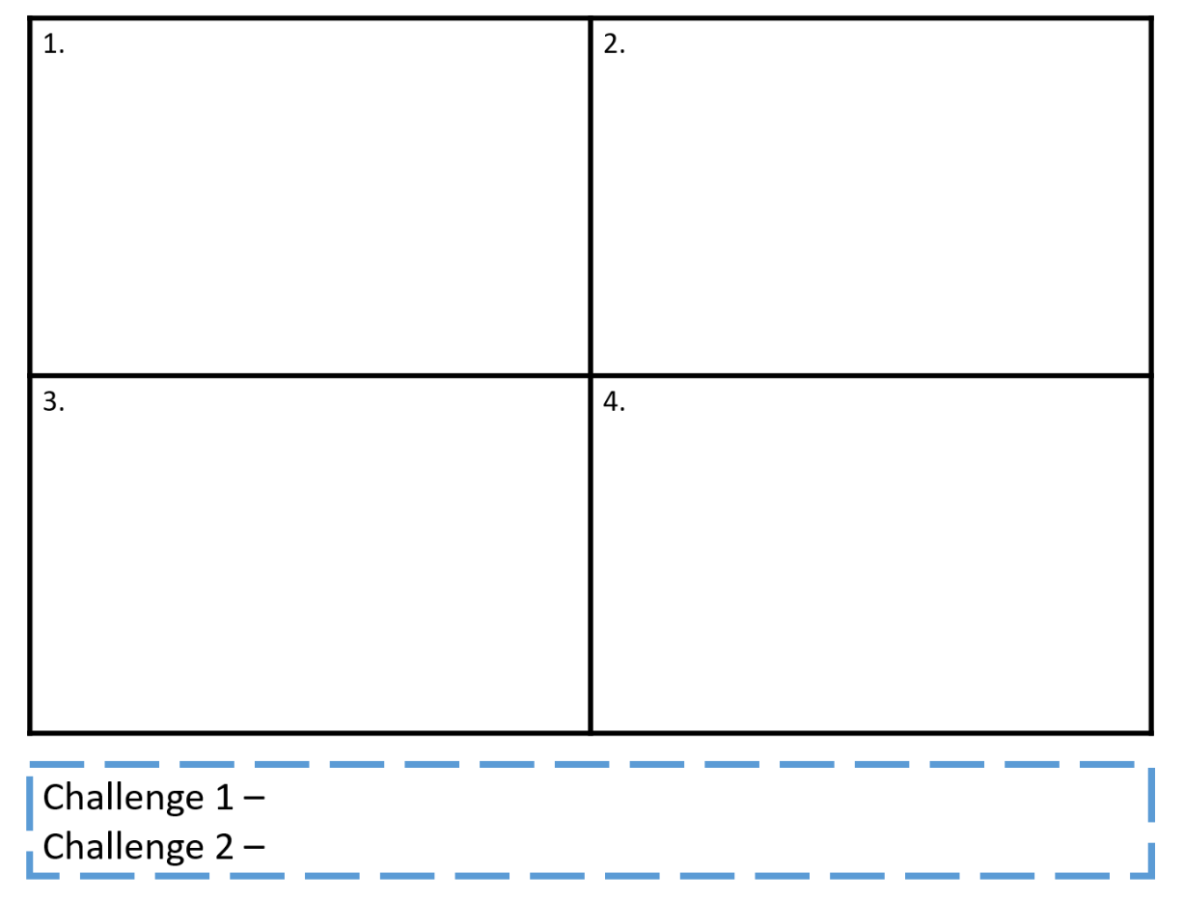
IDENTIFY the 4 lifestyle factors (4)
DESCRIBE 2 lifestyle factors
DNA
Lifestyle Factors
EXPLAIN 1 lifestyle factor linking it to the impact on performance (sporting example)
Explain 2-3 risks one of the lifestyle factors may have on your health
Link a sporting example (AO2) to two or more lifestyle factors
Explain to a partner all the lifestyle factors and how they can impact performance

Slide 2
The Impact of Diet
Good Progress | Outstanding Progress
Be able to link lifestyle choices content with an energy balance description | Describe the impact of diet with the full energy balance equation
Be able to link lifestyle choices content with an energy balance description with a practical example | Link the energy balance with a sedentary lifestyle with examples to support

Slide 3
Explain a poor lifestyle
Attempt 1
Attempt 2
Discuss and bullet point what you would say if this question was asked to you (in your book)

Slide 4
Question… What is a balanced diet?
A balanced diet is divided into:
Macro nutrients – carbohydrates, fats and protein. Makes up the bulk of the dietary intake, energy and growth
Micro nutrients – Vitamins and minerals. Small amounts – enable cells of our body to function correctly

Slide 5
Energy Balance
Balanced Energy Balance
You eat the amount of calories you burn
Negative Energy Balance
Eat less calories than you burn
Positive Energy Balance
You eat more calories than you burn
Your daily
calories burnt
A calorie is the amount of energy your body takes from a piece of food

Slide 6
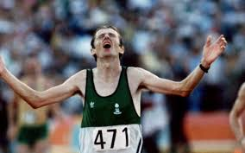
Negative Energy Balance
Will cause weight loss
Increased risk of:
Malnutrition
Extreme weight loss
Dizziness
Lack of energy
Muscle fatigue
Risk of serious illness

Slide 7
‘Balanced’ Energy Balance
Body gains enough nutrients to recover from activity and continue to perform
This is the target!

Slide 8
Positive Energy Balance
Gain more calories than you burn, causing weight gain
Increasing the risk of:
Overweight/overfat/obesity
Strokes
Heart disease
High blood pressure
Diabetes
?
See the link?

Slide 9
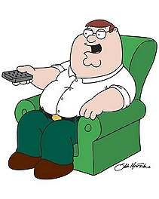
Sedentary Lifestyle
A lifestyle with NO EXERCISE &
A POOR DIET
1 minute
Discuss the risk of such a lifestyle

Slide 10
Sedentary Lifestyle
A lifestyle with NO EXERCISE & A POOR DIET

Slide 11
Explain a poor lifestyle
Attempt 1
Attempt 2
What if we changed how things looked……..

Slide 12
Discuss the impact a sedentary lifestyle can have on physical health

Slide 15
Mark Scheme
Self/Peer
Assessment
Anything linking: lifestyle choices into describing a good diet, activity levels, work/rest/sleep balance accesses more marks

Slide 16
The Impact of Diet
Good Progress | Outstanding Progress
Be able to link lifestyle choices content with an energy balance description | Describe the impact of diet with the full energy balance equation
Be able to link lifestyle choices content with an energy balance description with a practical example | Link the energy balance with a sedentary lifestyle with examples to support

Slide 17
Extension Task

Slide 20
Additional Content

Slide 21
Carbohydrate loading
Carbohydrates are the main source of fuel endurance athletes. Carb-loading, Carbo-loading is a strategy used by these athletes to maximize the stores of glycogen (energy) in their muscles and liver.
E.g.
If an athlete has a race in a weeks time, the early part of the week will be eating more protein to repair their muscles but then later in the week they will have a carbohydrate high diet. This will store in the liver and muscles ready to use.
Also take food in and replace the carbohydrates lost within the 1st two hours after exercise.

Slide 22
Timing protein intake
Power athletes use this.
Protein stimulates growth, the timing of the intake = best results. This ‘best time’ is immediately after exercise when is does most to;
Minimise protein breakdown- exercise breaks down muscles
Stimulates muscle protein synthesis – this process repairs and grows muscles after exercise
Helps build muscles – because less muscle is broken down and more is grown, total muscle increase
https://www.youtube.com/watch?v=N60utqXf5HQ

