Slide 1
Do Now Activity - Whiteboards
What do you know?
Fill in the blank – TB / GB / __ / KB
101010 in Denary
130 in Binary
01101111 in Hexadecimal
48 in Decimal
16

Slide 2
Do Now Activity - Answers
What do you know?
Fill in the blank – TB / GB / MB / KB
101010 in Denary 42
130 in Binary 10000010
01101111 in Hexadecimal 6F
48 in Decimal 72
16

Slide 3
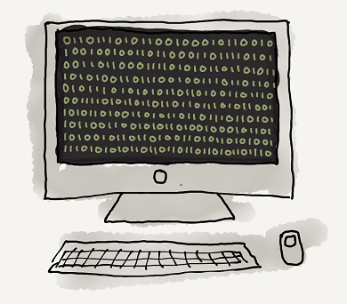
Unit 12 Data Representation
Lesson 4
Good – Describe the effect a binary shift has on numbers
Outstanding – Explain how a Binary Shift to the right is not always accurate
Binary = a BASE 2 number system invented by Gottfried Leibniz

Slide 4
Shifting in Denary
Here we have the number 320.
If we add another 0 to the right side we get 3200
The number has multiplied by ?
100,000 | 10,000 | 1000 | 100 | 10 | 1
 |  |  | 3 | 2 | 0
100,000 | 10,000 | 1000 | 100 | 10 | 1
 |  | 3 | 2 | 0 | 0

Slide 5
Left Binary Shift
Binary shifting is very similar. Here we have the number 110.
If we add another 0 to the right and shift the numbers left we get 1100
The number has multiplied by ?
32 | 16 | 8 | 4 | 2 | 1
 |  |  | 1 | 1 | 0
32 | 16 | 8 | 4 | 2 | 1
 |  | 1 | 1 | 0 | 0

Slide 6
Left Binary Shift
Here we have the number 111.
If we add two 0’s to the right and shift the numbers left we get 1100
The number has multiplied by ?
32 | 16 | 8 | 4 | 2 | 1
 |  |  | 1 | 1 | 1
32 | 16 | 8 | 4 | 2 | 1
 | 1 | 1 | 1 | 0 | 0

Slide 7
Left Binary Shift
Here we have the number 101.
32 | 16 | 8 | 4 | 2 | 1 | Denary
 |  |  | 1 | 0 | 1 | 5
 |  | 1 | 0 | 1 | 0 | 10
 | 1 | 0 | 1 | 0 | 0 | 20
1 | 0 | 1 | 0 | 0 | 0 | 40
1 Shift left = x2
2 Shifts left = x4
3 Shifts left = x8
Stretch: How would a computer use this to multiply an number by 6?

Slide 8
Right Binary Shift
Here we have the number 1010.
If we remove a bit from the right and shift the numbers right we get 101
The number has ?
32 | 16 | 8 | 4 | 2 | 1
 |  | 1 | 0 | 1 | 0
32 | 16 | 8 | 4 | 2 | 1
 |  |  | 1 | 0 | 1

Slide 9
Right Binary Shift
Now we have the number 1100.
If we remove two bits from the right and shift the numbers right we get 11
The number has ?
32 | 16 | 8 | 4 | 2 | 1
 |  | 1 | 1 | 0 | 0
32 | 16 | 8 | 4 | 2 | 1
 |  |  |  | 1 | 1

Slide 10
Right Binary Shift - Issues
Now we have the number 101.
If we remove a bit from the right and shift the numbers right we get 10
32 | 16 | 8 | 4 | 2 | 1
 |  |  | 1 | 0 | 1
32 | 16 | 8 | 4 | 2 | 1
 |  |  |  | 1 | 0
Stretch: What is the issue here?

