Slide 1
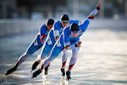
Training Thresholds
DNA
Watch the video and discuss if the movements are aerobic or anaerobic
Progress Indicators
Good Progress | Outstanding Progress
Recall what makes the different types of training zones | Be able to explain the process accurately
https://www.youtube.com/watch?v=Xdij2lozIVo

Slide 2
Maximum Heart Rate
220 - AGE
220 – 31 = 189

Slide 3
Aerobic Training Zone
60-80% of maximum heart rate
60 %
80 %
of 189
= 113
= 151
My Aerobic
Training ZONE
113 – 151 BPM
of 189

Slide 4
Anaerobic Training ZONE (target)
80-90% of maximum heart rate
80 %
90 %
of 189
= 151
= 170
My Anaerobic
Training ZONE
151 – 170 BPM
of 189

Slide 5
Training zones/thresholds
Anaerobic Training ZONE (target)
80-90% of maximum heart rate
Aerobic Training
60-80% of maximum heart rate
Resting HR

Slide 6
Injury Prevention
How can you reduce the risk of injury for this football team?
Correct application/adherence of rules
Use of protective
clothing and equipment
Take in turns with a partner, you must try and explain 2 points per category
Checking of equipment
Correct application
of principles of training

Slide 7
Correct application of the principles of training to prevent overtraining
Follow the principles of training, DO NOT OVERTRAIN and allow sufficient REST AND RECOVERY!
Does your programme or level of competition match your ability/ fitness level
Specificity
Progressive Overload
Overload
Reversibility
Threshold Training
Individual needs
Frequency
Intensity
Time
Type
If you train too frequently = overtrain
If you train too hard = overtrain
If you train too long= overtrain
If you don’t take into account your needs for your your training programme you will hurt yourself

Slide 8
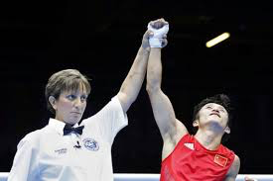
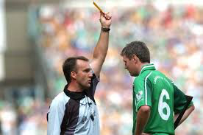
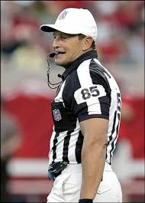
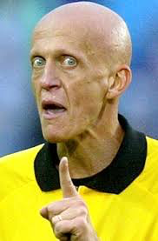
Correct application and adherence to the rules
Know the rules of the game. Some rules are in place to stop injuries from happening.
In football the referee controls the game, if he did not then players would try late tackles etc..
Use the correct technique that is within the sports rules, e.g. tackles in rugby. If not the official could stop you from playing
Use officials e.g. referee, linesman, umpire, 4th official to ensure there is fair play and that rules are being followed.

Slide 9
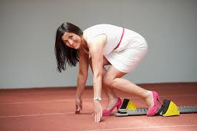
Use of appropriate clothing and equipment
Some sports require certain items of clothing or equipment that performers are required to wear, as stated in governing body’s rules and regulations.
E.G – cricket helmets recommended to be worn up to the age of 18, and other protective clothing
Sometimes, items of clothing are not specified in rules but are used by participants to protect themselves from injury. E.g. skiers wearing base layers to keep them warm, which prevents muscle strain. Runners will wear support on there calf muscles to help the blood pump around their muscles to prevent injury
Clothes should be:
In good order
Not flap in oppositions face and hinder performance
Not catch on equipment
Allow free movements
Fit appropriately

Slide 10
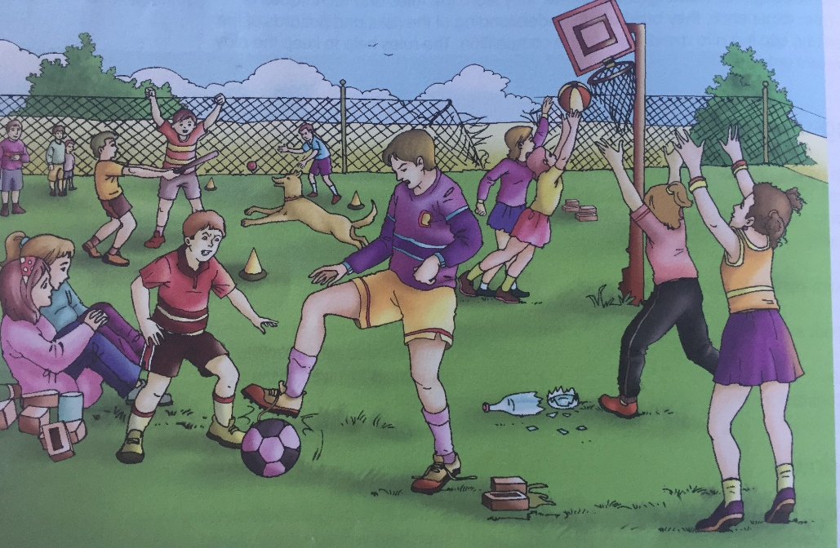
Checking of equipment and venue
Who Checks:
The person in charge (caretaker) but also the teacher, coach, sports leader
Damaged equipment could be a safety hazard. You must check all safety equipment before it is used.
Must be one of the 1st things you do before playing at a venue
Glass could be hidden in the grass during a football game.
What happens if a football is broken and you try and head the ball? Injury to the eye

Slide 11
Injury Prevention
Correct application/adherence of rules
Use of protective clothing and equipment
Don’t wear anything that could get caught
Know the rules, some prevent injuries
Wear suitable footwear
Use protective clothing / equipment e.g. gum shield
Use correct techniques – tackle safely
Checking of equipment
Correct application of principles of training
Use the right equipment – Check its safe and not damaged
Follow the principles of training - To avoid overuse injuries
Progressively overload your training, slowly increasing FIT to prevent overuse injuries
Check for Possible dangers e.g. glass in the grass

Slide 12
Injury Prevention
How can you reduce the risk of injury for this football team?
Correct application/adherence of rules
Use of protective
clothing and equipment
Checking of equipment
Correct application
of principles of training

Slide 13
Exam Q
Mark scheme on the back

