Slide 1
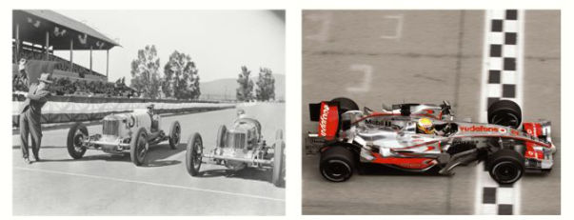
CwK
Thursday, 24 September 2020
Centre of Mass
Do Now Activity
Why do you think formula one cars need to be as low to the ground as possible?

Slide 2
Progress Indicators
Good Progress
Define centre of mass as the point at which mass is thought to be concentrated.
Describe an experimental technique to determine the centre of mass of a symmetrical and irregular object.
Outstanding Progress
Explain why a suspended object comes to rest with the centre of mass directly below the point of suspension in terms of balanced forces.

Slide 3
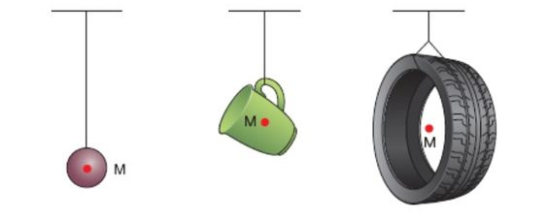
Centre of Mass
The weight of an object may be considered to act at a single point referred to as the object’s ‘centre of mass’.
Depending on the object's shape, its centre of mass can be inside or outside it.

Slide 4
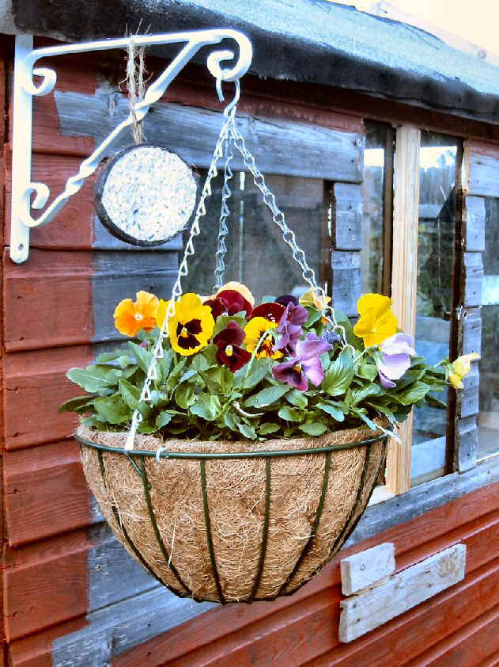
Suspended Equilibrium
If suspended, a body will come to rest with its centre of mass directly below the point of suspension.
The object is then in equilibrium.

Slide 5
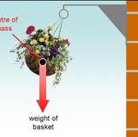
If the object is turned from this position and then released, it will swing back to its equilibrium position.
This is because the weight has a turning effect.

Slide 6
Symmetrical objects
The centre of mass of a symmetrical body is along the axis of symmetry
If a body has more than one line of symmetry it is where the axes of symmetry meet

Slide 7
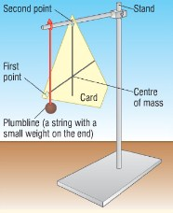
Irregular Objects
Rest the card/paper, freely suspended
Add a plumb line
Draw a vertical line on the card from the rod downwards
Repeat by suspending the card from another point
The centre of mass is where the two lines meet.

Slide 8
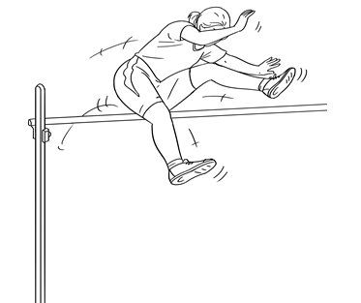
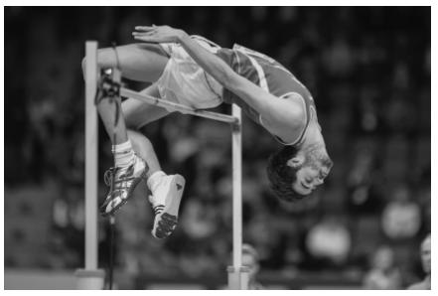
It is possible for a person to change the position of their centre of mass?
https://www.youtube.com/watch?v=RaGUW1d0w8g

Slide 9
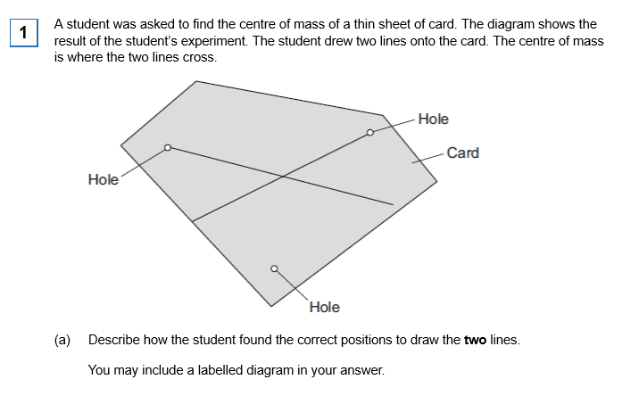
Task

Slide 10
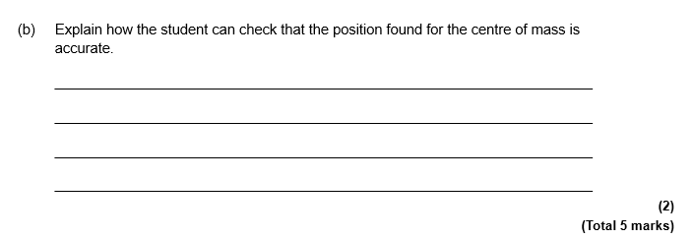

Slide 11
Plenary
Describe how you would find the centre of mass of an irregular object
Where is the centre of mass of your exit ticket?
Why does a suspended object come to rest with the centre of mass directly below the point of suspension

