Slide 1
DNA:
Name the positives effects of media on sport

Slide 2
Looks at the positive effects that media you learnt about in LO1 can provide

Slide 4
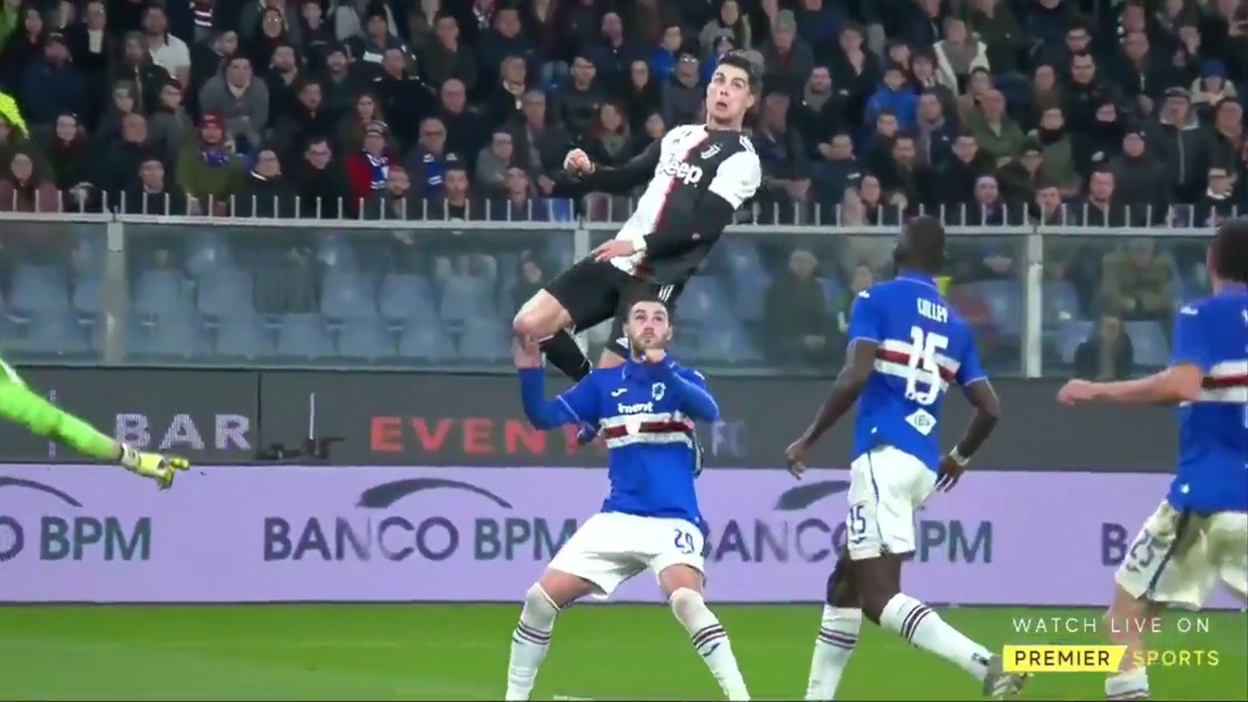
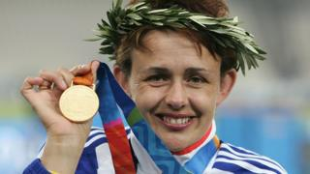
This is what a MB3 slide look like
Relevant positive effect explanation
Inspiring People to Participate
Exposure/coverage in media makes more people want to take part (e.g. participation in tennis usually increases around the time of Wimbledon). It Creates positive role models for example Baroness Tanni Grey-Thompson DBE has become a prominent role model through coverage of her success in the Paralympics. Another example is the numerous good things that sports stars do in there local community. For example Aston Villa player often visit sick children in hospital. This inspires the younger generation. Another example is when sports stars do incredible things on the pitch. For example Cristiano Ronaldo scoring an amazing header will inspire younger generations to be like him and take up the sport.
Two or more sporting examples
https://www.bbc.com/news/uk-42466312
https://wwos.nine.com.au/football/cristiano-ronaldo-header-stuns-football-world/4d122f16-aef6-4f3c-adf4-6abdbeb8cdaf

Slide 5
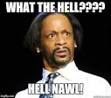
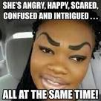
Mark bands
MB1
The descriptions have been supported by two or more relevant
examples.
Why a MB3???
A wide range of possible positive effects that the media has on sport have been described.
MB3

Slide 6
Basicalllllyyyyyyyyyy!
For each category you are given on the tick sheet state:
Positive effects it has
Sporting examples of how a team or sport has used that type of media positively

Slide 7
Increased promotional opportunities:
Example of where I would start….
Title
Clubs/sports can promote themselves more:
See how many subtitles go into the main title.
Add them on (so I know I have to talk about them)
Individuals can have almost unlimited access to information:

Slide 8
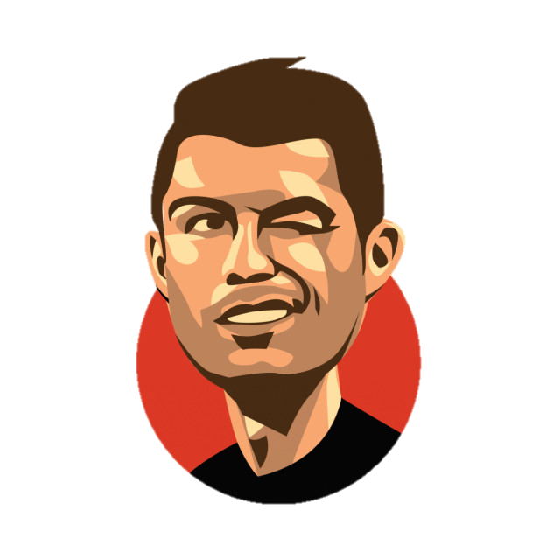
Understand POSITIVE effects that the media can have on sport
Increased promotional opportunities:
Increased exposure of minority sports:
Clubs/sports can promote themselves more through different media (e.g. own websites, TV channels)
Greater range of sport covered in the media (e.g. growth in popularity of darts after Sky coverage)
Advert
Individuals can have almost unlimited access to information about their favorite team/club/ performer through different media.
Challenge: What other sports have increased in popularity lately
Challenge: Can you think of a sport / team who have used media to promote? Explain…
Education:
Increased income which benefits sport:
Developing a better understanding of sports through media coverage (e.g. learning about rules or techniques through expert analysis)
Income generated by media rights goes to the sport or sports clubs, which they can invest (e.g. in facilities like stadium improvements, coaching facilities, etc.)
Challenge: Explain how match of they day can help increase knowledge
Challenge: Explain how better facilities will help a teams performance in a positive way
Inspiring people to participate:
Competition between sports and clubs:
Exposure/coverage in media makes more people want to take part (e.g. participation in tennis usually increases around the time of Wimbledon)
Competition for supporters/viewers means that sports and clubs need to think more about the needs of their customers and how to attract new audiences e.g. ticket offers for under 16s
Creation of positive role models (e.g. Baroness Tanni Grey-Thompson DBE has become a prominent role model through coverage of her success in the Paralympics)
Challenge: Explain other ways teams try and get their supporters to come and watch
Challenge: Explain your sporting role model and why

