Slide 1


EXAM RECAP
Lets break down the exam questions so this never happens
Mark with your red pen
Correct / add to your answers you can with your green pen

Slide 2


ALWAYS ELIMINATE ON THESE QUESTIONS (even if you know the answer go through them all!... incase)
Long Bone!
Happens in Long Bones!
FLat Bone!
Classification | LONG | SHORT | IRREGULAR | FLAT
Job
Leverage , movement
Weight baring
Protection, muscle attachment ,
Protection, broad surface for muscle attachment ,

Slide 3

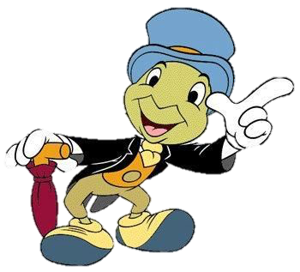
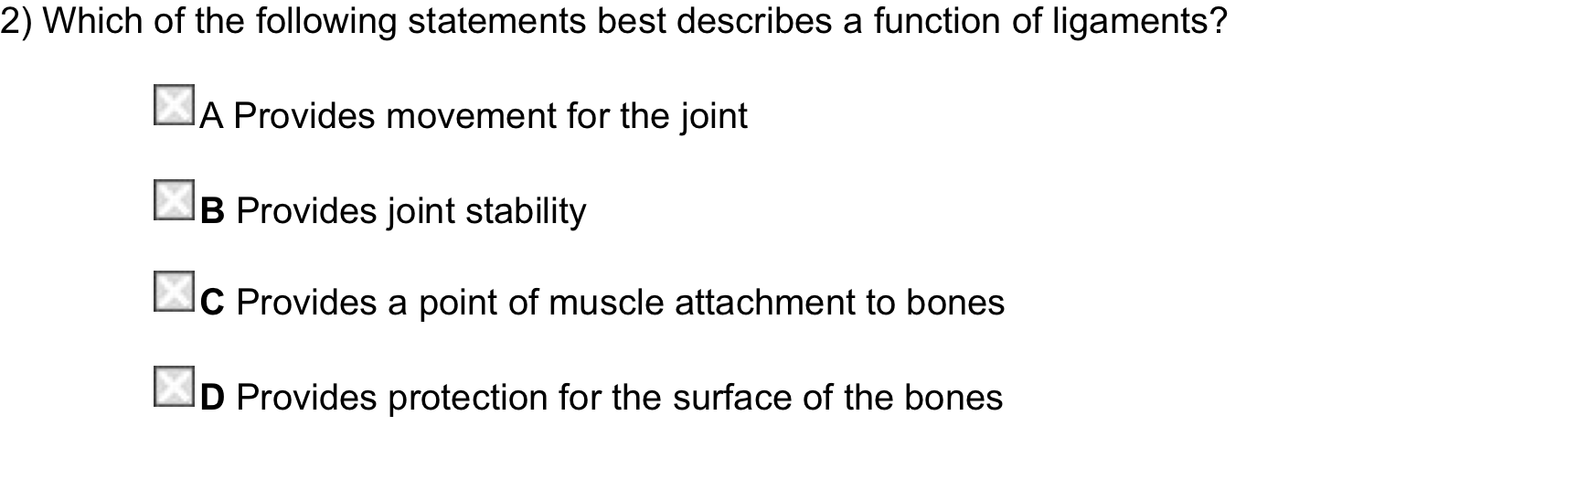
=TENDON!
=TENDON!
=Cartilage!
Ligaments
A ligament is an elastic band of tissue that connects bone to bone and provides stability to the joint
A ligament help in sport to prevent injuries and keep the body stable when running and jumping

Slide 4
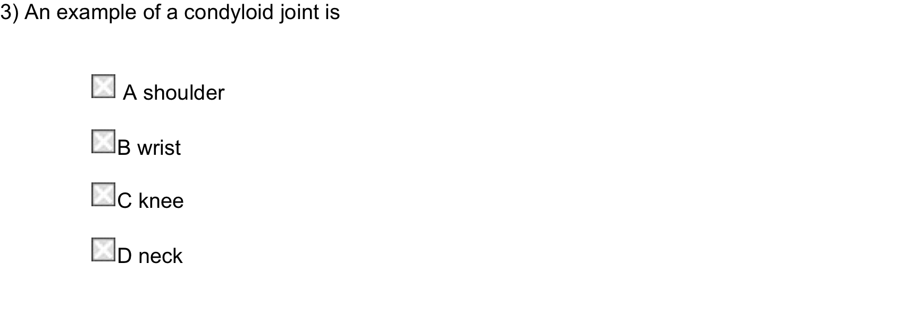
=Ball and Socket!
=Hinge
=Pivot
Type | Example | Flexion and Extension | Adduction and Abduction | Rotation | Circumduction
Condyloid
Wrist

Slide 5
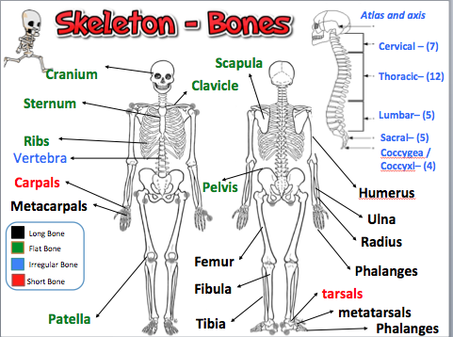
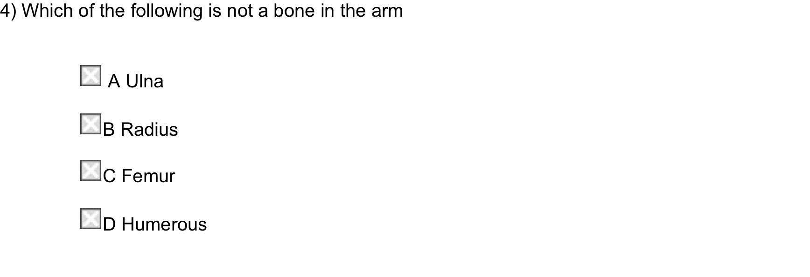
SECTION 1 = TOTAL 4 MARKS

Slide 6
1 Protection is a function of the skeletal system.
Explain, using one example, how the skeletal system’s protective function aids performance in physical activity. (3)
How the marks are broken down:
One mark for protective function
One mark for an example of how protective function aids performance
One mark for appropriate expansion of explanation.
Protection reduces the chance of the performer becoming injured (1)
for example in football the cranium protects the brain/the sternum protects the heart (1)
therefore performers can head the ball/prevent being knocked out (1)

Slide 7
2) Figure 1 shows an athlete preparing to throw the discus.
Analyse, using one example, how one of the ball and socket joints in the body allows the athlete to show the discus (3)
How the marks are broken down:
One mark for example
One mark for how ball and socket allows athlete to throw a discus
One more mark for appropriate expansion of explanation.
The ball and socket joint at the shoulder gives a complete range of movement (1)
which means they move their arm from extension to flexion/can get the required sideways movement of the arm (1)
in order to throw the discus with the correct technique/flight/follow through (1)

Slide 8
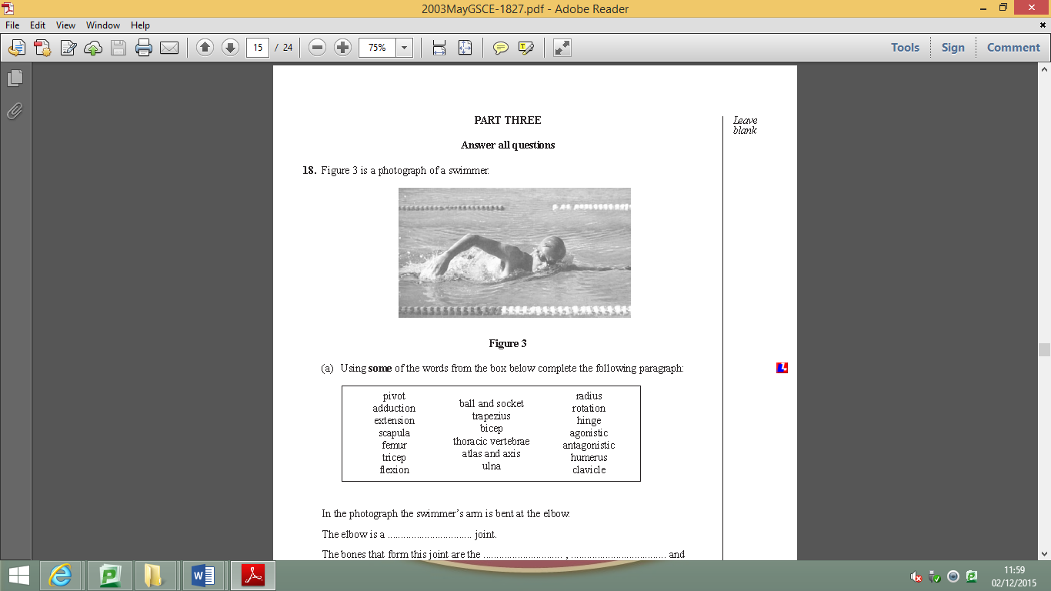
3(a) Using some of the words from the box below complete the following paragraph:
In the photograph the swimmer’s arm is bent at the elbow.
The elbow is a Hinge joint.
The bones that form this joint are the
The type of movement possible at the elbow joint is ........................................... and ....................................... and the muscles which allow the arm to bend and straighten in this way are the ....................................... and ....................................... .
In the picture the swimmer is seen turning his head to the side to allow him to breathe.
This movement takes place at the .................................. and ..................................
which is a ......................................... joint
ulna/humerus/radius, (3)
flexion (1)
Extension (1)
biceps, (1)
triceps (1)
Atlas (1)
axis, (1)
pivot (1)

Slide 9
4) Bones in other areas of the skeleton meet to form important joints, for example, the knee.
What type of synovial joint is the knee?
....................................................................................................................... (1)
There can be very slight rotation or sideways movement at the knee joint. What stabilises the knee joint to prevent unwanted movement?
.....................................................................................................................(1)
(iii) As well as slight rotation, what are the TWO types of movement possible at the knee? (2)
.......................................................................................................................
.......................................................................................................................
Hinge joint
connects bone to bone and provides stability to the joint
ligaments
Hinge joint = Like a door!
flexion and Extension

Slide 10
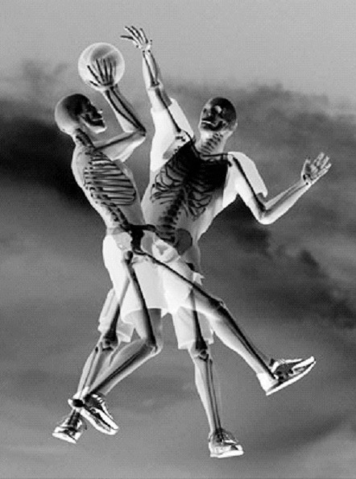
5) The skeletal system plays an important role in allowing for a healthy, active lifestyle. Figure 5 shows the skeletal system of two basketball players. Figure 5
Function of the skeletal system during physical activity | Example of use during a basketball game
Protection
protects the vital organs when someone tries to charge or if you fall over
provides points for muscle attachment which means you can run or throw the ball
Movement
Red blood cells carry oxygen so that the performer can work for longer and last the whole game
Blood production

Slide 11
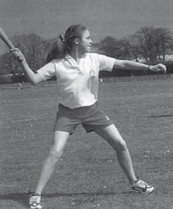
(6) The photo shows a member of the rounder’s team preparing to hit the ball
Name the bones of the upper and lower arm (3)
1) .
2)
3)
Humerus
Radius
Ulna

Slide 12
What type of synovial joint is formed where the bones meet? (1)
Another type of synovial joint is a pivot joint. What type of movement is possible at this joint? (1)
With reference to the picture, give and example how the player is using this type of joint (1)
Tendons are very important components of a joint. What is its function? (1)
Hinge
rotation
Turn the head (to see the ball)
Attach muscle to bone

Slide 13
7) a) A joint is formed where two or more bones meet. Name the bones that form the knee joint
1)............................... (1)
2)............................... (1)
B) The knee is a hinge joint, name another type of synovial joint
.............................................................................. (1)
(f) What body tissue adds stability to the knee joint?
.............................................................................. (1)
Tibia
Femur
Ball and socket, Condyloid, Pivot
Ligament

Slide 14
Question 8
(Total 4 marks)
A Tendon / muscle/ quadriceps/ quadricep
Is there a muscle in the picture??
B Ligament
D :Job of B
Join bone to bone
stabilise the joint
hold joint together
(or equivalent)

Slide 15
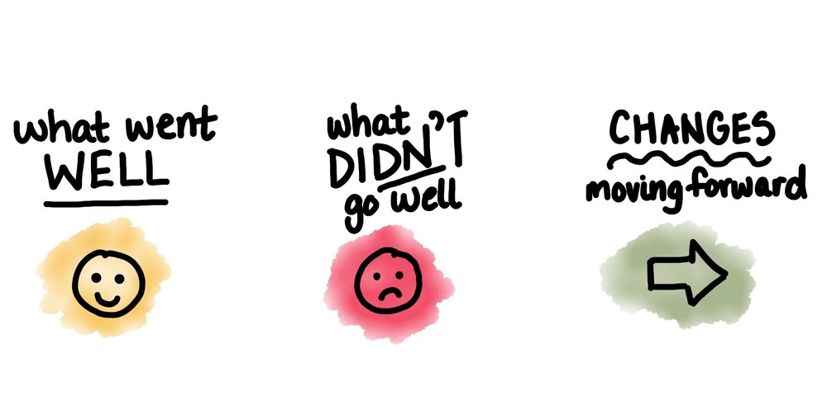

Calculate your score
After looking through your EXAM–
Write what you think your WWW/EBI’s are from your exam
What do I need to recap???

